Slide 1

Douglas County Wisconsin Statewide Parcel Initiative Report 2025
December 3, 2025

Slide 2
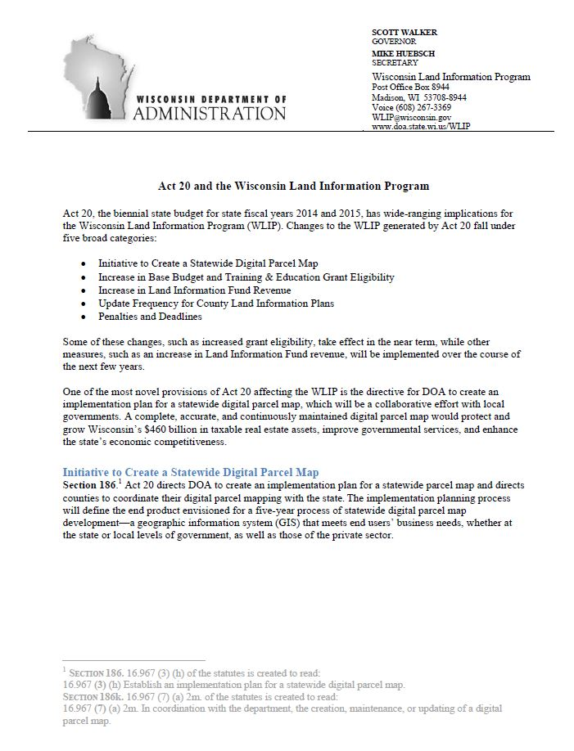
WI Statewide Parcel Initiative
Act 20

Slide 3
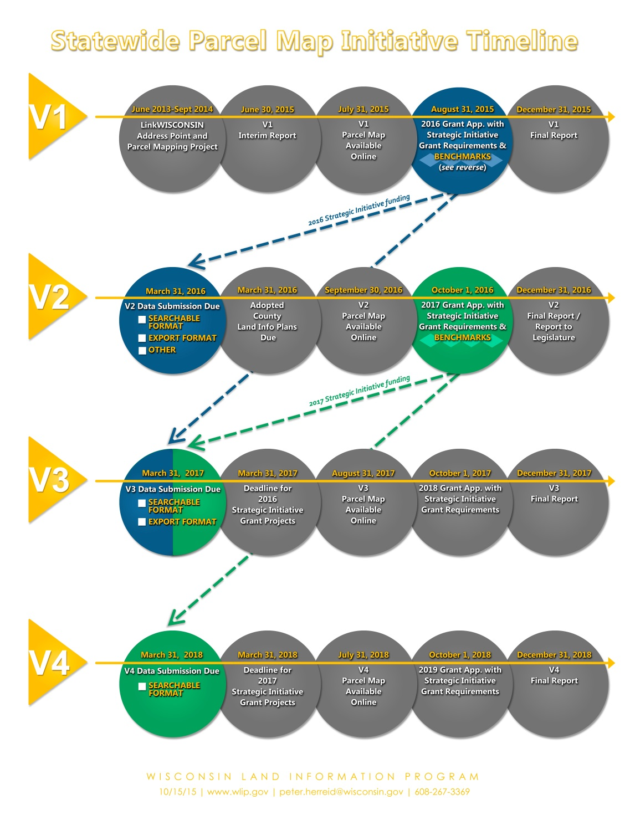
WI Statewide Parcel Initiative
Now at V12
Benchmarks

Slide 4
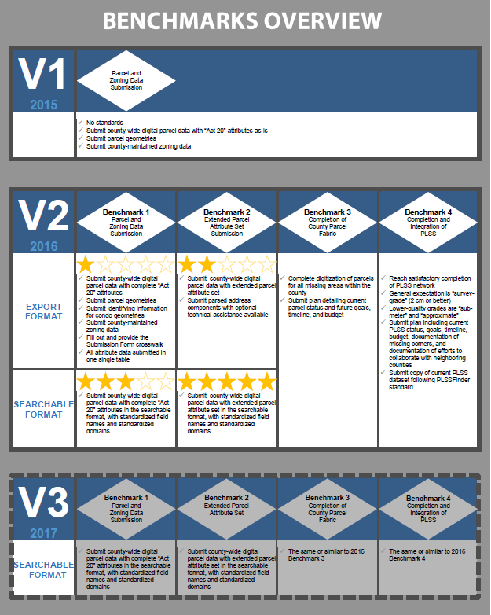
WI Statewide Parcel Initiative
Benchmarks

Slide 5
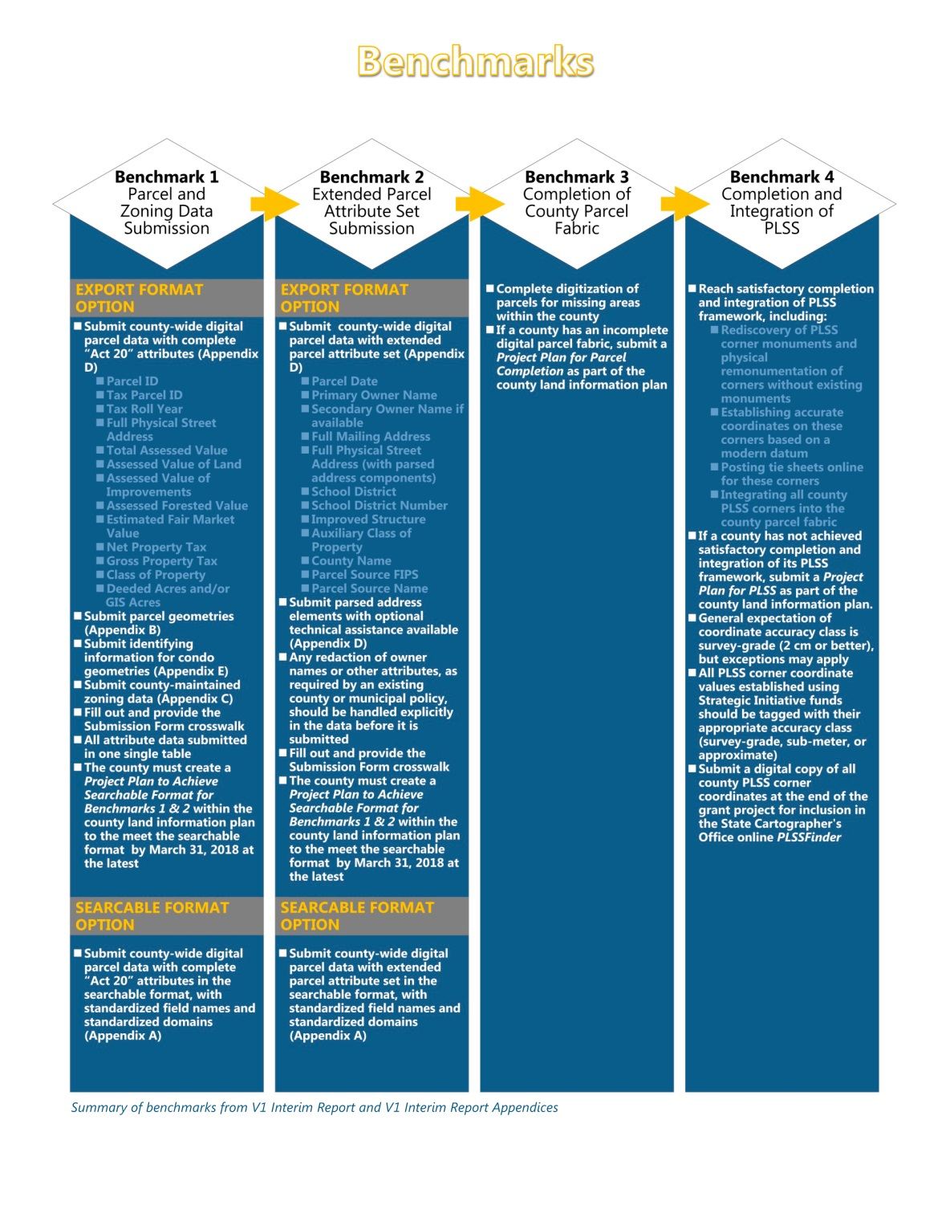
WI Statewide Parcel Initiative
Benchmarks

Slide 6
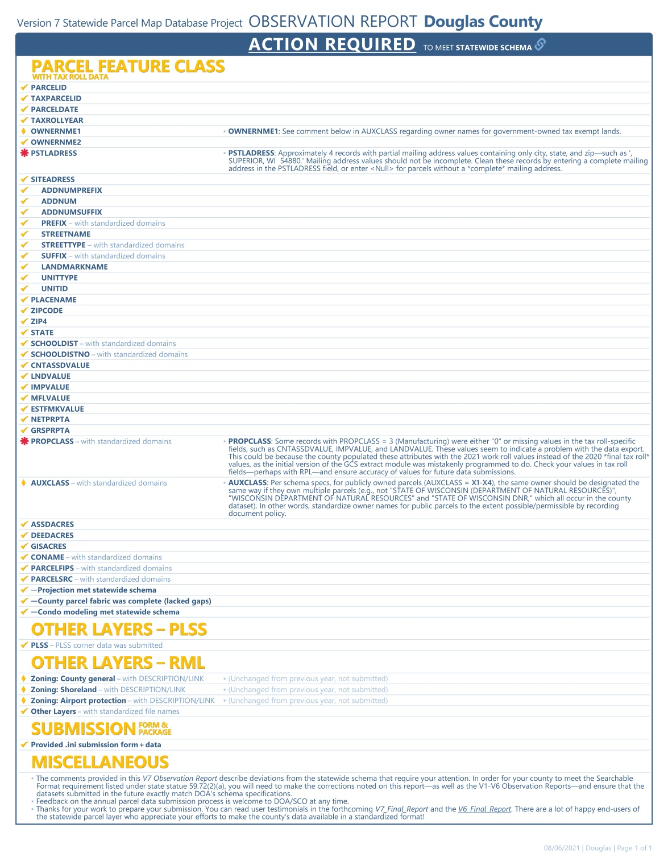
WI Statewide Parcel Initiative

Slide 7
WI Statewide Parcel Initiative
Data Submitted
Parcels
Zoning General
Shoreland
Floodplain
PLSS Corners
Roads
Addresses
Hydrography
ROW
CBAS Submitted twice a year
Wards
Supervisor Districts
Annexations
NextGen911 Data

Slide 8
Background Information on Parcels and Ownership Data
Parcel Editing Process
Currently every 24 hours parcels
Ownership is updated and replicated from
GCS, Parcels are updated in groups of
edits once every week
2025 – 4749 (11/15/25)
2024 – 6479 Edits
2023 - 6010 Edits
2022 – 8284 Edis
2021 - 6337 Edits
2020 – 7541 Edits
2019 – 6875 Edits
2018 – 3725 Edits
GCS Ownership Changes
Currently editing daily (City/County Tax Listers)
  2025 - ~ 1550 Edits
  2024 - ~ 2323 Edits
  2023 - ~ 6919 Edits
  2022 - ~ 5000 Edits
  2021 - ~ 6153 Edits
  2020 - ~ 5896 Edits
GCS ownership data and parcels are the
most critical data the City and County
Maintain. It is used by all departments for
Various purposes.

Slide 9
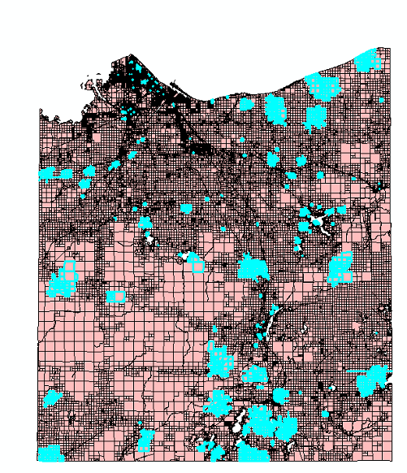
Parcels Edited in 2025
4749 Parcels Edited

Slide 10
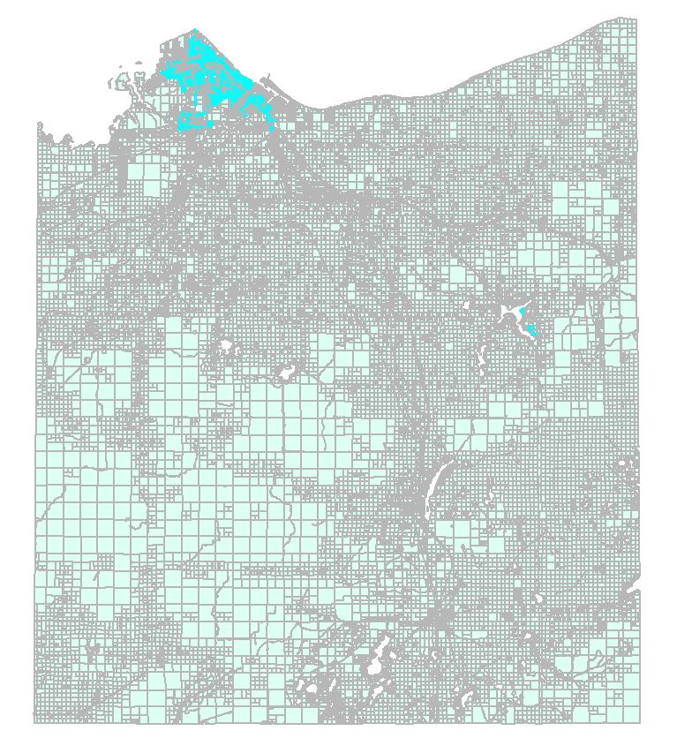
Vacated Streets and Alleys Documented
3057 Vacated Streets & Alleys Documented
In Fabric 2025

Slide 11
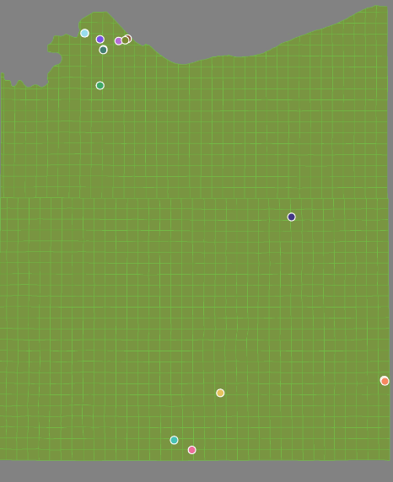
Condos in the Fabric - 2025
18 Condo Plat boundaries
107 Tax Parcels
2016 – 94
2017 – 105
2018 – 107
2019 – 109
2020 – 109
2021 - 109
2022 – 109
2023 – 108
2024 – 108
2025 - 107

Slide 12
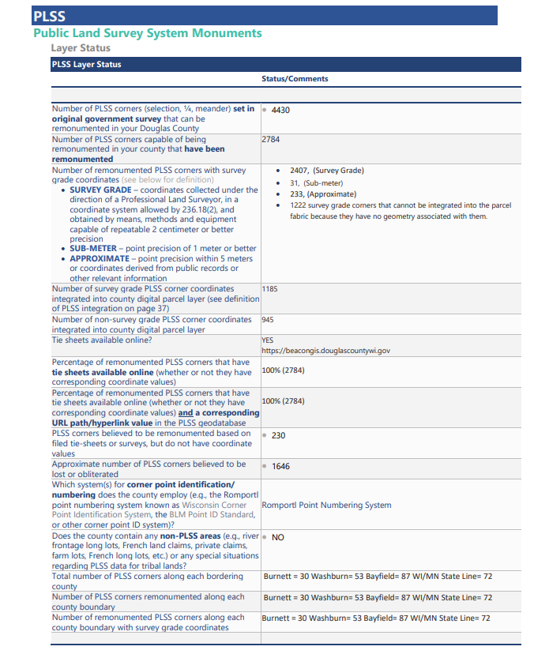
V9 Benchmark Status for PLSS Corner Integration

Slide 13
Survey Documents Inventory
Douglas County Surveyor Control Summary
2025 (As of 11/25/2025)
Centerline Monuments = 10
Section Corners = 64
Section Corners via the County Bounty System = 10
Contracted Section Corners = 34
New Collected Corners = 50
Survey Site , https://surveys.superiordcgis.org/map
Updated with new corners and current links to survey docs. Currently being taken down due to software sun setting.
We also added Survey data to the County GIS Online Site at https://beacongis.douglascountywi.gov

Slide 14
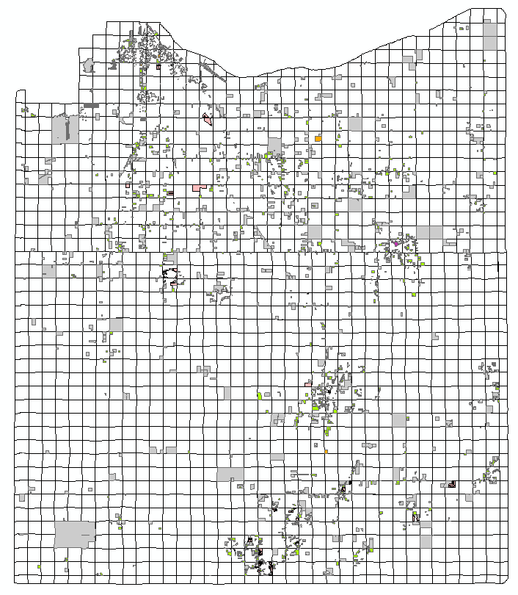
Survey Documents Inventory
Georeferenced Survey Documents Inventory
6297 Total Documents
ALTA = 83
Certified Survey Maps = 1675
Site Plans = 211
Maps of Survey = 3653
Plats = 675

Slide 15
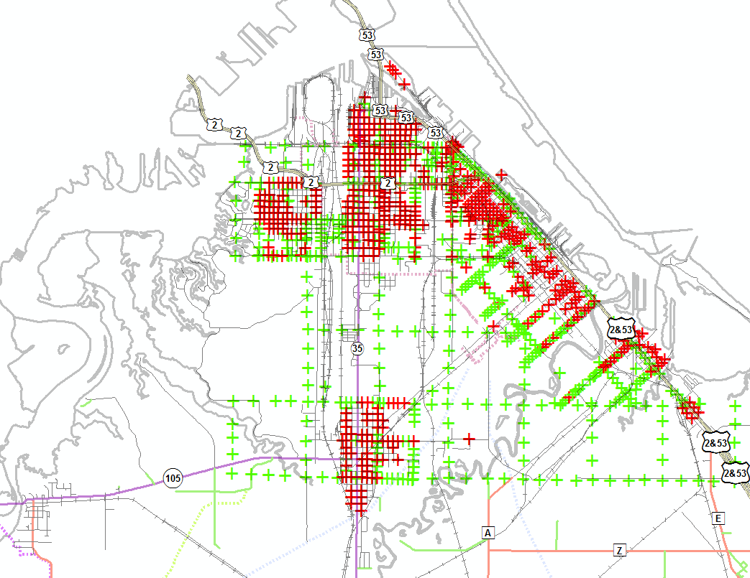
Street Centerline Monuments
City of Superior Street Centerline Monuments
Attributed Monuments = 517 (Red)
Unattributed Monuments = 539 (Green)

Slide 16
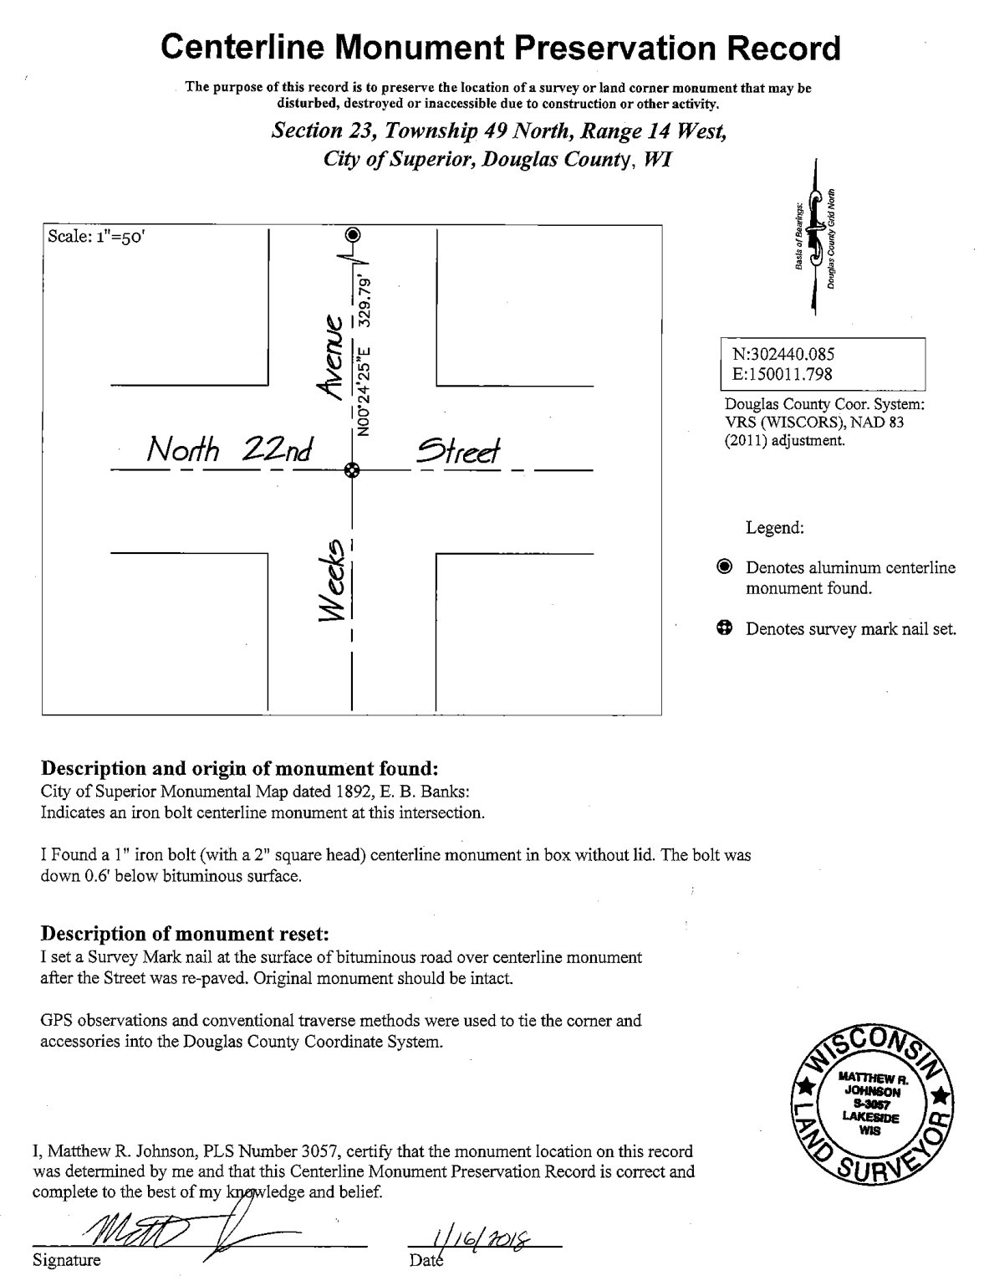
Street Centerline Monument Record
City of Superior Street Centerline Monument Record Sample
26 CMPRs

Slide 17
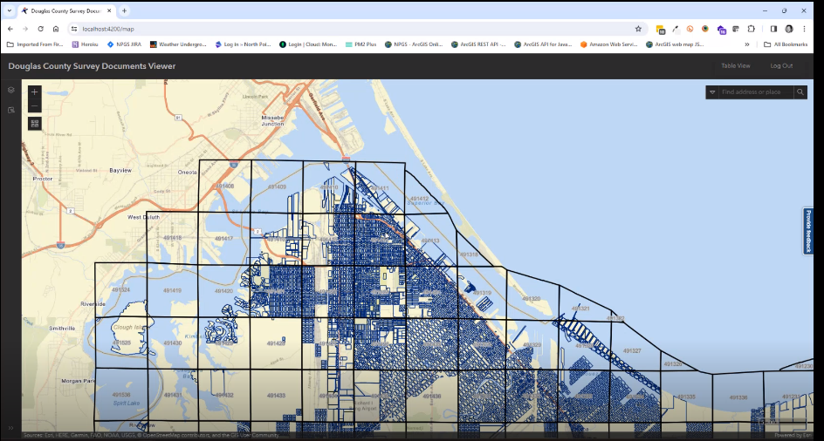
North points GEODOCS Survey App/Management System
GEODOCS Survey App/Management System
https://surveys.superiordcgis.org/map

Slide 18
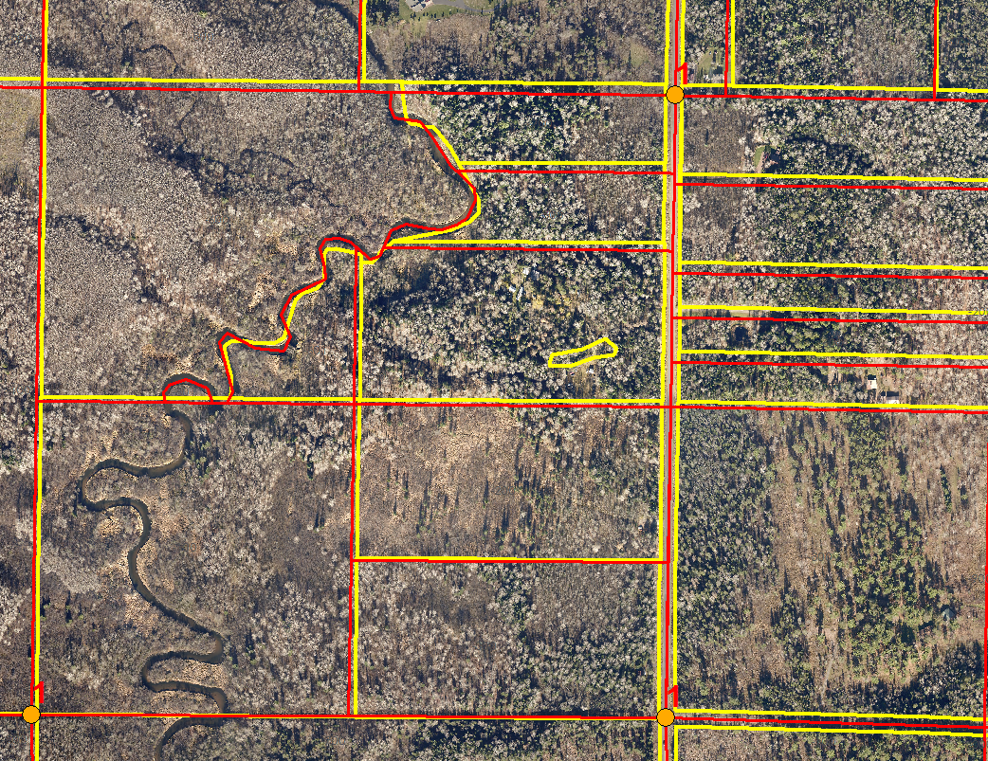
Brule Area
Brule Area Adjustment to PLSS
Yellow = Before Adjustment
Red= After Adjustment

Slide 19
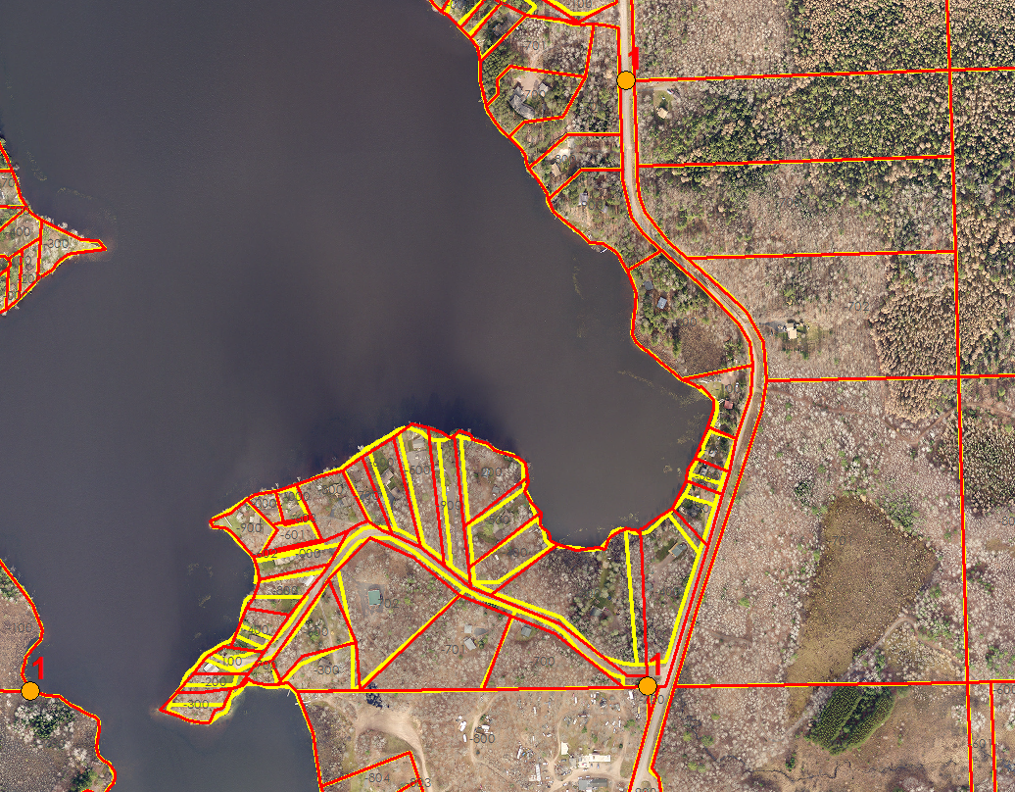
Minnesuing Lake
Adjustment
Yellow = Before Adjustment
Red = After

Slide 20
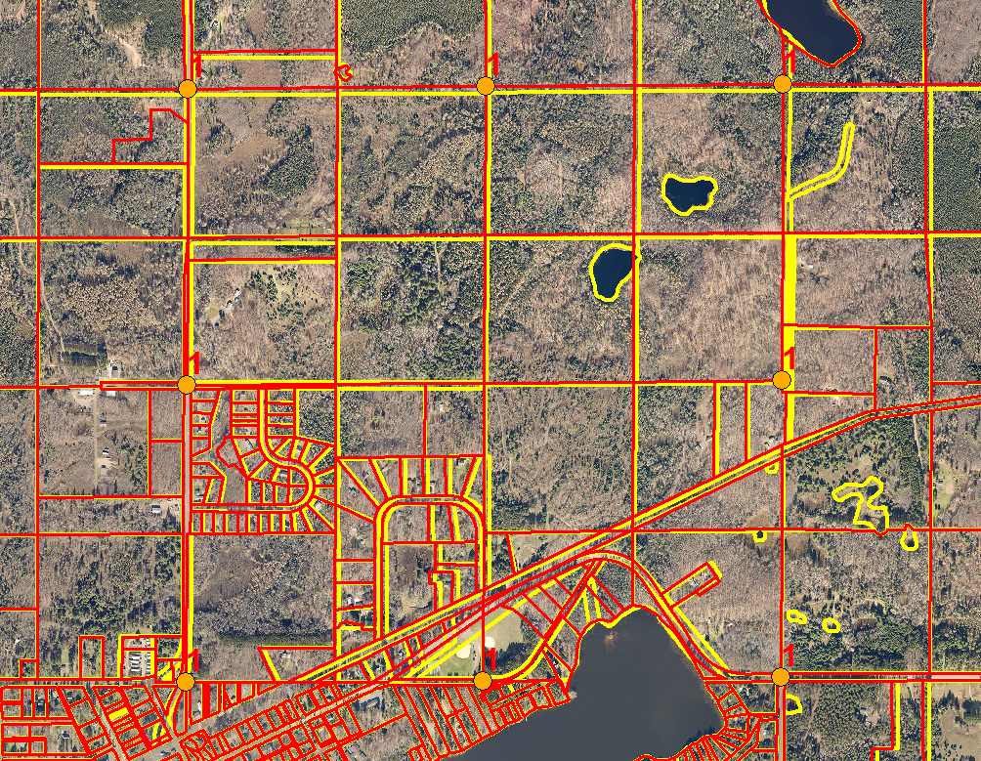
471125 Adjustment
Yellow = Before Adjustment
Red= After

Slide 21
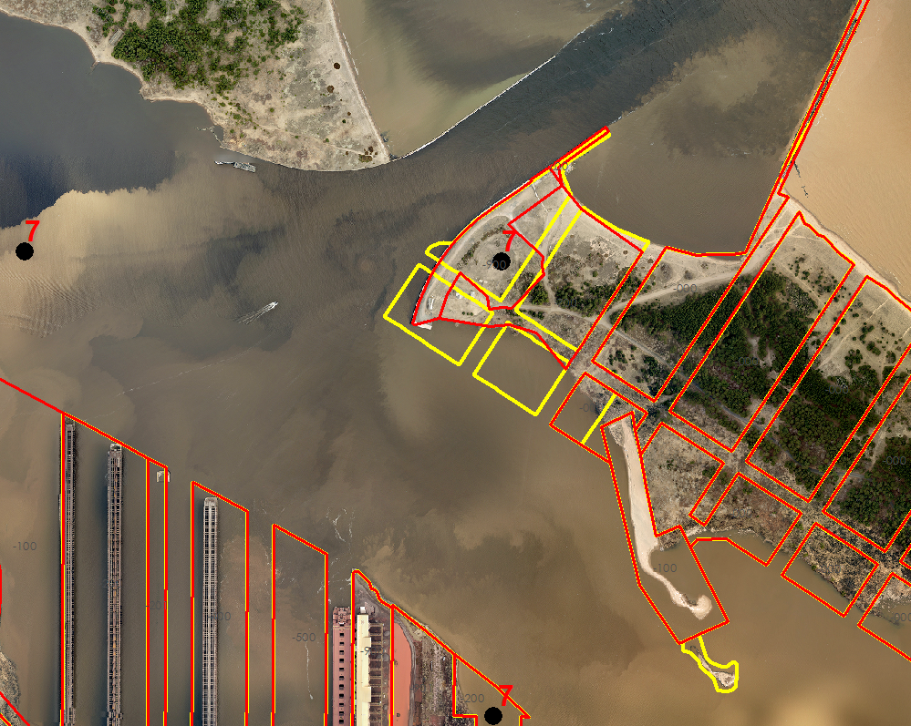
Wisconsin Point
Adjustment
Yellow = Before Adjustment
Red = After Adjustment

Slide 22

Land Information Office’s NextGen911 Activities in 2023
NextGen911(NG911) is a Federally required upgrade to the CAD/911 systems throughout the nation. Wisconsin is developing standards and requirements for County systems to meet. NG911is a fully GIS integrated system with stringent requirements that must be met.
Douglas County NG911 Activities include:
CAD911/GIS data assessment in 2020
Budgeting for GIS staff assistance
Continued monitoring of the State’s NG911 recommendations and needed response
Implementation of GIS data changes as required by the State and Federal governments
Challenges for LIO in NG911
Address system used by Douglas County
Migration of current data to required schema
Future maintenance needs and costs

Slide 23

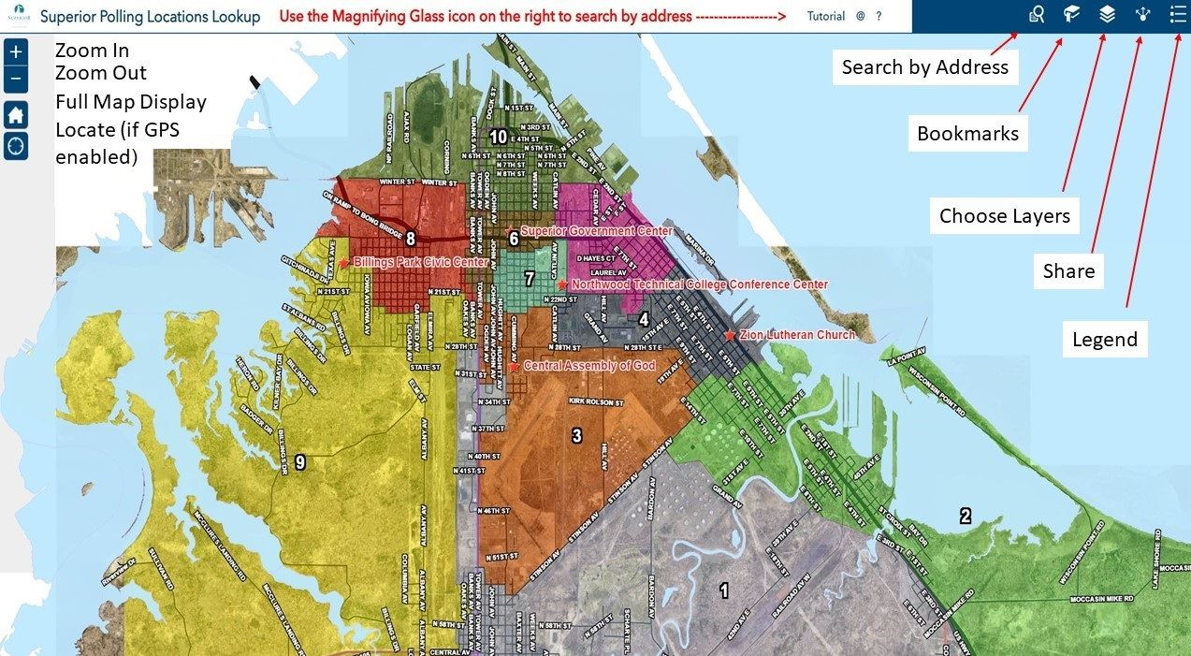
City Polling Locations Lookup
City Poll Site Lookup
https://portal.superiordcgis.org/portal/apps/webappviewer/index.html?id=b2eeeb1a43124ffbb0e0db2ad2a3f65b
Views = 5552

Slide 24
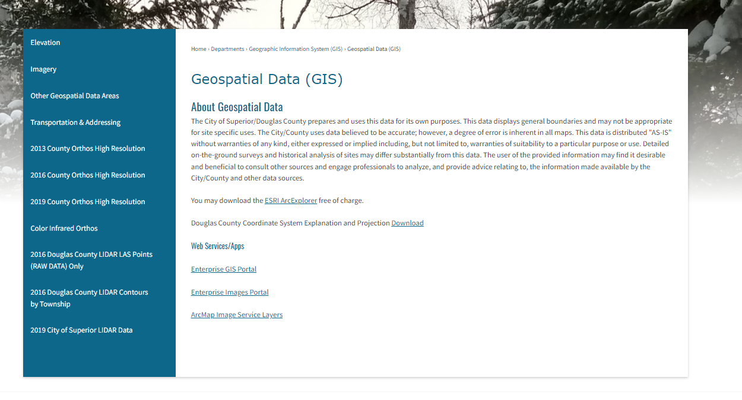
Geospatial Data Downloads
The City/County LIO currently has nearly all it’s GIS data available for download (free)it’s been in place since 2010
http://www.ci.superior.wi.us/474/Geospatial-Data-GIS

Slide 25
City/County Aerial Photos
City/County Aerial Photos
2025
2023 City Only
2022
2019
2016
2013
2009
2006
1999
1986
1973
1962
1948
1938

Slide 26
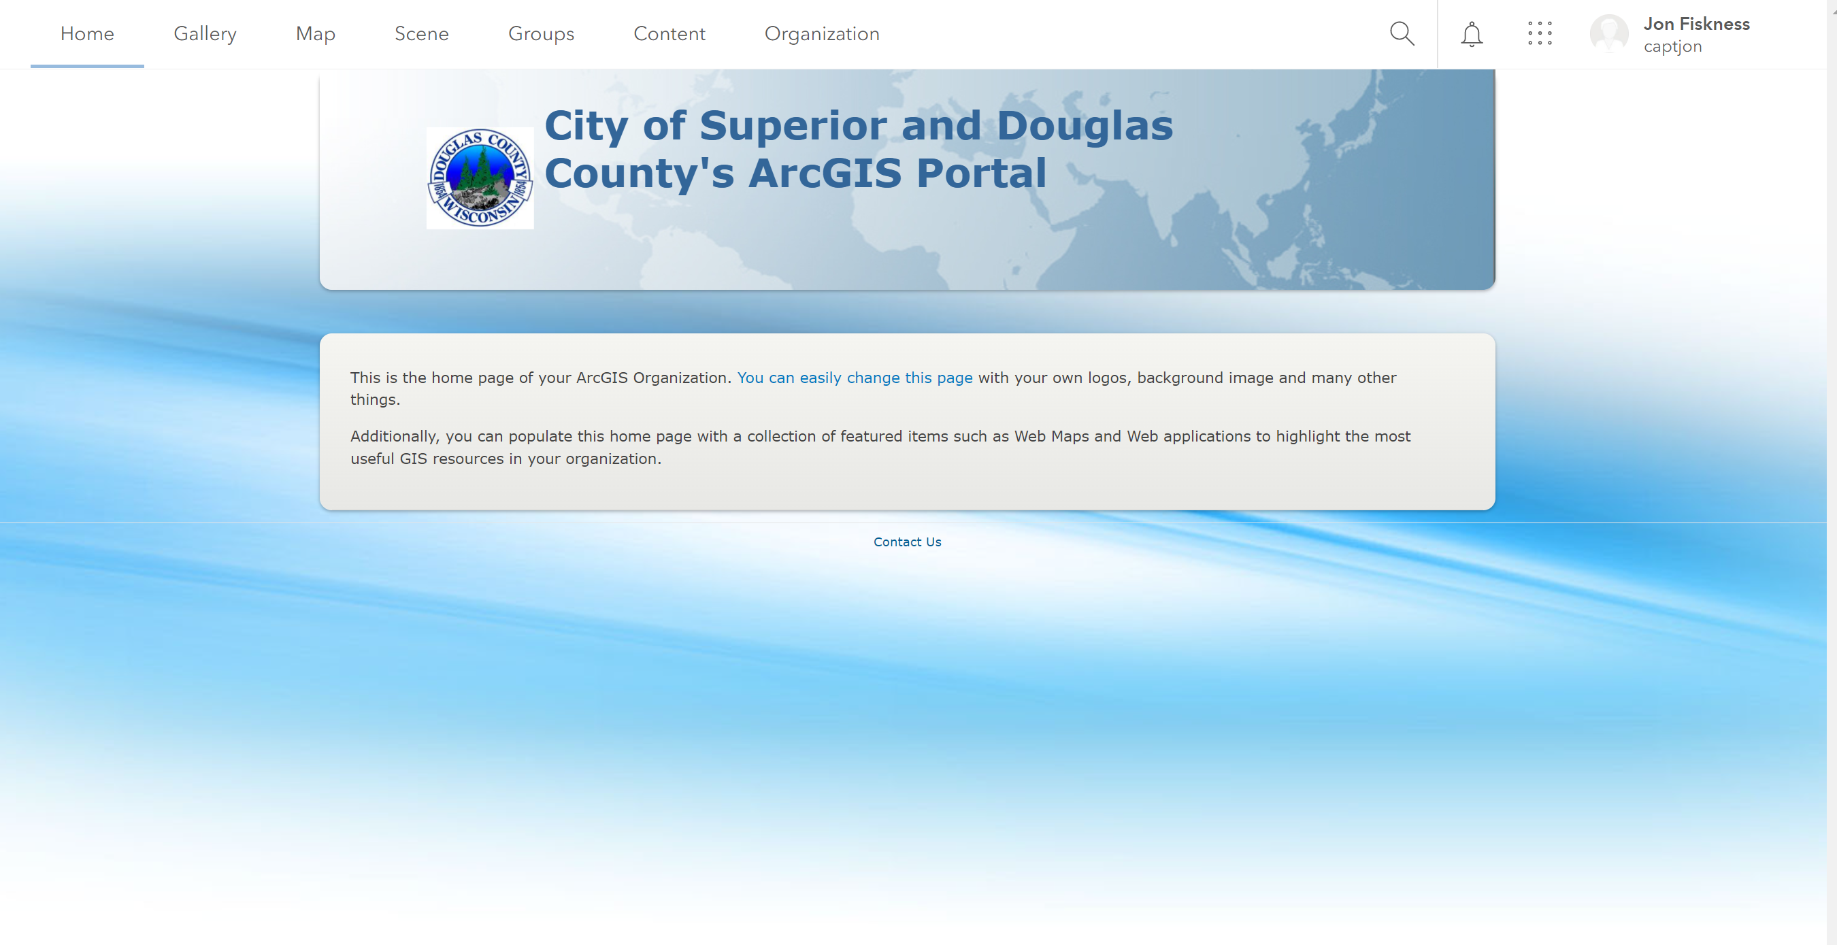
Land Information Office’s Mobile /online Presence
City/County Portal Servers in 2020-2025
City/County COSDC Enterprise Server
  https://portal.superiordcgis.org/portal
Currently working on an permissions and training
for 2025

Slide 27
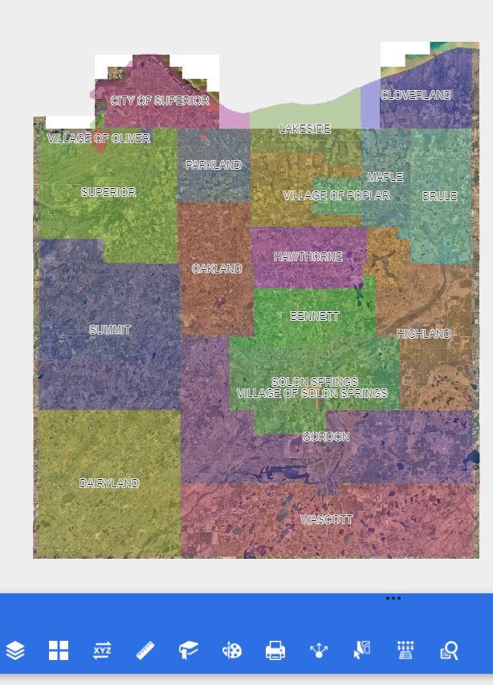
Land Information Office’s Mobile /online Presence
City/County Map Services
https://dcland.douglascountywi.gov/

Slide 28

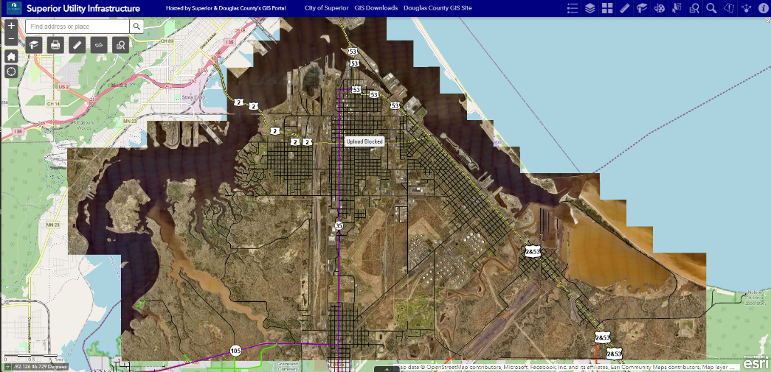
Land Information Office’s Mobile /online Presence
City/County
Portals
Total of Items
Servers = 5
Apps = 121
Dashboard = 30
Map Services = 442
Image Services = 89

Slide 29
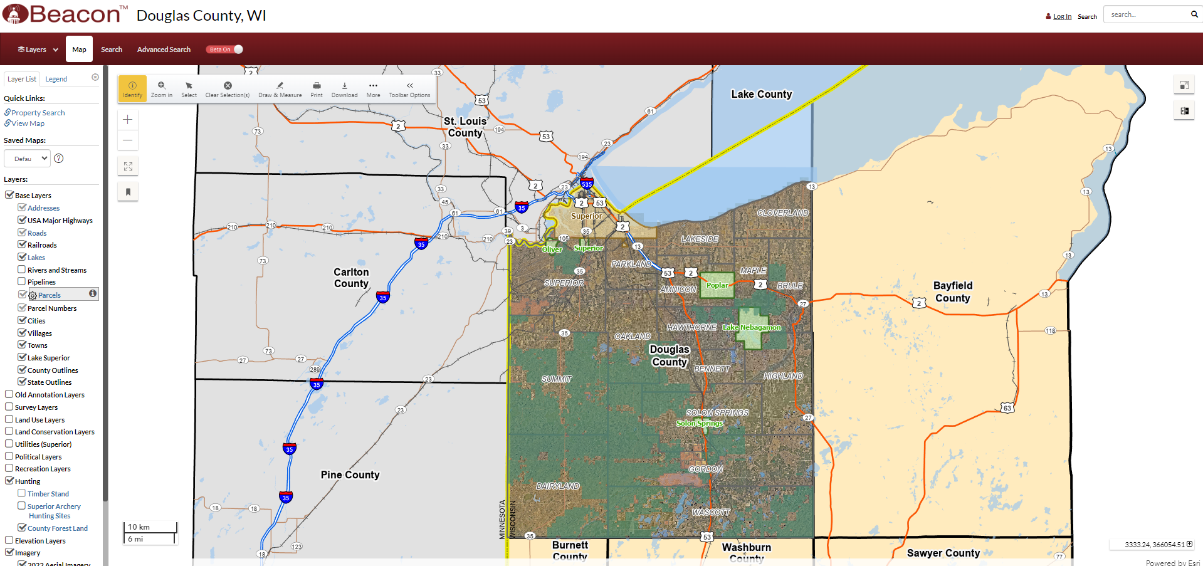
City/County Beacon GIS Site
Douglas County BeaconGIS (Schneider GIS) Online Site
https://beacongis.douglascountywi.gov

Slide 30
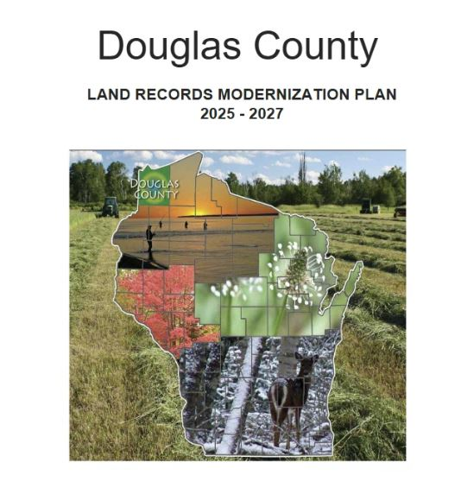
Land Information Plan
Douglas County Land Information Plan 2025-2027
Submitted 12/31/2024

Slide 31
Land Information 2025 Projects
Douglas County Land Information 2025 Projects
3 GIS Server Upgrades
Parcel Fabric Migration to ArcPro
CAD/911 GIS Server Upgrade & NG911 Compliance
2025 Superior Aerial Photo Acquisition
Departmental Mobile Apps; EMS, LIO, Assessor, Public Works, ESD
Superior Change Finder
GCS to SDL Permitting

Slide 32
Land Information Upcoming Projects
Douglas County Land Information Upcoming Projects 2026
Parcel Fabric Server Migration to New Data Model
ArcMap Sunset, ArcPro Implementation
CAD/911 GIS Server Upgrade
Survey Docs App and Maintenance System
NG911 Federal and State Requirements
2026 Aerial Photo Acquisition for Superior (St Louis County)

Slide 33
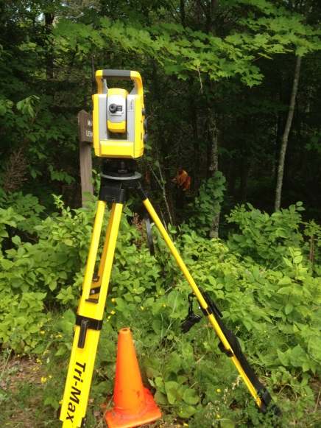
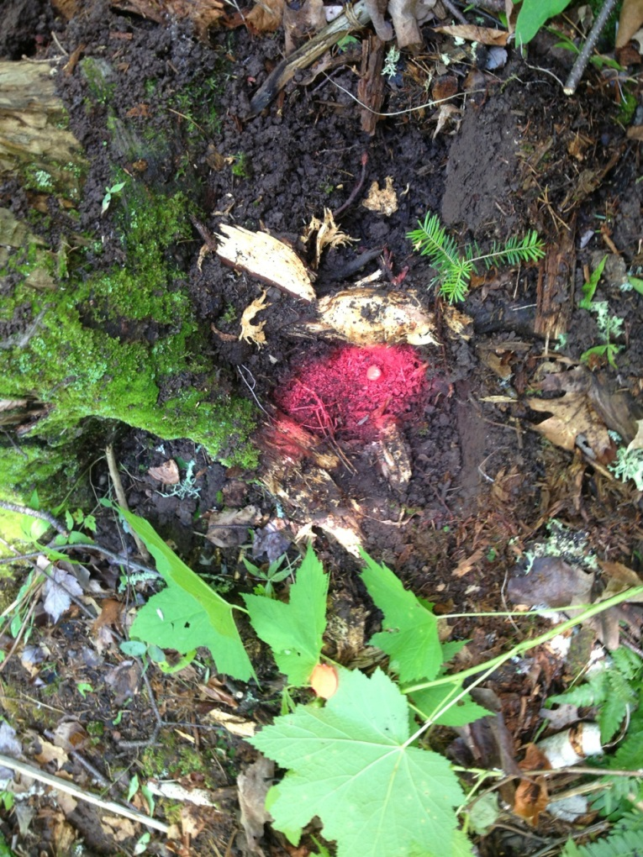
Discussion?

