Slide 1
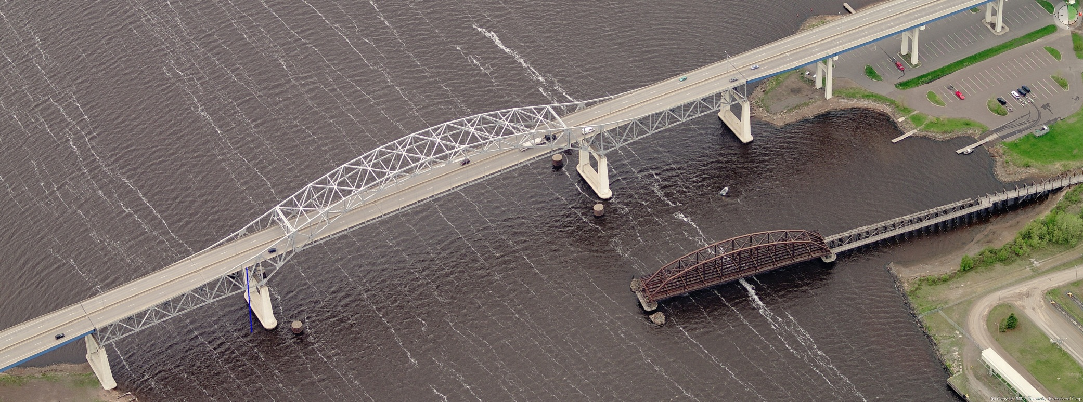
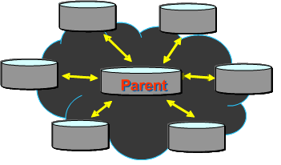
City of Superior/Douglas County GIS Data Replication

Slide 2
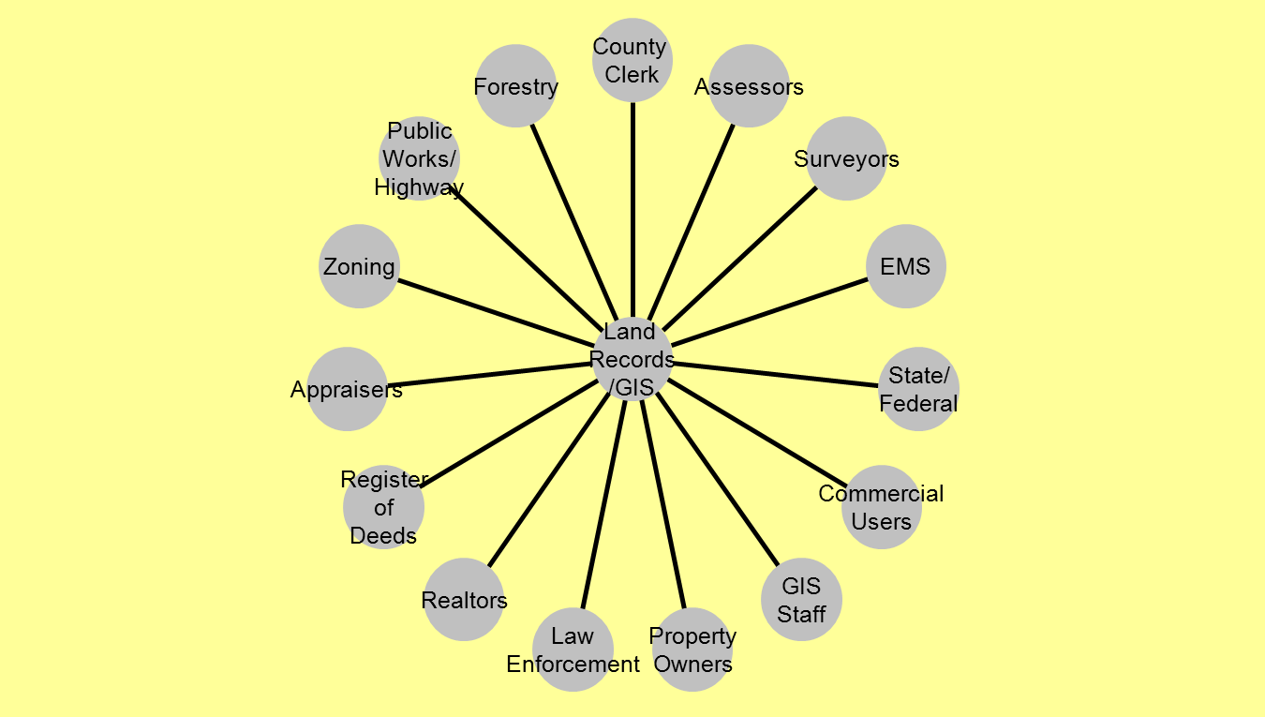
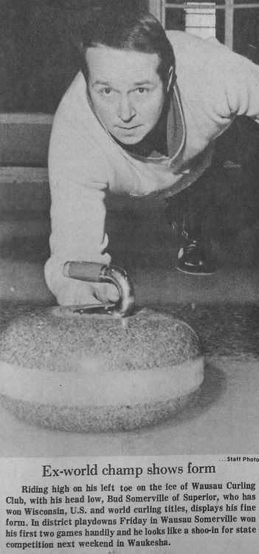
Bud’s Land Records/GIS Wheel

Slide 3
What is GIS?
Geographic Information Systems (GIS) - An integrated collection of computer software and data used to view and manage information about geographic places, analyze spatial relationships, and model spatial processes. A GIS provides a framework for gathering and organizing spatial data and related information so that it can be displayed and analyzed.
GIS is more than just maps, it is:
Data
Hardware
Software
People
Methods

Slide 4
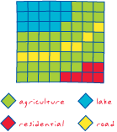
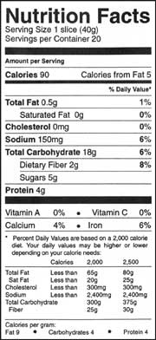
Some Common GIS Terms
Metadata = The data about the data
Vector = A coordinate-based data model that represents geographic
features as points, lines, and polygons.
Raster = A spatial data model that defines space as an array of
equally sized cells arranged in rows and columns, and composed of
single or multiple bands.
Shapefile = A vector data storage format for storing the location,
shape, and attributes of geographic features. A shapefile is stored in a
set of related files and contains one feature class. Geodatabase = A database or file structure used primarily to store, query, and manipulate spatial data. Geodatabases store geometry, a spatial reference system, attributes, and behavioral rules for data.
Map Service - A type of Web service that generates maps.
For More Definitions visit ESRI’S GIS Dictionary @ http://support.esri.com/index.cfm?fa=knowledgebase.gisDictionary

Slide 5
COSDC ENTERPRISE GIS
ST LOUIS COUNTY GIS
2010 WLIA GIS AWARD
WLIA DATA STANDARDS/EXPORTS & LRM
NEXTGEN 911
AERIAL PHOTOS/LIDAR
PHOTOS EVERY 3 YEARS
LIDAR EVERY 10 – HOPEFUL?

Slide 6
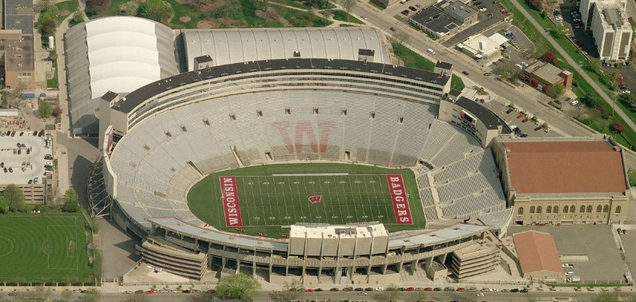
GIS @ Douglas County and the City of Superior
ESRI Enterprise License Agreement
Periodic ArcMap Training Sessions
Web Site and Web Applications
MapServices Based Templates

Slide 7
City/County GIS Staff
Superior GIS Staff (2)
GIS Coordinator
GIS Technician (Douglas County WLIP Grant Fabric Maintenance)
Douglas County Land Information Office Staff (4)
Land Information Director
Taxlister
Two GIS Technicians

Slide 8
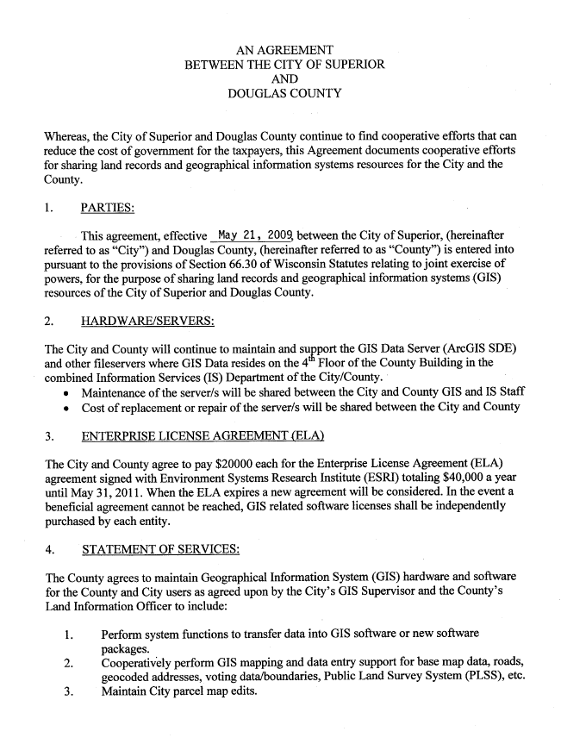
Cooperative Agreement Between the City of Superior and Douglas County

Slide 9
Data Infrastructure

Slide 10
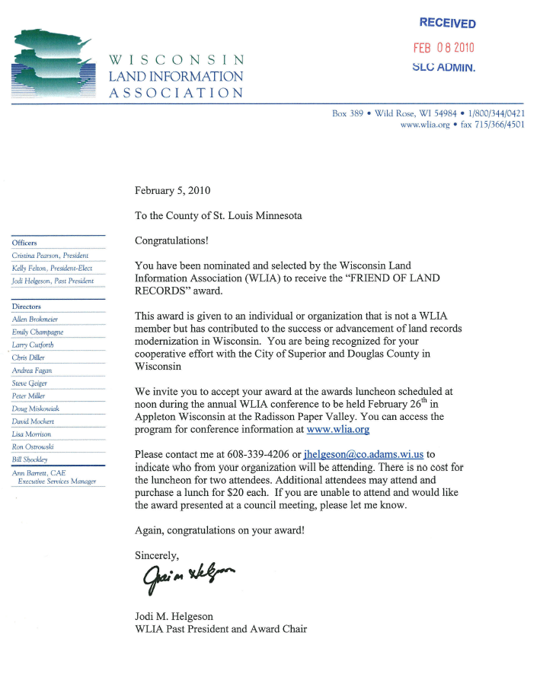
WLIA LOCAL GOVERNMENT ACHEIVEMENT Award

Slide 11
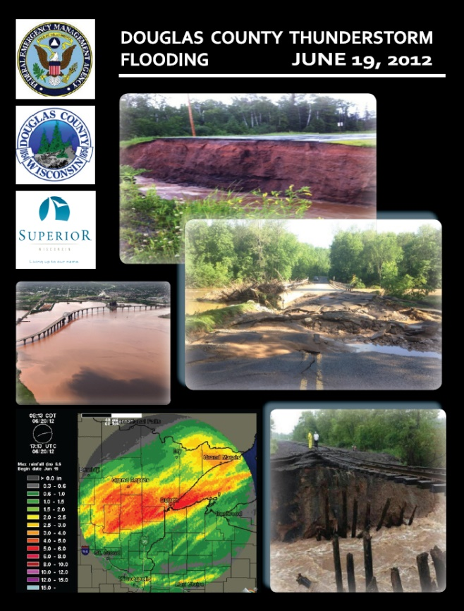
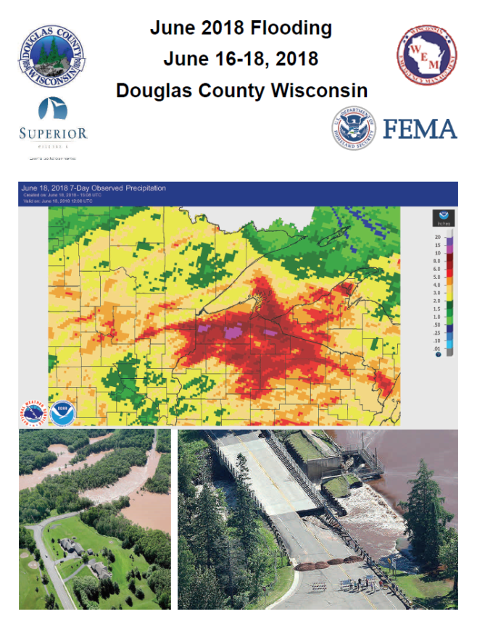
FEMA Floods

Slide 12
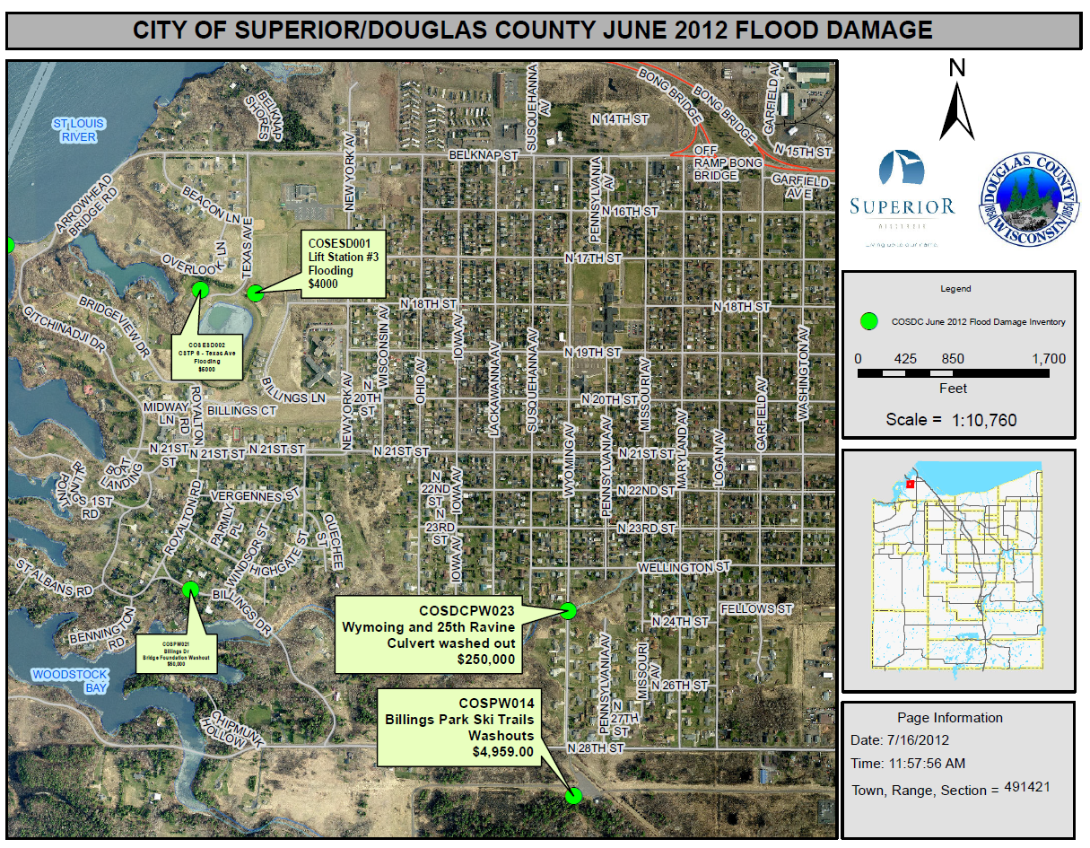
FEMA Floods

Slide 13
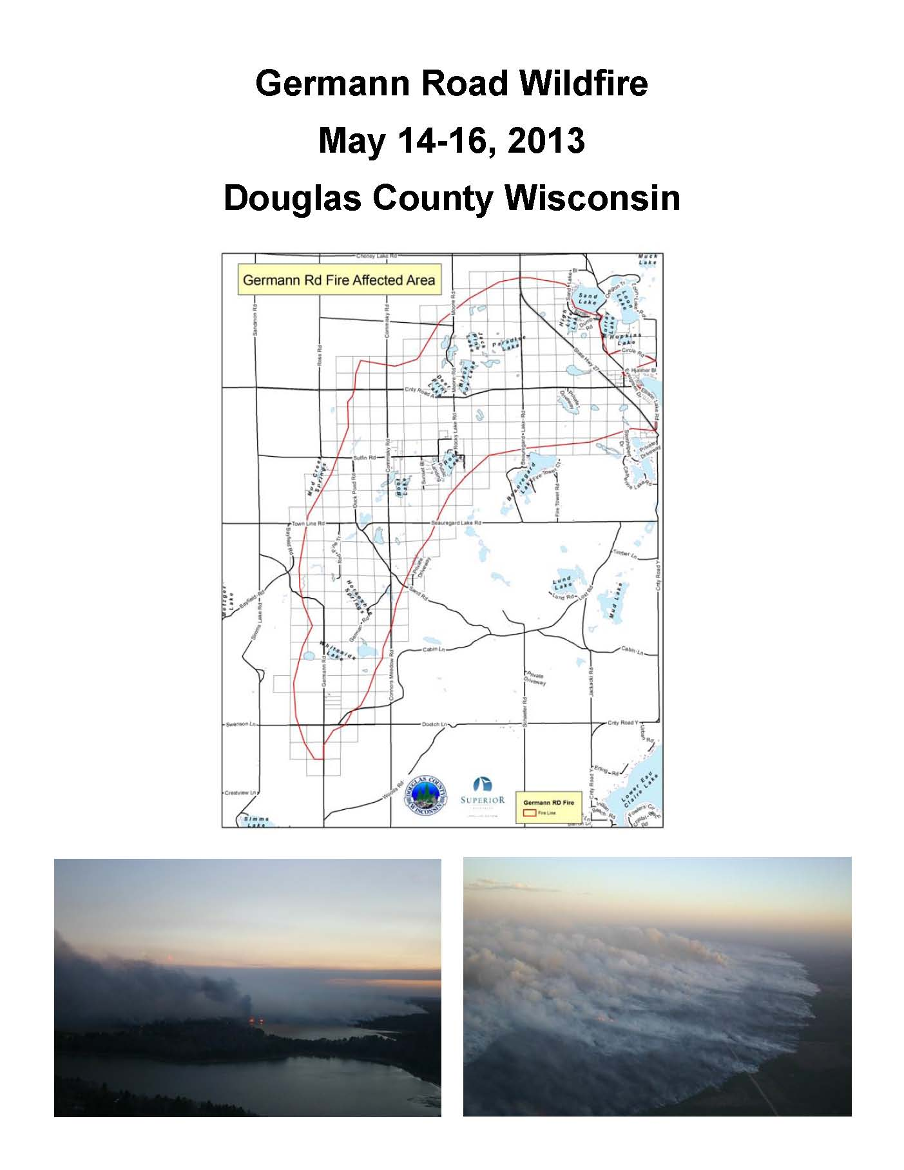
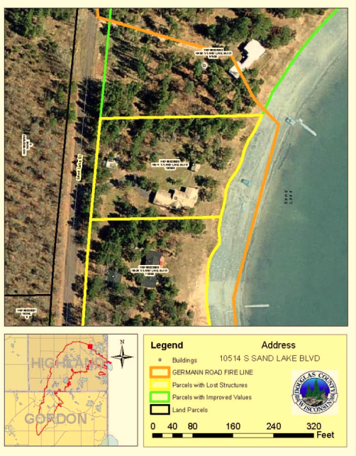
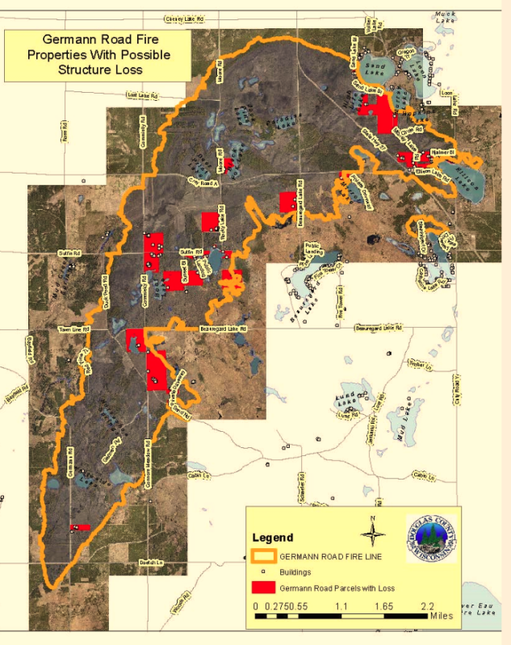
Germann Road Fire

Slide 14
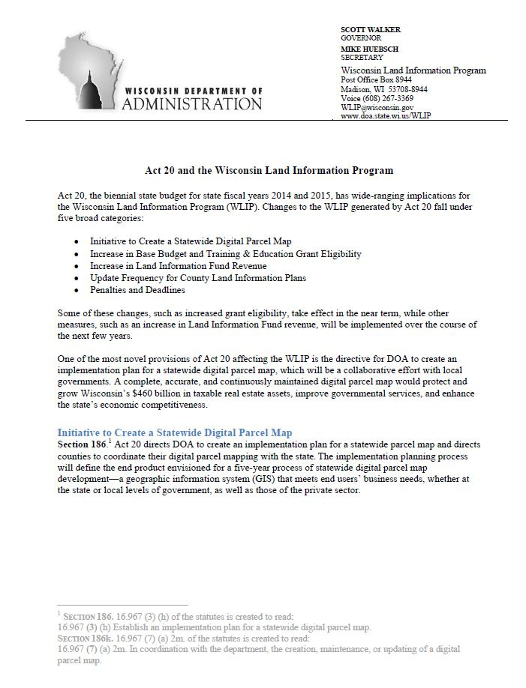
Act 20 and the
Wisconsin Land Information
Program (WLIP)

Slide 15
Act 20 and the
Wisconsin Land Information
Program (WLIP)
Land Modernization Plan

Slide 16
Douglas County Land Information Council
The Land Information Council is a subcommittee of the Douglas County Zoning Committee
https://www.douglascountywi.org/545/Other-Committees
City/County GIS staff update the Zoning Committee monthly on projects and get needed approvals for Wisconsin Land Information Program Grants, Land Records Management Plan, and other items that need approval during the year
LAND INFORMATION COUNCIL
Rosemary Lear, Chair Matt Johnson Tracy Middleton Jon Fiskness Carol Jones | Maria Letsos Zach DeVoe Dave Sletten Brad Theien

Slide 17
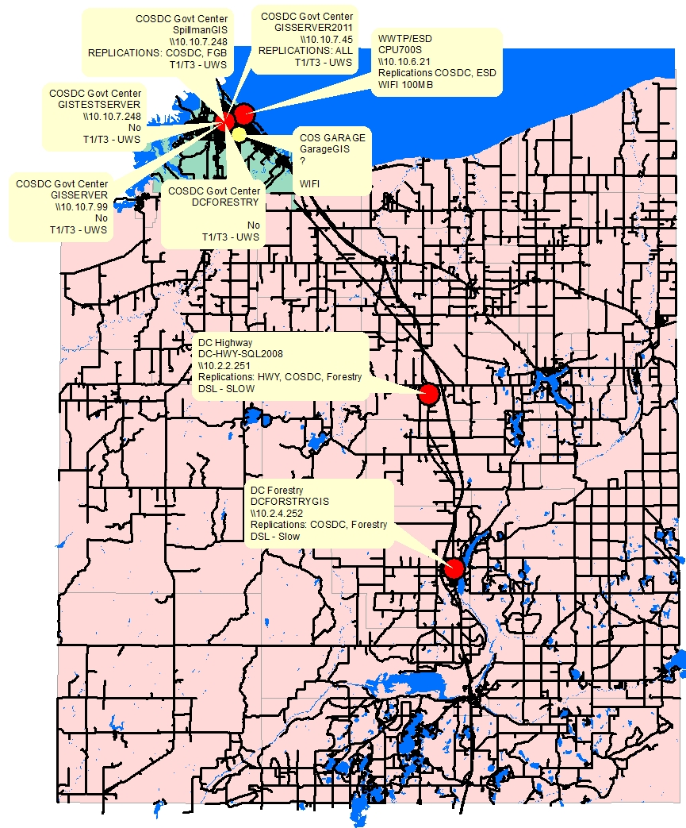
Replication Servers

Slide 18
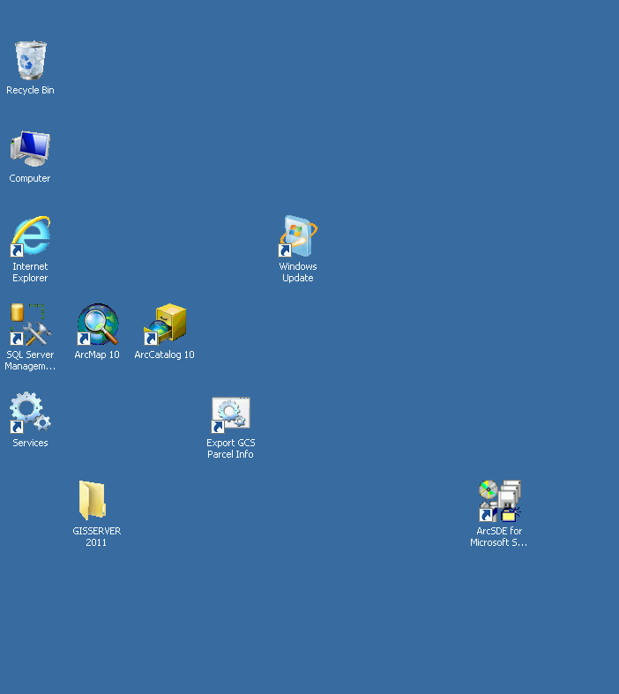
Replication of GCS Taxlister Data
GCS (tax roll) Replication Sequence
-Script (Python) to create a summarized table (SQL Business table)
-Export to Forestry, Highway, Spillman
-Table can be joined to Parcels for ownership info
-Roll Over mid-January to new year

Slide 19
City of Superior/Douglas County Enterprise GIS
Server Infrastructure and Replication
Design Elemental
Proposed Development
ArcGIS
WMS
ArcGIS
Portal
GISWEB
Survey Docs
Firewall
GIS-Fabric
Enterprise SDE
(100)
GCS
Ownership
Highway SDE
(8)
City
Services
CAD/
911
(15)
ESD
(25)
Forestry
(10)
Enterprise Server Based Management allows for:
Multiple Editors and Viewers
Replication of data
Backups Simplified
Less Duplication of data
More efficient data delivery and speeds to users

Slide 20
Thank You!!!
Any Questions?
Jon Fiskness, GISP
GIS Coordinator
fisknessj@ci.superior.wi.us
715-395-7423

