Slide 1
HUSKY REFINERY FIRE
Douglas County GIS Response

Slide 2
Timeline April 26th, 2018
First report of explosion and fire approximately 9:00 AM
No call to our department. Smoke visible from the courthouse.
Second fire approximately 11:45 AM
Notified approximately 12:30 requesting GIS support in the Emergency Operations Center (EOC).

Slide 3
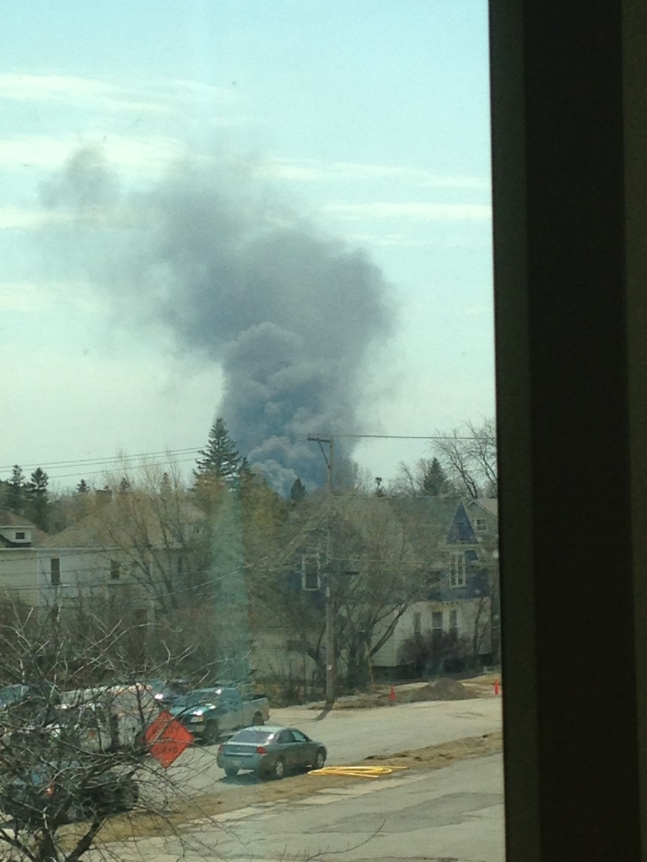
Out our window

Slide 4
Courthouse steps east side

Slide 5
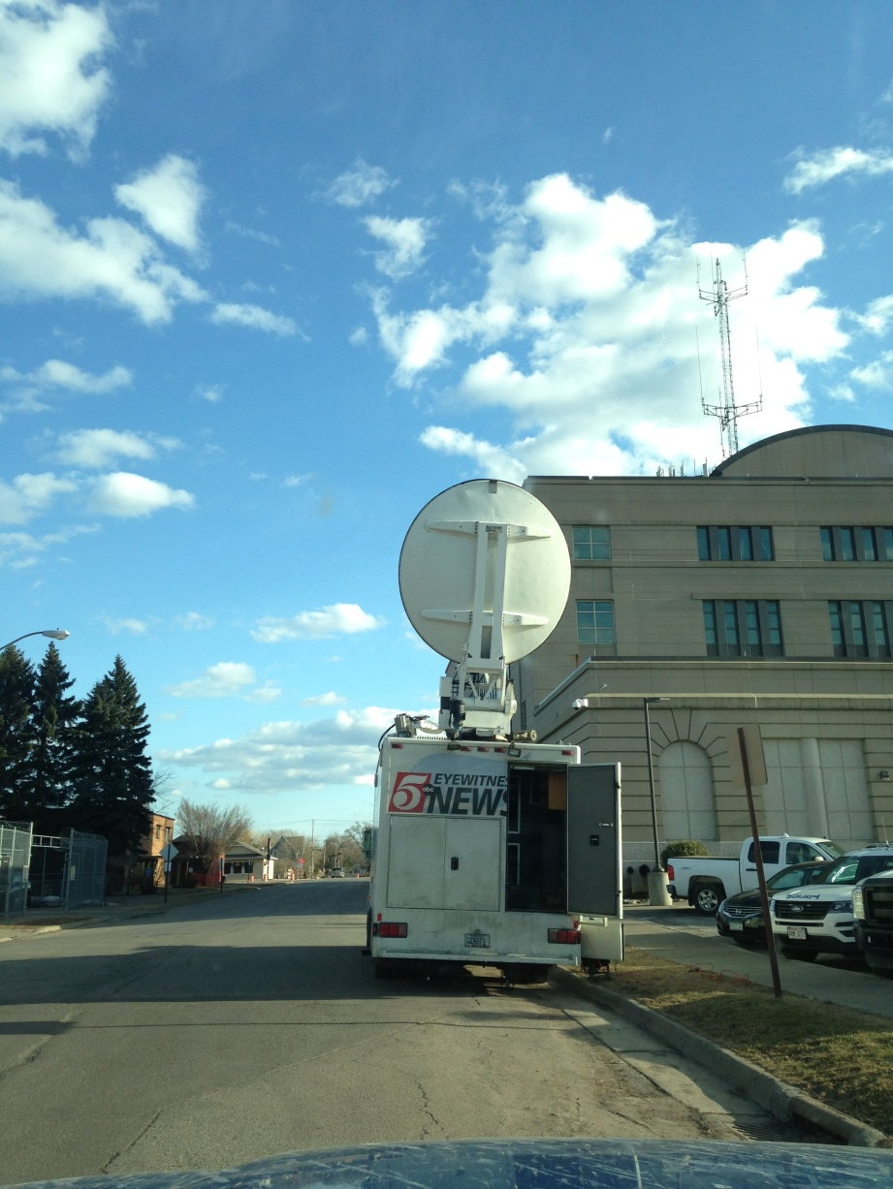

Slide 6
Maps Needed

