Slide 1

Douglas County Wisconsin Statewide Parcel Initiative Report 2021
December 13, 2021

Slide 2
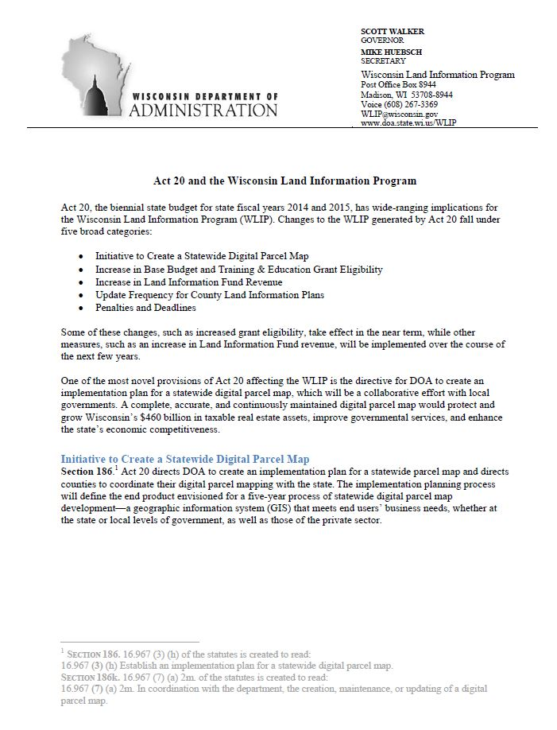
WI Statewide Parcel Initiative
Act 20

Slide 3
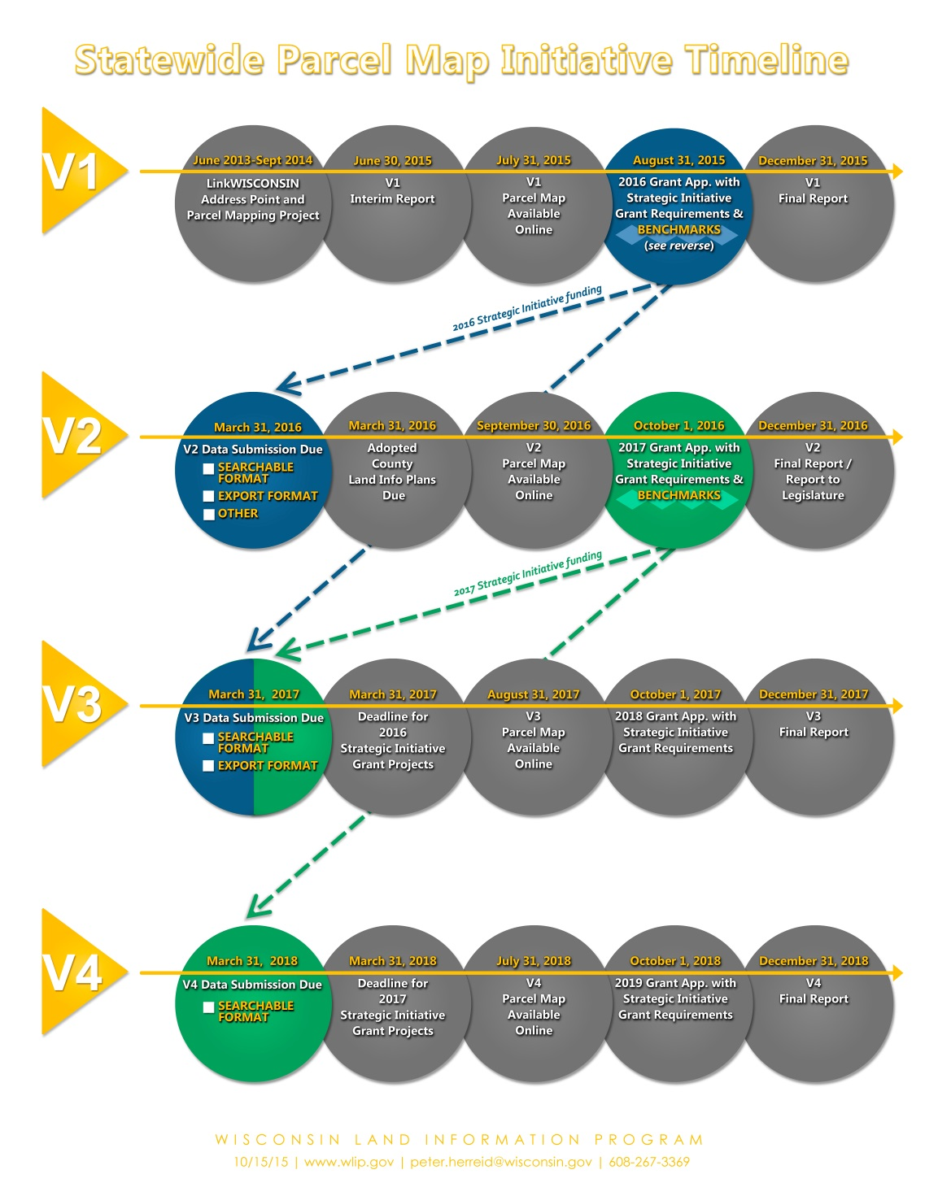
WI Statewide Parcel Initiative
Now at V7
Benchmarks

Slide 4
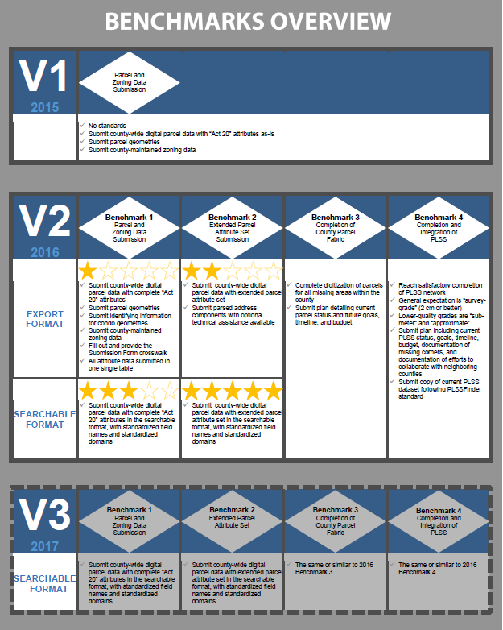
WI Statewide Parcel Initiative
Benchmarks

Slide 5
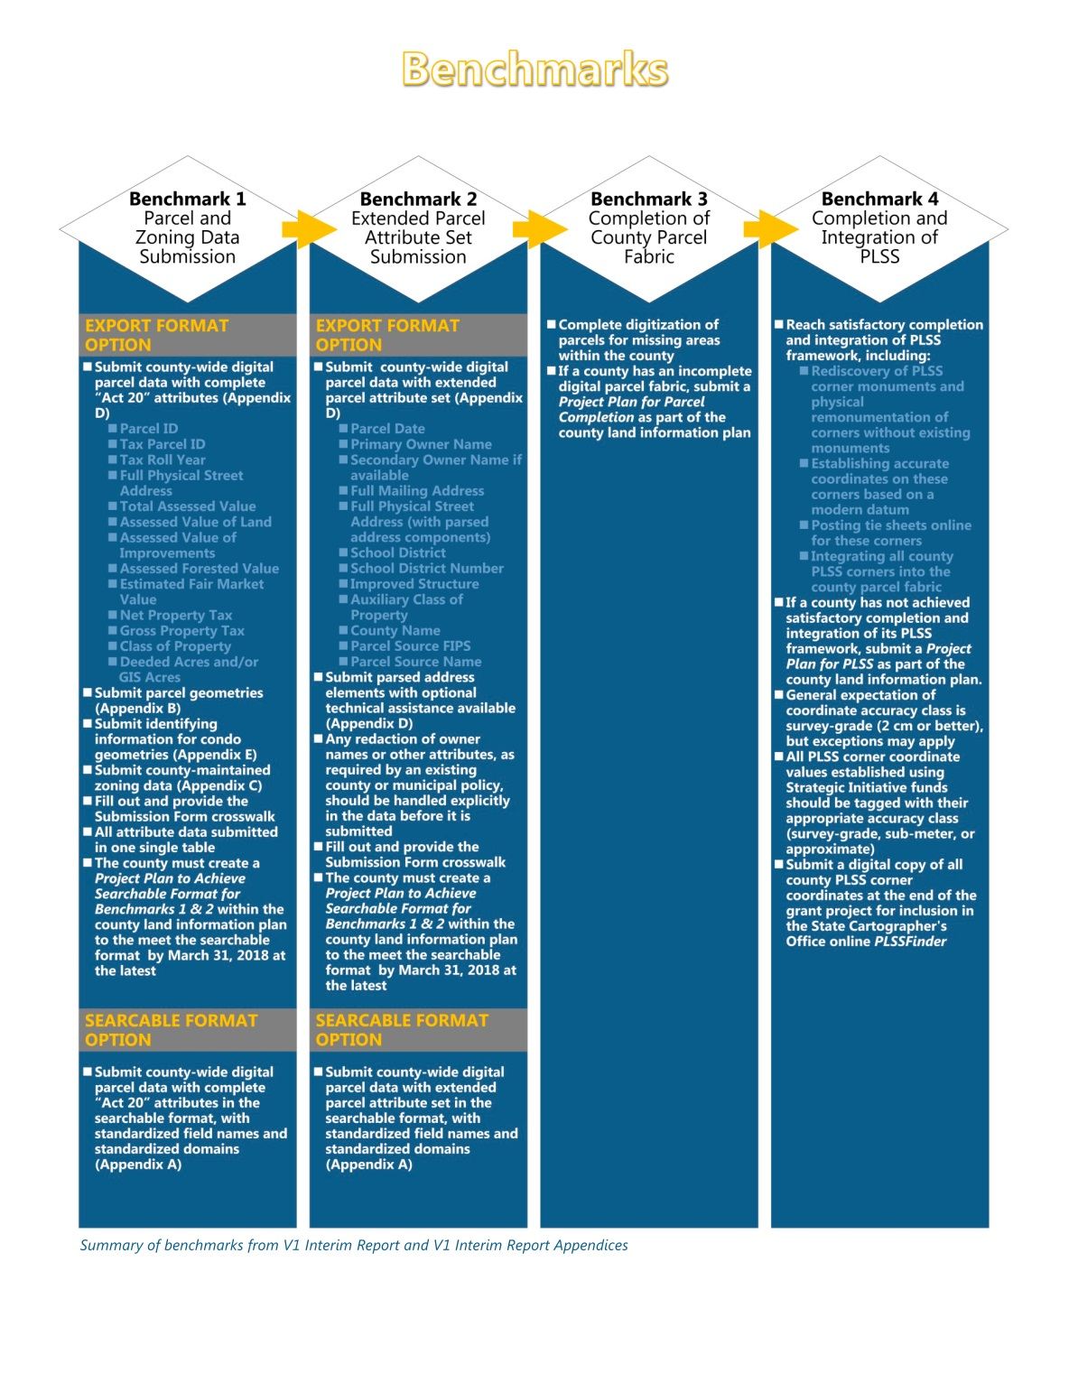
WI Statewide Parcel Initiative
Benchmarks

Slide 6
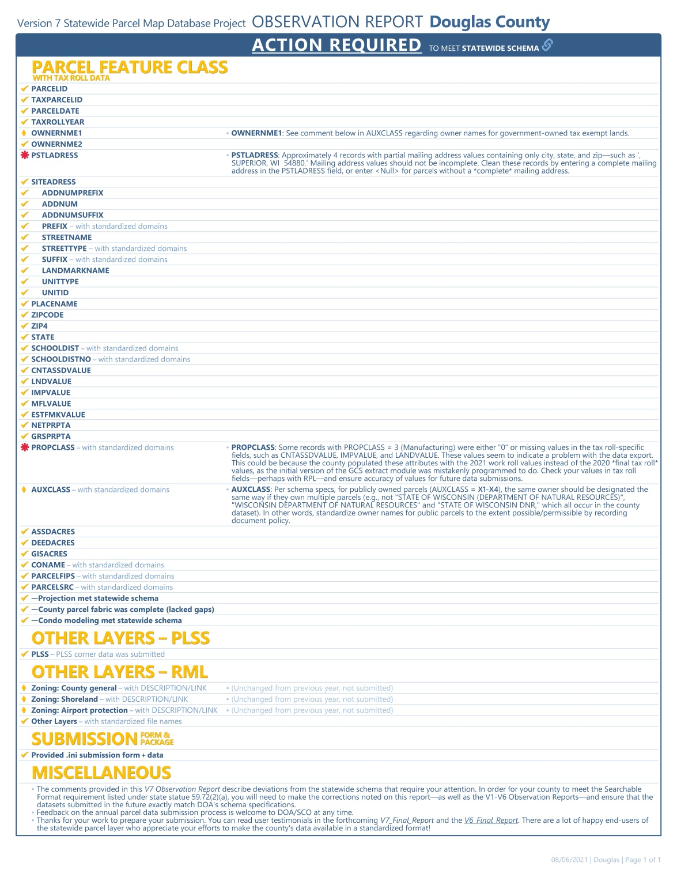
WI Statewide Parcel Initiative
V7 submittal on
March 31, 2020

Slide 7
WI Statewide Parcel Initiative
Benchmark 4 (V5) submittal on
March 28, 2018
Final V3 Submittal is due on March 13, 2019
Parcels
Zoning General
Shoreland
Floodplain
PLSS Corners
Roads
Addresses
Land Use
Trails
Boat Accesses
Parks
Buildings
Hydrography
ROW

Slide 8
Background Information on Parcels and Ownership Data
Parcel Editing Process
Currently every 24 hours parcels
Ownership is updated and replicated from
GCS, Parcels are updated in groups of
edits once every week
2021 = 6337 Edits
2020 – 7541 Edits
2019 – 6875 Edits
2018 – 3725 Edits
2017 – 24,574 Edits
2016 - ~15,000 Edits
2015 – 11,252 Edits
2014 – 4,570 Edits
2013 - 1,380 Edits
2012 – 581 Edits
GCS Ownership Changes
Currently editing daily (City/County Tax Listers)
  2021 - ~ 6153 Edits
  2020 - ~ 5896 Edits
  2019 - ~ 12,000 Edits
  2018 - ~ 15,000 Edits
  2017 – ~ 22,000 Edits
GCS ownership data and parcels are the
most critical data the City and County
Maintain. It is used by all departments for
Various purposes.

Slide 9
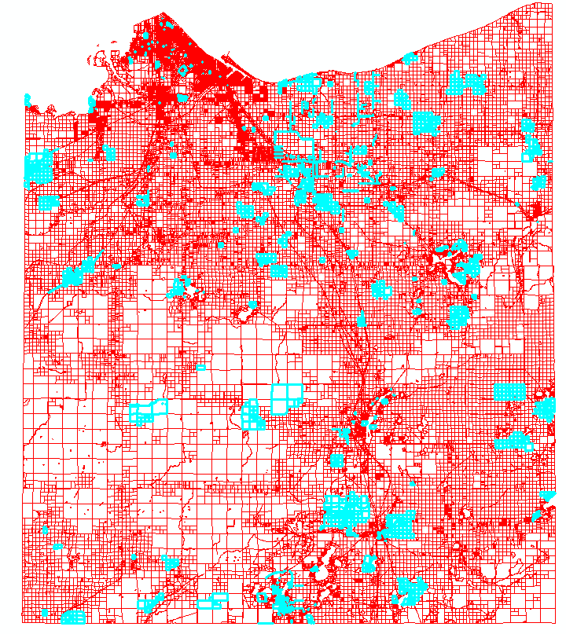
Parcels Edited in 2021
Parcels Edited 6337

Slide 10
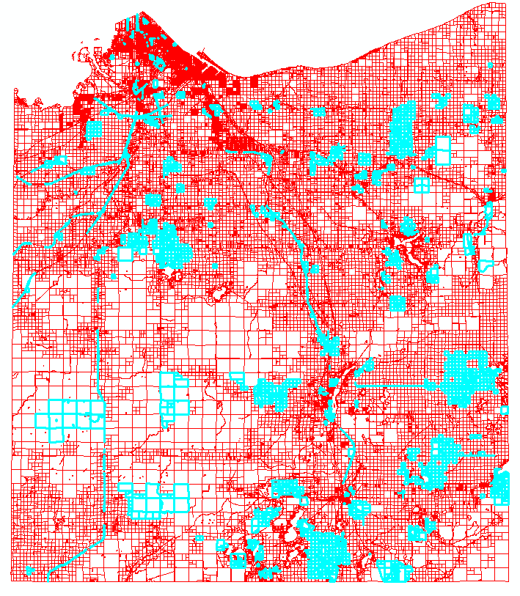
Parcels Edited in 2020
Parcels Edited 7541

Slide 11
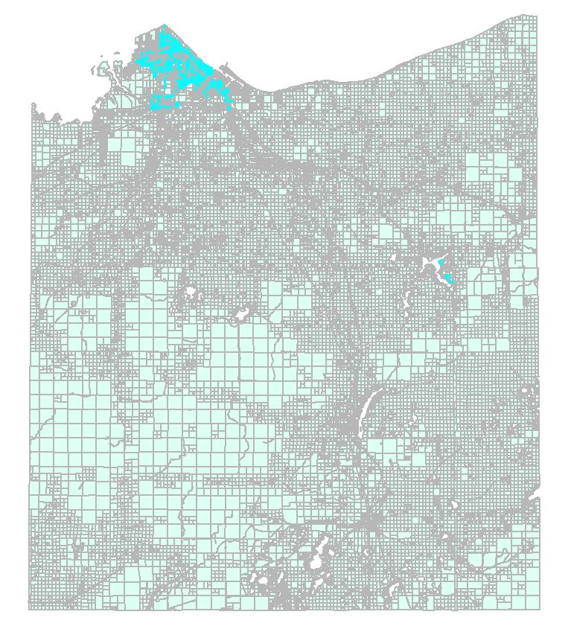
Vacated Streets and Alleys Documented
2770 Vacated Streets & Alleys Documented
In Fabric 2021

Slide 12
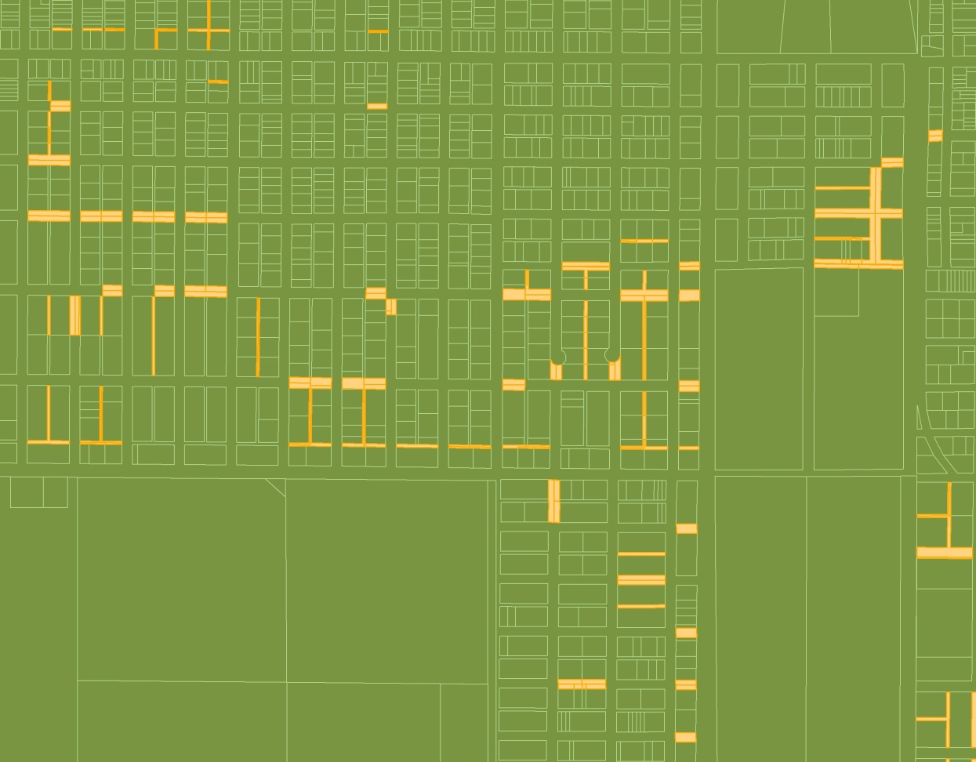
Vacated Streets and Alleys Documented
2016 = 2180
2017 = 2678
2018 = 2733
2019 = 2756
2020 = 2765
2021 = 2770

Slide 13
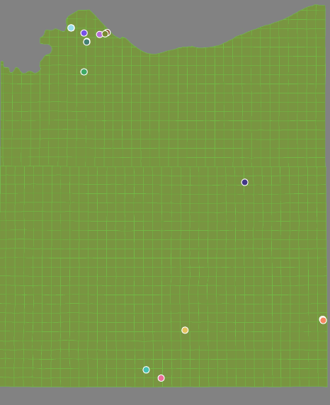
Condos in the Fabric - 2021
19 Condo Plat boundaries
109 Tax Parcels
200 Associated parcel features
328 Total Parcel Fabric elements
2016 – 94
2017 – 105
2018 – 107
2019 – 109
2020 – 109
2021 = 109

Slide 14
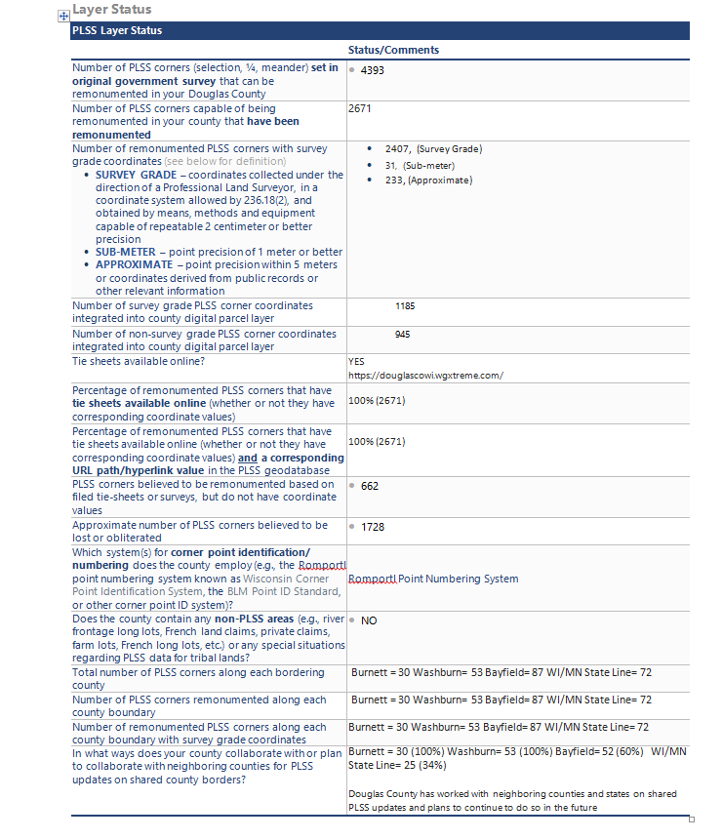
V3 Benchmark Status for PLSS Corner Integration

Slide 15
Survey Documents Inventory
Douglas County Surveyor Control Summary
2021 (As of 12/7/2021)
Centerline Monuments = 15
Section Corners = 106
Section Corners via the County Bounty System = 30
Contracted Section Corners = 26
DC Surveyor Collected Corners = 50
Survey Site , http://www.superiordcgis.org/surveyors/
Updated with new corners and current links to survey docs. Currently being taken down due to software sun setting.
We also added Survey data to the County GIS Online Site at http://douglascowi.wgxtreme.com/

Slide 16
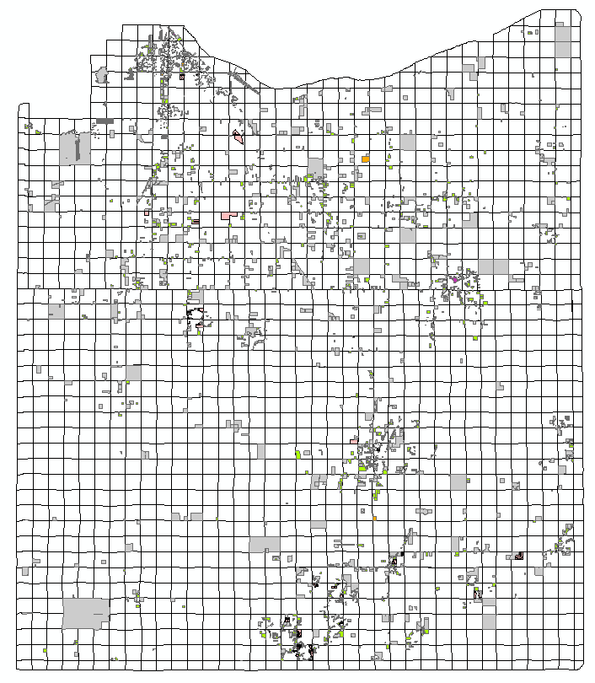
Survey Documents Inventory
Georeferenced Survey Documents Inventory
5130 Total Documents
ALTA = 46
Certified Survey Maps = 1557
Site Plans = 224
Maps of Survey = 3255
Plats = 48

Slide 17
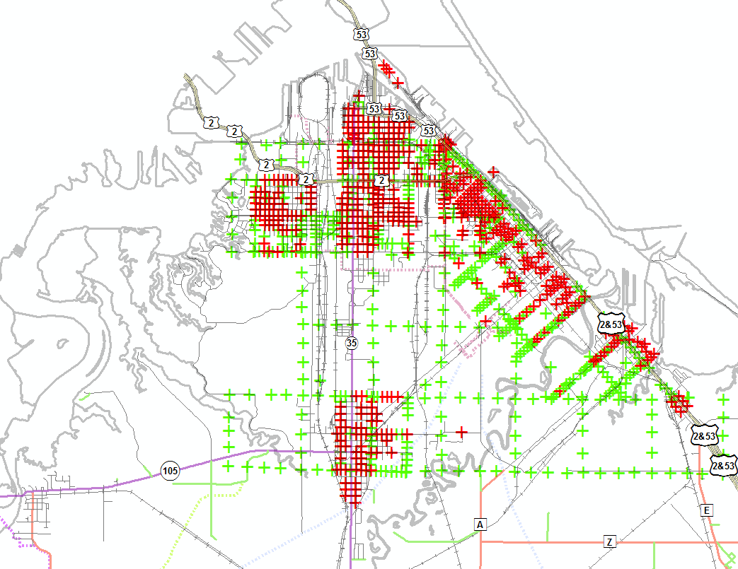
Street Centerline Monuments
City of Superior Street Centerline Monuments
Attributed Monuments = 501 (Red)
Unattributed Monuments = 512 (Green)

Slide 18
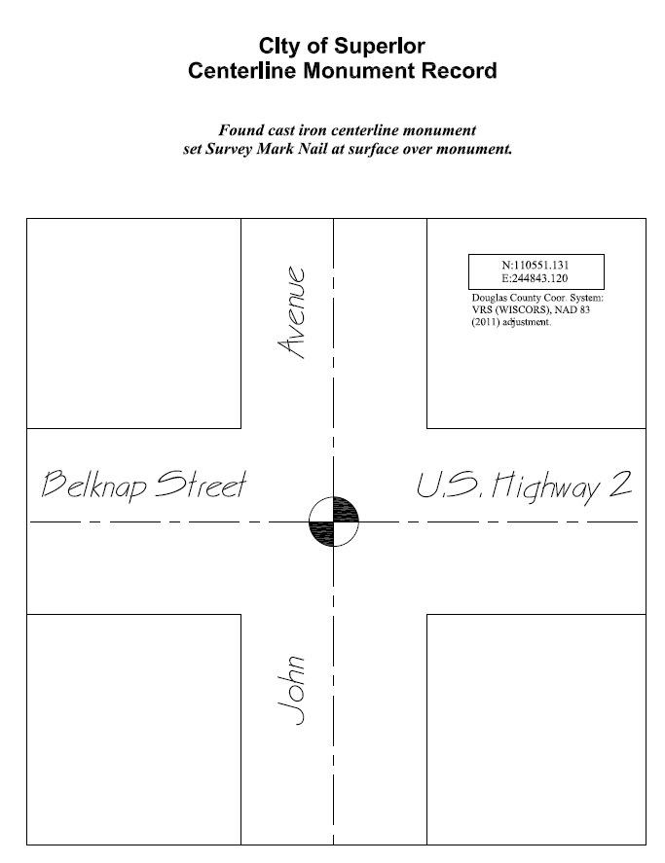
Street Centerline Monument Record
City of Superior Street Centerline Monument Record Sample

Slide 19
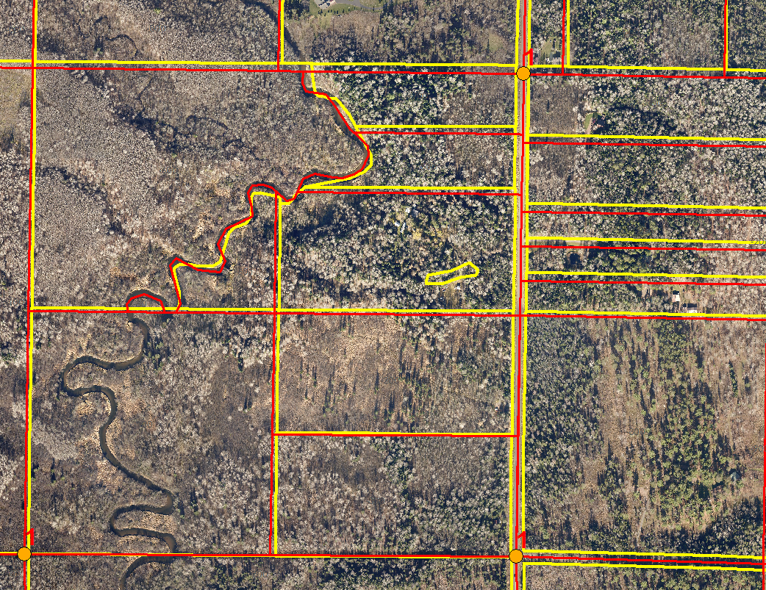
Brule Area
Brule Area Adjustment to PLSS
Yellow = Before Adjustment
Red= After Adjustment

Slide 20
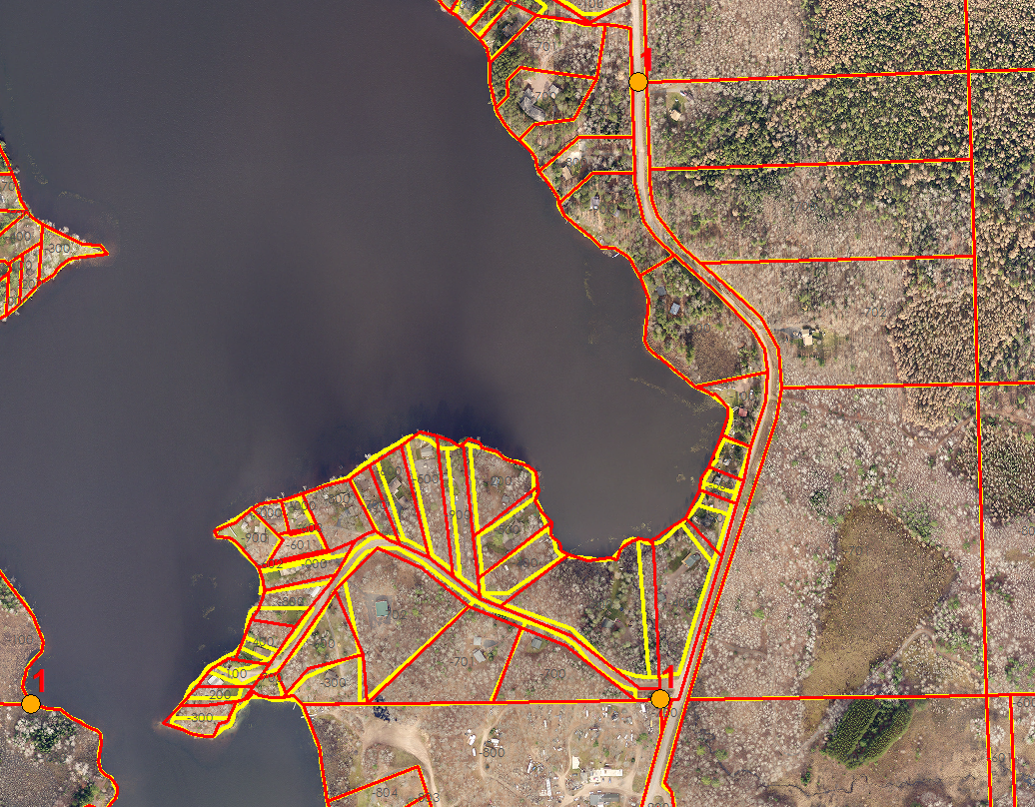
Minnesuing Lake
Adjustment
Yellow = Before Adjustment
Red = After

Slide 21
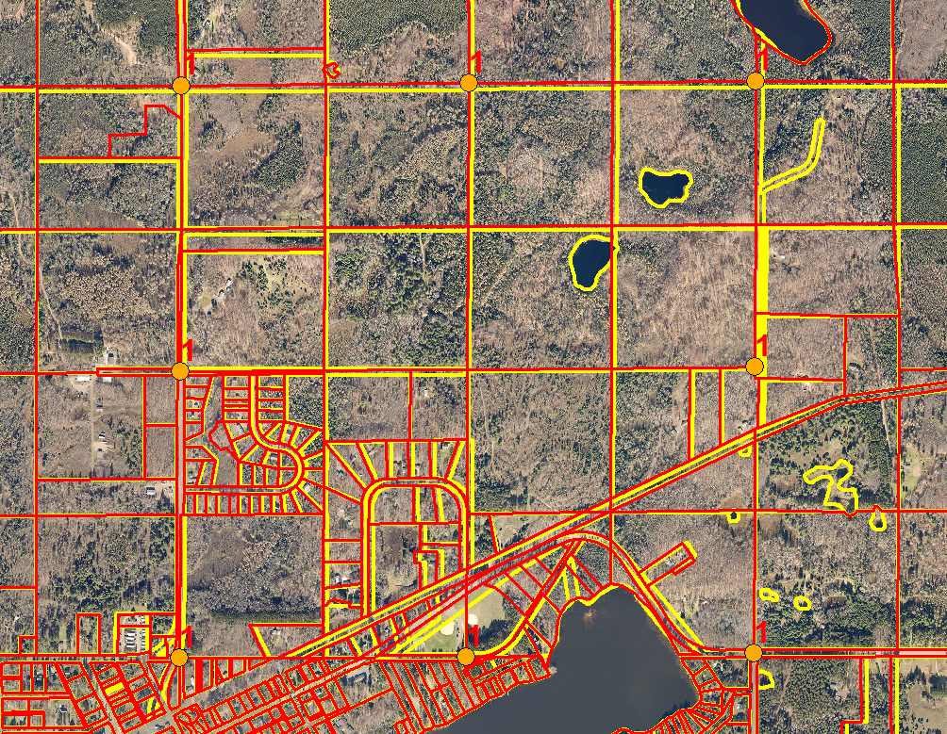
471125 Adjustment
Yellow = Before Adjustment
Red= After

Slide 22
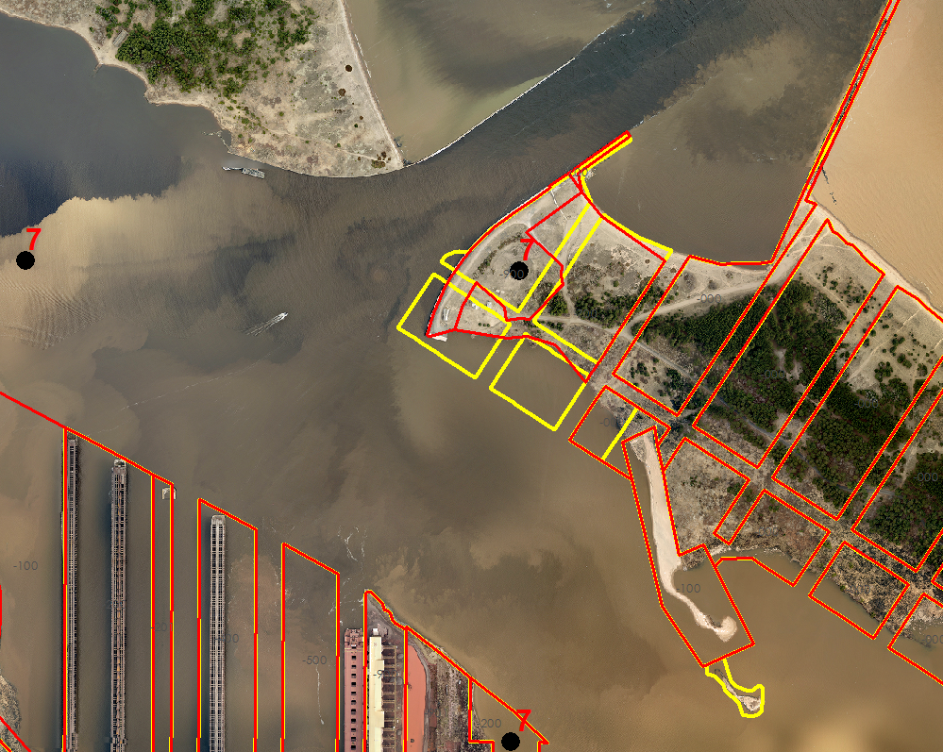
Wisconsin Point
Adjustment
Yellow = Before Adjustment
Red = After Adjustment

Slide 23

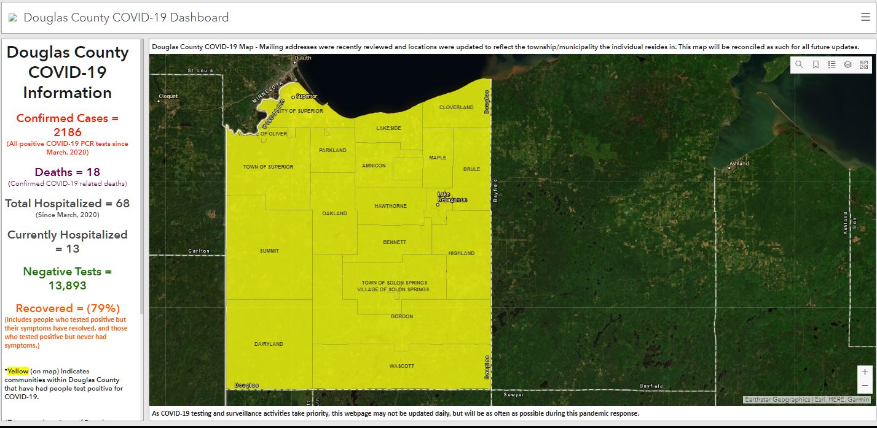
Land Information Office’s COVID-19 Response
Douglas County COVID-19 Dashboard
https://douglascountywi.maps.arcgis.com/apps/opsdashboard/index.html#/
Baa24df0bdd349cca4847f6722a30fa9
Over 100,000 hits when turned off June 1, 2021

Slide 24

Land Information Office’s NextGen911 Activities in 2020
NextGen911(NG911) is a Federally required upgrade to the CAD/911 systems throughout the nation. Wisconsin is developing standards and requirements for County systems to meet. Ng911is a fully GIS integrated system with stringent requirements that must be met.
Douglas County NG911 Activities include:
CAD911/GIS data assessment in 2020
Budgeting for GIS staff assistance
Continued monitoring of the State’s NG911 recommendations and needed response
Implementation of GIS data changes as required by the State and Federal governments
Challenges for LIO in NG911
Address system used by Douglas County
Migration of current data to required schema
Future maintenance needs and costs

Slide 25

Land Information Office’s Redistricting Role in 2020-2021
US Census April 2020 kicks off the census count and then in April 2021 redistricting for the City of Superior and Douglas County begins
The process: (Subject to change) April 1, 2021 to October 1, 2021 (180 days)
April 2021, County Wards Plan development starts (60 days to complete and approve)
City Aldermanic redistricting starts as soon as a County Ward Plan is approved (60 days to complete and approve)
County Supervisor Boundaries Plan starts (60 days to complete and approve)
Due to census data not being complete the process
Started on August 23, 2021 and was completed by
November 10, 2021

Slide 26
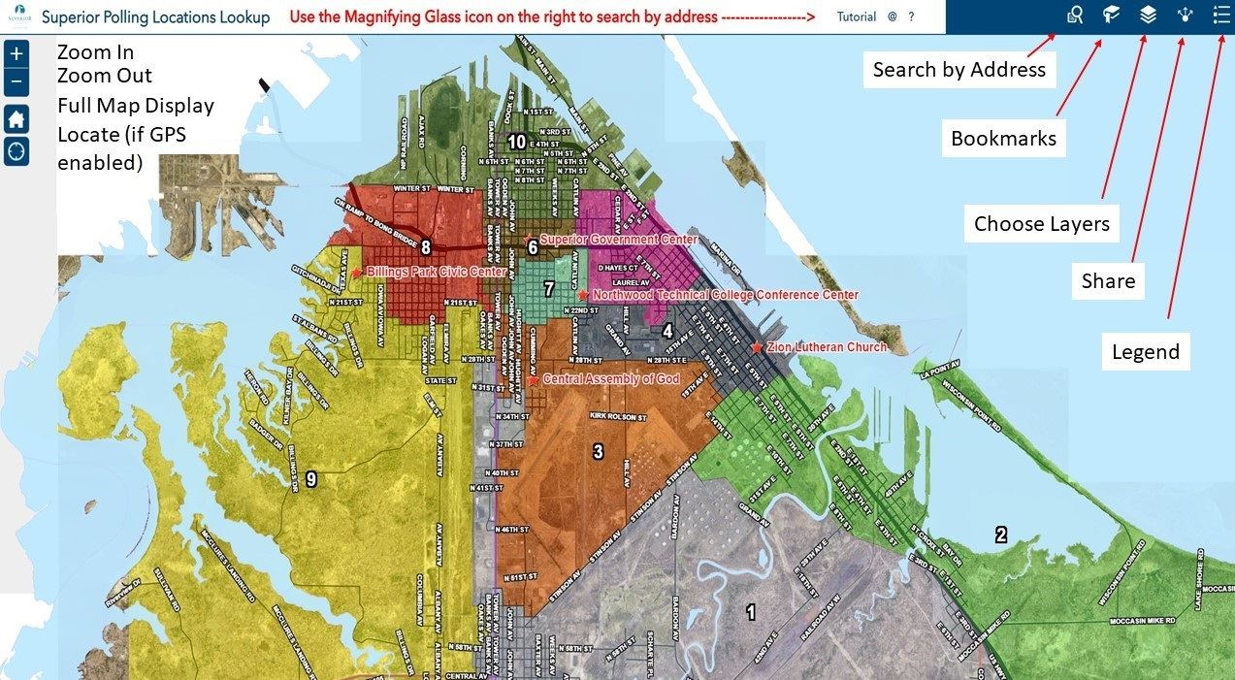
Land Information Office’s Redistricting Role in 2021
City Poll Site Lookup
https://portal.superiordcgis.org/portal/apps/webappviewer/index.html?id=b2eeeb1a43124ffbb0e0db2ad2a3f65b

Slide 27
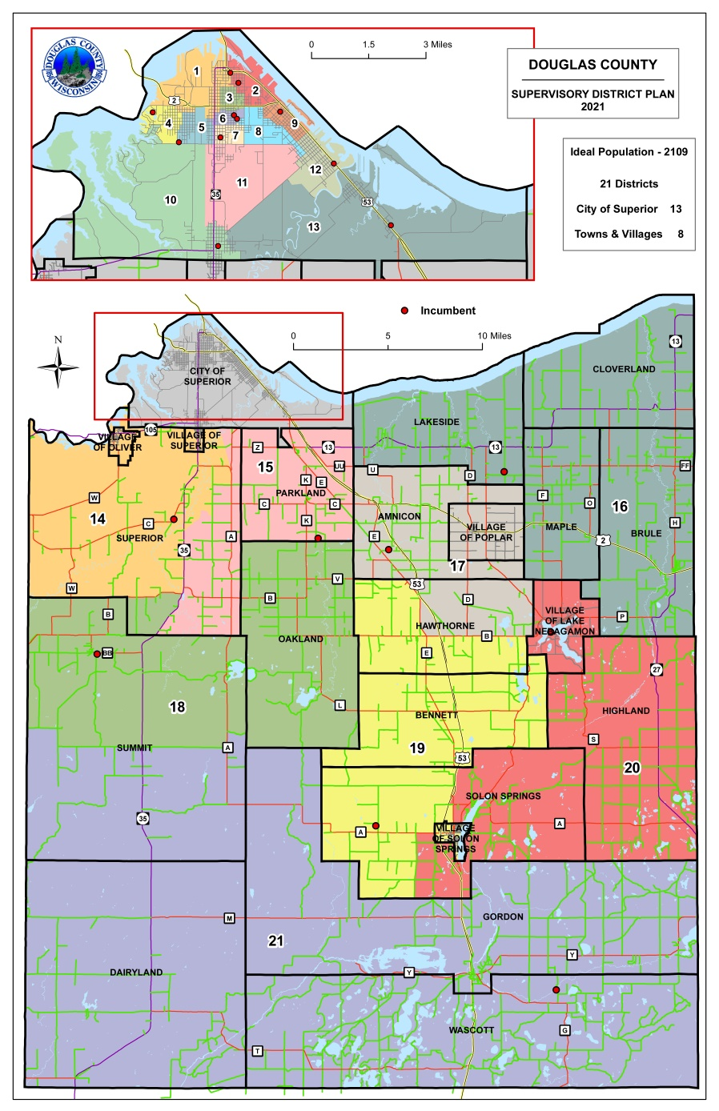
Land Information Office’s Redistricting Role in 2021
County Supervisor Districts
https://www.douglascountywi.org/DocumentCenter/View/503/District-Maps?bidId=

Slide 28
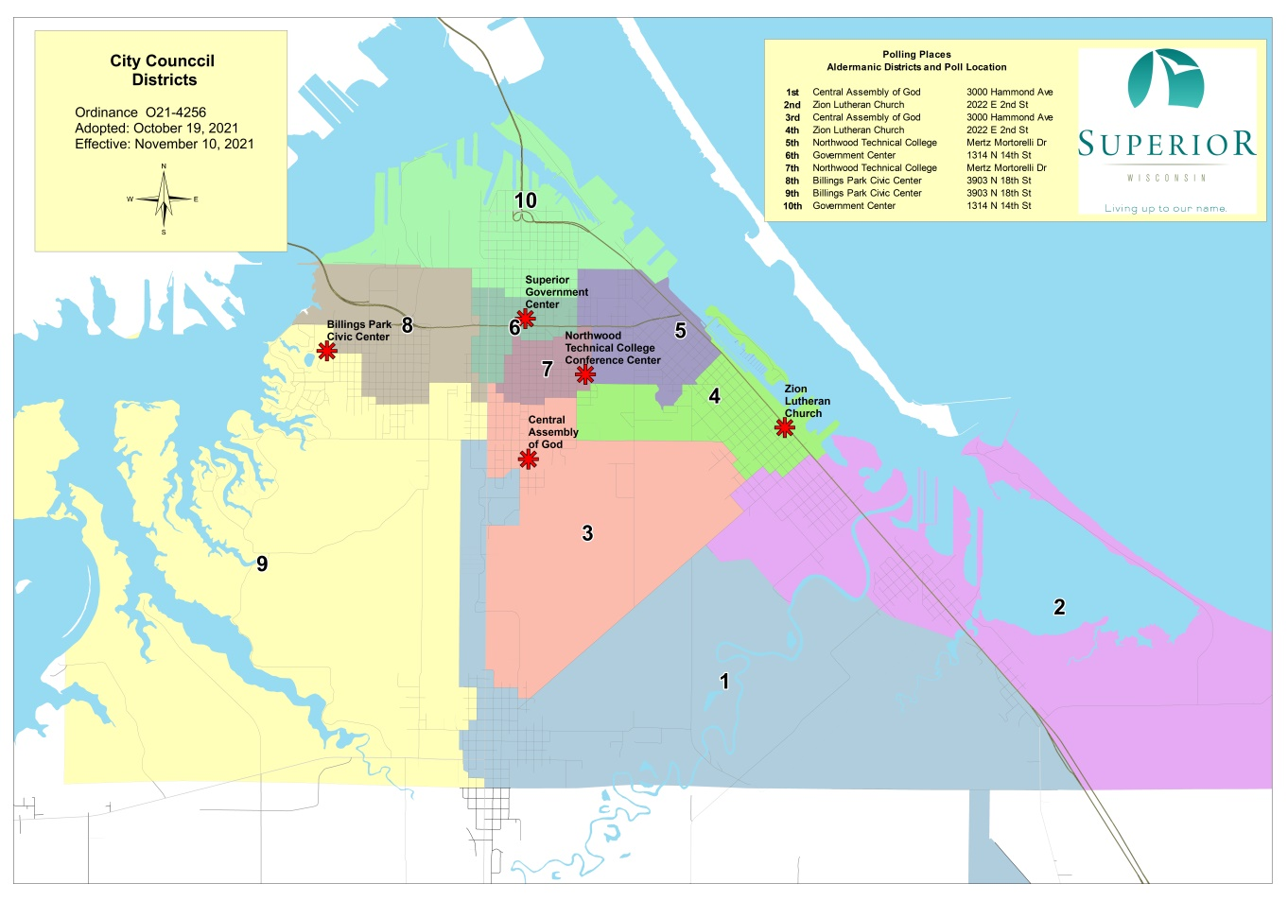
Land Information Office’s Redistricting Role in 2021
City Aldermanic Districts
http://www.ci.superior.wi.us/190/Polling-Places

Slide 29
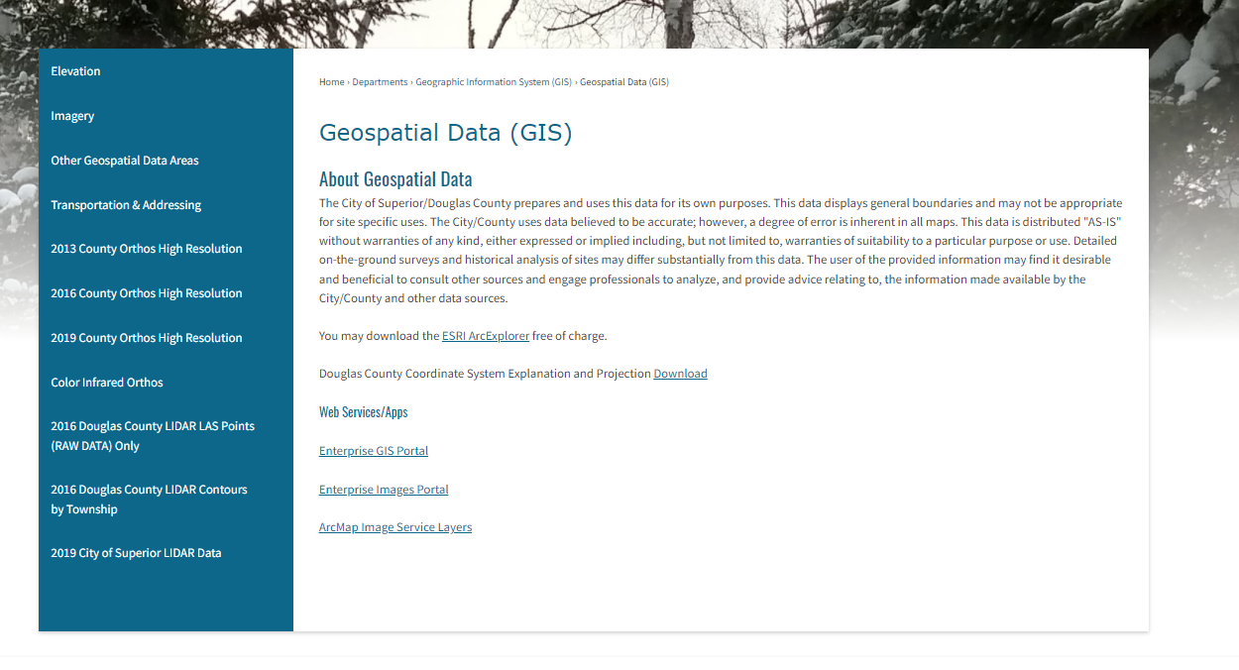
Geospatial Data Downloads
The City/County LIO currently has nearly all it’s GIS data available for download (free)it’s been in place since 2010 or so
http://www.ci.superior.wi.us/474/Geospatial-Data-GIS

Slide 30
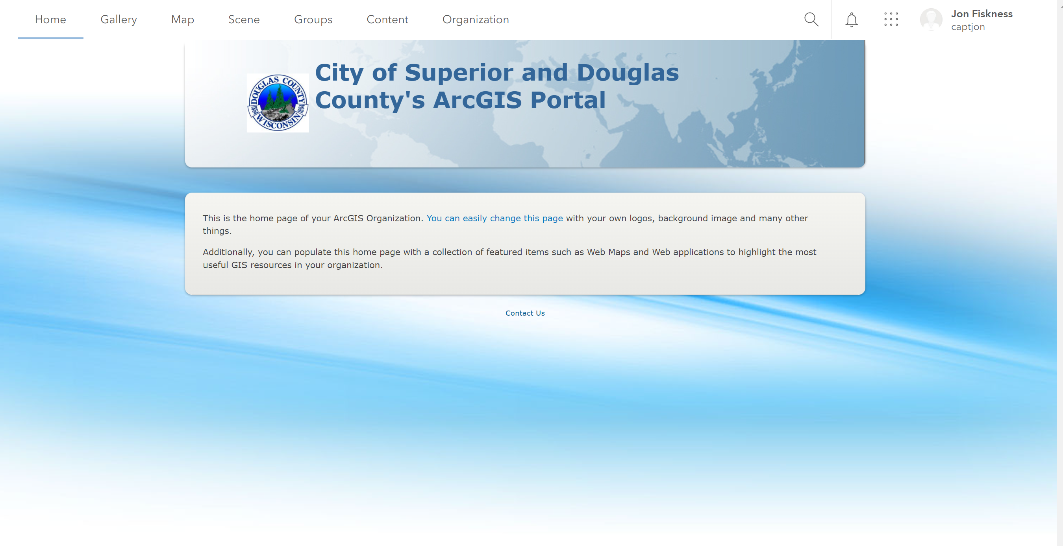
Land Information Office’s Mobile /online Presence
City/County Portal Servers in 2020-2021
City/County COSDC Enterprise Server
  https://portal.superiordcgis.org/portal
Currently working on an permissions and roll-out plan
for 2022

Slide 31
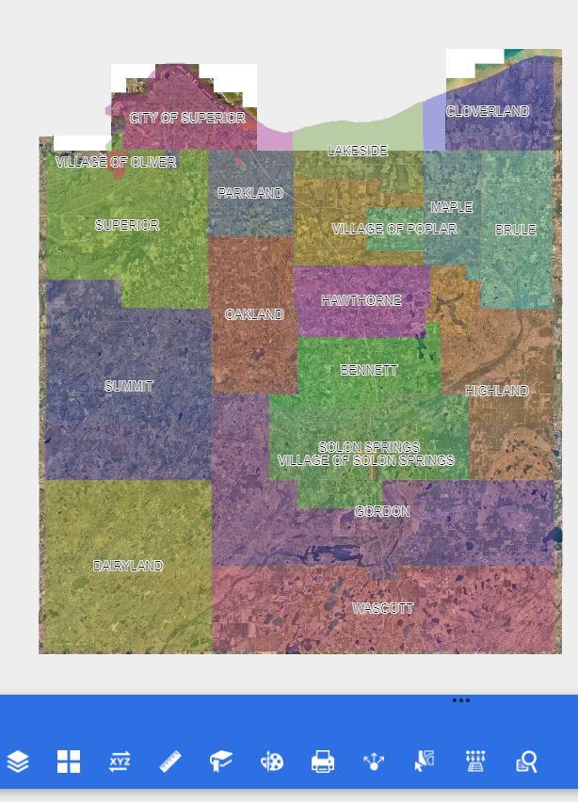
Land Information Office’s Mobile /online Presence
City/County Map Services
https://portal.superiordcgis.org/portal/apps/webappviewer/index.html?id=cccdec273dc342828351bc3bca1e49ee

Slide 32
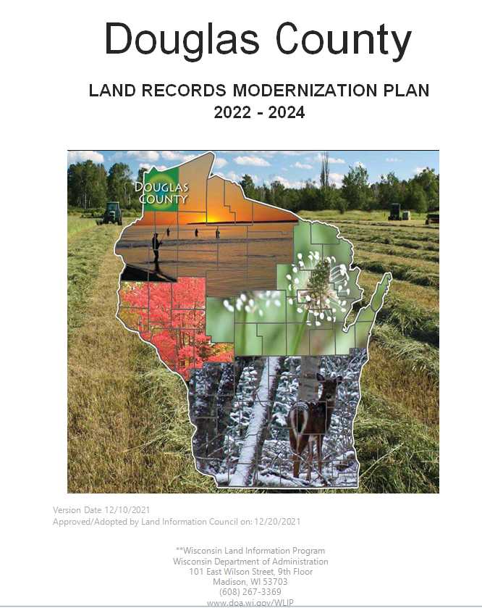
Land Information Plan
Douglas County Land Information Plan 2022-2024
Submitted 12/31/2021

Slide 33
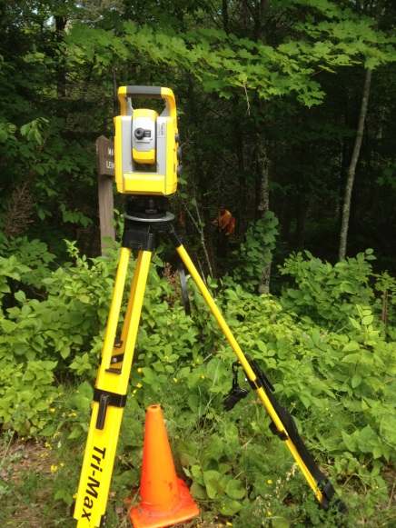
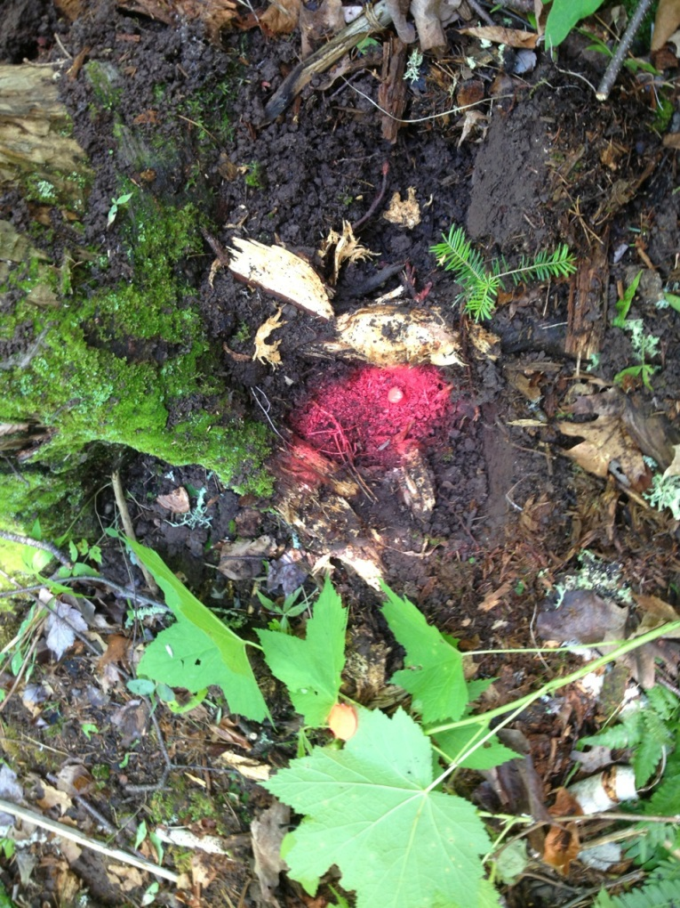
Discussion?

