Slide 1
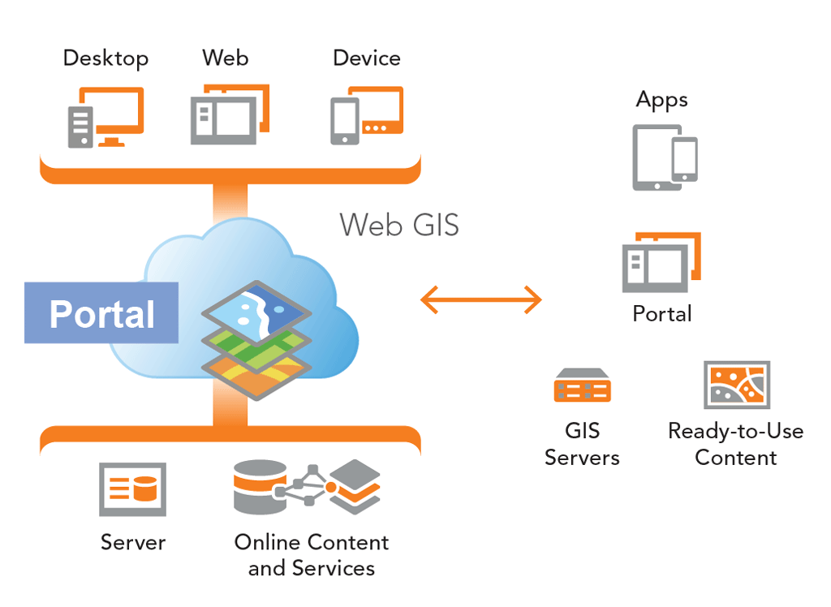
Introduction to ArcGIS Enterprise: ESRI’S Mobile/Portal Environment
City of Superior & Douglas County

Slide 2
Introduction
Preface/Timeline
Terms and Definitions
Server Architecture
Mobile Apps/Browser Based Apps
Credentials/Permissions
My ESRI
AGO
Portal
Accessing Services
Limitations
Resources

Slide 3
Preface
City Tyler Permitting Software
Required
Nearing Completion
Early stages – Walk before you can run
Planning
Structure
Development
Permissions – Users
Training
Growth and Keeping Up
Powerful
Migration from ArcMap to ArcPro - Long Term

Slide 4
Terms and Definitions
Cloud
AGO = ESRI ArcGIS Online Cloud Based Hosted by ESRI
Portal = Cloud Based Hosted Internally Online Services
Services
Map Services = Cloud Based Mapping Services
Feature Services = Cloud Based Editable Services
Image Services = Raster Data, Cloud Based Image Services
Other Services: WFS, WFTS, KML, REST, JSON
Software
ArcMap = Desktop GIS with some online service capabilities
ArcPro = Desktop GIS with extensive online service capabilities
Servers
ArcSDE = Geospatial Data Stores
ArcGIS Server = ArcGIS 10.7.1 or older
ArcGIS Enterprise = ArcGIS 10.8 or higher

Slide 5
What is the ESRI Enterprise Server ArcGIS Server 10.8 or higher
Enterprise is a combination of the server architectures used all together

Slide 6
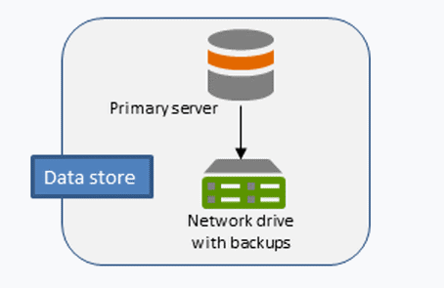
ArcGIS Data Store (SDE)
Enterprise Geodatabase – Where the data lives internally within the LAN
RDBMS – SQL Server (permission based access)
Not mapped Drive Letter (feature classes and feature datasets)

Slide 7
ArcGIS Server
ArcGIS Server before the
Portal Version 10.7.1 or older
ArcGIS Enterprise Version
10.8 or higher

Slide 8
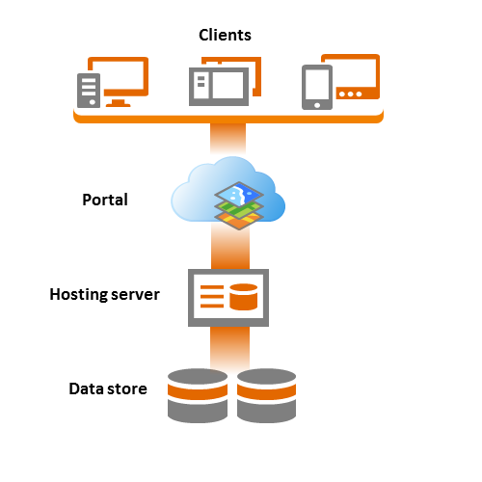
What is the Portal?

Slide 9
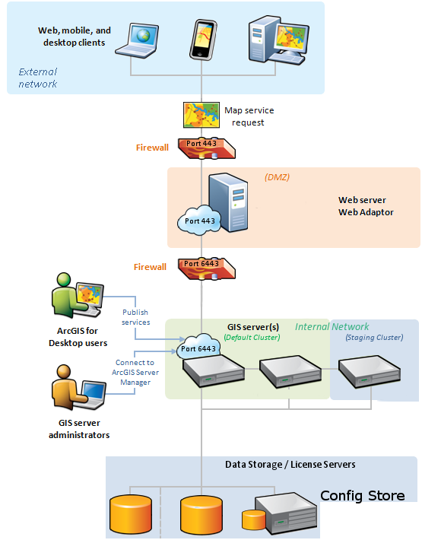
ArcGIS Web Adapter

Slide 10
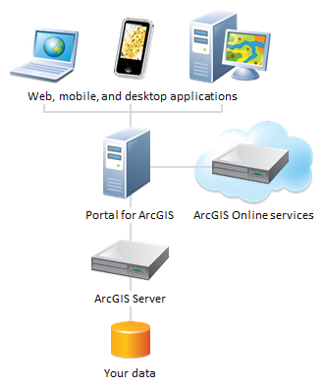
ArcGIS Image Server

Slide 11
ESRI Mobile Apps
IOS, Windows, Android, Browser Based
Different Apps available depending on the operating System
IOS, typically the most advanced

Slide 12
Browser Based Apps
Work in most browsers
Chrome, Firefox, Edge, etc
Simple to use and have really neat tools
More capabilities than the Apps
URL Based
https://portal.superiordcgis.org/portal/apps/webappviewer/index.html?id=cccdec273dc342828351bc3bca1e49ee

Slide 13
Browser Based Example

Slide 14
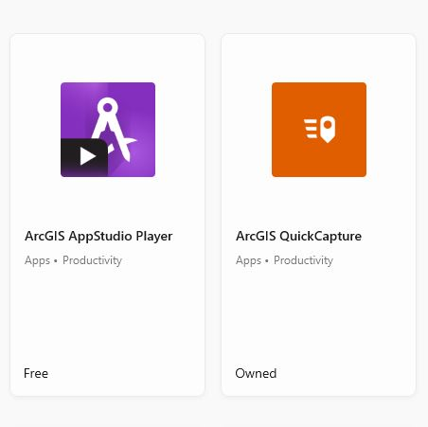
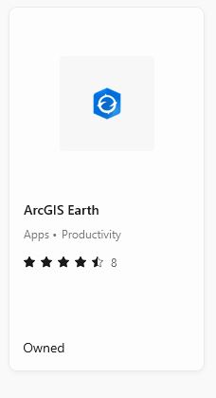
ESRI Mobile Apps (Windows 10)

Slide 15
ESRI Mobile Apps (IOS)

Slide 16
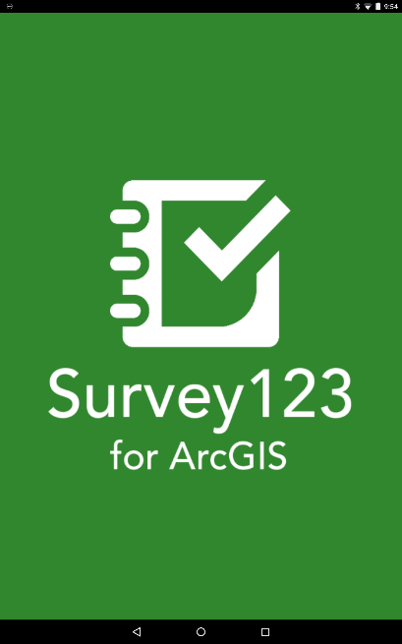
ESRI Mobile Apps (Android)

Slide 17
Credentials and Permissions
Portal Credentials
Email Address
ESRI Credentials
My ESRI (online training)
AGO
Permissions currently read-only, working on permissions for those who need to edits data

Slide 18
Accessing Services
Portal = https://portal.superiordcgis.org/portal
AGO = https://douglascountywi.maps.arcgis.com/

Slide 19
Limitations
Somewhat Limited user licenses/access
Internet/Data Connection Required
Issues with table joins
Parcel and GCS Ownerdata
Data Development and existing schema of data
Schema is NOT flexible
Staff Support for Enterprise/Mobile
Funding to quickly move forward
Consultants needed for build out
Training

Slide 20
Resources
GIShelp@ci.superior.wi.us
https://portal.superiordcgis.org/portal/apps/sites/#/superior-douglas-county-data-and-mapping-apps
https://secure.superiordcgis.org/SFTP/GIS/AGO/portal%20access.pdf

Slide 21
Devices: Setting up
Tablets (depends on OS)
Phones (depends on OS)
Laptops – Microsoft Store
Desktops – Microsoft Store

