Slide 1





Douglas County/City of Superior ArcGIS Server Structure
Using ESRI ArcGIS Enterprise Server Technologies

Slide 2
COSDC Range
Portal
GISWEB
GISFabric
GISserver2015
GISserver2011
POL
ADC
GCS Web
ESDGISserver
ForestryGIS
Spillman-
GIS-
SQL
Portal Servers
ESDGISPORTAL
PORTAL
GCSserver
GCSServer
BEACON
GIS

Slide 3
GIS Servers & Related Servers
GISserver2011 – The Enterprise Server (SDE), ArcMap Concurrent License Server
(“All” data flows through here)
GISserver2015 – File Server, but delivers Tyler Permitting data (ArcGIS Server)
GISFabric – SDE, Parcel Fabric, limited users due to complexity of the data
GISWEB – Survey Doc Server, GIS data downloads and Image Server
ESDGISserver – SDE server for ESD, ArcMap Concurrent License Server
ForestryGIS – Arc Enterprise Server for Forestry, ArcMap Concurrent License Server
Spillman-SQL-GIS - ArcGIS Server for 911
Portal - Arc Enterprise Server, delivers COSDC services to the web and also the media server, ArcPro Concurrent License Server
CityServices – Design Elemental Framework, Permitting
GCSserver – Owner data
Tyler Permitting – uses Portal Map Services
GIS-FabricNew – NEW ARCPRO Fabric Server
SPILLMANGIS-NEW – New spillman server to meet requirements of Spillman Upgrade
FISKYTEST – Test server for GIS deployments
BEACONGIS – File transfer server to Beacon (Schneider)for online site
Sup-App01 – Market Drive Assessment Server
AGO – ArcGIS Online through ESRI (Cloud) Subscription based
ADC – Consumer (public) mapping Site Now BeaconGIS
Pictometry Connect – Aerial Photo Cloud Site (Subscription based)

Slide 4
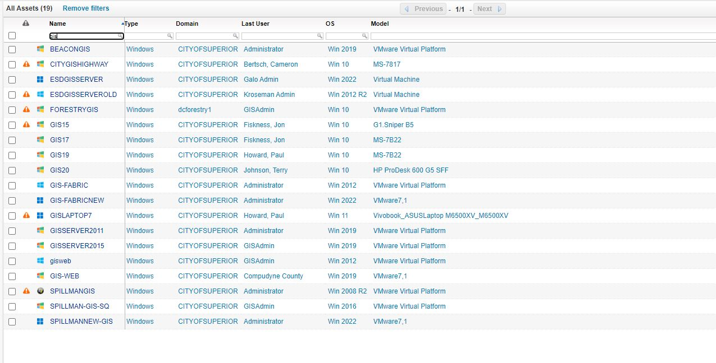
LANSWEEPER GIS ASSETS

Slide 5
Server Structure/Organization Chart
WWW(ADC)
WWW(ADC)
WWW(ADC)
AGO
POL
Tyler
DC)
Portal
Gisserver 2011 (SDE)
(Govt Center)
Gisserver2015 (SDE)
(Govt Center)
DC)
BEACONGIS
BEACON
Replication
Replication
ESDGIS (SDE)
(WWTP)
ForestryGIS (SDE)
(Solon Springs)
GCSserver
ESDGISPORTAL
ESD Desktop GIS Users
(25)
Forestry Desktop GIS Users (10)
Govt Center Desktop GIS Users
(100)
Spillman-GIS-SQL
Garage Desktop GIS Users
(5)
Law/
911
(50)

Slide 6
GIS Servers Retired or Being Retired
ForestryGIS-OLD
CITYSERVICES
GISAssets
ESDGISSERVER-OLD

