Slide 1
Douglas County Wisconsin Statewide Parcel Initiative Report 2023
December 8, 2023

Slide 2
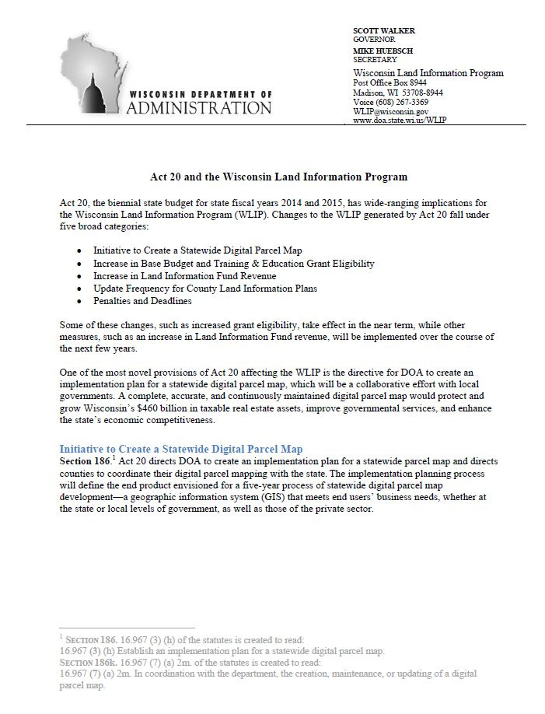
WI Statewide Parcel Initiative
Act 20

Slide 3
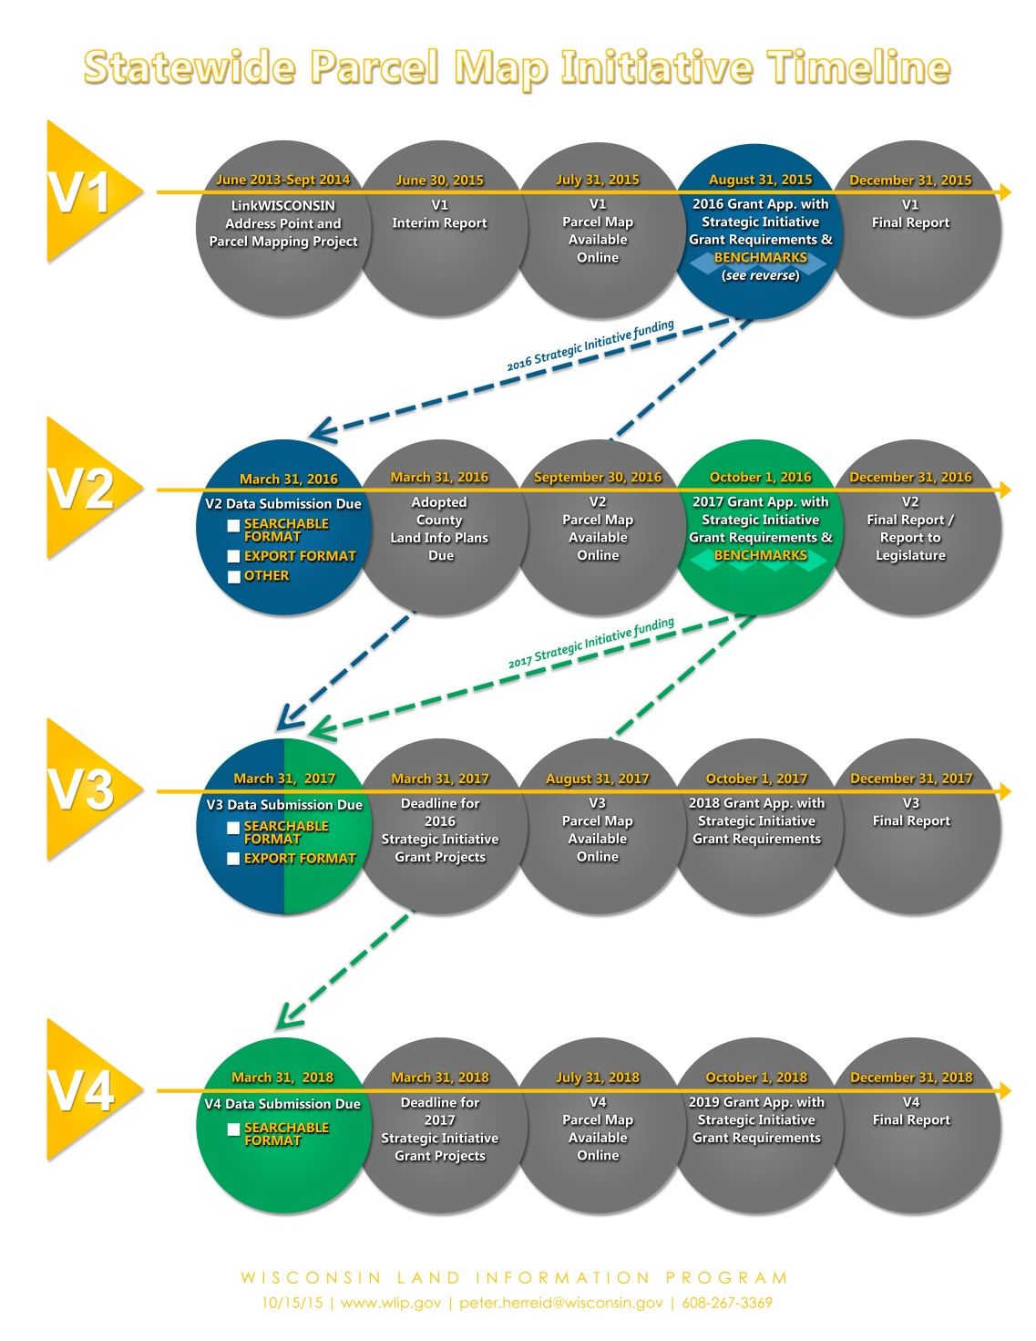
WI Statewide Parcel Initiative Now at V7
Benchmarks

Slide 4
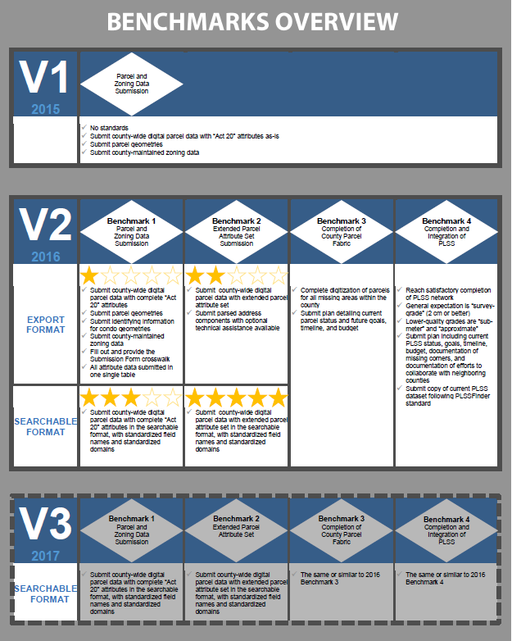
WI Statewide Parcel Initiative
Benchmarks

Slide 5
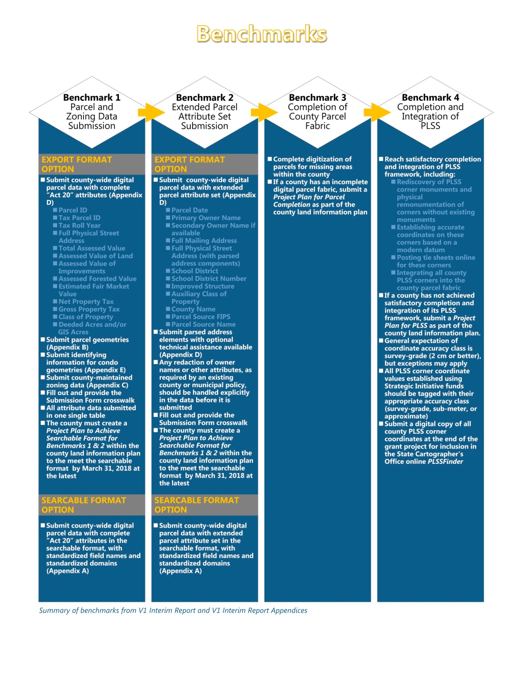
WI Statewide Parcel Initiative
Benchmarks

Slide 6
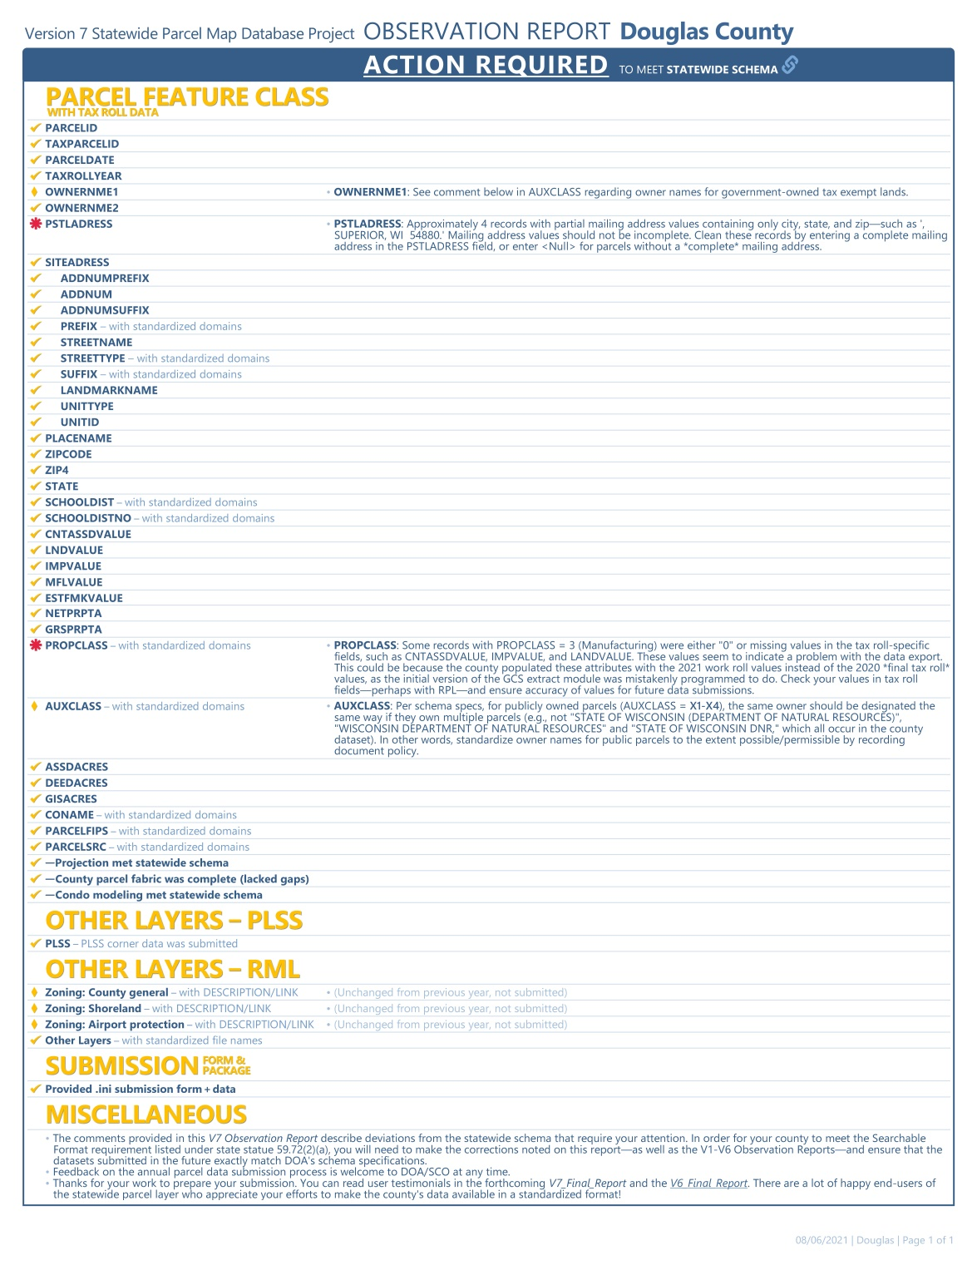
WI Statewide Parcel Initiative
V7 submittal on
March 31, 2020

Slide 7
WI Statewide Parcel Initiative
Data Submitted
Parcels
Zoning General
Shoreland
Floodplain
PLSS Corners
Roads
Addresses
Hydrography
ROW
CBAS Submitted twice a year
Wards
Supervisor Districts
Annexations

Slide 8
Background Information on Parcels and Ownership Data
Parcel Editing Process
Currently every 24 hours parcels
Ownership is updated and replicated from
GCS, Parcels are updated in groups of
edits once every week
2023 - 6010 Edits
2022 – 8284 Edis
2021 - 6337 Edits
2020 – 7541 Edits
2019 – 6875 Edits
2018 – 3725 Edits
GCS Ownership Changes
Currently editing daily (City/County Tax Listers)
2023 - ~ 6919 Edits
2022 - ~ 5000 Edits
2021 - ~ 6153 Edits
2020 - ~ 5896 Edits
GCS ownership data and parcels are the
most critical data the City and County
Maintain. It is used by all departments for
Various purposes.

Slide 9
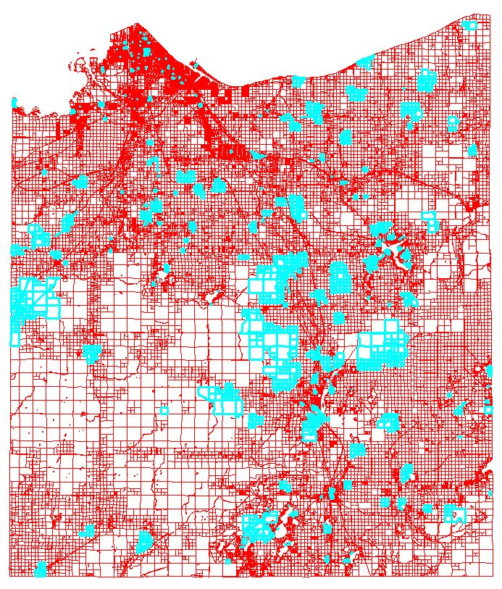
Parcels Edited in 2023
6010 Parcels Edited

Slide 10
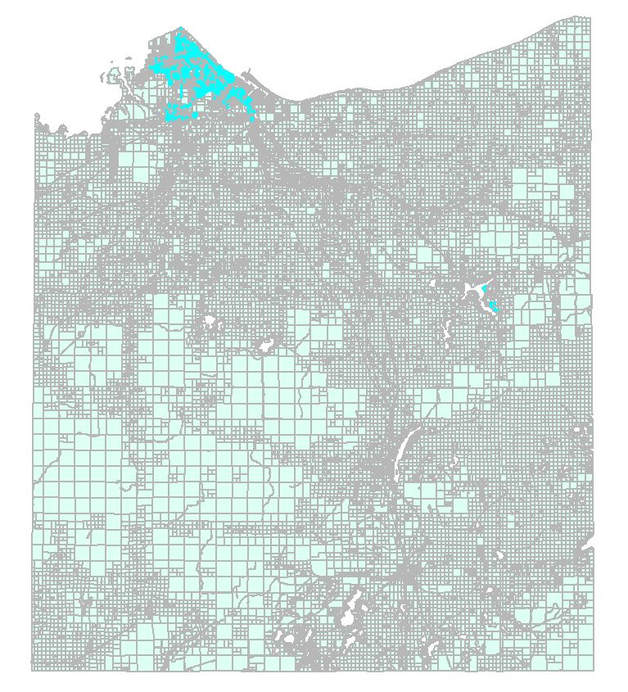
Vacated Streets and Alleys Documented
3126 Vacated Streets & Alleys Documented
In Fabric 2023

Slide 11
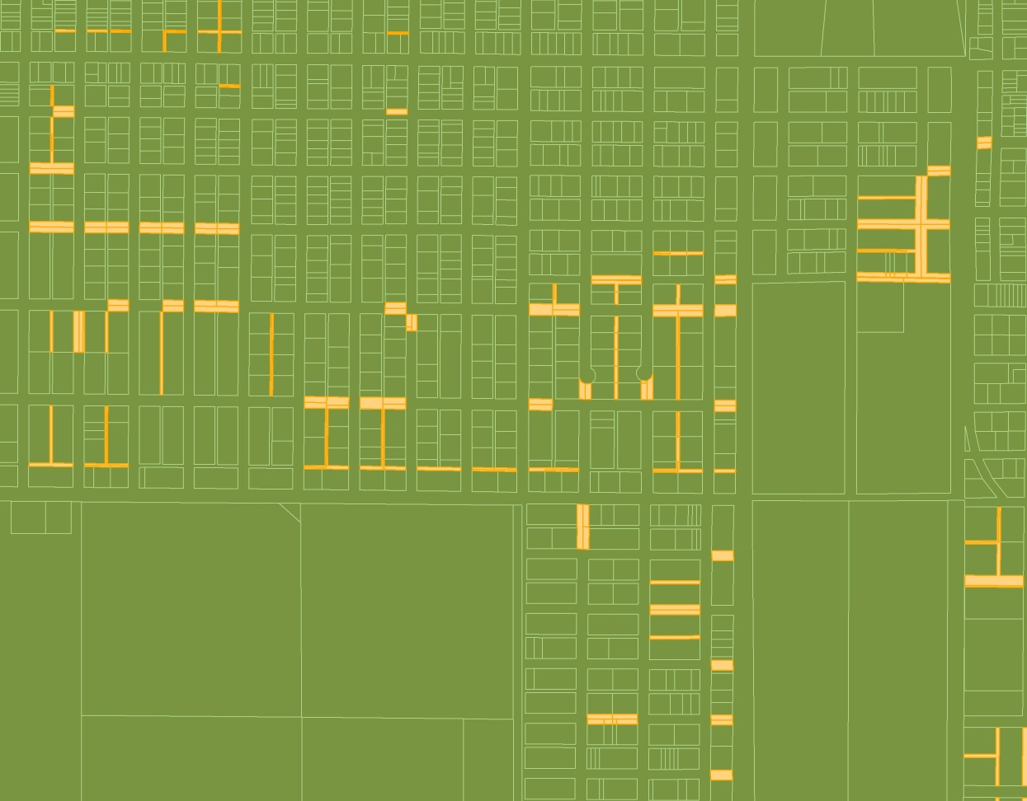
Vacated Streets and Alleys Documented
2017 = 2678
2018 = 2733
2019 = 2756
2020 = 2765
2021 = 2770
2022 = 2784
2023 = 3126

Slide 12
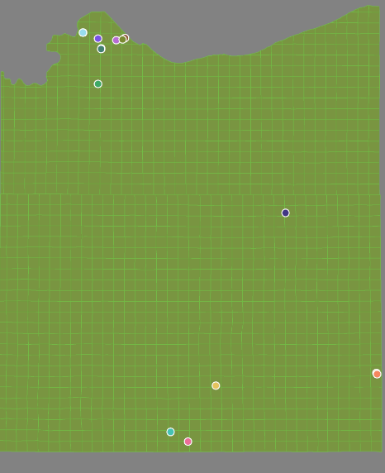
Condos in the Fabric - 2022
19 Condo Plat boundaries
108 Tax Parcels
180 Associated parcel features
301 Total Parcel Fabric elements
2016 – 94
2017 – 105
2018 – 107
2019 – 109
2020 – 109
2021 - 109
2022 – 109
2023 - 108

Slide 13
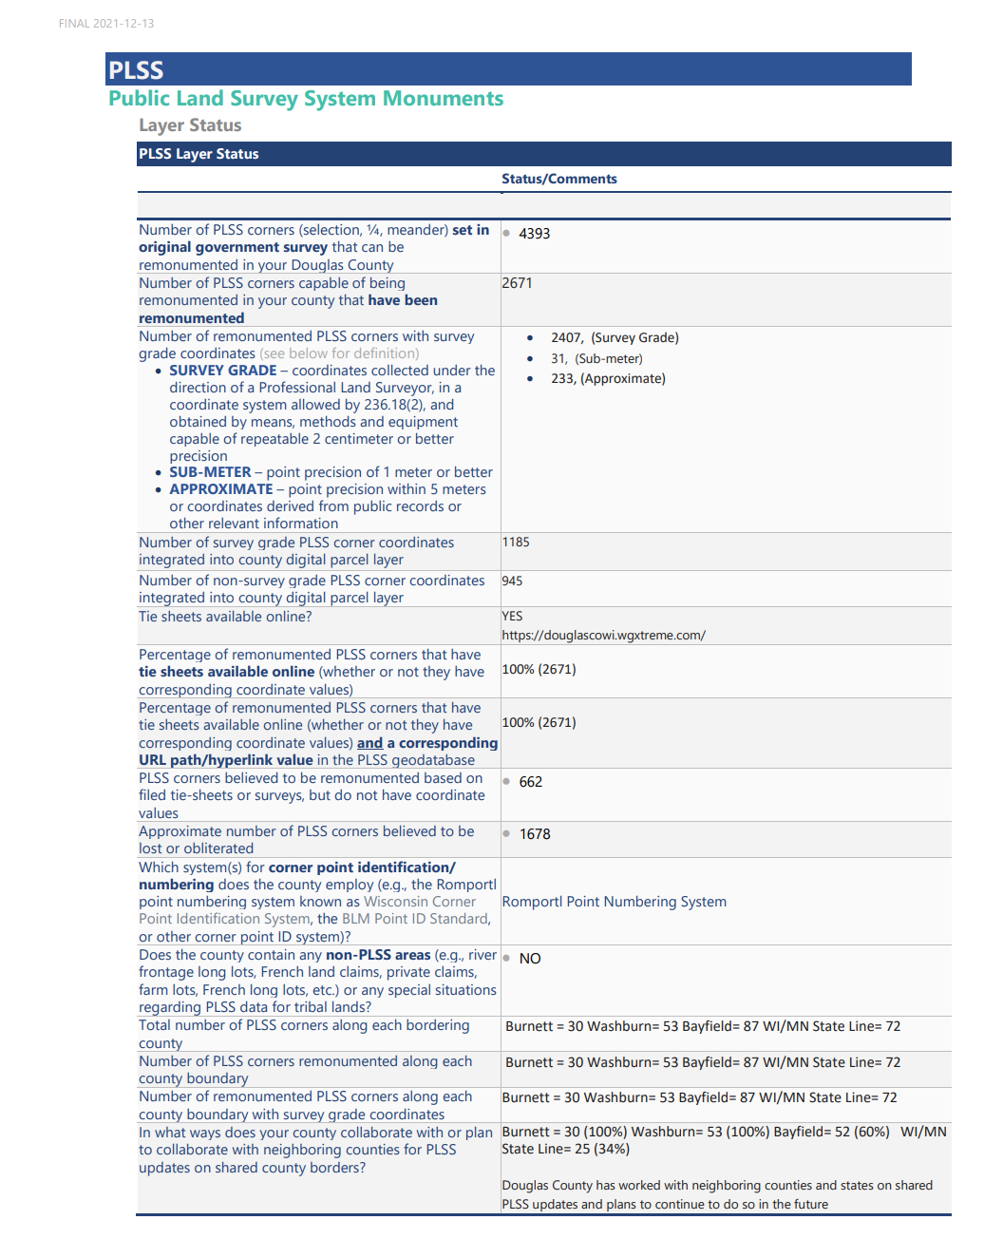
V9 Benchmark Status for PLSS Corner Integration

Slide 14
Survey Documents Inventory
Douglas County Surveyor Control Summary
2023 (As of 12/4/2023)
Centerline Monuments = 10
Section Corners = 85
Section Corners via the County Bounty System = 30
Contracted Section Corners = 35
New Collected Corners = 20
Survey Site , http://www.superiordcgis.org/surveyors/
Updated with new corners and current links to survey docs. Currently being taken down due to software sun setting.
We also added Survey data to the County GIS Online Site at http://douglascowi.wgxtreme.com/

Slide 15
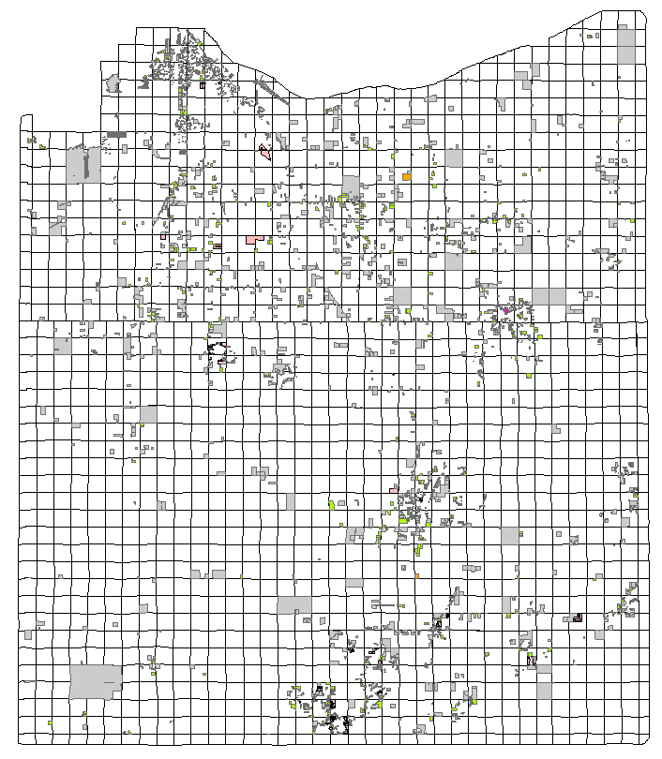
Survey Documents Inventory
Georeferenced Survey Documents Inventory
6047 Total Documents
ALTA = 81
Certified Survey Maps = 1614
Site Plans = 211
Maps of Survey = 3468
Plats = 673

Slide 16
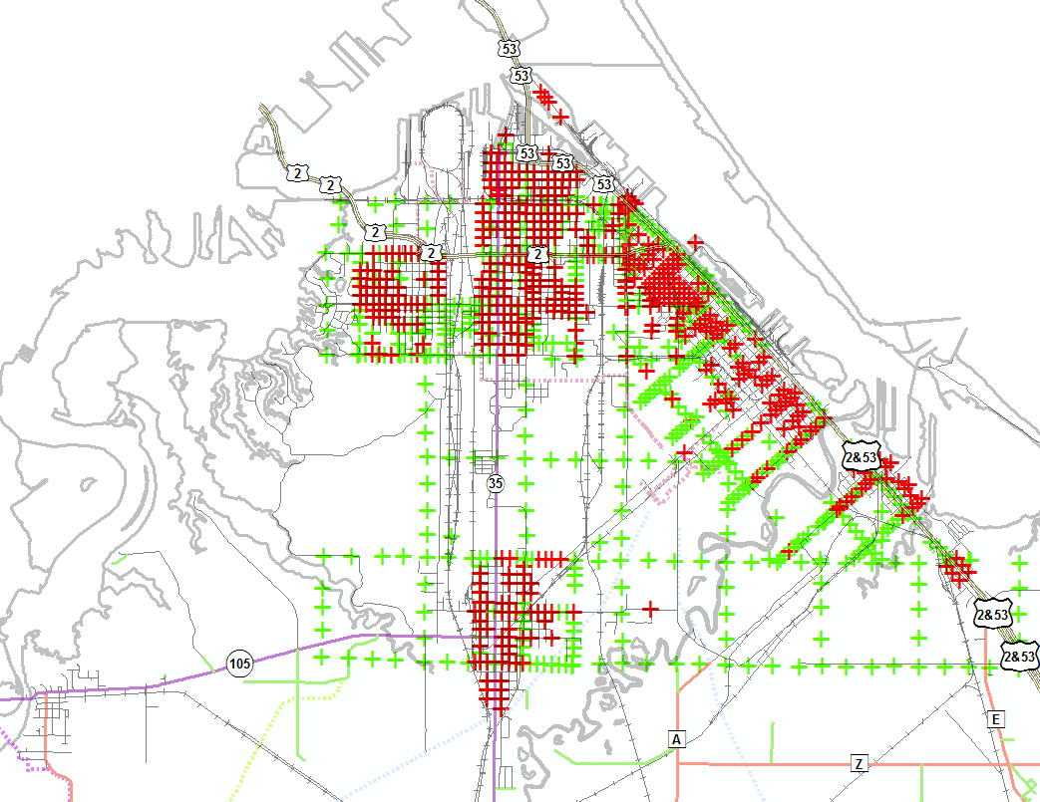
Street Centerline Monuments
City of Superior Street Centerline Monuments
Attributed Monuments = 517 (Red)
Unattributed Monuments = 539 (Green)

Slide 17
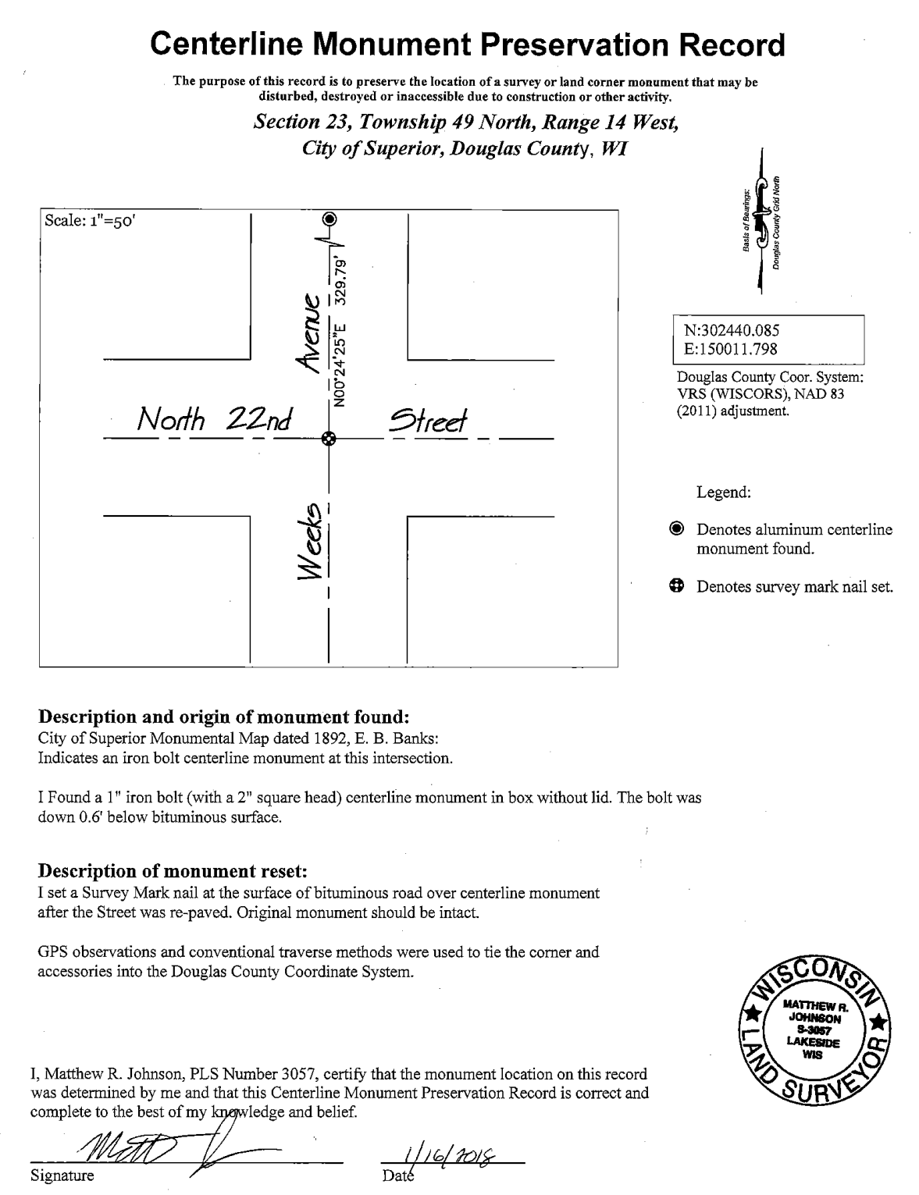
Street Centerline Monument Record
City of Superior Street Centerline Monument Record Sample
26 CMPRs

Slide 18
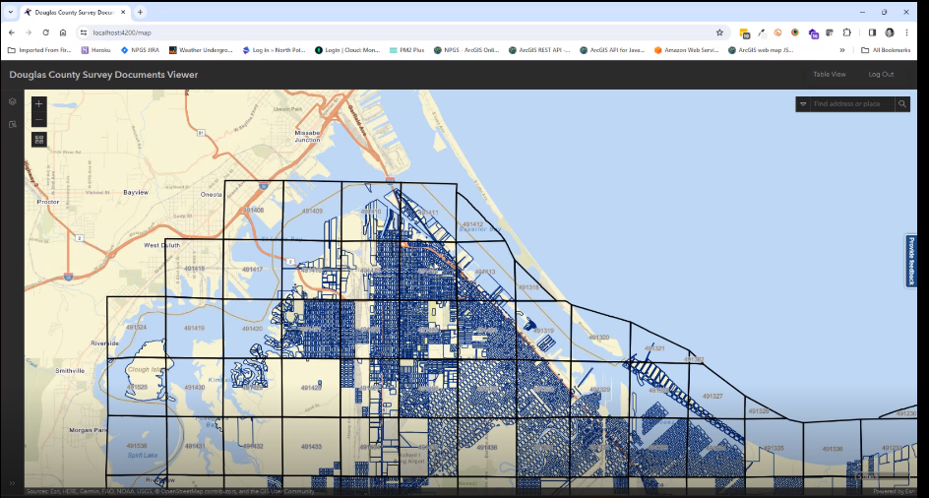
North points GEODOCS Survey App/Management System
North points GEODOCS Survey App/Management System

Slide 19
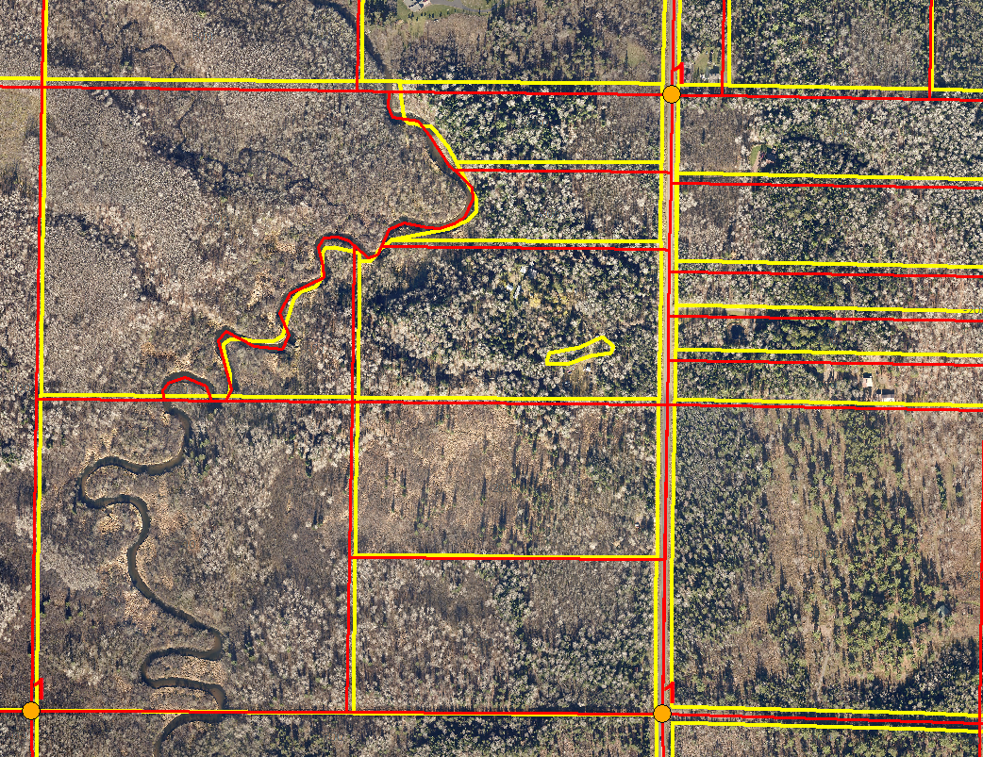
Brule Area
Brule Area Adjustment to PLSS
Yellow = Before Adjustment
Red= After Adjustment

Slide 20
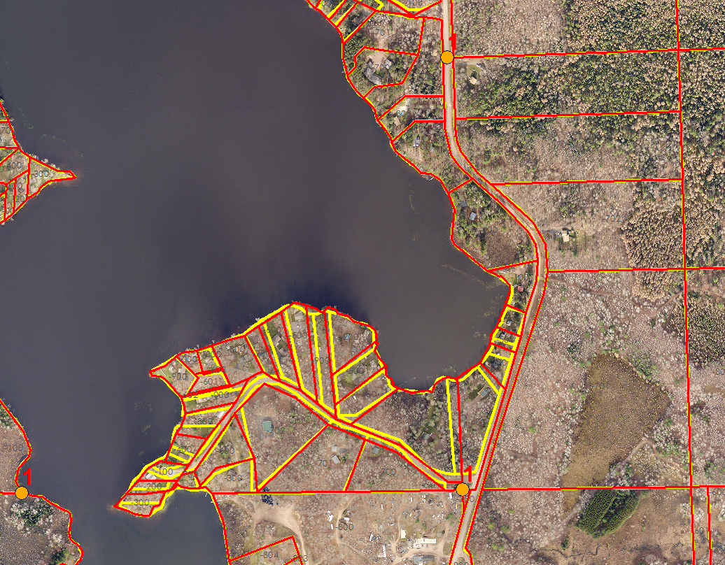
Minnesuing Lake Adjustment
Yellow = Before Adjustment
Red = After

Slide 21
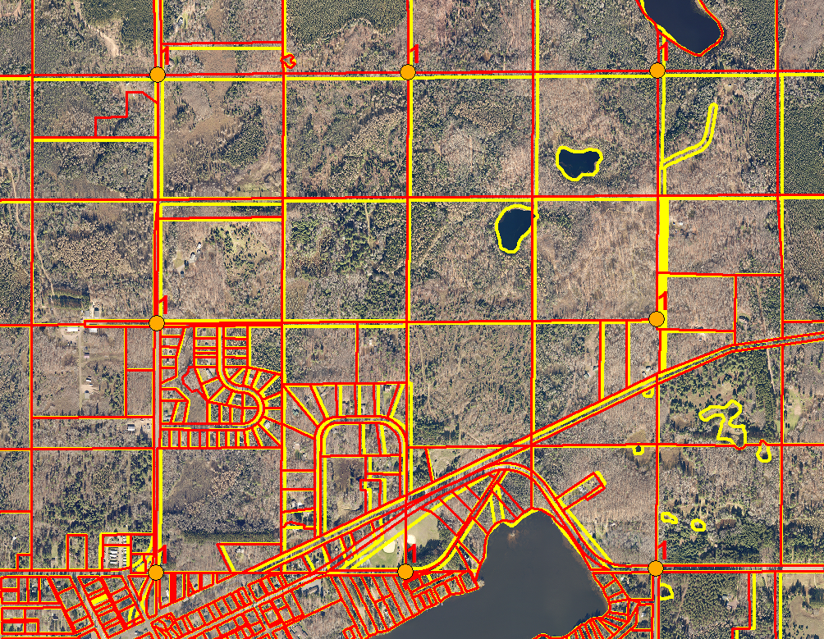
471125 Adjustment
Yellow = Before Adjustment
Red= After

Slide 22
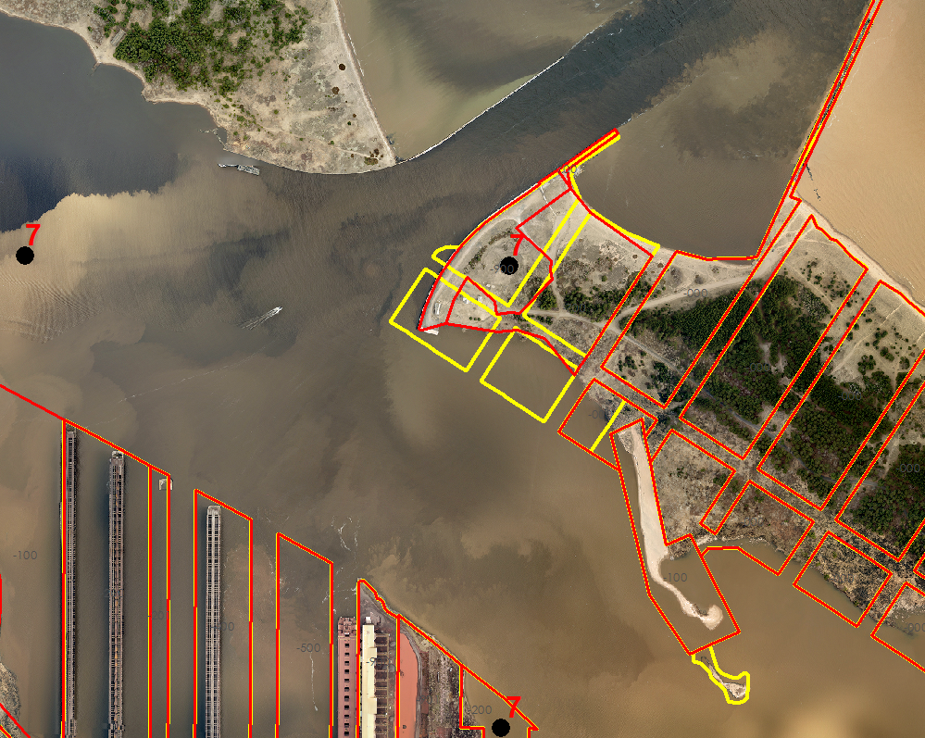
Wisconsin Point Adjustment
Yellow = Before Adjustment
Red = After Adjustment

Slide 23
Land Information Office’s NextGen911 Activities in 2023
NextGen911(NG911) is a Federally required upgrade to the CAD/911 systems throughout the nation. Wisconsin is developing standards and requirements for County systems to meet. NG911is a fully GIS integrated system with stringent requirements that must be met.
Douglas County NG911 Activities include:
CAD911/GIS data assessment in 2020
Budgeting for GIS staff assistance
Continued monitoring of the State’s NG911 recommendations and needed response
Implementation of GIS data changes as required by the State and Federal governments
Challenges for LIO in NG911
Address system used by Douglas County
Migration of current data to required schema
Future maintenance needs and costs

Slide 24
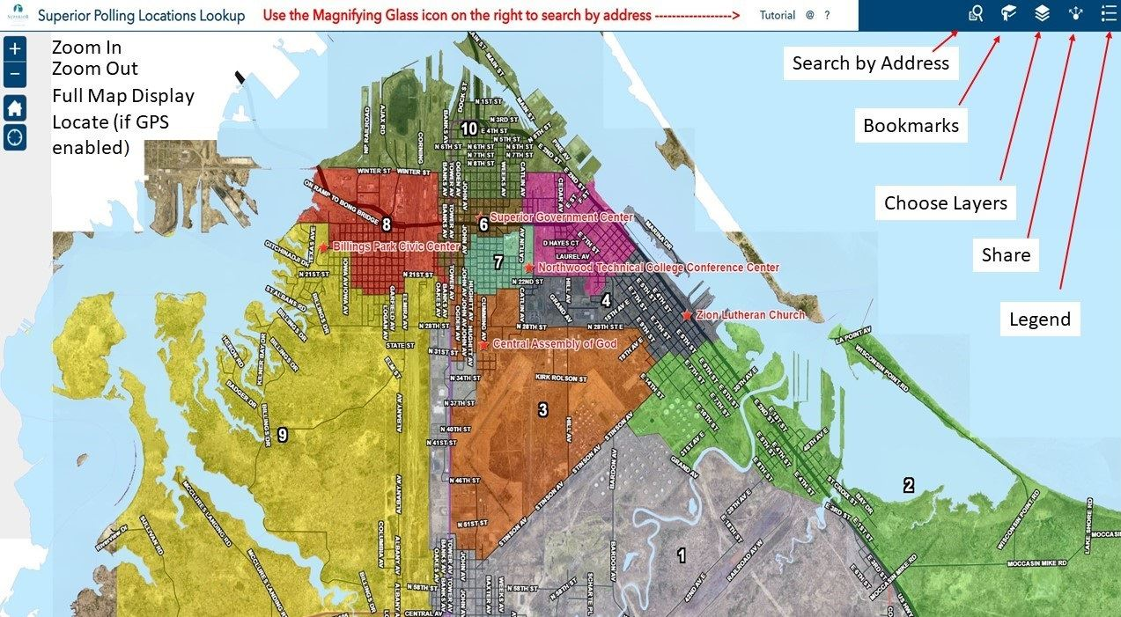
City Polling Locations Lookup
City Poll Site Lookup
https://portal.superiordcgis.org/portal/apps/webappviewer/index.html?id=b2eeeb1a43124ffbb0e0db2ad2a3f65b
Views = 2800

Slide 25
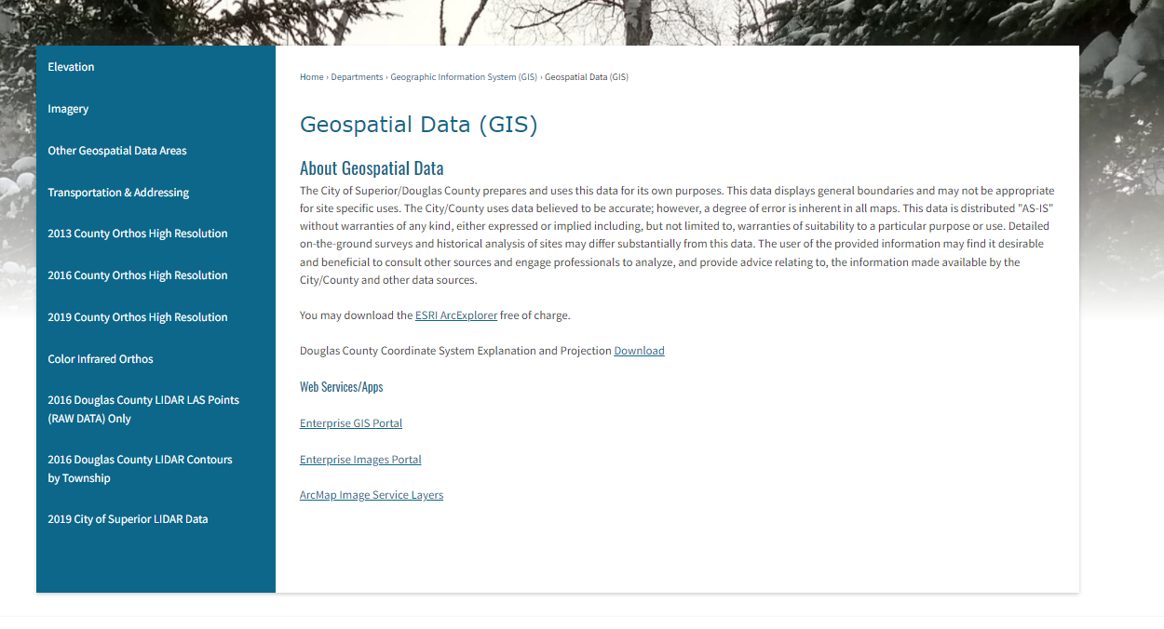
Geospatial Data Downloads
The City/County LIO currently has nearly all it’s GIS data available for download (free)it’s been in place since 2010
http://www.ci.superior.wi.us/474/Geospatial-Data-GIS

Slide 26
City/County Aerial Photos
City/County Aerial Photos
2023 City Only
2022
2019
2016
2013
2009
2006
1999
1986
1973
1962
1948
1938

Slide 27
Land Information Office’s Mobile /online Presence
City/County Portal Servers in 2020-2023
City/County COSDC Enterprise Server
https://portal.superiordcgis.org/portal
Currently working on an permissions and training
for 2023

Slide 28
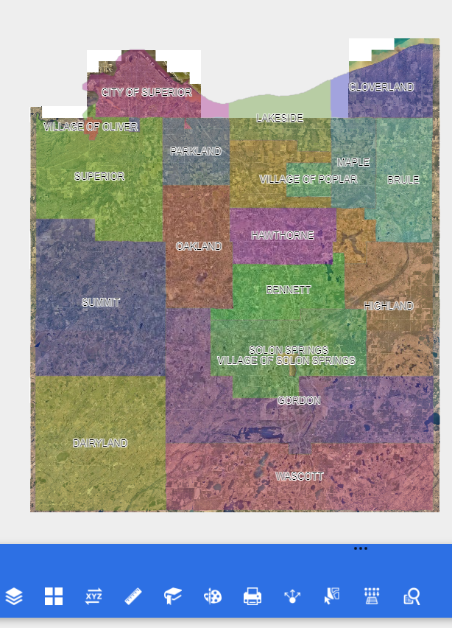
Land Information Office’s Mobile /online Presence
City/County Map Services
https://portal.superiordcgis.org/portal/apps/webappviewer/index.html?id=cccdec273dc342828351bc3bca1e49ee

Slide 29
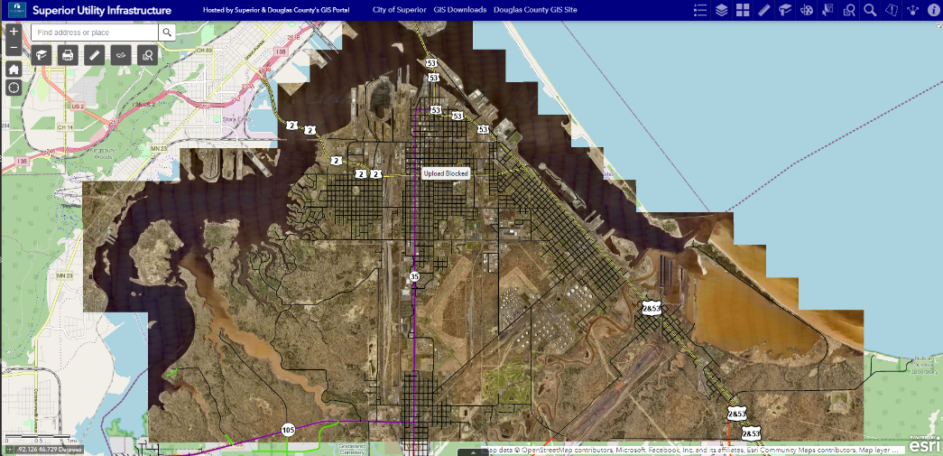
Land Information Office’s Mobile /online Presence
City/County Portals
Total of Items
Servers = 4
Apps = 121
Dashboard = 30
Map Services = 442
Image Services = 89

Slide 30
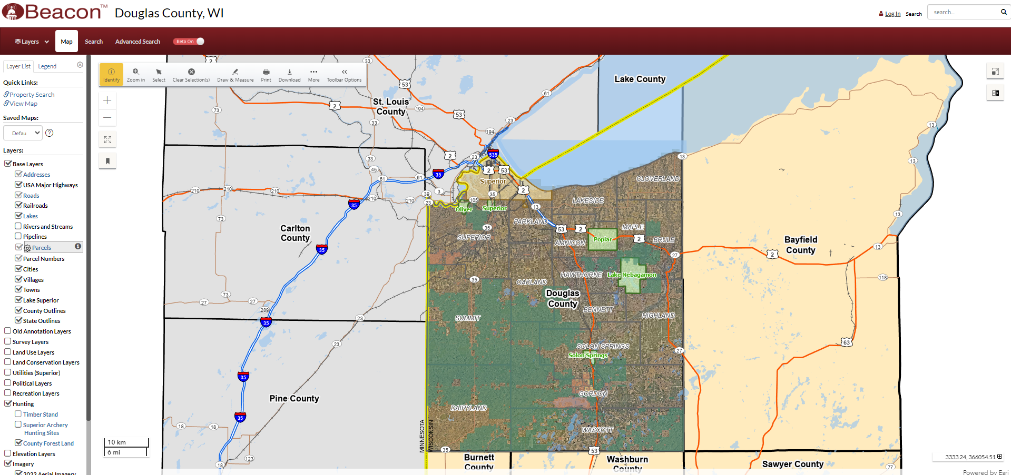
City/County Beacon GIS Site
Douglas County BeaconGIS (Schneider GIS) Online Site
https://beacon.schneidercorp.com/Application.aspx?App=DouglasCountyWI&PageType=Map

Slide 31
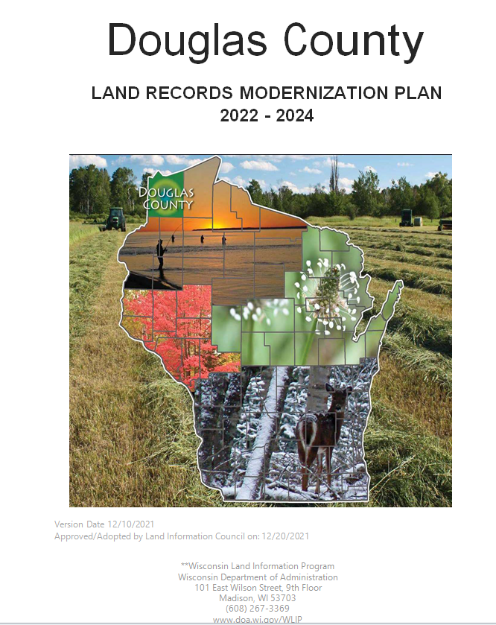
Land Information Plan
Douglas County Land Information Plan 2022-2024
Submitted 12/31/2021

Slide 32
Land Information 2023 Projects
Douglas County Land Information 2023 Projects
4 GIS Server Upgrades
1 GCS Server Upgrades
ADC to Schneider GIS site Migration
150 Users upgraded to ArcMap 10.8+
2023 Superior Aerial Photo Acquisition
ArcMap Training for Users
NG911 Compliance
Departmental Mobile Apps; EMS, LIO, Assessor, Public Works, ESD

Slide 33
Land Information Upcoming Projects
Douglas County Land Information Upcoming Projects
Parcel Fabric Server Migration to New Data Model
CAD/911 GIS Server Upgrade
Survey Docs App and Maintenance System
NG911 Federal and State Requirements
WLIA Land Information Plan Renewal

Slide 34
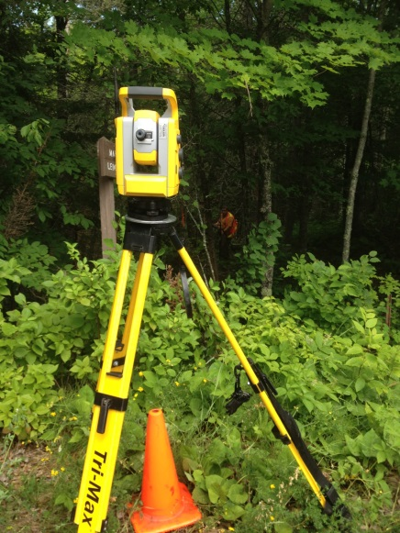
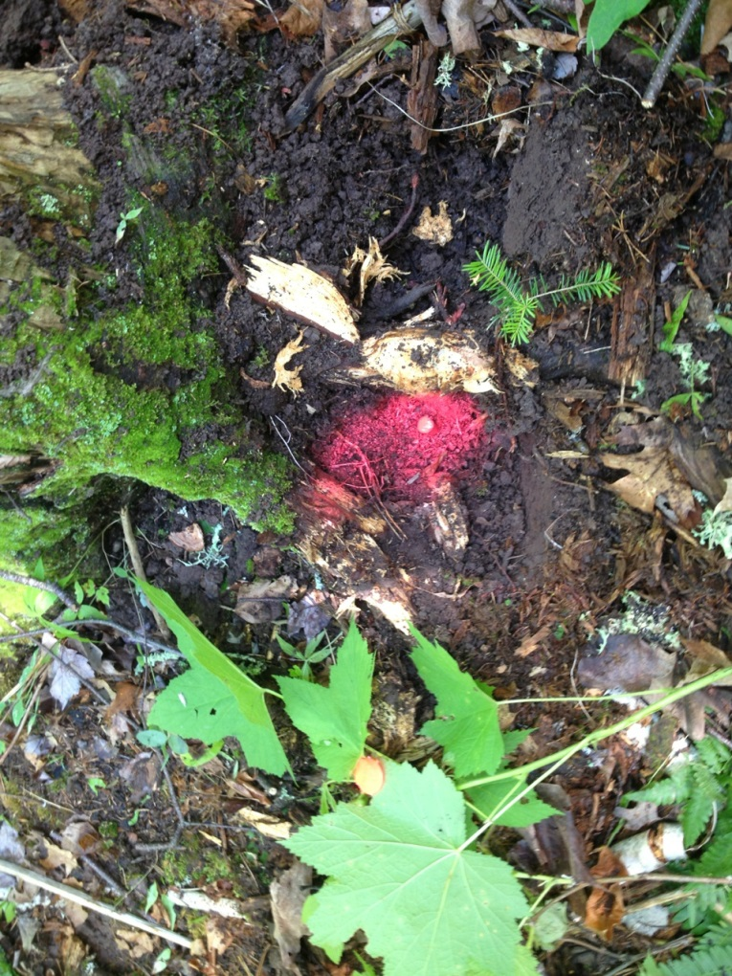
Discussion?

