Slide 1


Superior police training mapping App
https://portal.superiordcgis.org/portal/apps/webappviewer/index.html?id=037976eb58f648dab5ee286ebbb86a6c

Slide 2
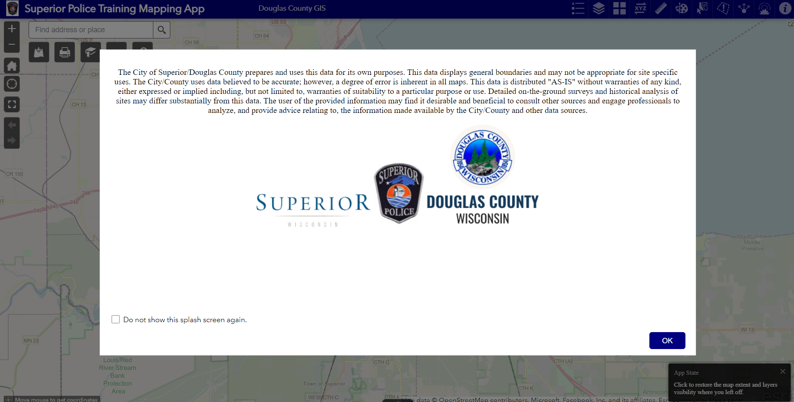
Opening page

Slide 3
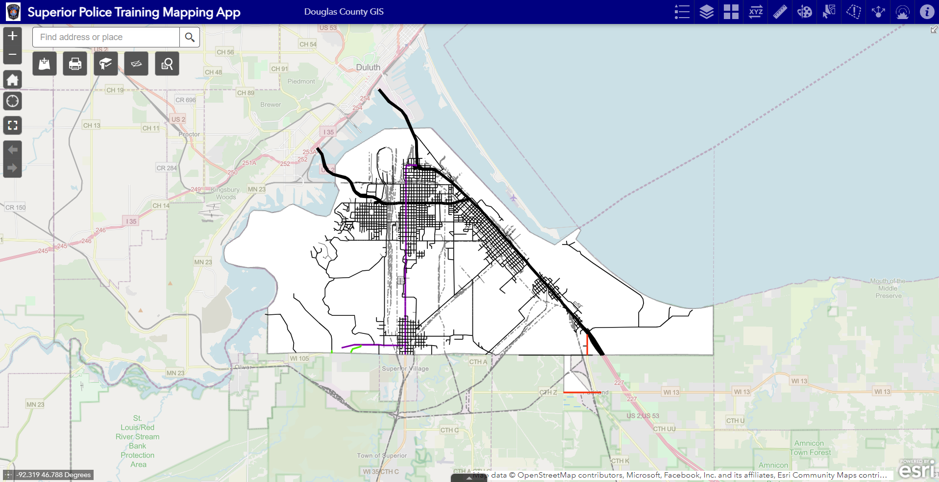
Widgets (tools)
Address Search
Bookmarks
Search Parcel Information
Pictometry Aerial Imagery
Print PDFs/
Images
Add Data from ESRI AGO or
The City/County GIS Portal
(data added will only be available during the current Session)

Slide 4
Widgets (tools)
Legend
Drawing Tools
Basemap Gallery
App Info
Measurements
Threat
Hazard
Areas
Email
Map
View
Layer List (toggle on/off)
Coordinate Conversion
Select
Buffers

Slide 5
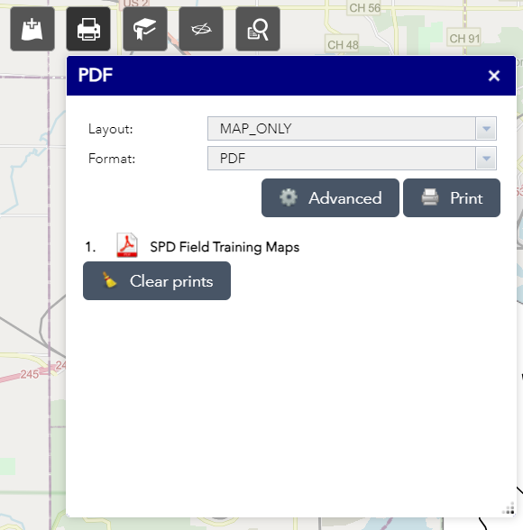
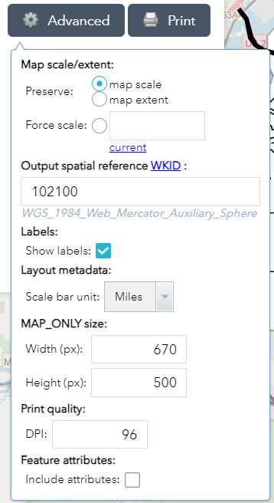
Printing Tool
Layout Menu
  Choose Size and Type
Format Menu
  Choose PDF (default) or image file type
Advanced allows for advanced setting choices

Slide 6
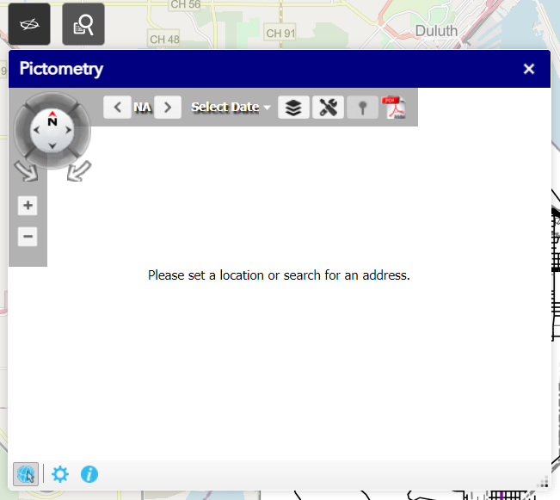
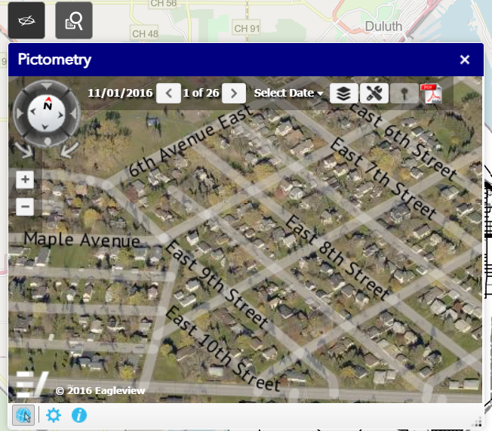
Pictometry tool
Select Date Menu
  Choose Which Year of Photos to See
Arrows
  Move Through Photo Library for Each Year Available
GIS Layers Overlay
Pictometry Tools
Export Area as PDF
Click on Map
to Select a location

