Slide 1
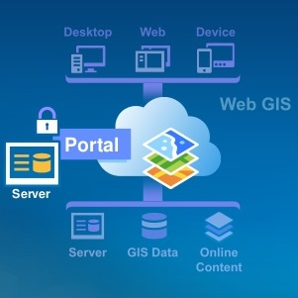




Accessing the Douglas County Forestry GIS Portal through ESRI Apps
Https://forestry.superiordcgis.org/portal

Slide 2
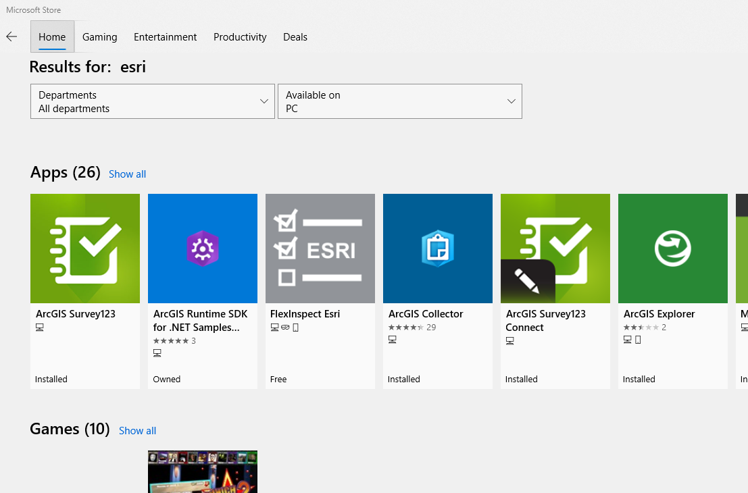
Download ArcExplorer from the Microsoft Store or Apple Apps
May need to search for ESRI in the search bar of the “stores”

Slide 3



Opening ArcExplorer
Each computer may look a little different but the icon that is used is the same

Slide 4
Logging In (Internet Required)
Required: Internet Connection
  Data Plan on Tablet
  WI-FI Connection with Internet
ArcExplorer is a READ-ONLY App from ESRI
  No Data can be edited in this App
  The Windows version is considerably slower and limited in capabilities compared to the Apple IOS

Slide 5
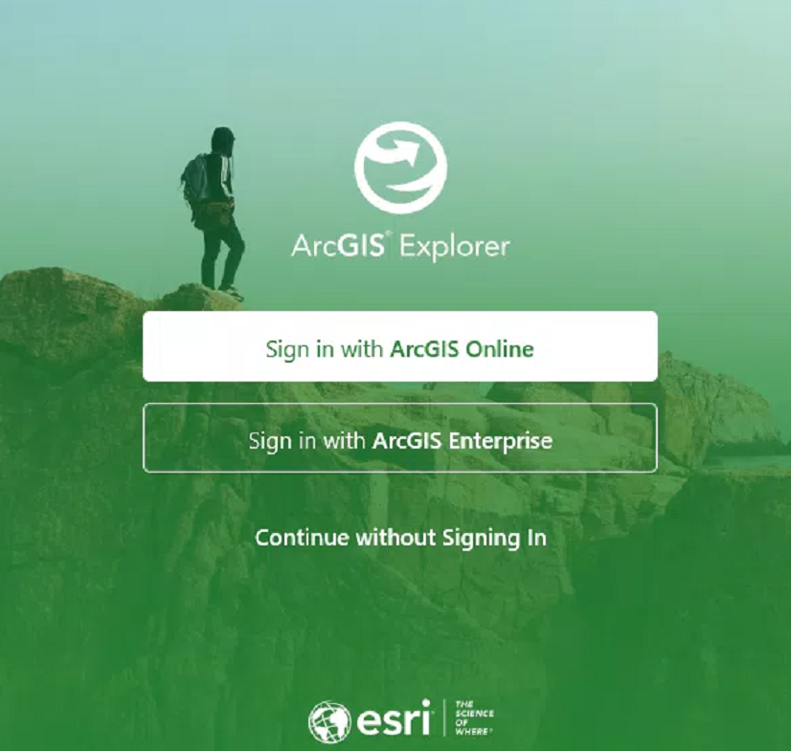
ArcExplorer

Slide 6
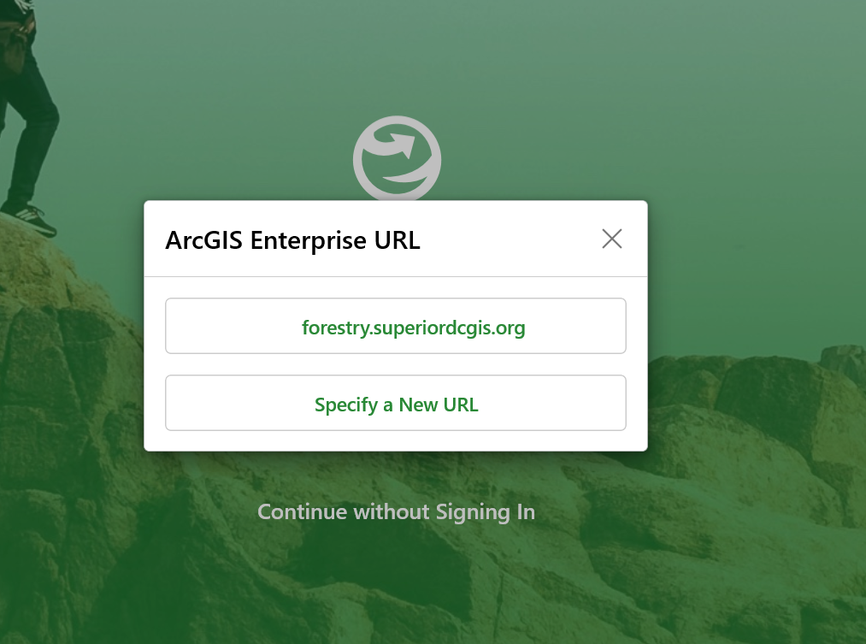
ArcExplorer

Slide 7
Credentials
Portal Address: https://forestry.superiordcgis.org/portal
Login: Email address (if this doesn’t work contact gishelp@ci.superior.wi.us)
Password: COSDC#11 (once logged in feel free to change your password)
*FYI, this account is completely separate from your ESRI ArcGIS Online Account through ESRI.com (if you have an account there)
**You may be asked to answer a security question to gain access on the first login attempt

Slide 8
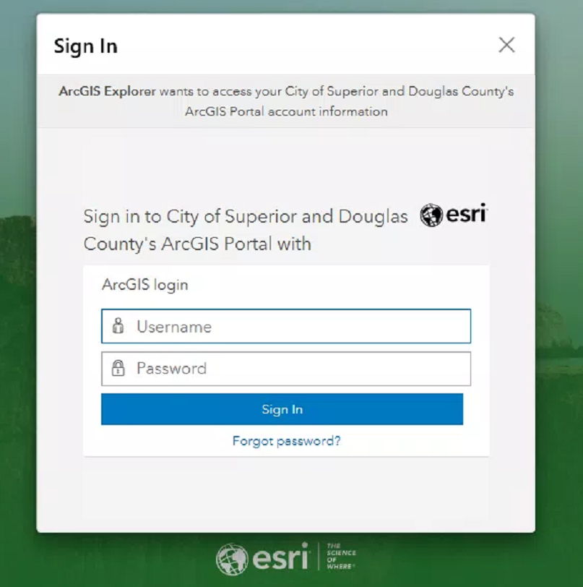
Login:
Email address
Password: COSDC#11

Slide 9

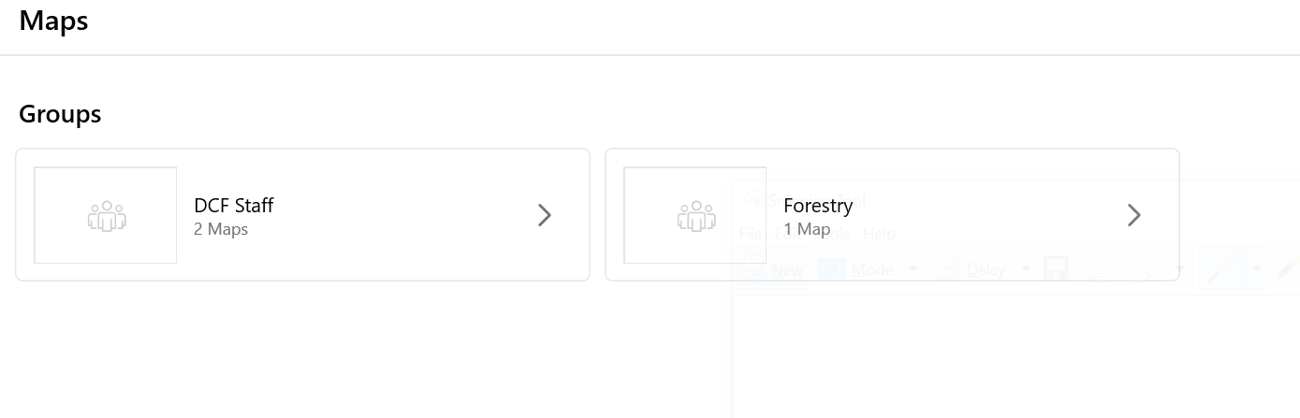
Using ArcExplorer
Search for Services
Favorite Items

Slide 10
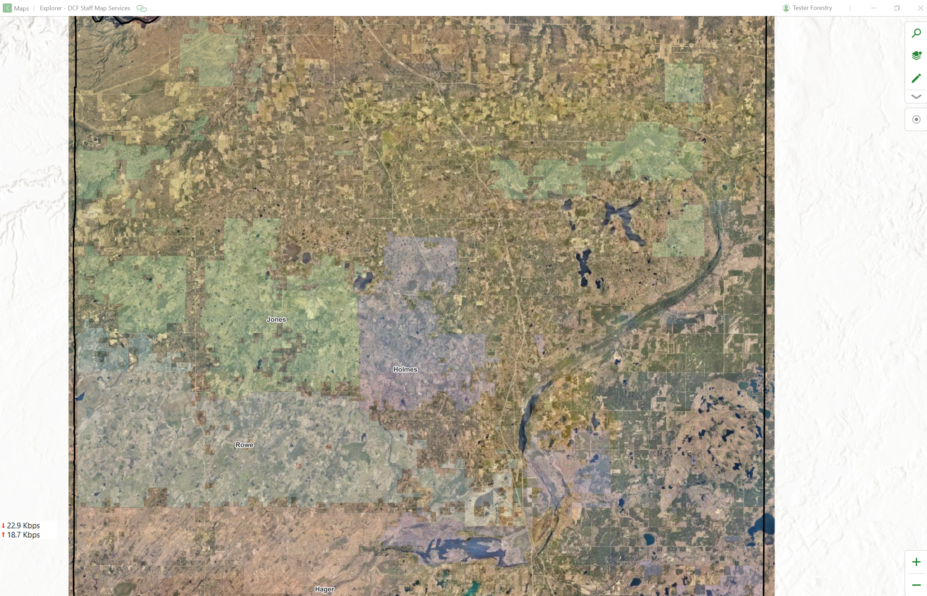
DCF Staff Map

Slide 11
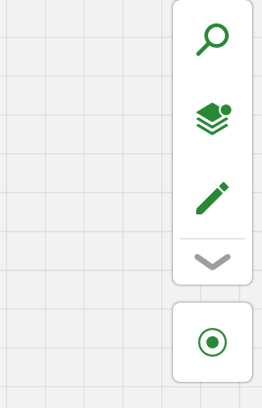
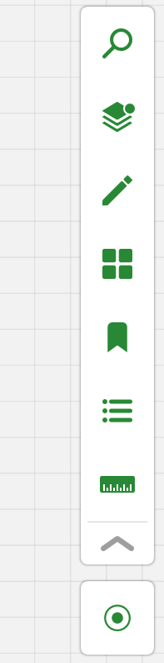

ArcExplorer Capabilities
Search Addresses
Layers
Basemap
Draw
Bookmarks
Legend
More Tools
Measure
Locate using GPS
Zoom In
Zoom Out

Slide 12

Browser Based Apps
https://forestry.superiordcgis.org/portal/apps/webappviewer/index.html?id=a173dc6b281147e4bfe2b7bbb3072a90
https://portal.superiordcgis.org/portal/apps/webappviewer/index.html?id=0bea90c7bd45461cb9cbbe0955a8f1a1
https://portal.superiordcgis.org/portal/apps/webappviewer/index.html?id=b2eeeb1a43124ffbb0e0db2ad2a3f65b
https://portal.superiordcgis.org/portal/apps/webappviewer/index.html?id=db8bbba2ca32476a9971f182127e545a

Slide 13
ArcExplorer Resources
https://www.esri.com/en-us/arcgis/products/arcgis-explorer/overview
https://www.microsoft.com/en-us/p/arcgis-explorer/9plxrwkxxj21?activetab=pivot:overviewtab
https://apps.apple.com/us/app/arcgis-explorer/id860708788
https://portal.superiordcgis.org/portal
https://forestry.superiordcgis.org/portal/

Slide 14
Media Sharing
(FTP)
https://media.superiordcgis.org/FTP/Douglas/Forestry/
Public Use Downloads only (Directory Browsing is Enabled)
Media
  Videos
  Pictures
Software
Can used to link images to Data
Send info to me to get something uploaded: gis@ci.superior.wi.us

