Slide 1
Ciena Residential Broadband Solution
Success Cases
Jenny Post Washington
Ciena
October 2023

Slide 2
Success Cases and Takeaways

Slide 3

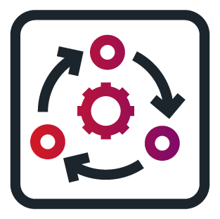




Ciena Residential Broadband Solution for Municipalities
Town of Dryden
Customer:
  Municipality: ~6,000 households
  ARPA funding - $1.2M
MCP
Domain Controller
1:32
Split Ratio
.
.
.
XGS-PON
2 x 100Gbps
XGS-PON
uOLT Pluggable
1024
.
.
.
XGS-PON
5164
x5
“Ciena’s solution is compact in size and temperature hardened, making it ideal for rural areas where both residential and business services are supported.
The solution’s openness, flexibility and density make it possible for Dryden to support whatever services its subscribers will consume in the future—things like smart farming, smart cities and private 5G.”
Ryan Garrison, Principal/Director of Technology at HUNT

Slide 4

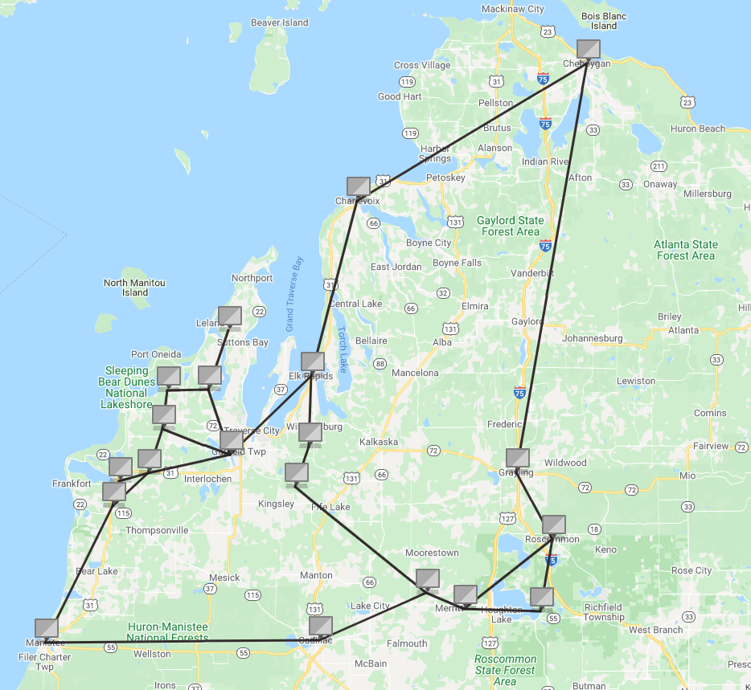



Ciena Residential Broadband Solution for Rural Service Providers
Cherry Capital Communications
MCP
Domain Controller
Benu
vBNG
XGS-PON
XGS-PON
uOLT Pluggable
From n x100GbE up nx400GbE
XGS-PON
5164
5166
“In rural rollouts especially, it’s common to encounter space constraints and intemperate weather. Ciena’s dense, hardened, easy-to-manage solution helped us simplify and de-risk our journey.
Particularly, Ciena’s pluggable OLT modules have allowed us to reduce transport costs, footprint and power consumption—key to our economics.”
Tim Maylone, Cherry Capital CEO

Slide 5

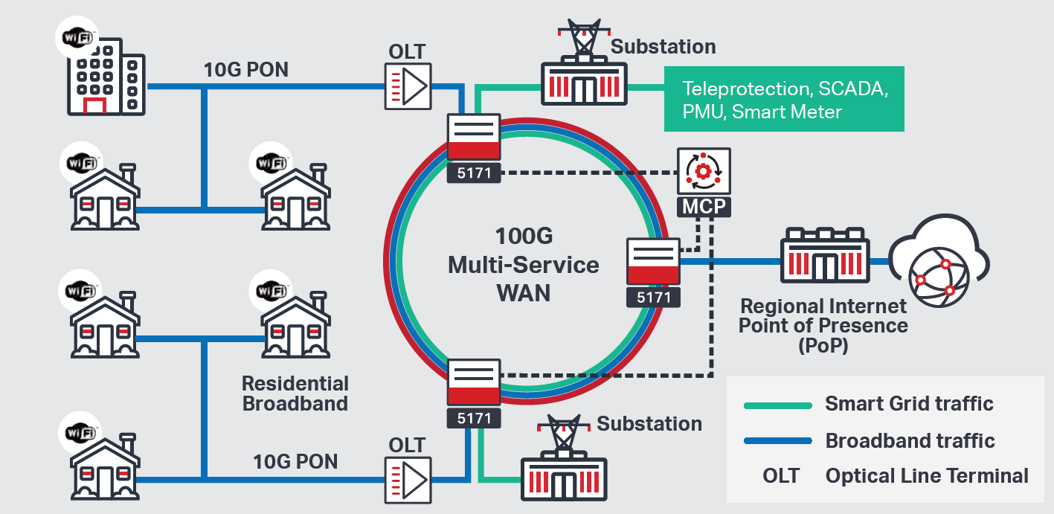
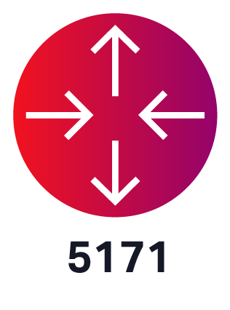
Ciena Residential Broadband Solution for Utilities
Cullman Electric (Alabama Co-op)
MCP
Domain Controller
Substation
1GbE
Residential
XGS-PON
XGS-PON
uOLT Pluggable
From n x100GbE
XGS-PON
5171
Residential
Key Customer Benefits
Increased bandwidth speed to deliver a middle mile aggregation layer at 100G that has sufficient headroom for Cullman’s residential customer applications
Improved smartgrid performance delivered through field-proven, ultra-low latency packet WAN enabling optimal teleprotection performance
Converged mission-critical smart grid and substation traffic along with broadband customer traffic via middle mile aggregation, while ensuring OT traffic gets the highest priority

Slide 6
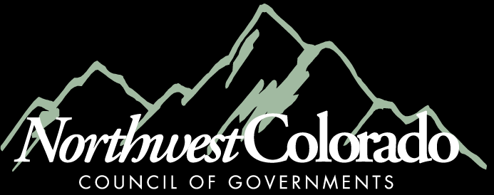
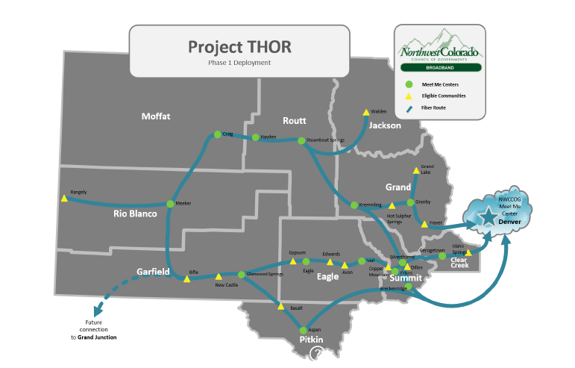
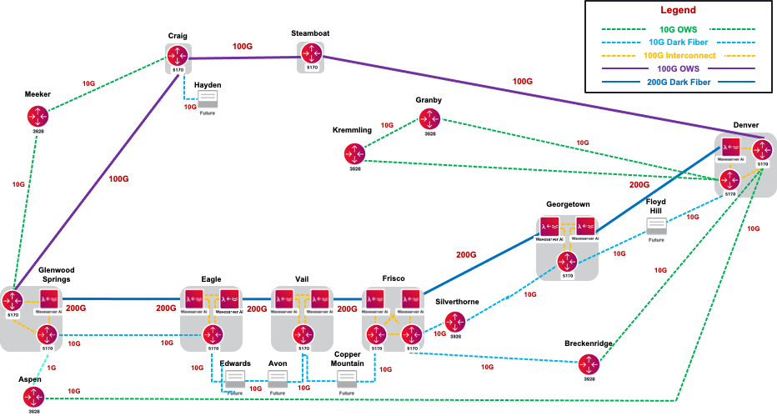
Customer & Project Overview:
  Northwest Colorado Council of Governments is an association of county and municipal governments covering 7,000 square miles with 28 member jurisdictions, and 230,000 residents.
  Project THOR utilizes over 400 miles of fiber to serve local communities across 10 counties.
Ciena’s Winning Solution:
  Ciena and Graybar created a middle-mile network operated by Mammoth Networks and supported by Ciena’s backbone network equipment.
  Ciena provided Waveserver Ai and the 5170 Platform to turn up Ethernet and other packet-based services rapidly and securely.
Notes:
Customer & Project Overview:
Open access transport for providers and ISPs to increase competition, availability, and lower broadband service prices in our rural communities
Abundant, reliable, lower cost broadband access to ISP’s, schools, libraries, and healthcare and public safety facilities
Fiscally sustainable and scalable network
Provide resiliency through redundancy was a fundamental challenge that had to be resolved

Slide 7
Thank You

