Slide 1



ArcGIS Pro
Importing ArcMap Projects (.mxds)

Slide 2

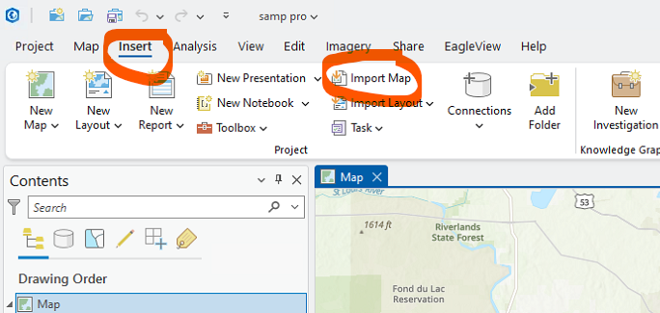
Open ArcGIS Pro
Go to Insert Menu
Select Import map

Slide 3
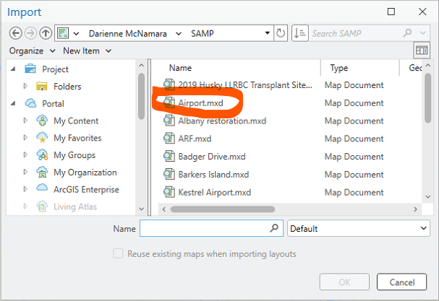
Select the file to Import

Slide 4
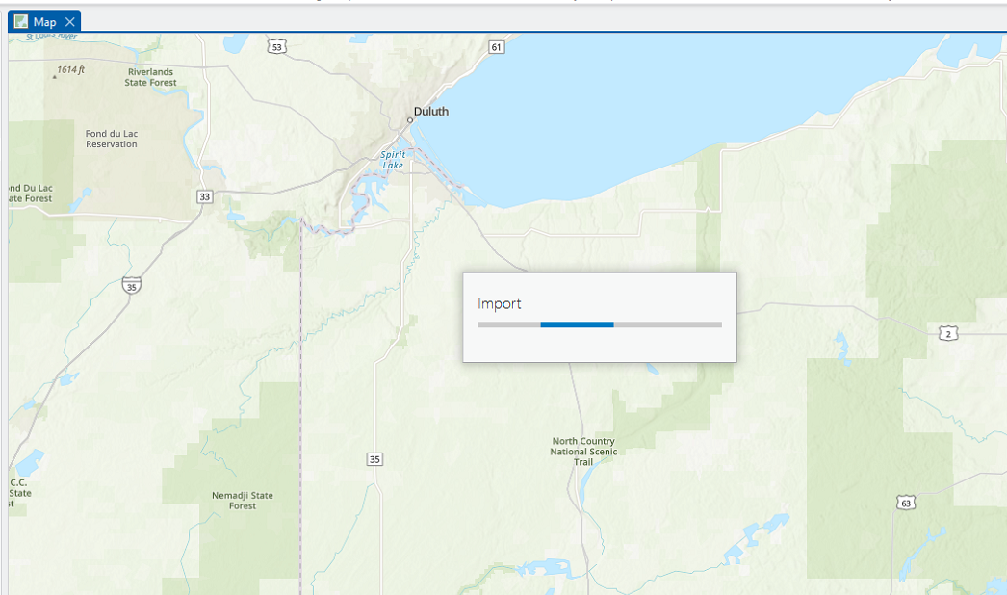
Import the file
Note: Typically takes a while

Slide 5
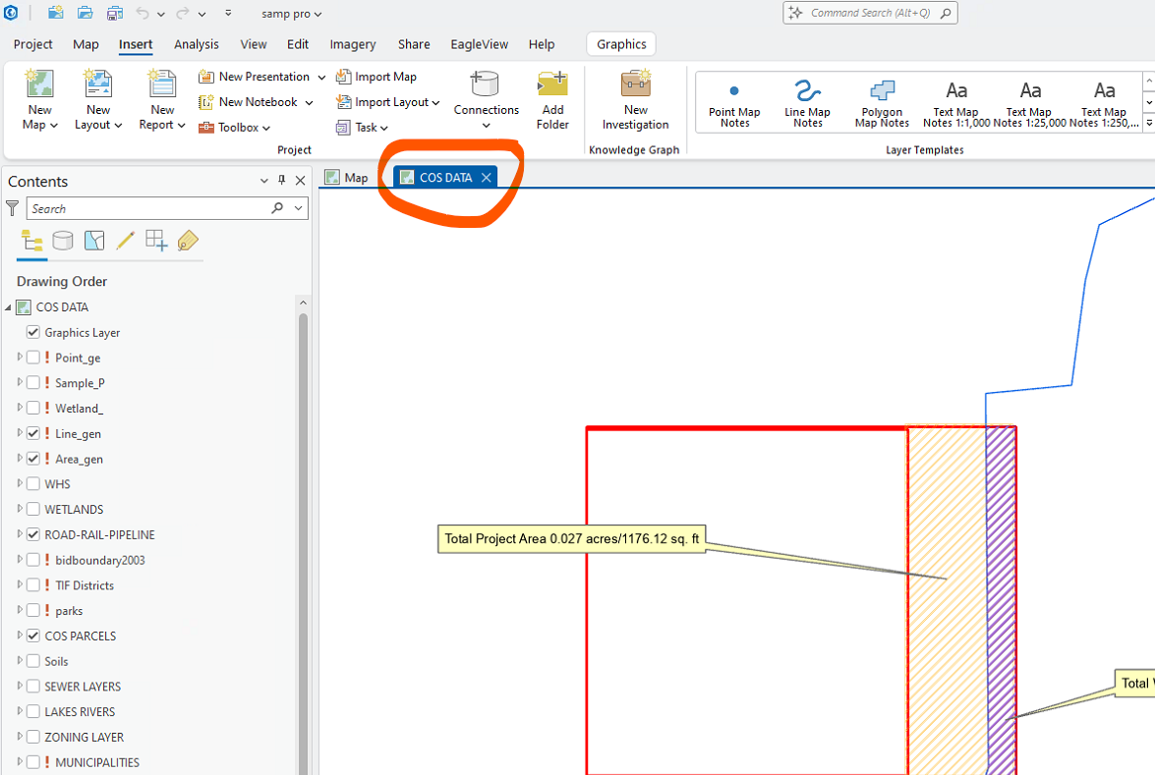
Layer Added

Slide 6
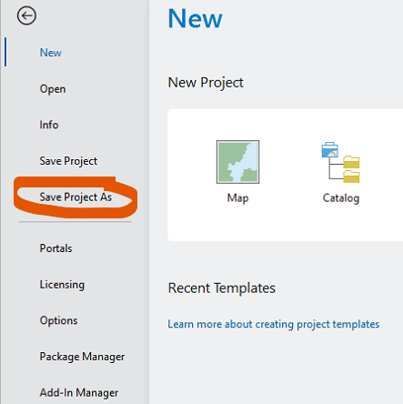
Save Project As…

Slide 7
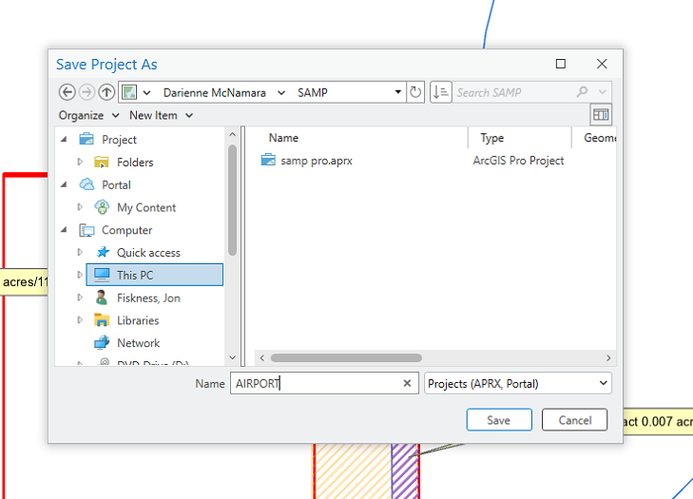
Choose Location to save and name file

Slide 8
ArcGIS Pro Resources
https://media.superiordcgis.org/FTP/GIS/Training/ArcPro/

Slide 9
Thank you
Jon Fiskness, GISP
gis@superiorwi.gov
https://media.superiordcgis.org/FTP/GIS/Training/ArcPro/

