Slide 1
60% Meeting
Faxon Creek Flood Study
December 2, 2013

Slide 2
Faxon Creek Watershed
3,600 Acres
20% impervious
K-Street Sewer
2000’ long
10’ diameter
Constructed in 1890’s.

Slide 3
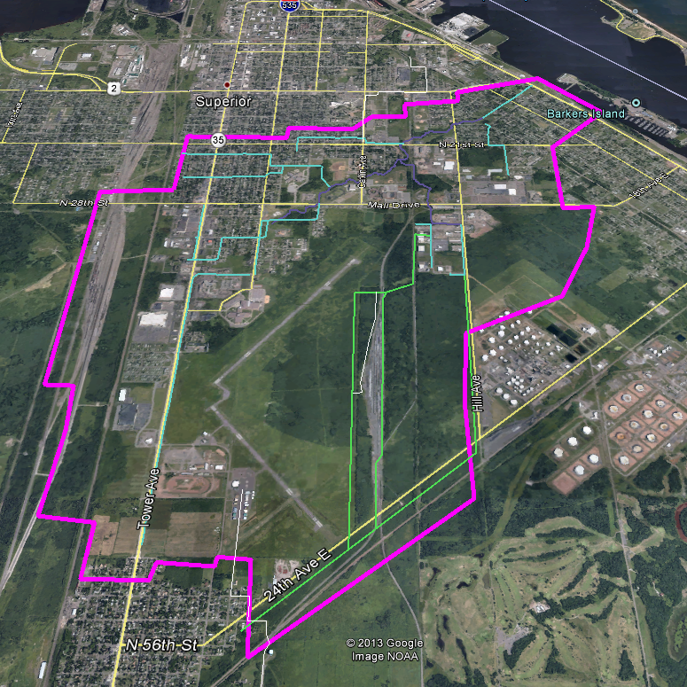
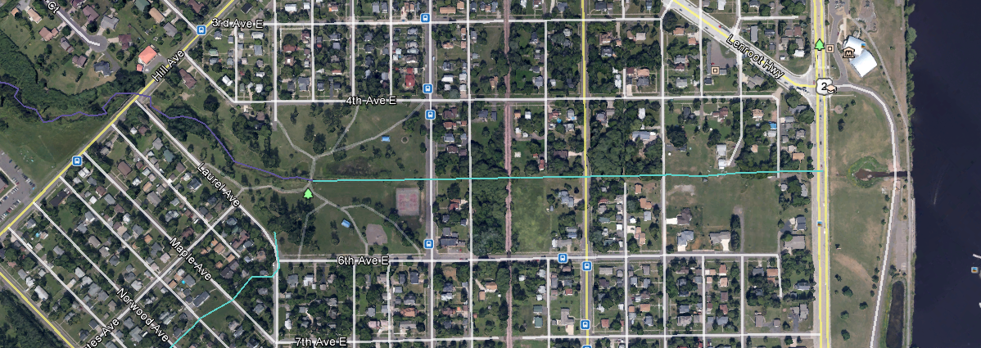
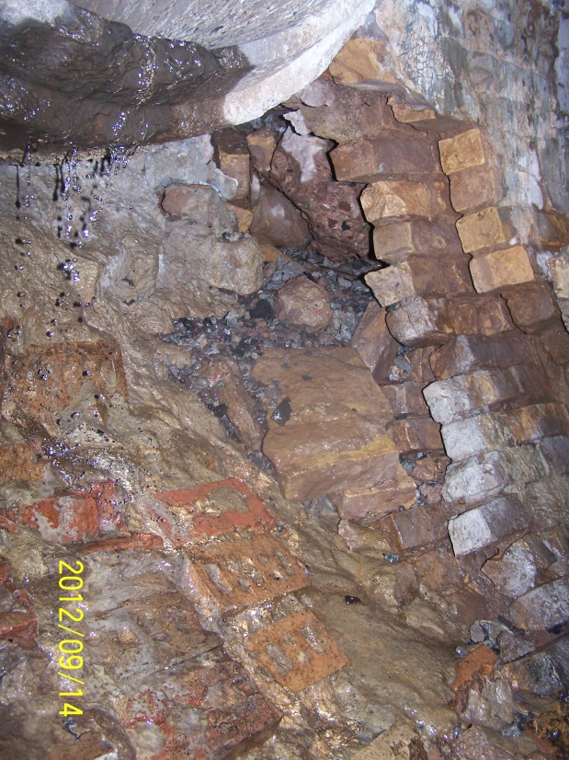
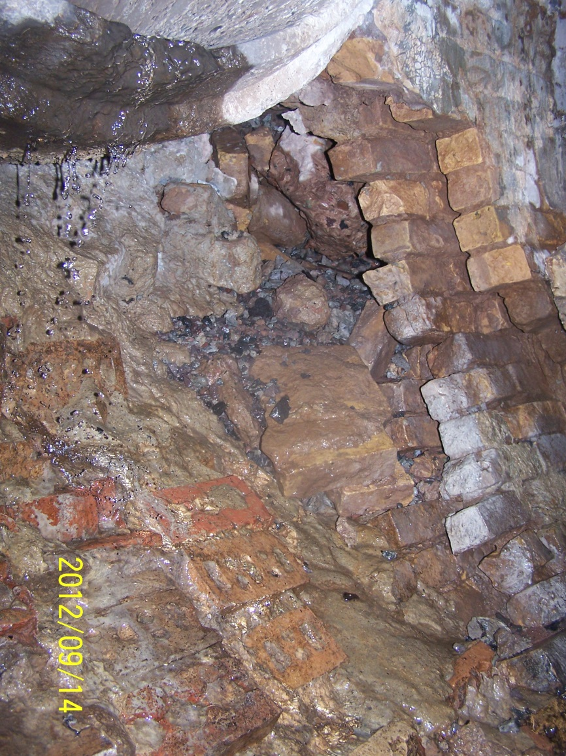
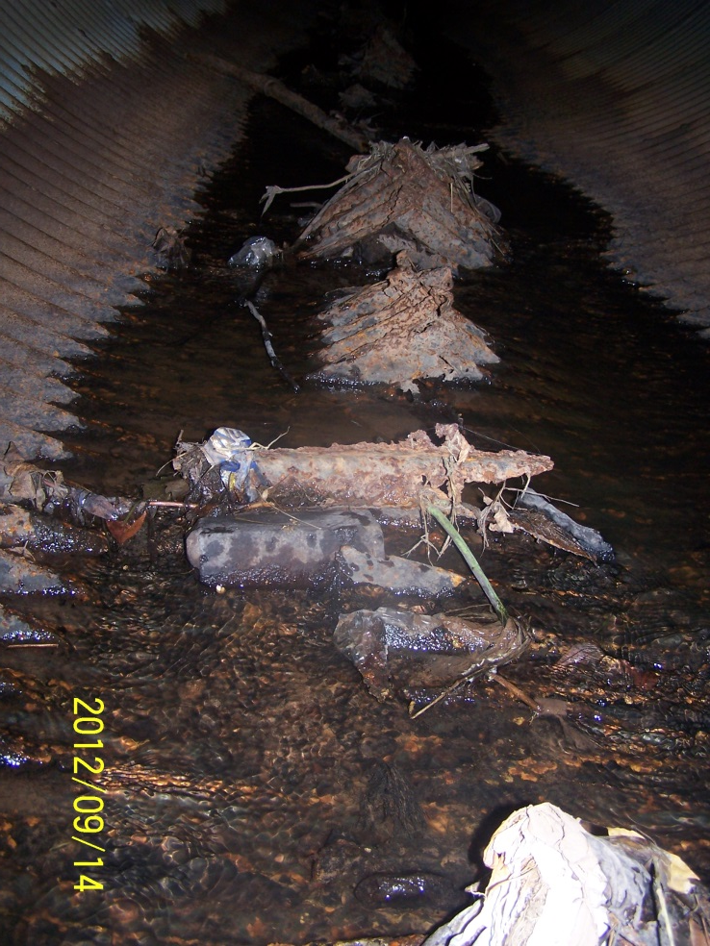
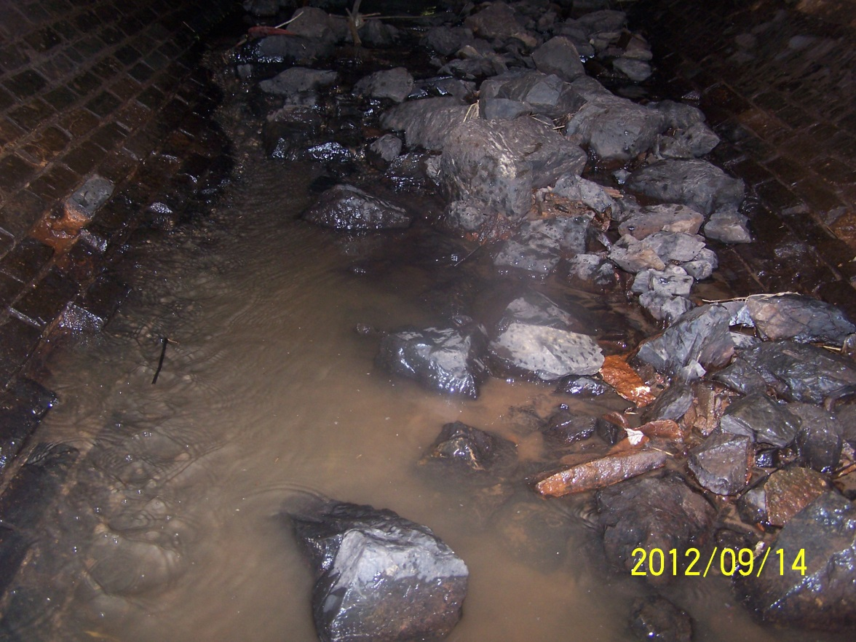
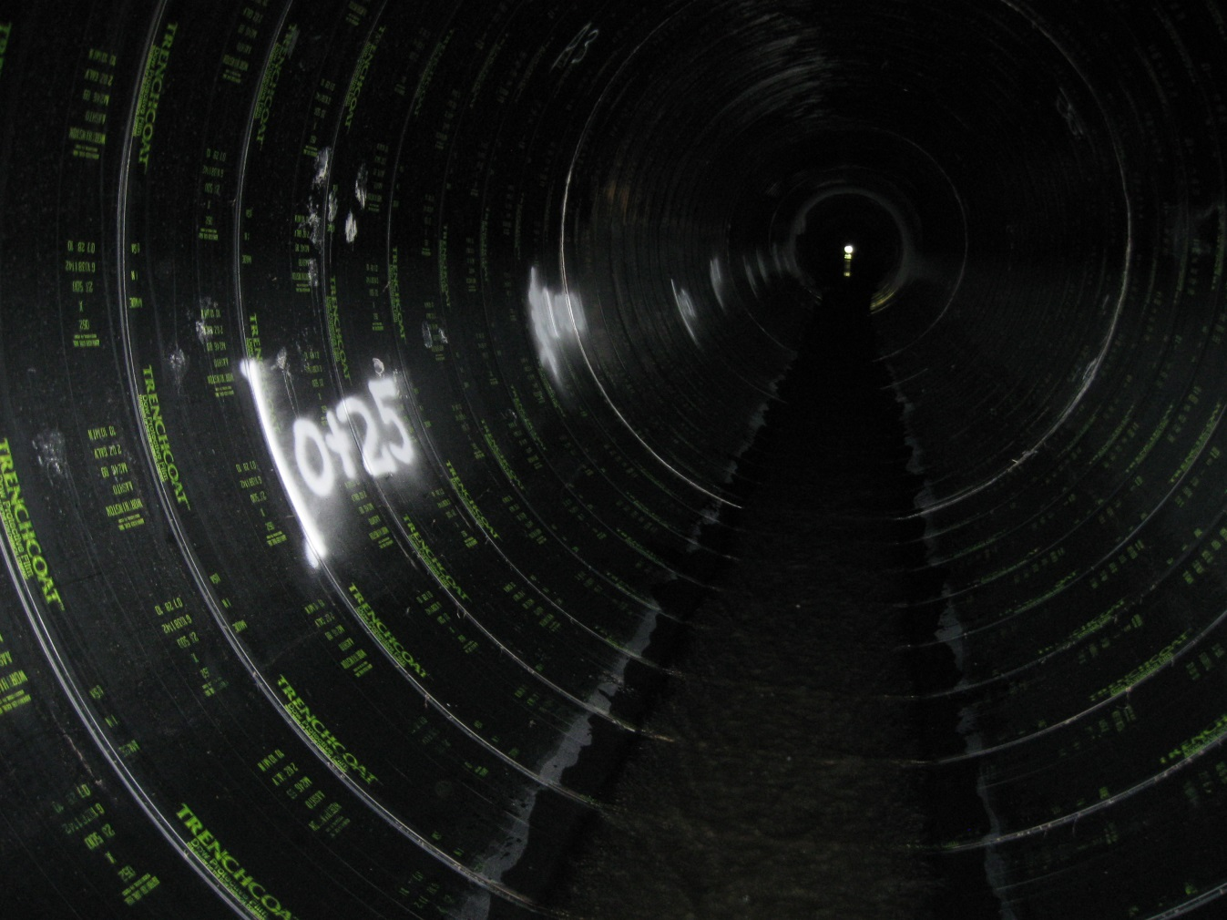
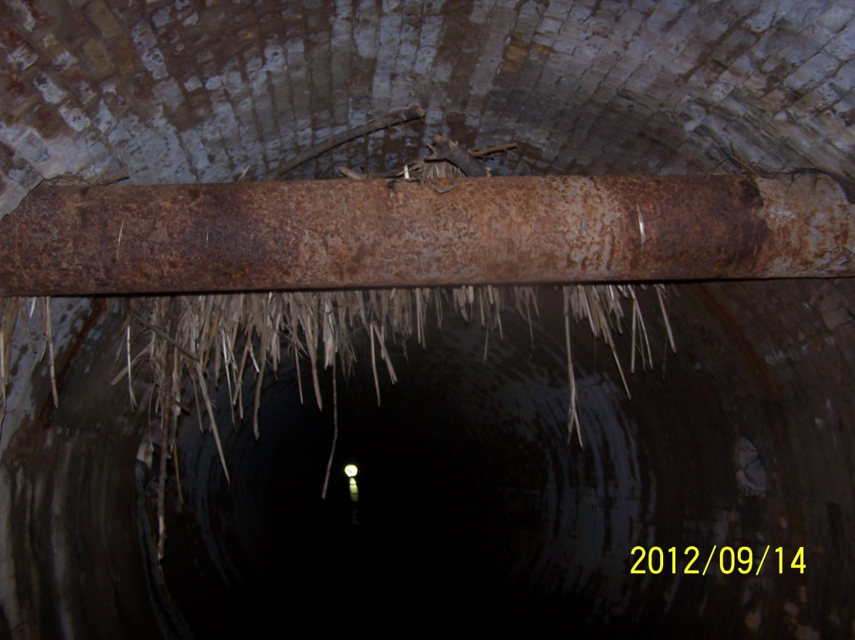
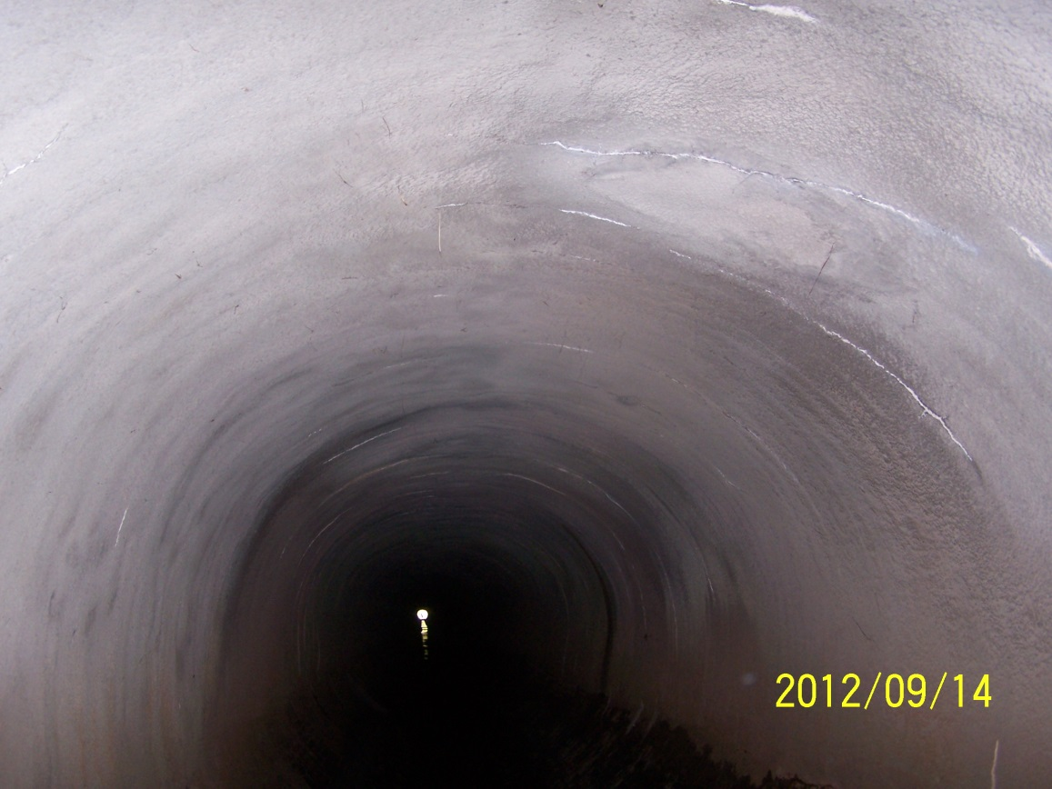
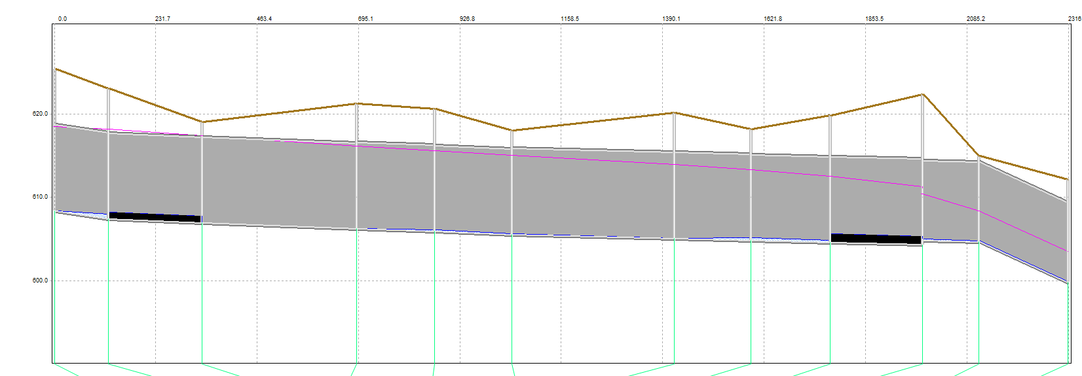
K-Street Sewer Rehabilitation
Built in 1890’s
Accelerating degradation

Slide 4
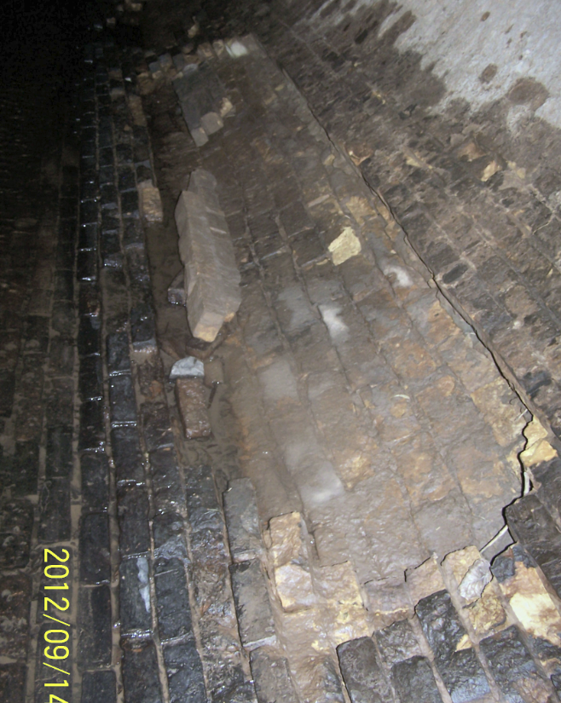
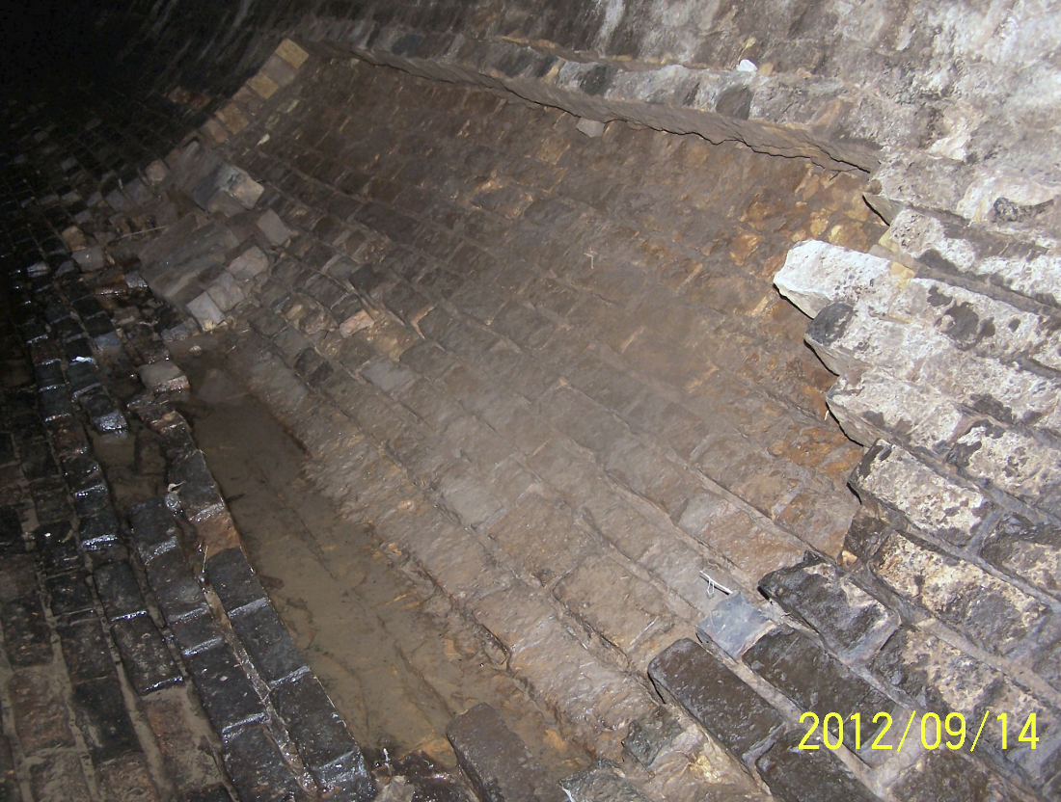
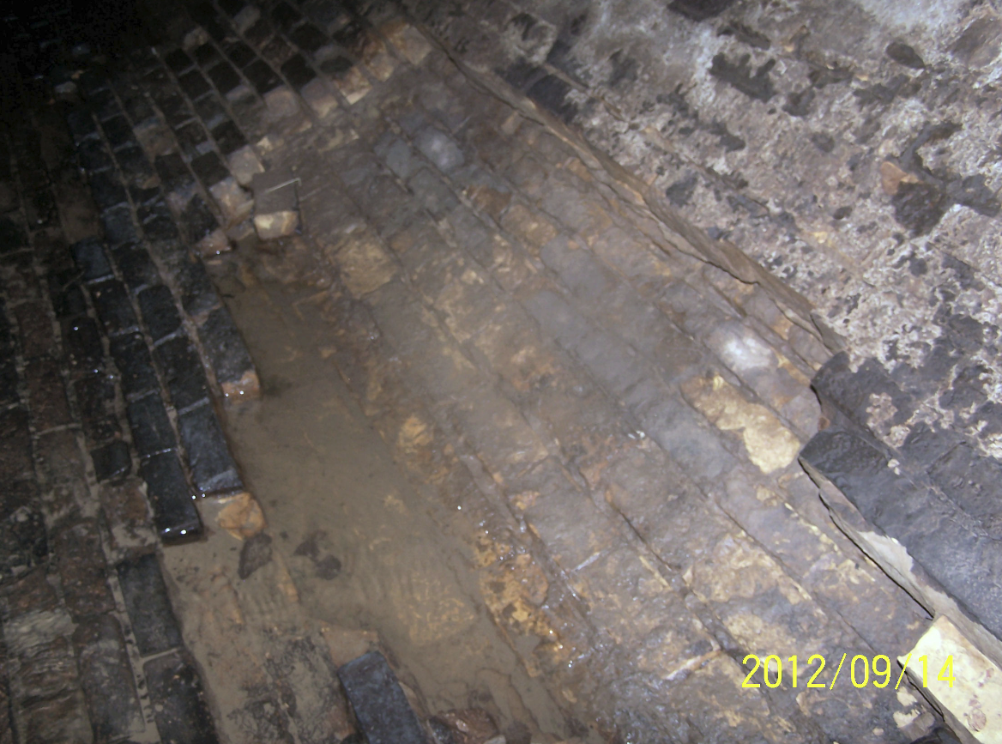
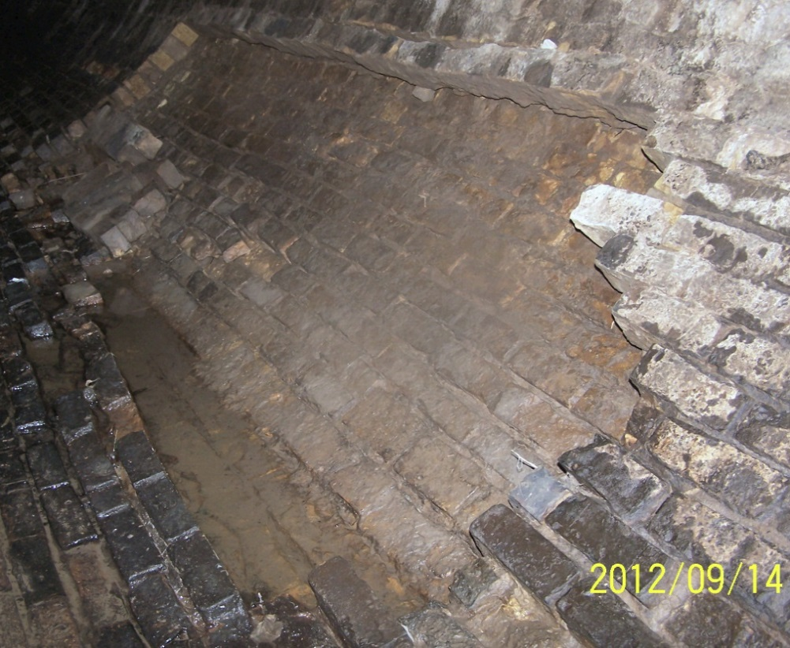

Slide 5
K-Street Sewer Rehab
Shotcrete most upstream 600’-700’
No reduction in capacity
Environmental Assessment not required
Preparing stream application
40-60 days for receipt of permit
Spring 2014 bidding and construction
Approximate cost: $1M

Slide 6
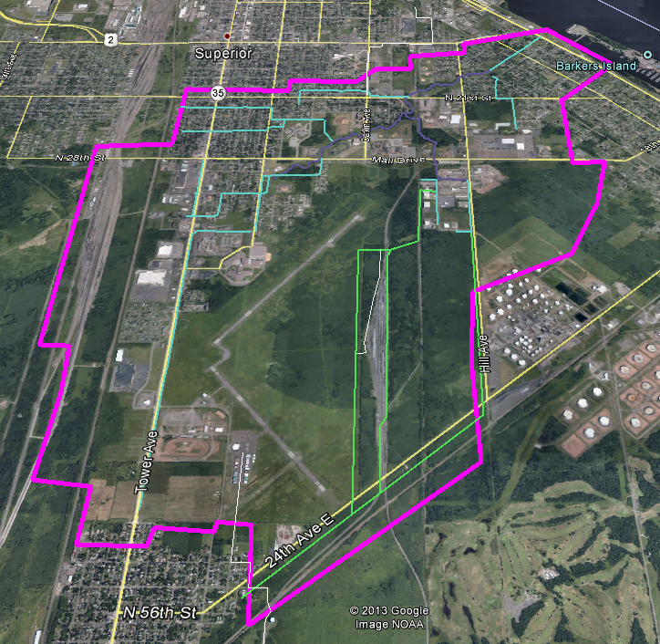
Model Development

Slide 7
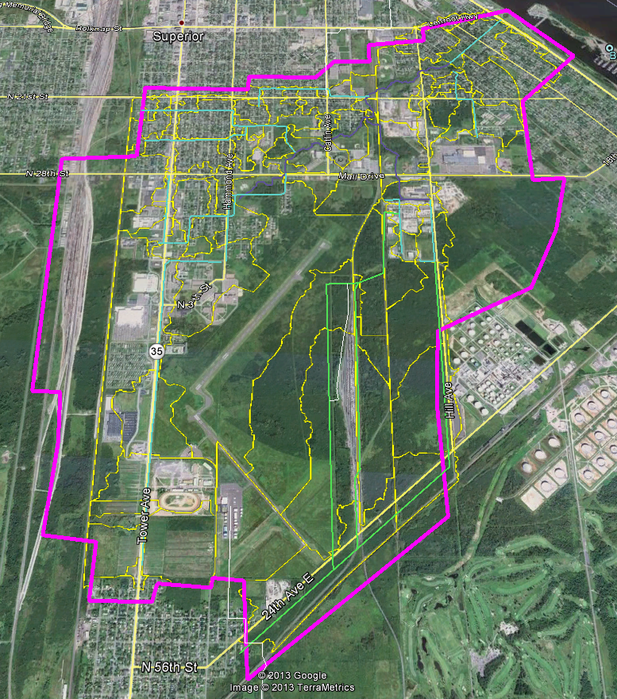
Model Development
XP-SWMM 2D
88 catchments
3900’ of storm sewers
2.6 miles of open channels

Slide 8
Model Calibration
October 2007
June 2012

Slide 9
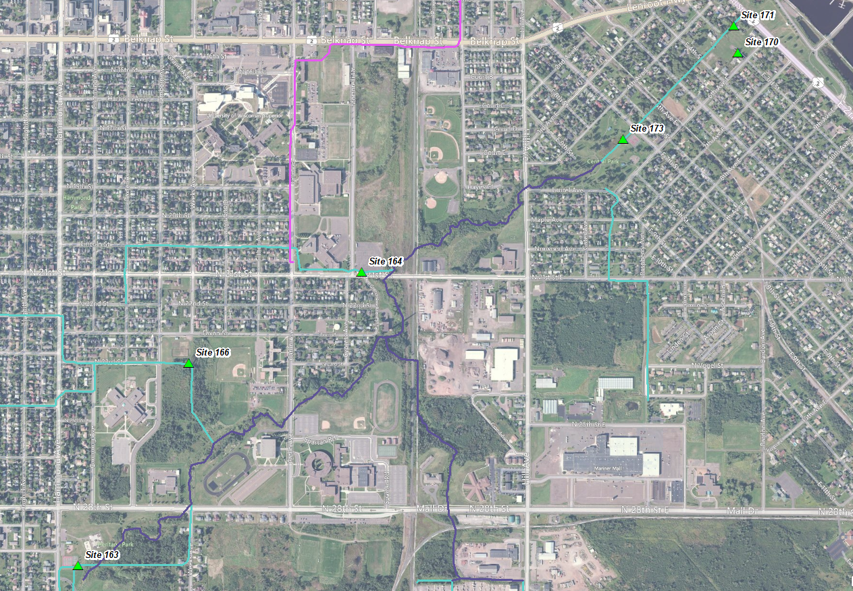
Calibration Sites

Slide 10
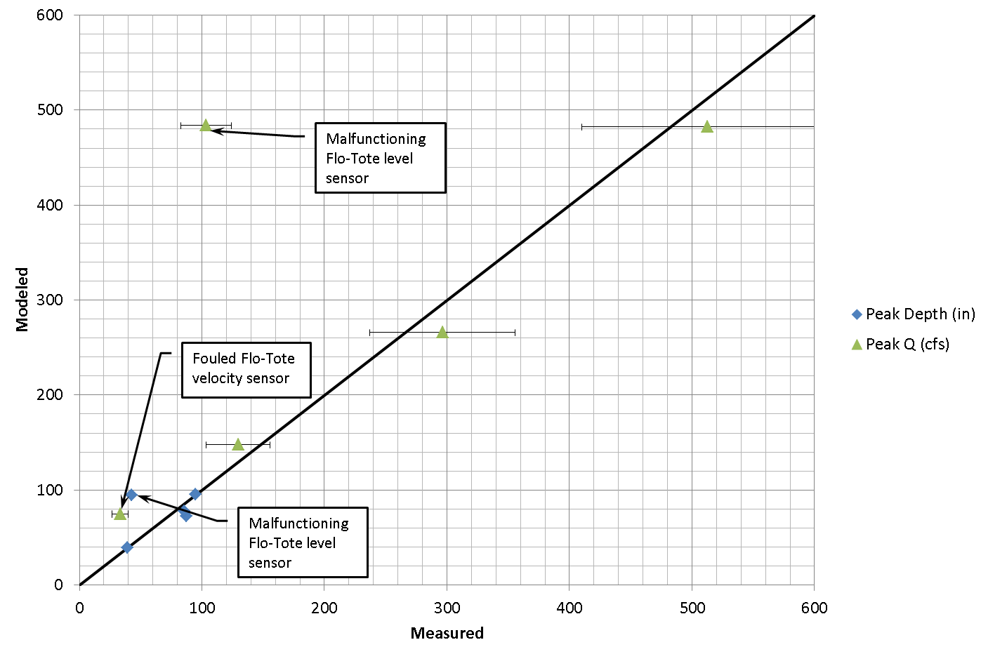
October 2007

Slide 11
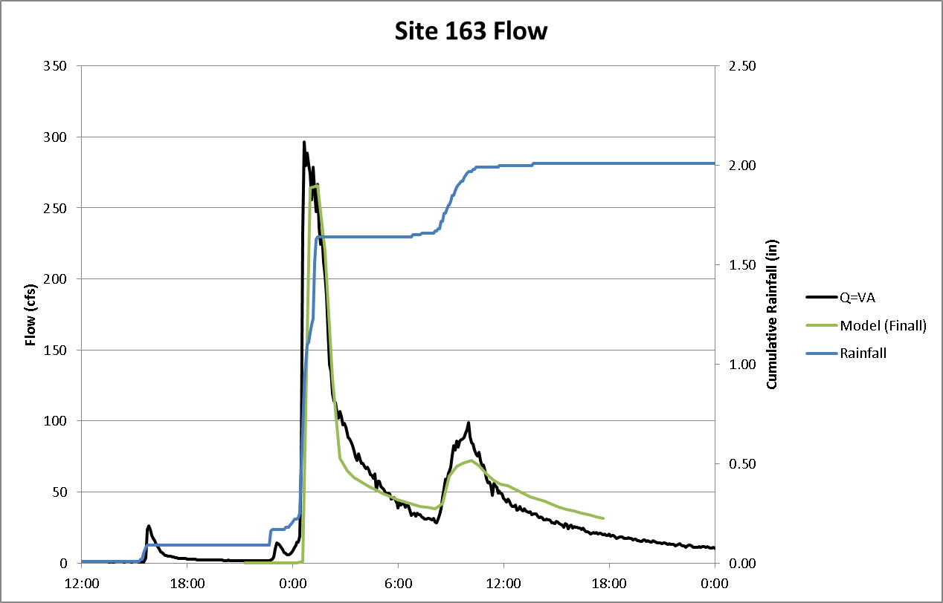
Site 163

Slide 12
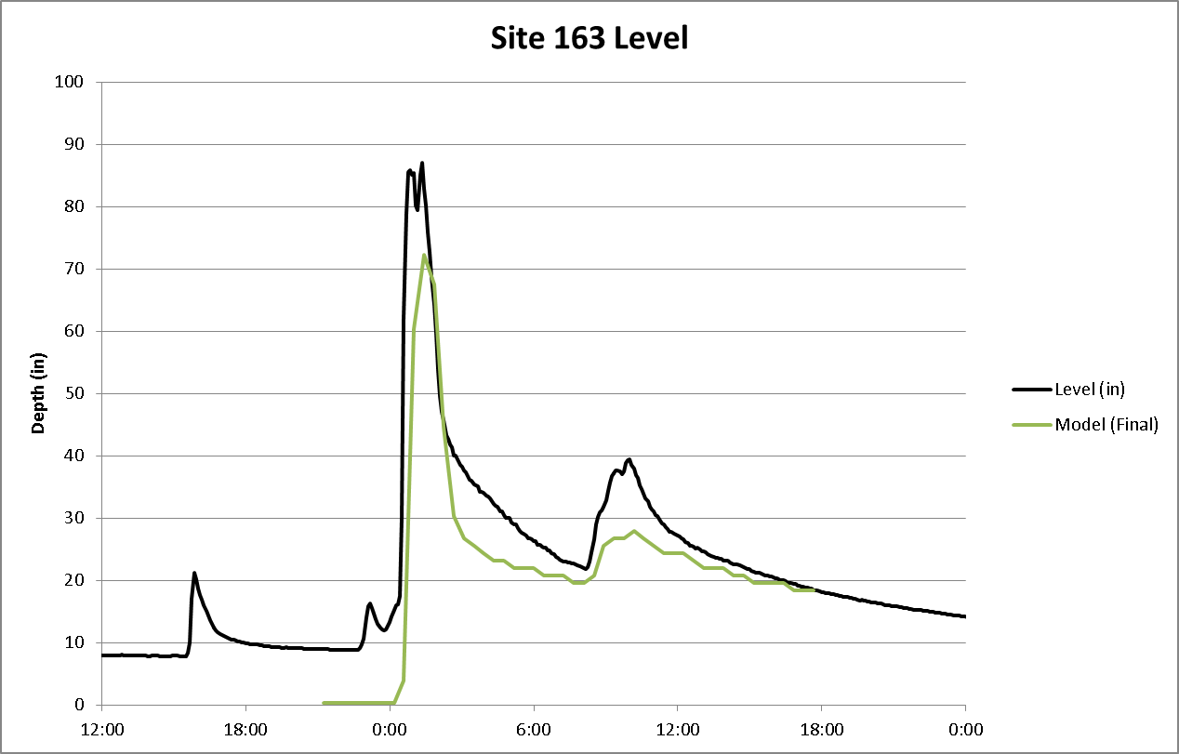
Site 163

Slide 13
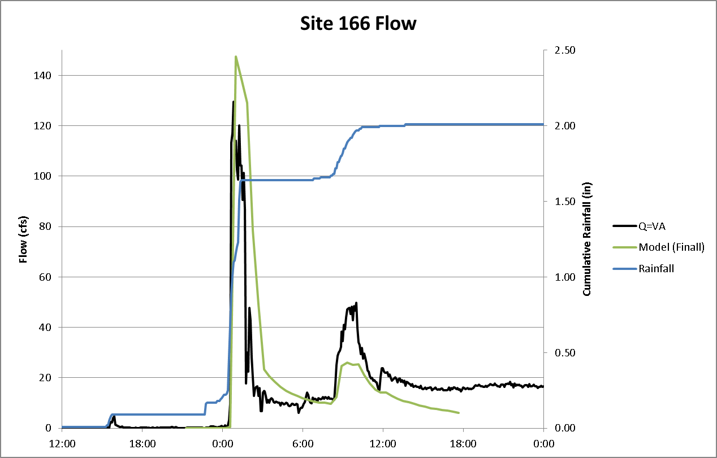
Site 166

Slide 14
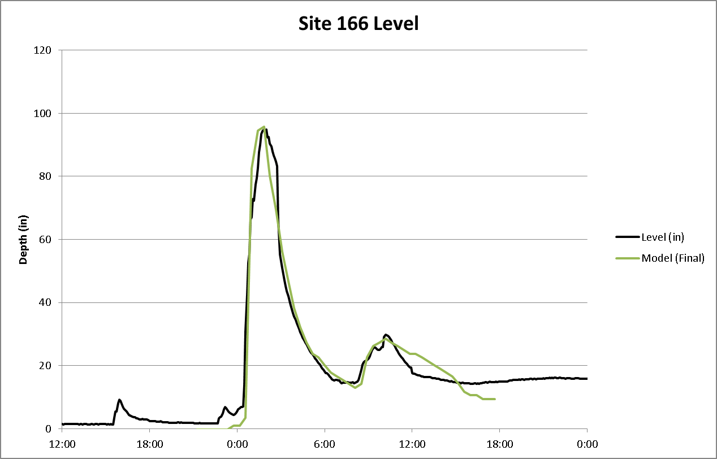
Site 166

Slide 15
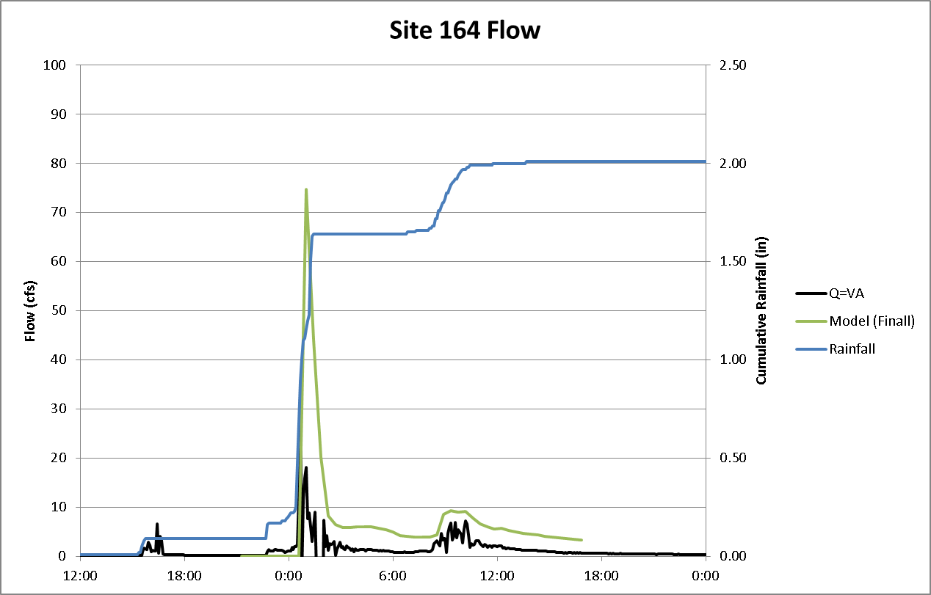
Site 164

Slide 16
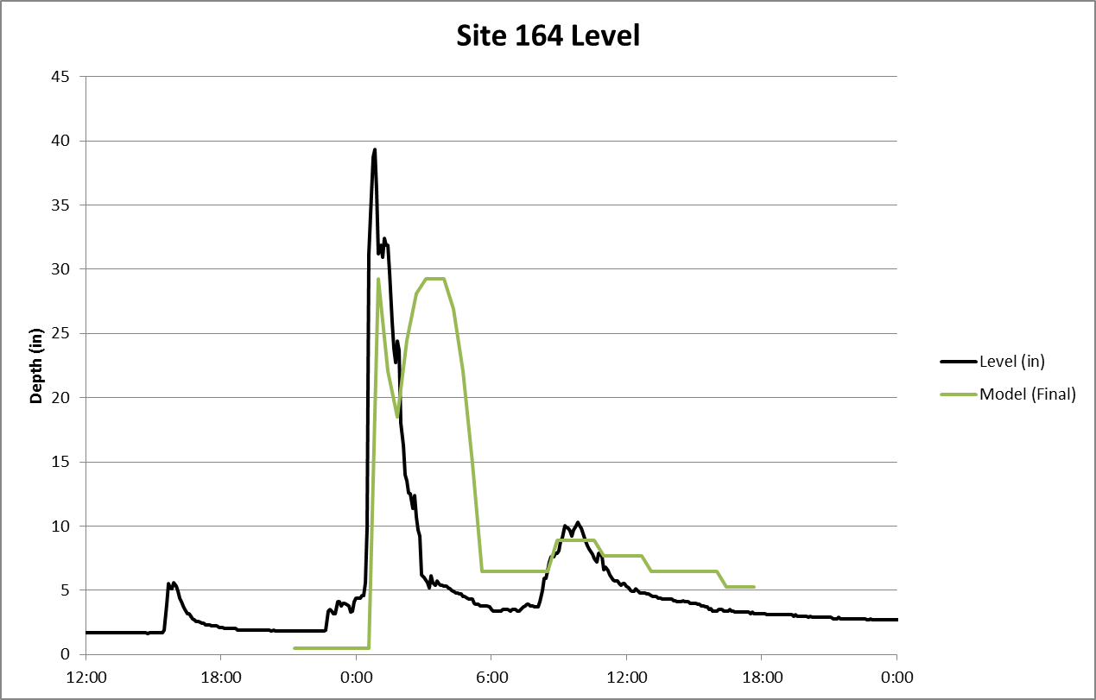
Site 164

Slide 17
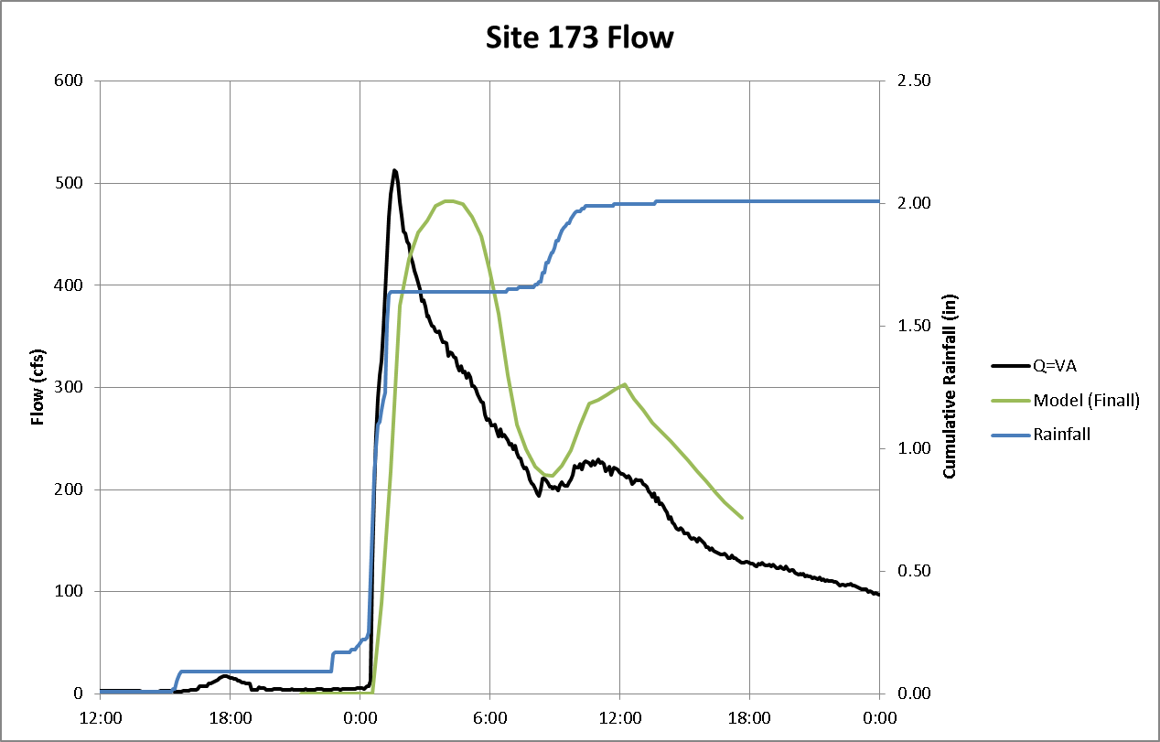
Site 173

Slide 18
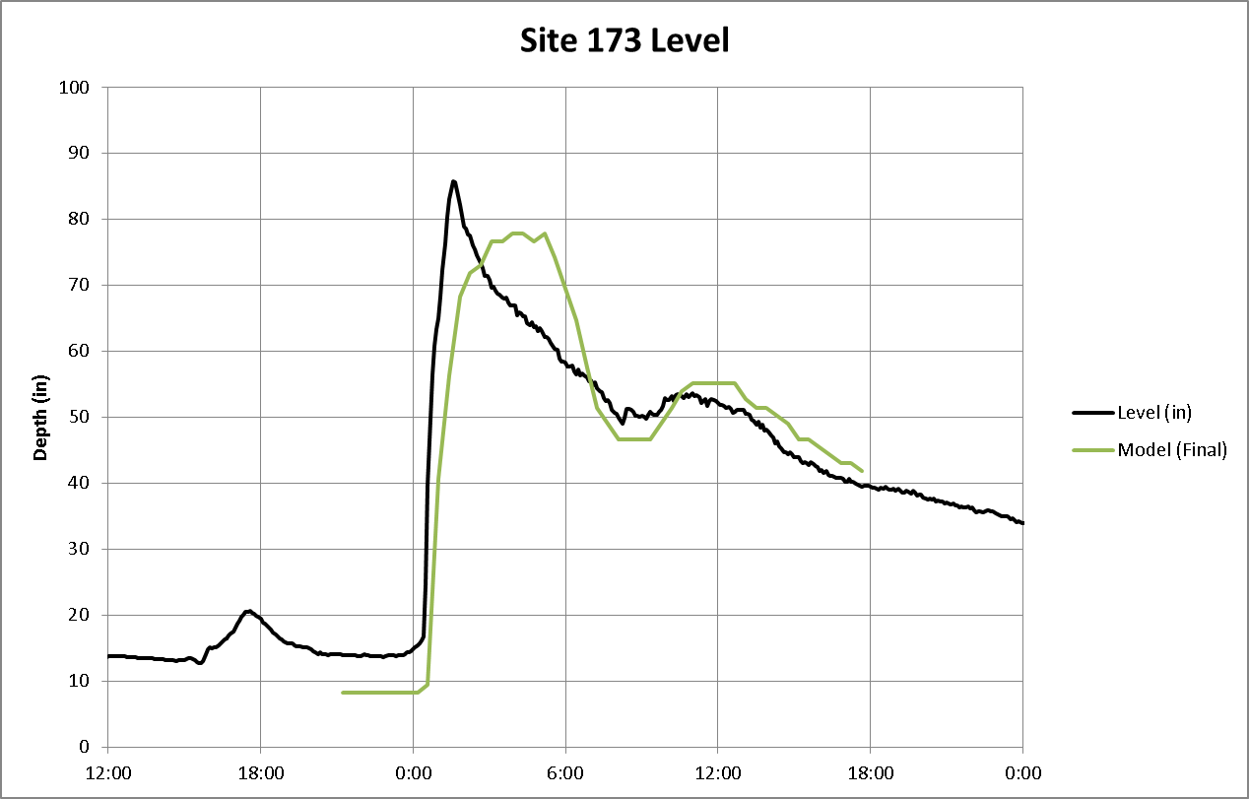
Site 173

Slide 19
June 2012 Flood
About 8” of rain
High antecedent soil moisture
500-year event (on a 12-24 hour basis)
Widespread Flooding
Surface flooding
Basement flooding

Slide 20
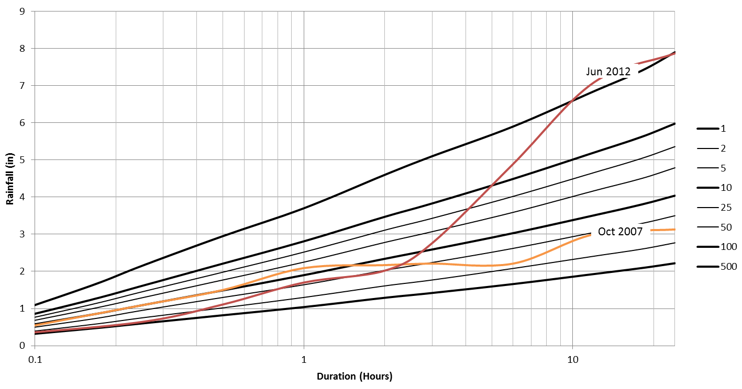
Model Calibration Events

Slide 21
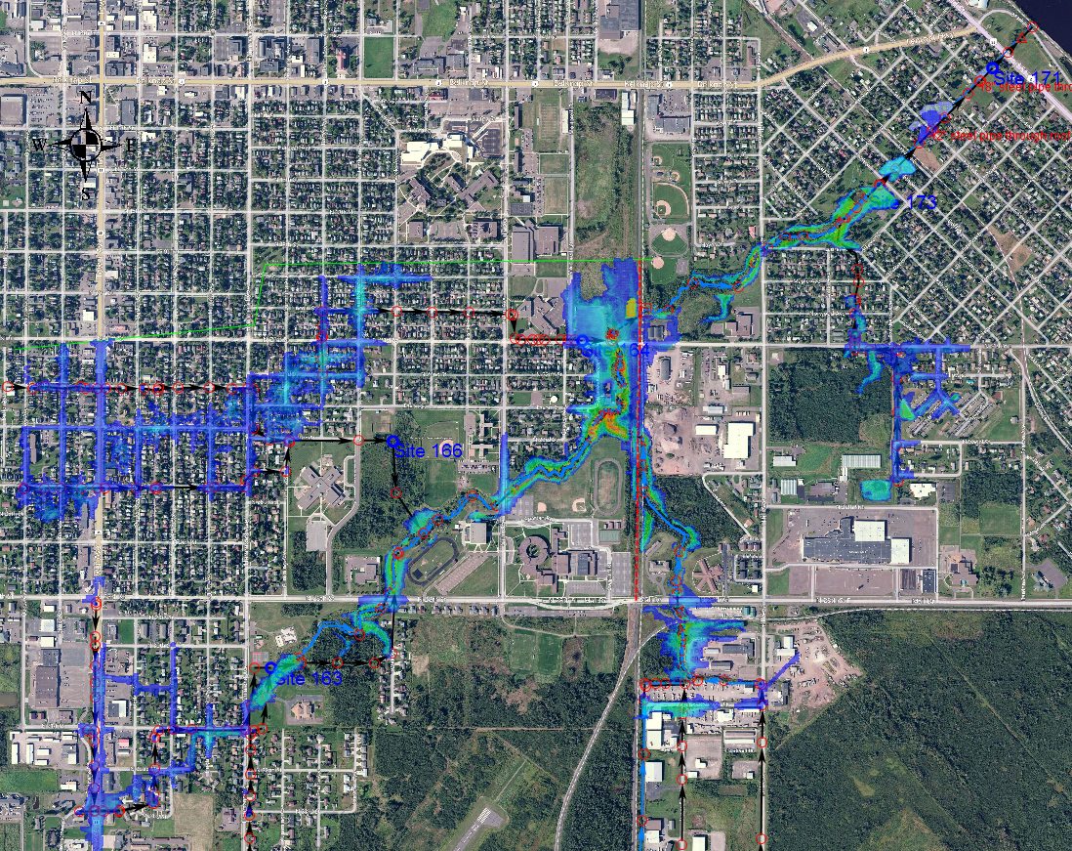
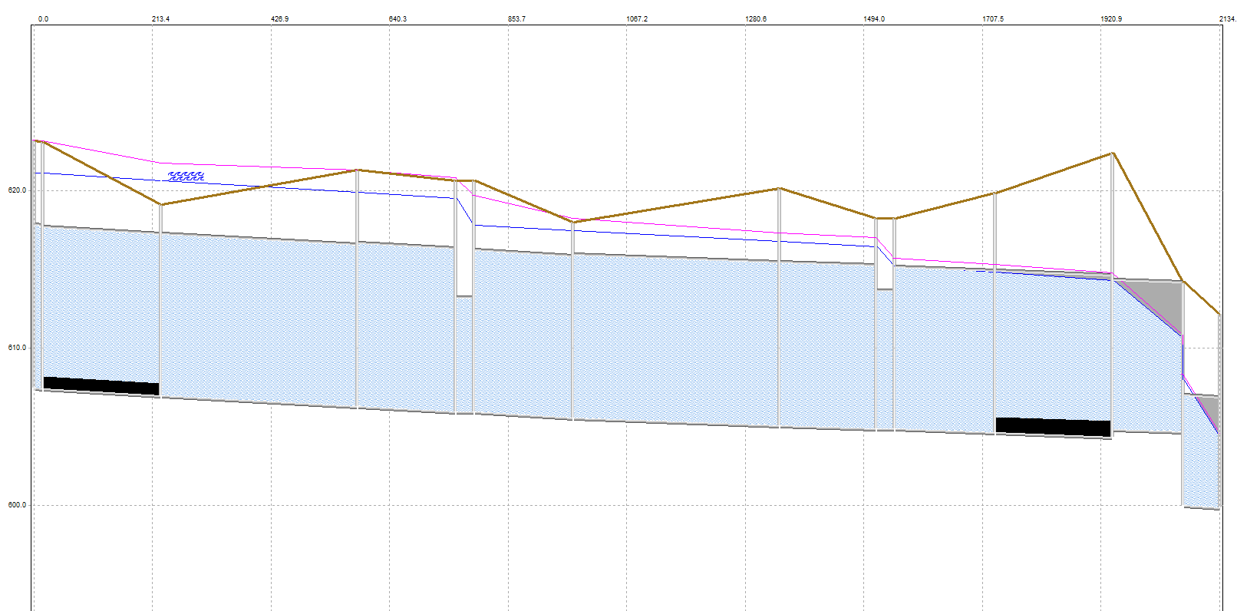
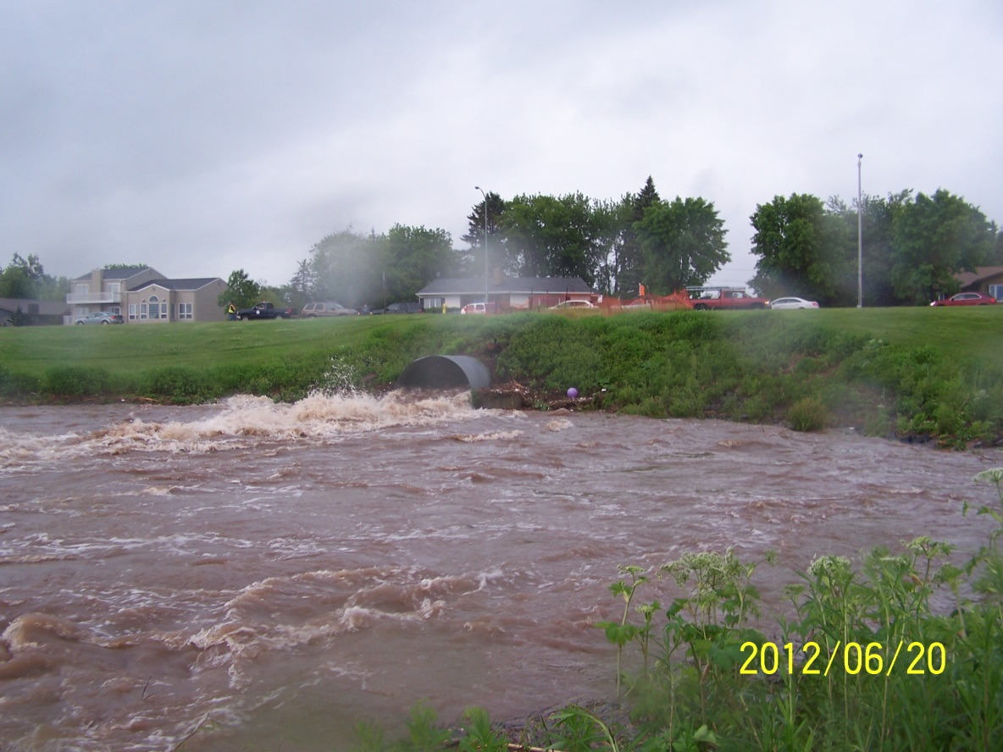
June 2012 Flood

Slide 22
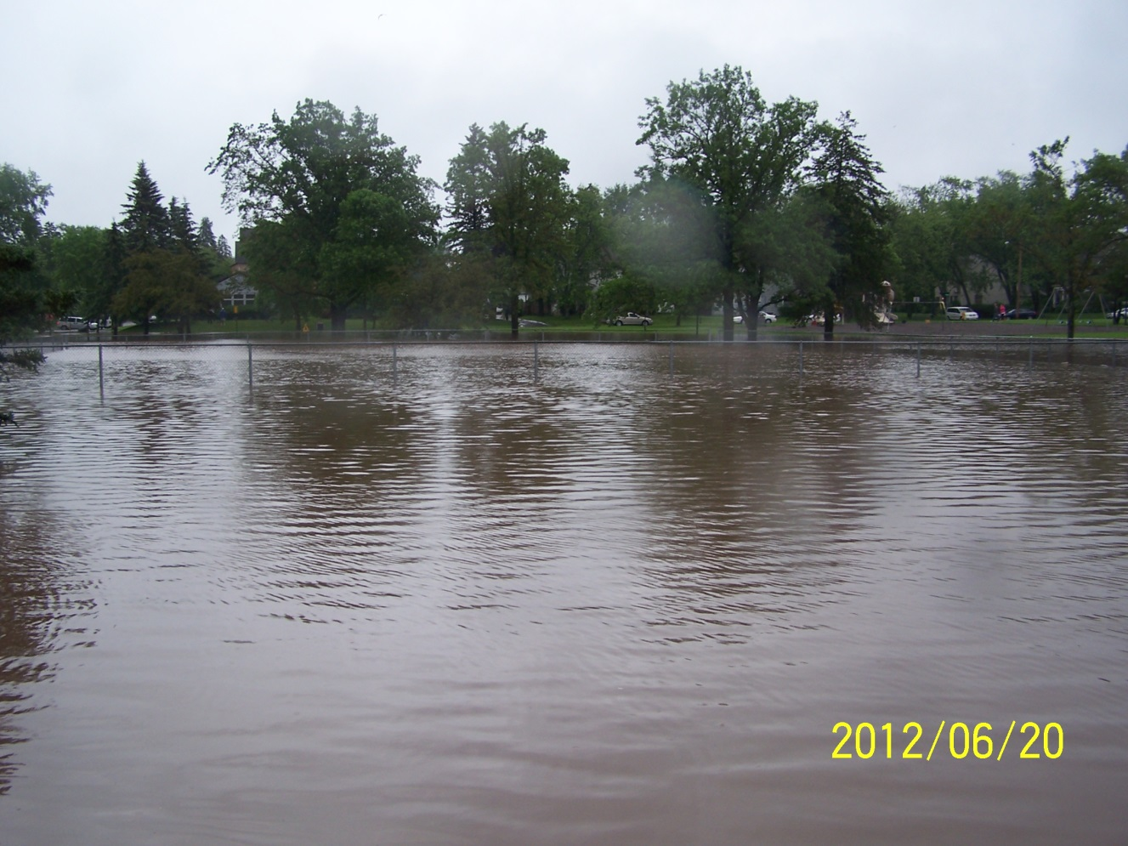
June 2012 Flood

Slide 23
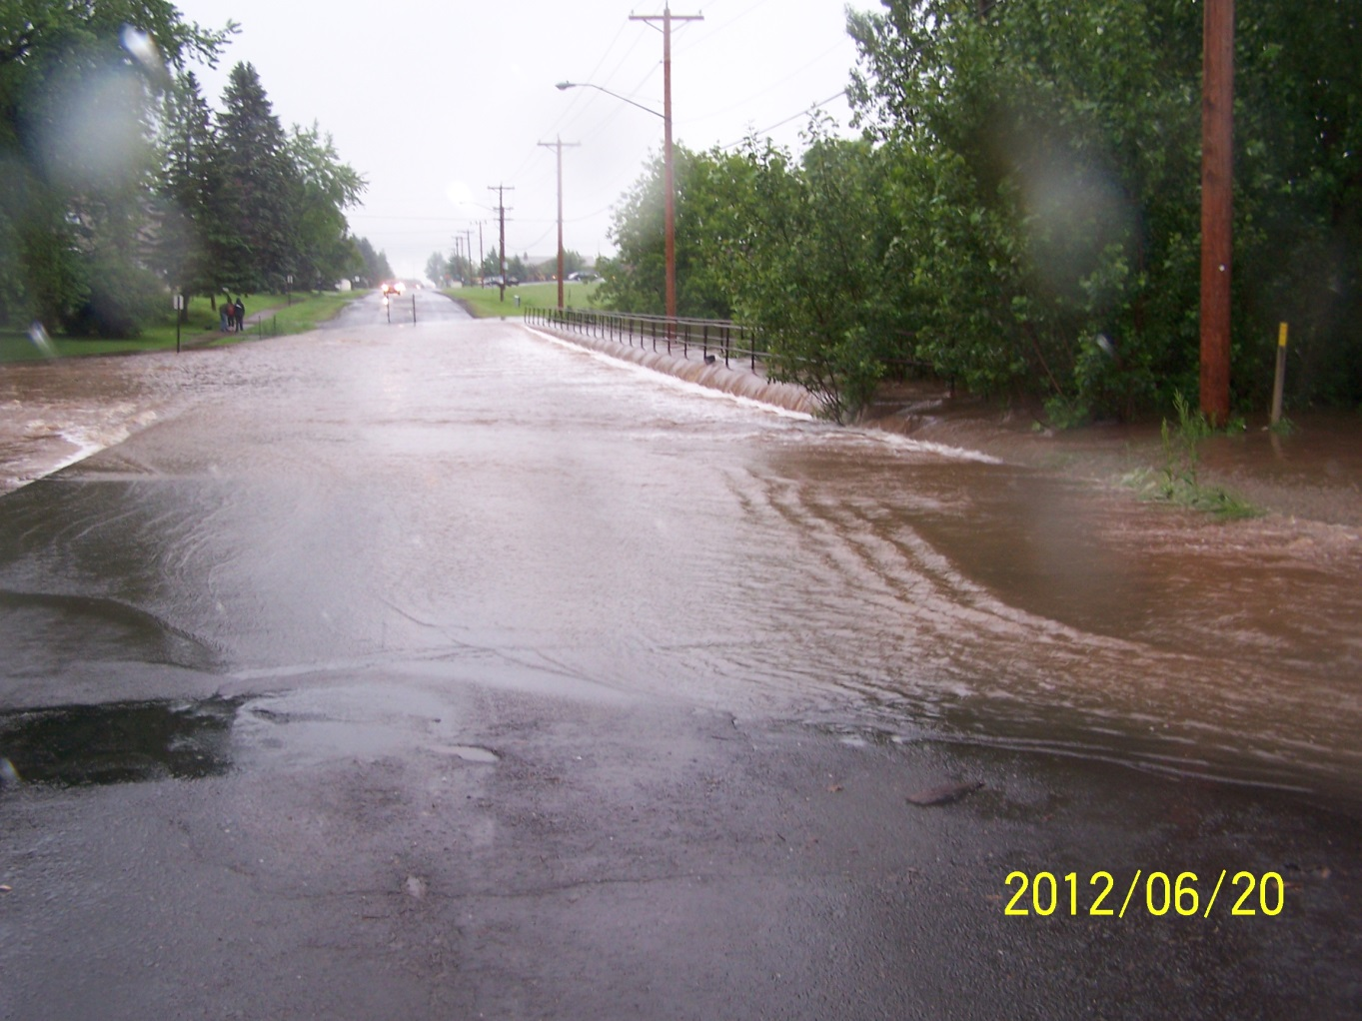
June 2012 Flood

Slide 24
June 2012 Flood

Slide 25
Existing Conditions
10, 50, 100, and 500-year design storms

Slide 26
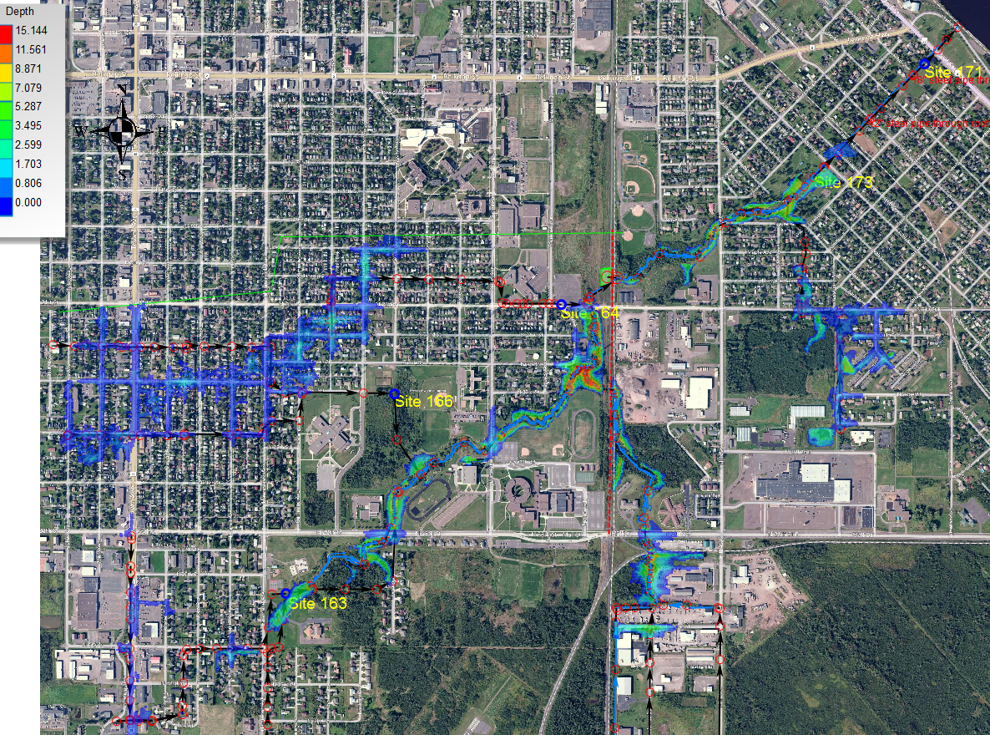
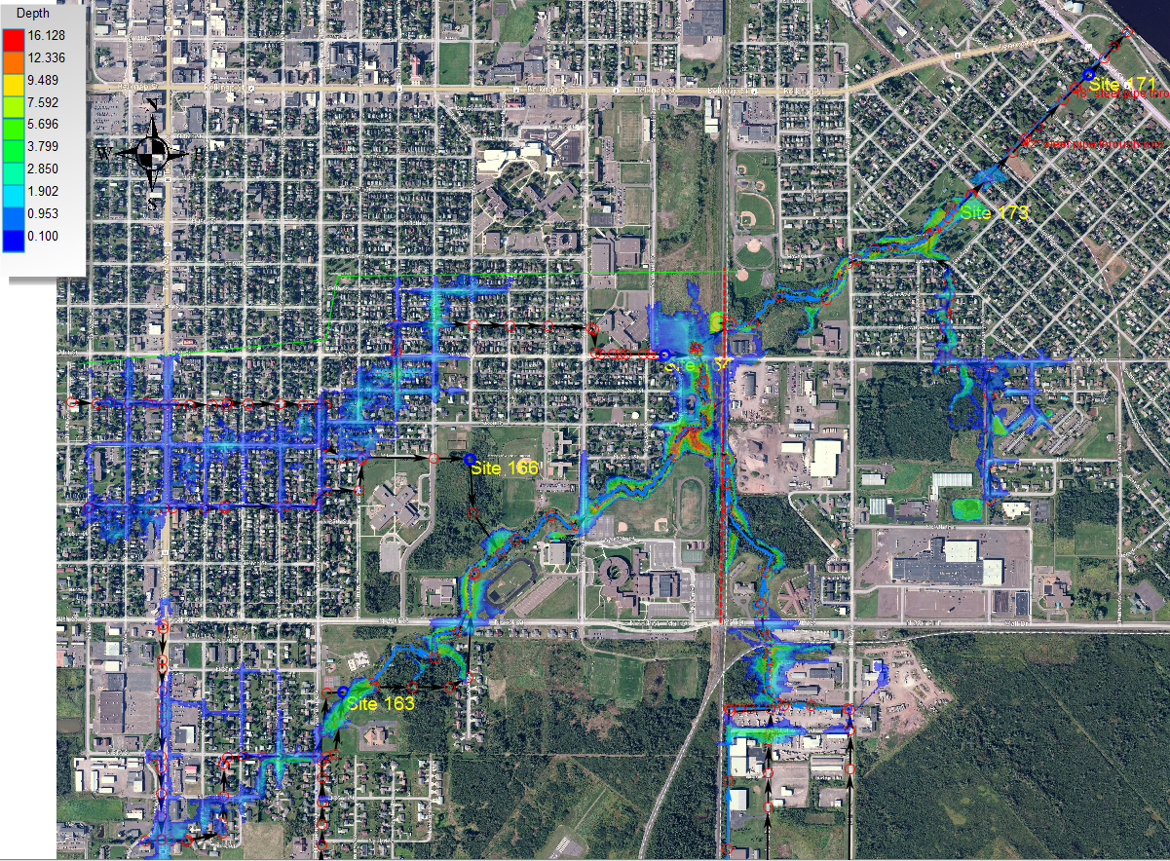
100-Year Existing Conditions

Slide 27
Comparison To Ayres Results
Location | Ayres |  | Donohue
 | 100-yr | 500-yr | 100-yr | 500-yr
Halbert Heating Plant Culvert | Overtopped in 100-yr storm
Adjacent to Steam Plant | 632.1 | 637.3 | 637.61 | 638.36
Wessman Arena | 638.6

Slide 28
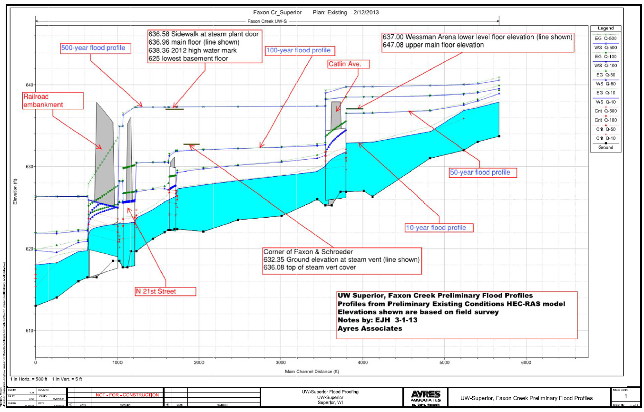
Faxon Creek Profile
Donohue 500-yr
Donohue 100-yr

Slide 29
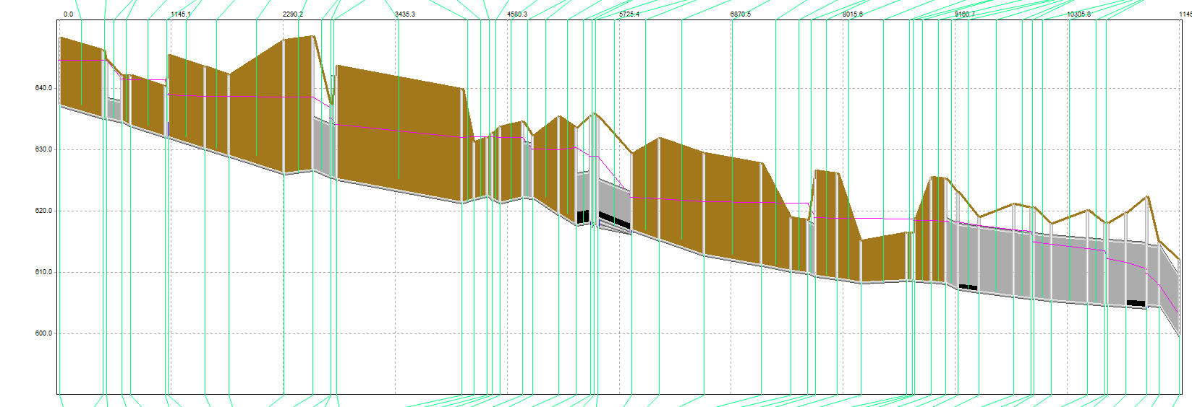
10-Year Hydraulic Grade Line

Slide 30
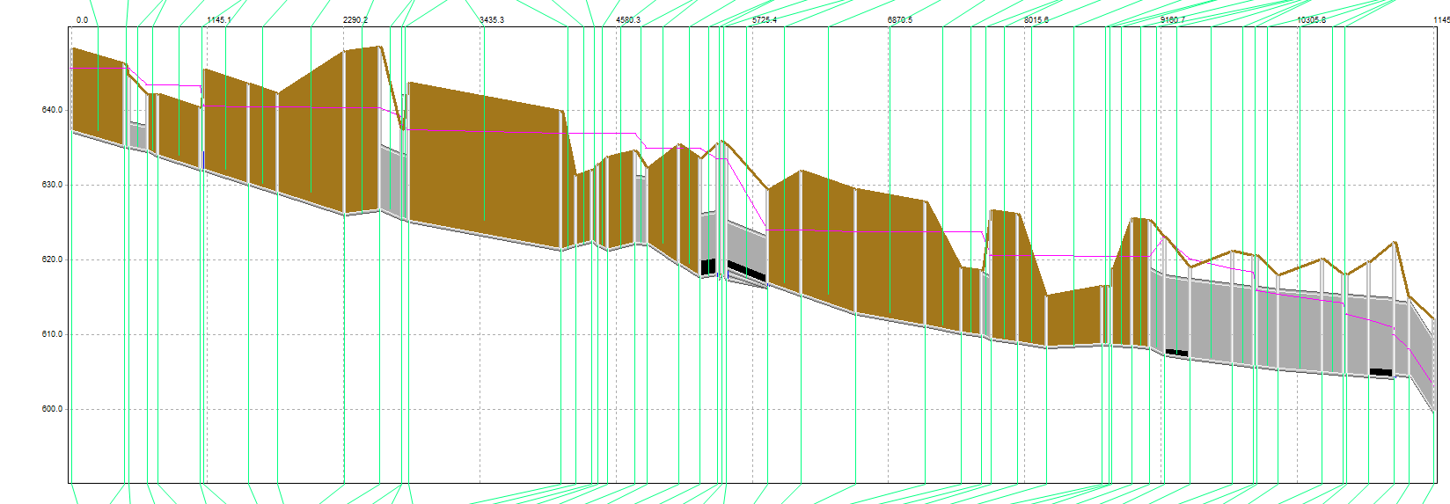
50-Year Hydraulic Grade Line

Slide 31
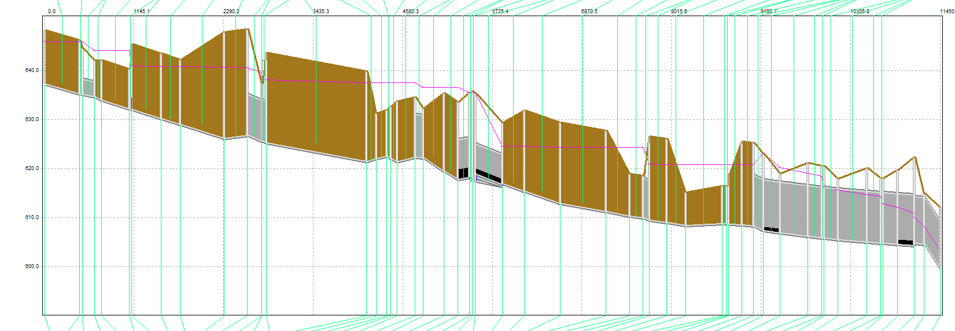
100-Year Hydraulic Grade Line

Slide 32
500-Year Hydraulic Grade Line

Slide 33
Existing Conditions
10, 50, 100, and 500-year design storms
Next Steps
Run model with crossings in good condition
Delineate of 100-year and 500-year flood plains

Slide 34
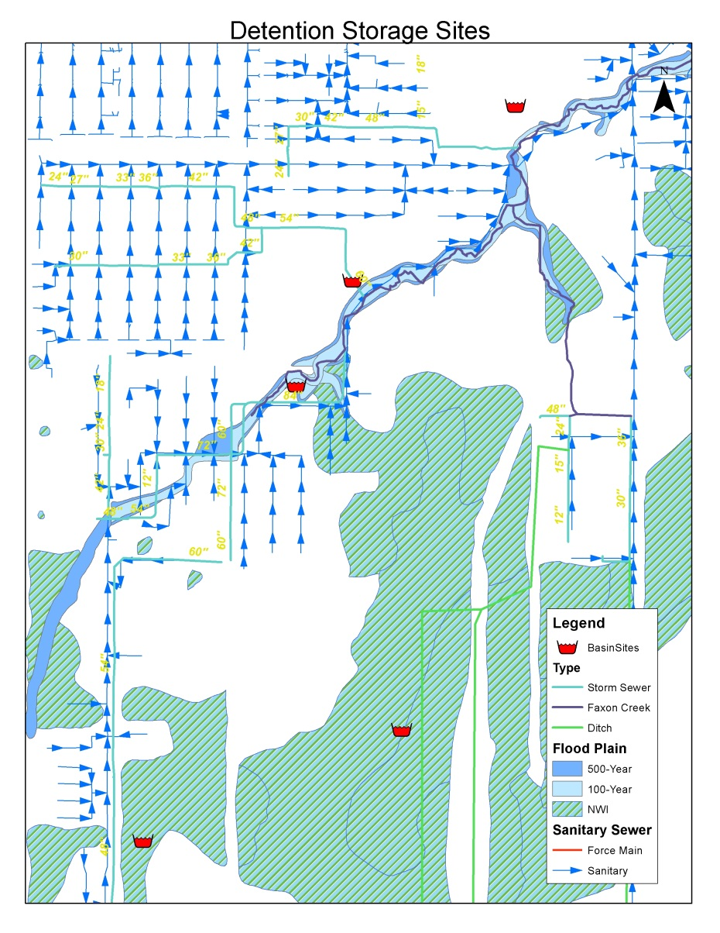
Detention Sites

Slide 35
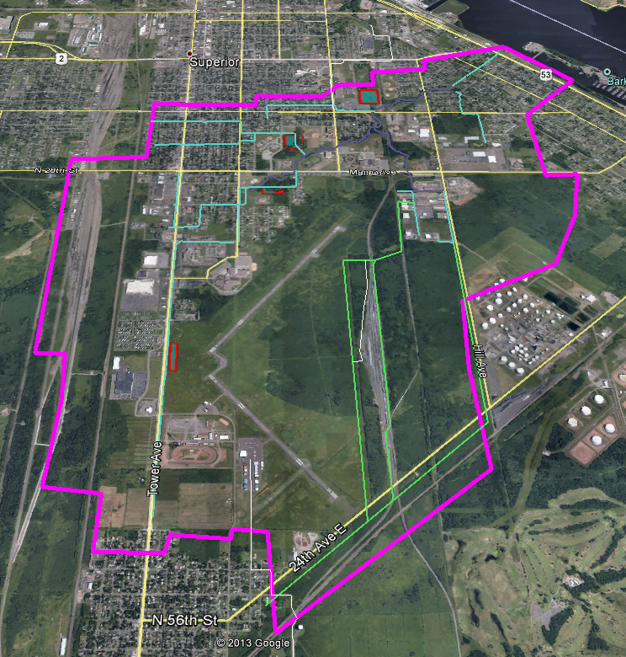
Detention Sites

Slide 36
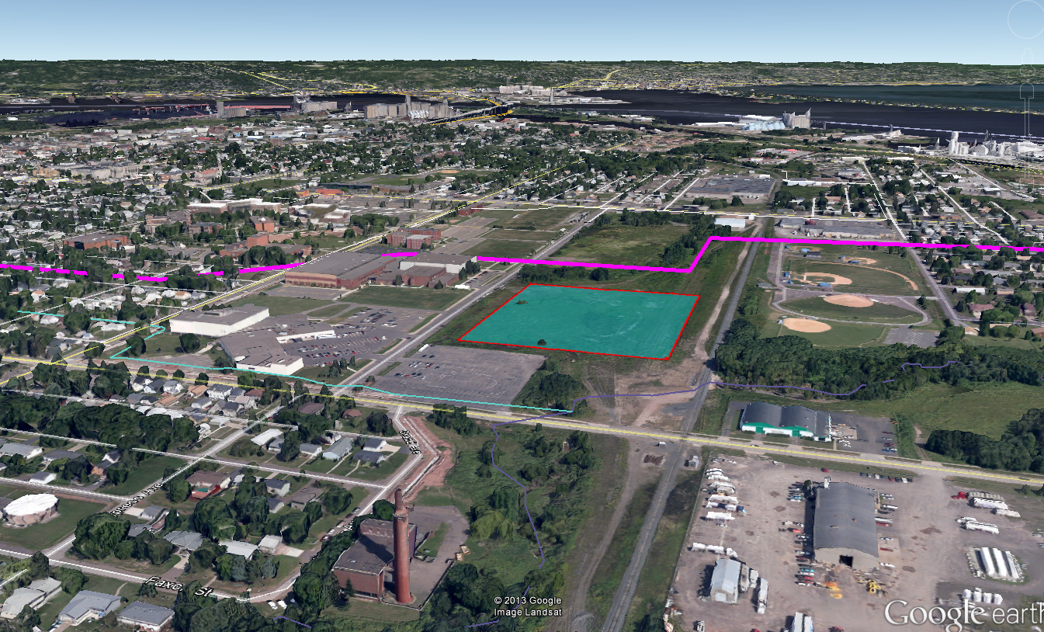
Detention Site #1

Slide 37
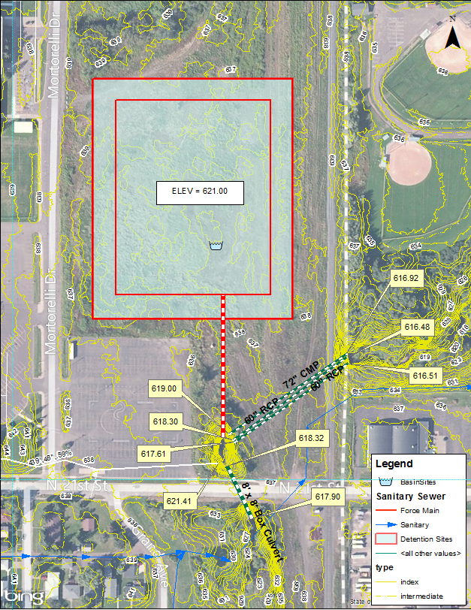
Detention Site #1
25-50 MG
Owned by Soo Line Railroad
Could accept flow from UW
Potential brownfield site

Slide 38
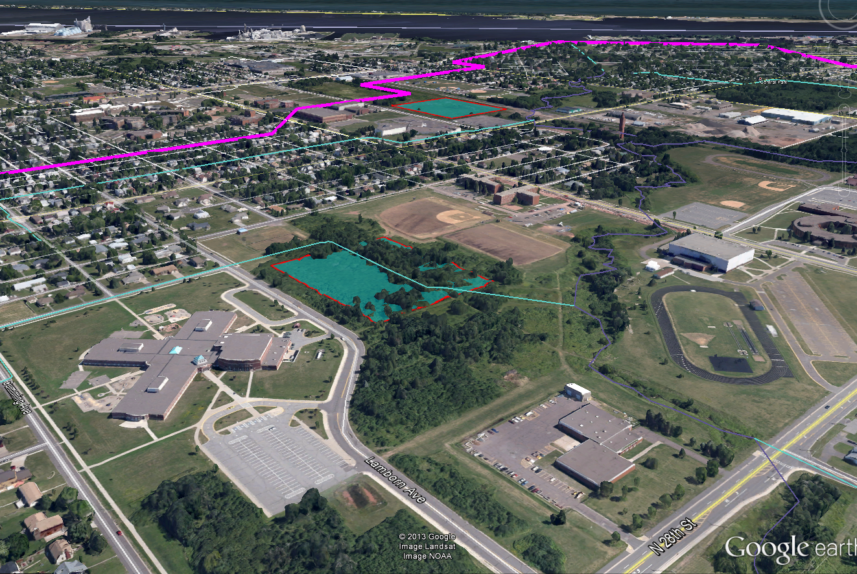
Detention Site #2

Slide 39
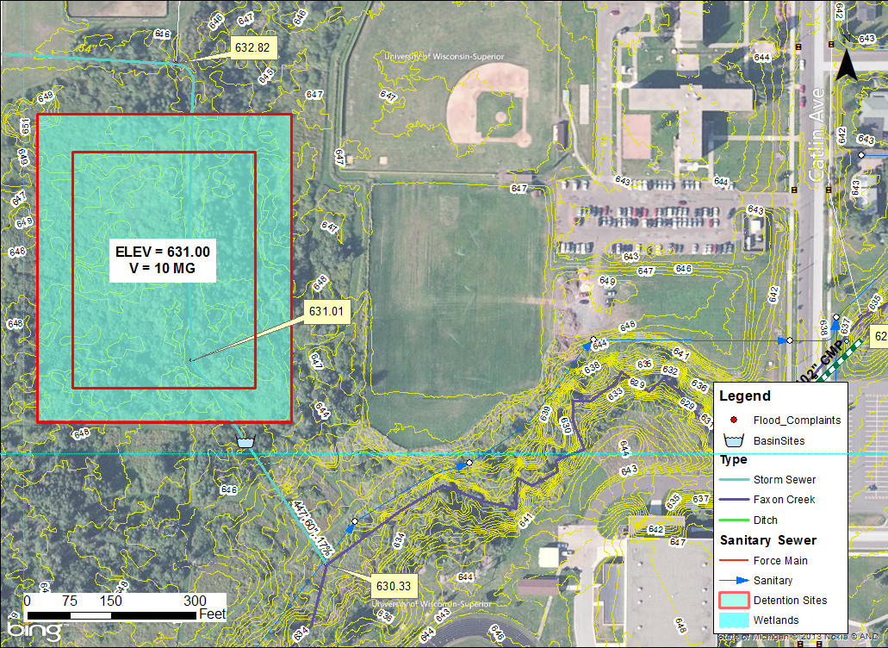
Detention Site #2
6-10 MG
Storm sewer on site
Owner?
Potential skating rink

Slide 40
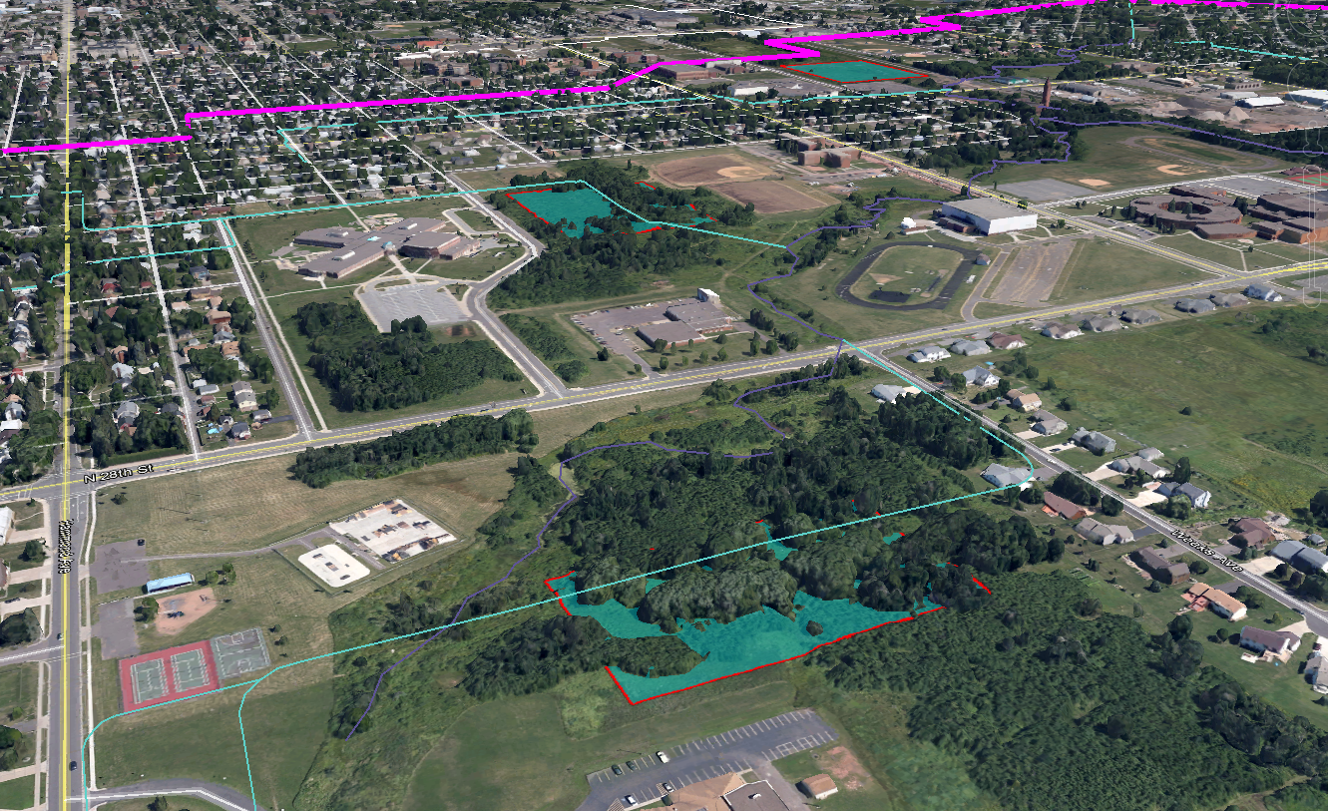
Detention Site #3

Slide 41
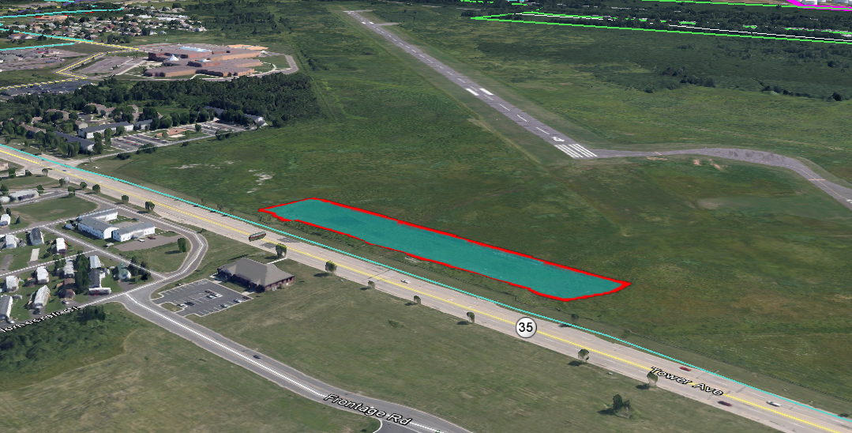
Detention Site #4

Slide 42
Next Steps
Complete alternative analysis
Optimize basin sizes
Release rates
Inlet/outlet structures
Cost estimates
SLAMM Modeling
Updated flood plain boundaries
Best Management Practices

Slide 43
Questions?

