Slide 1
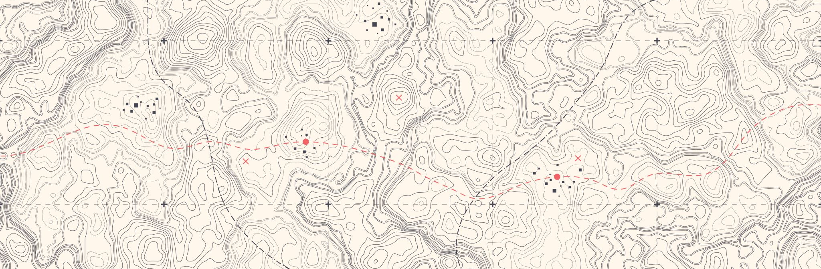
Douglas County Web Mapping - Beacon -
Jon Fiskness
Nick Lundgren

Slide 2
Table of contents
3 – Base Features/Search Functions
4 – Layers
7 – Select-ability
10 – Reports
13 – Surveys
15 – Toolbar
16 – Drawing Tools
22 – Spatial Buffer Tool
25 – Print Map
28 – Download Map
29 – Oblique Imagery
30 – Other Tools
34 - Bookmark

Slide 3
Basic features
Search
Name, Property Address, and Parcel Number
Advanced Search
Parcel range, Address, Municipality, TRS, Qtr. And Qtr. Qtr., Legals, Lot, Block, Acre range, Land Value range, Improvement Value range, Total Value range, and Fair Market Value range.
Autofill
All searches will autofill according to what is being typed
Ex. “Joh” will return John, Johnson, Johanson, etc.
Ex. “123” will return Main St, 1st St, 2nd St, etc.

Slide 4
Basic features: Map
Base layers
Addresses, roads, Lakes, Rivers and streams, cities, villages, towns, etc.
Other Layer Groups
Old Annotations, Survey Layers, Land Use, Land Conservation, Utilities, Political, Recreation, Hunting, Elevation, Imagery, ESRI basemaps
Legend tab displays how each layer is symbolized

Slide 5
Visibility
Some layers don’t appear until zoomed into a certain extent.
Check mark will turn fully black if the layer is visible immediately. Otherwise, the check marks is dull grey.
“Rivers and Streams” and “Cities” are currently visible on the map.
“Parcels” and “Parcel Numbers” are not visible

Slide 6
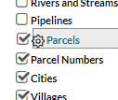
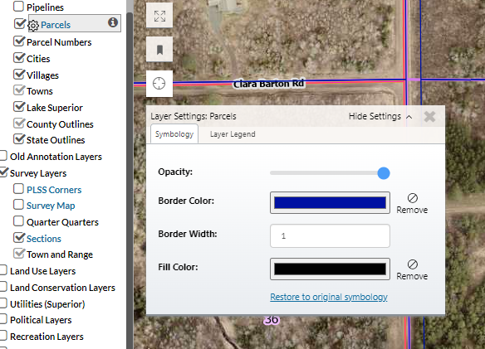
Symbology settings
Editable symbology
Customize the color scheme to
what works best for you
Saves after leaving the site

Slide 7
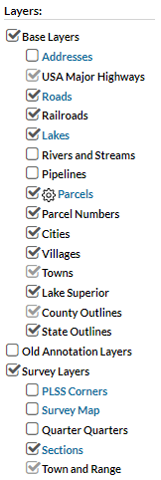
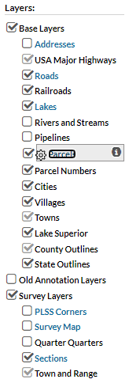
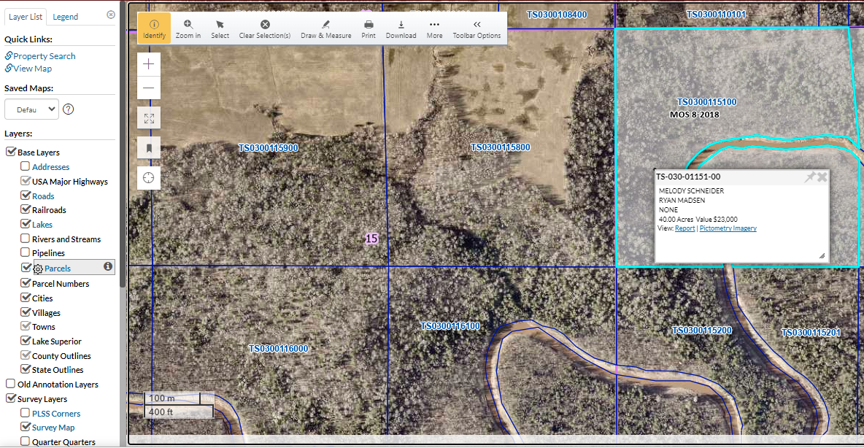
layers
Selectable Layers
Appear in blue font
Grey background when activated
Only one activated layer at a time
Notes:
- Selected layers allow you to selected the features in that layer on the map
- Returns information in that layer when selected on the map
- Parcels is selected, the parcel selected is highlighted, info of the parcel is displayed

Slide 8
Selectable layers
Selected layers allow you to selected the features in that layer on the map
Returns information in that layer when selected on the map
Parcels is selected, the parcel selected is highlighted, info of the parcel is displayed

Slide 9
New layer is activated, new info is displayed when selected.

Slide 10
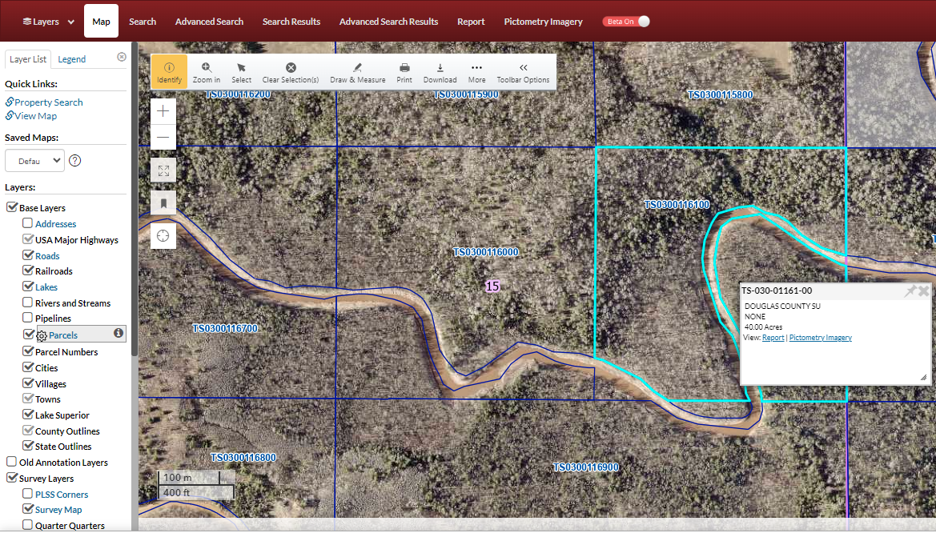
report
Returns information about the parcel (specific to parcels)

Slide 11
Report returns Owner info, Valuations, Tax History, Tax Payments, Sales, and Tax data
Share
Use the print button to print the report
Send report as an email
Arrows move to the parcel before/after numerically
Return to the map view
Edit the columns that appear in each table
Collapsing portions of the page will exclude it from being printed

Slide 12
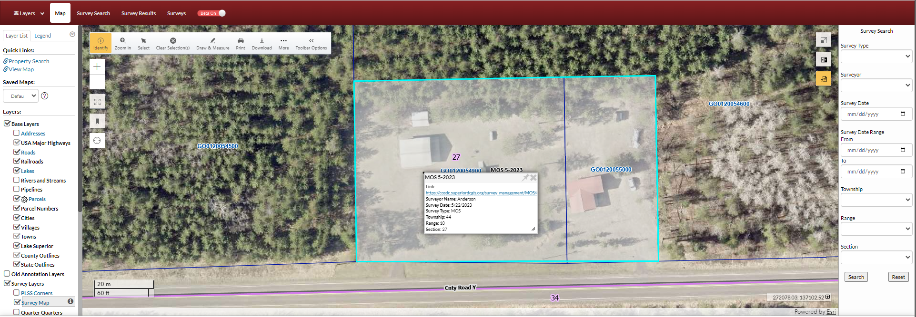
Different active layers have different tab options.
The survey tab at the top will give you the same info as the white pop-up box with the link, and a little more.
Both will have links to the pdf of the survey.

Slide 13
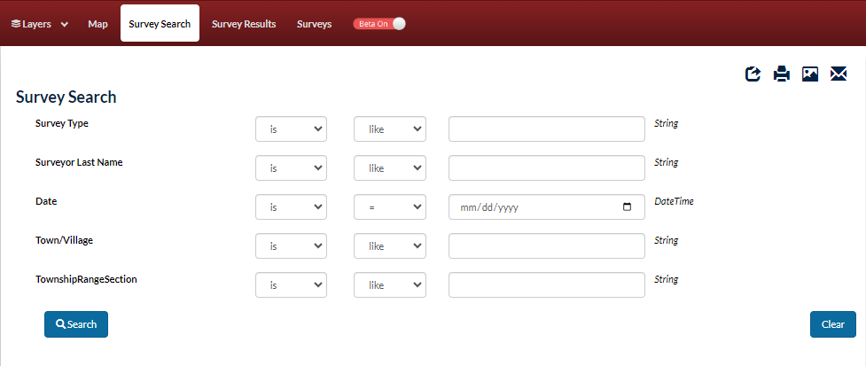
surveys
Search
Multiple ways to search
‘Survey type’ options
Certified Survey Map (CSM), Map of Survey (MOS), Alta, SP, PLAT

Slide 14
Csm and mos
MOS will have links to pdfs that are available to the public
CSMs will link to Landshark where the public can create an account and purchase a copy of the CSM. Copies are also available at the Register of Deeds office for purchase.
Register of Deeds address:
Courthouse Building
1313 Belknap St
Room 108
Superior, WI 54880

Slide 15
Toolbar

Slide 16
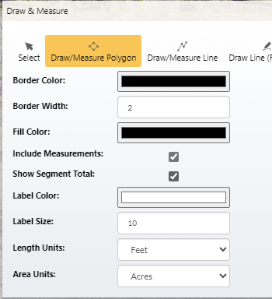
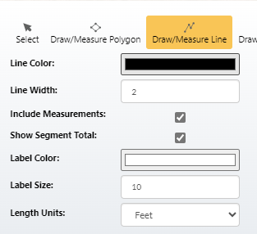
Draw and measure
Draw/Measure
Add measurements
Change units, color, labels

Slide 17
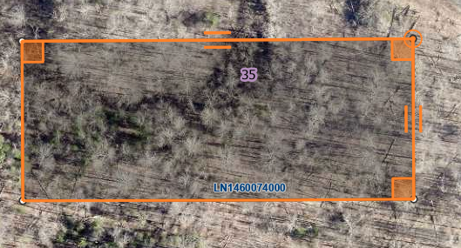
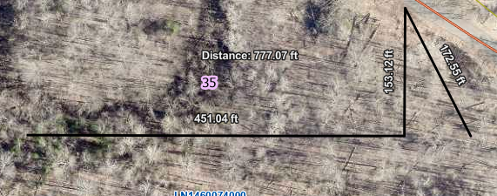
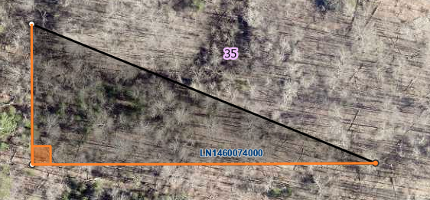
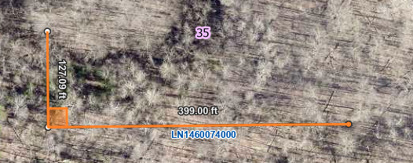
Draw/measure polygon
Draw/measure line
*when creating a polygon or line, you do not need to hold the click to drag to each spot. Simply click at each corner. Double click the last corner when the polygon/line is complete.

Slide 18
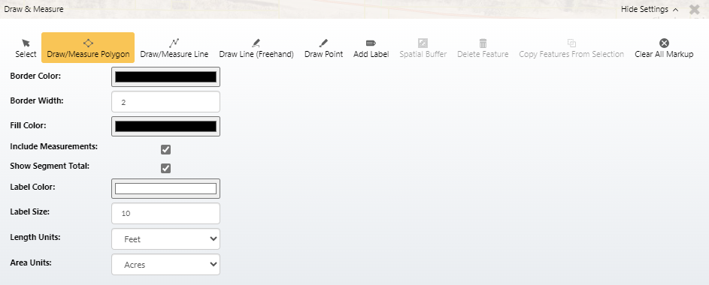
drawing
Double click to close a polygon OR end a line segment.
“Clear All Markup” will remove all polygons, lines, points that were added to the map.

Slide 19
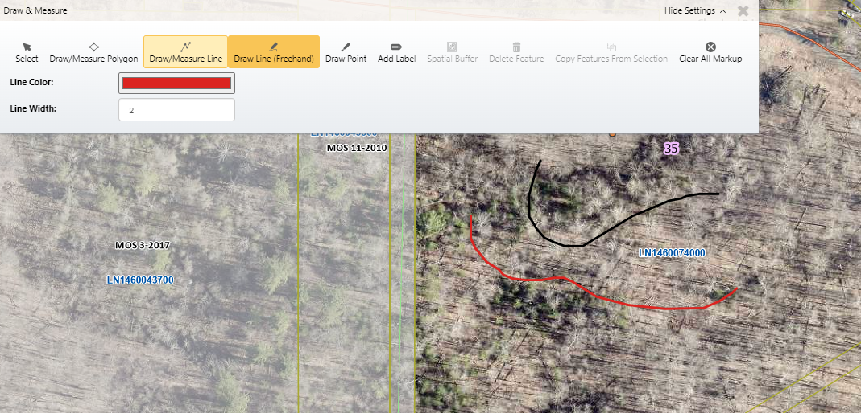
Draw Line (Freehand) lets you mark up the map with curved lines as you see fit.
The color and the line width can be changed.

Slide 20
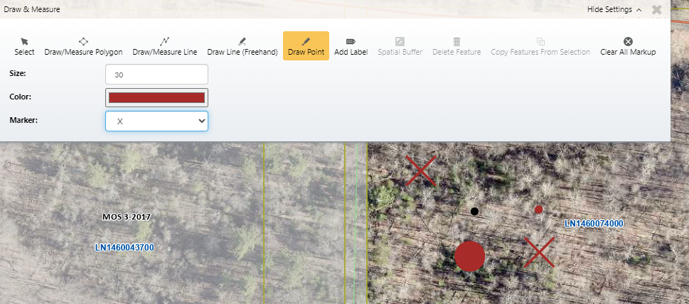
The draw point tools allow you to add points on the map for reference.
The size, color and symbol type can all be changed in the toolbar.

Slide 21
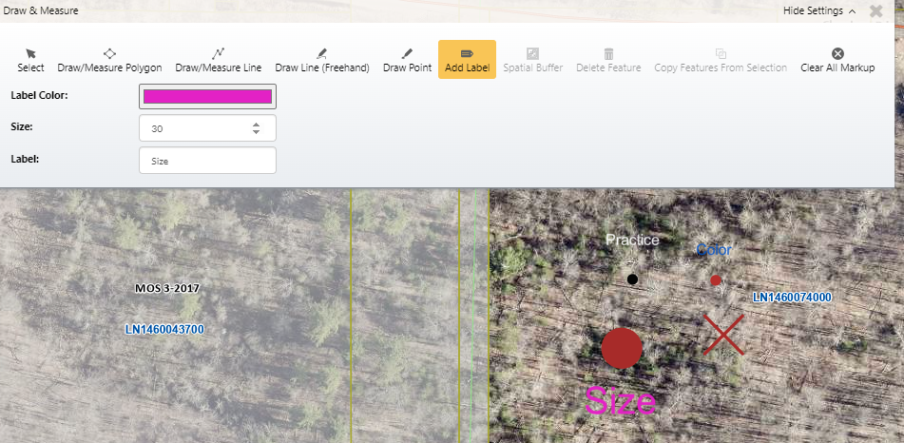
- The Add Label feature allows you to add labels to the map outside of what is provided in the layers
You can change the color and size of the labels
In the “Label” box, type what you would like your label to say.

Slide 22
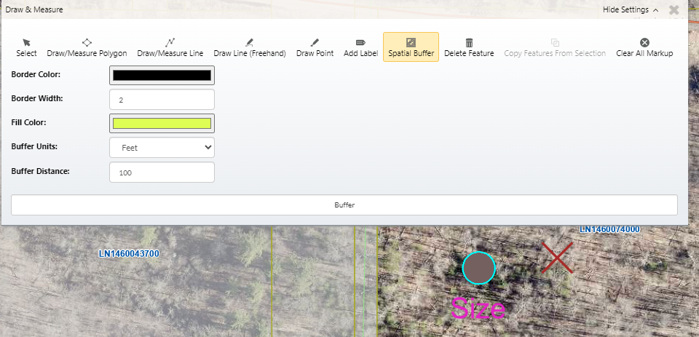
- The Spatial Buffer tool can be used to create buffers around drawn objects.
Once you have a point, line, polygon, etc. drawn, use the select tool to select the object you would like to buffer.
You can change the color, width, fill color, and size of your buffer
Once all the parameters you would like are selected, click “Buffer”
*Spatial Buffer tool only works on drawn objects, not on any of the provided layers.

Slide 23
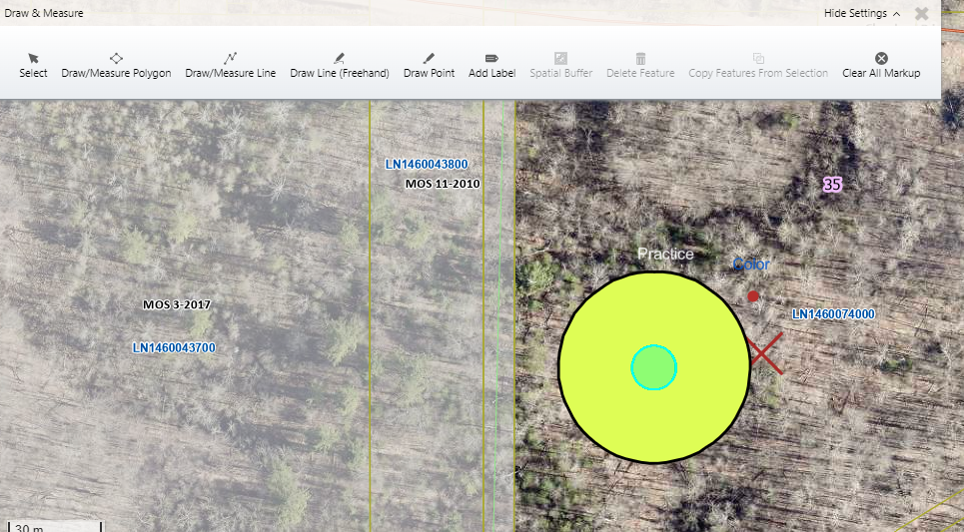
Result of a buffer on a point from previous slide

Slide 24
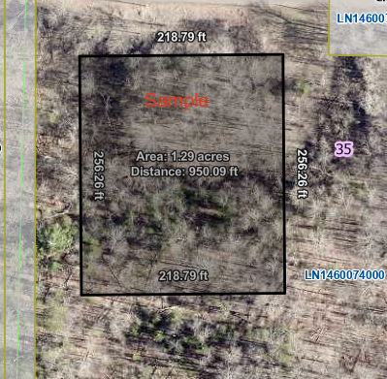
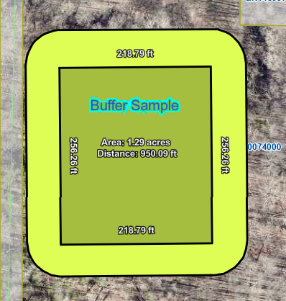
Spatial Buffer Example

Slide 25
print
The print function puts up a shaded area that shows you what will be included on the page when printed
You can click, drag, and zoom to change what will be added into the printed area.

Slide 26
print
There are details that can be changed what will be printed on the page
You can included/exclude any of the features shown in the red box above by checking/unchecking the boxes
To print, click “Download PDF” and a second window will open with the pdf displayed. Click the printer icon to print

Slide 27
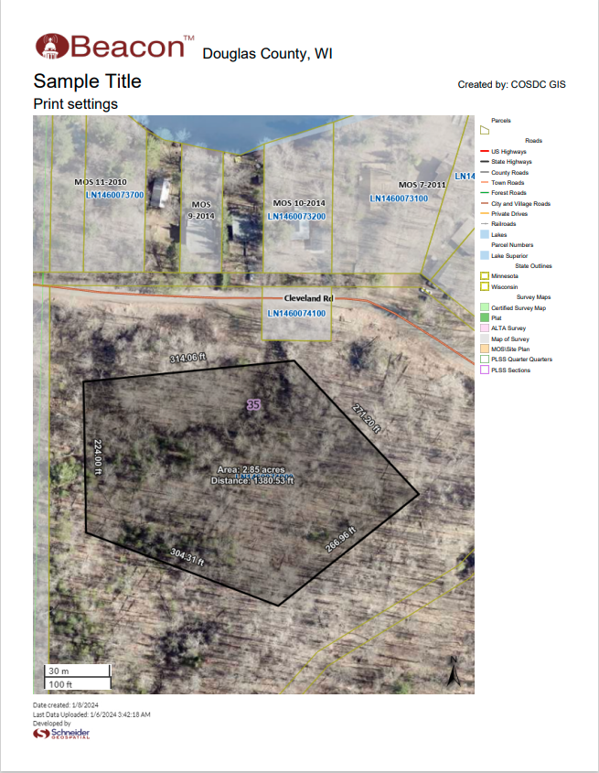
The different features that can be included or excluded from the previous Print options box
*If pop-ups are disables, printing will not function properly

Slide 28
download
Downloads a .jpg or .png of the screen extent of the map, nothing else.

Slide 29
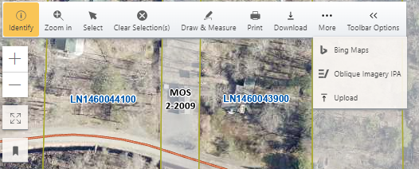
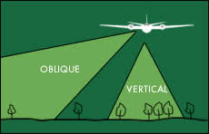
oblique
Under the “More” tool
View of property from different aerial angles (“obliques”)
Notes:
Photo: https://ncap.org.uk/feature/vertical-and-oblique-aerial-photography

Slide 30
Oblique imagery
Change oblique view direction
Change the date to filter when the photos were taken.
Zoom In/Out
- There will also be an option to zoom to ‘Neighborhood’ and ‘Community’ levels
Select different layer to show in the view.
Tools to identify with a point or a polygon.
Move to more angles of the parcel by using the arrows. The North arrow will indicate the angle of the photo.
Export image to a pdf.
Split screen to see two views at once.

Slide 31
Other tools
Zoom In/Out
Can also use the scroll wheel on the mouse
Full Screen
Full Extent
Zooms out to the full extent of Douglas County
Slider
Bookmarks
Find My Location

Slide 32
Imagery slider
Quickly view changes in imagery year vs year
Slider allows for quick comparison

Slide 33
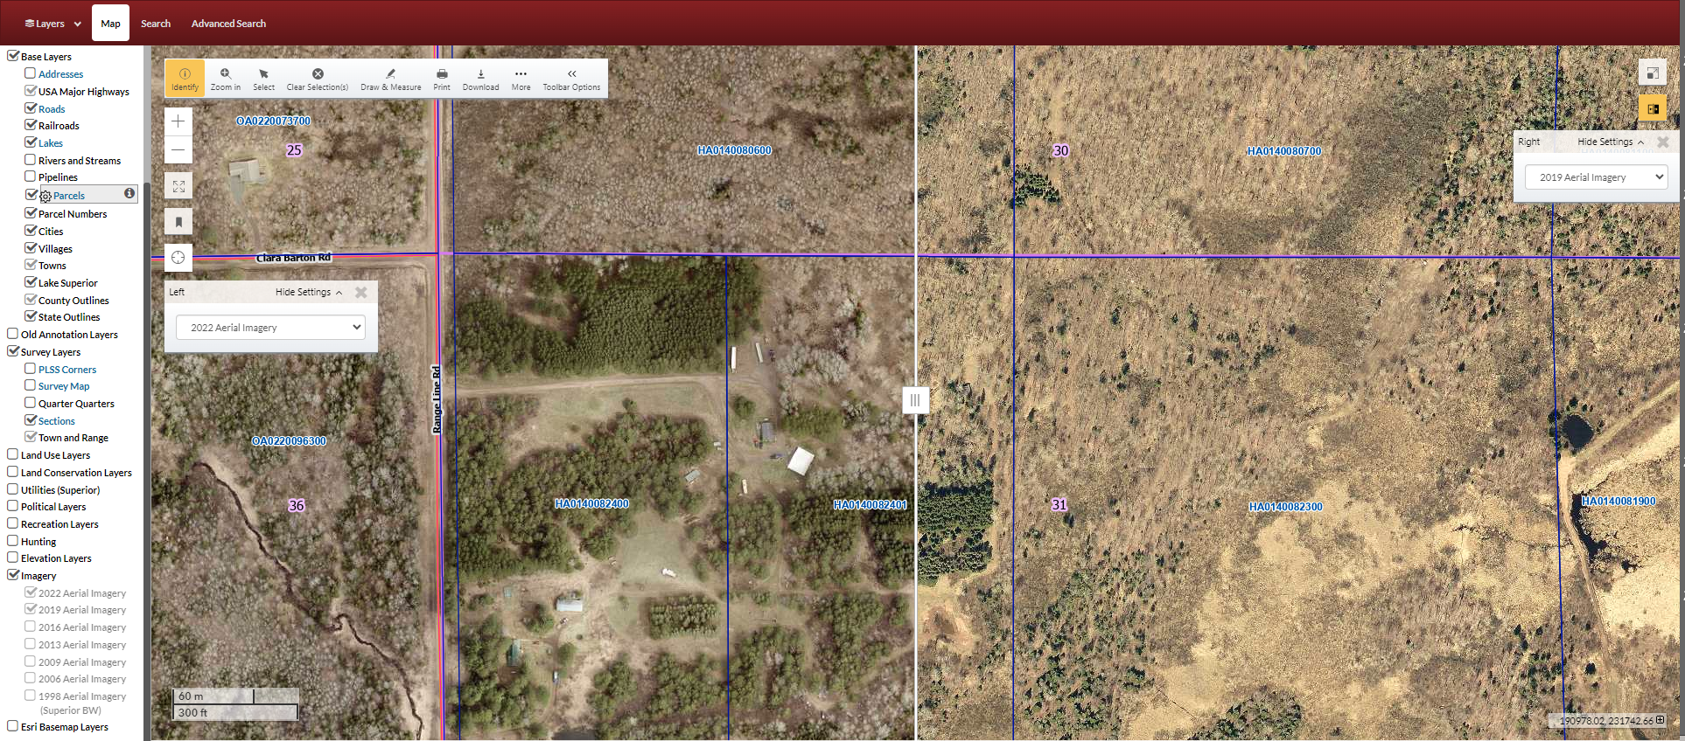

Slide 34
bookmarks
Add a name, saves the screen extent as the bookmark, click on the name of the bookmark to return to this view.
Bookmarks stay after closing the browser.

