Slide 1
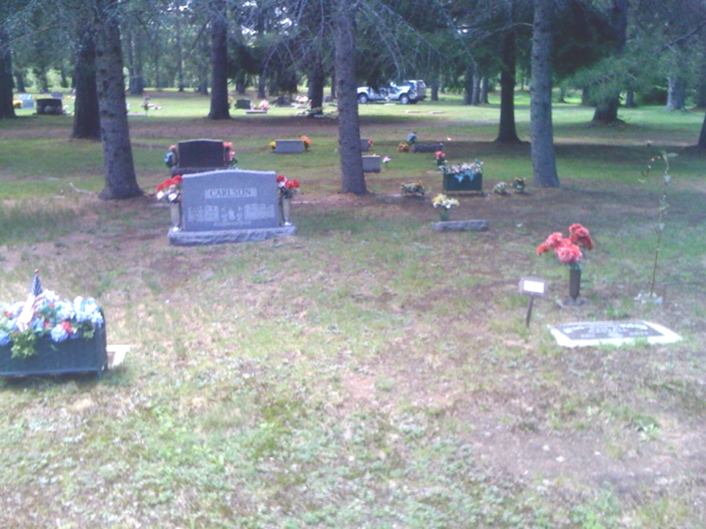


Douglas County Cemetery Modernization and Inventory
GIS Coordinator
Jon Fiskness
3/30/2011

Slide 2
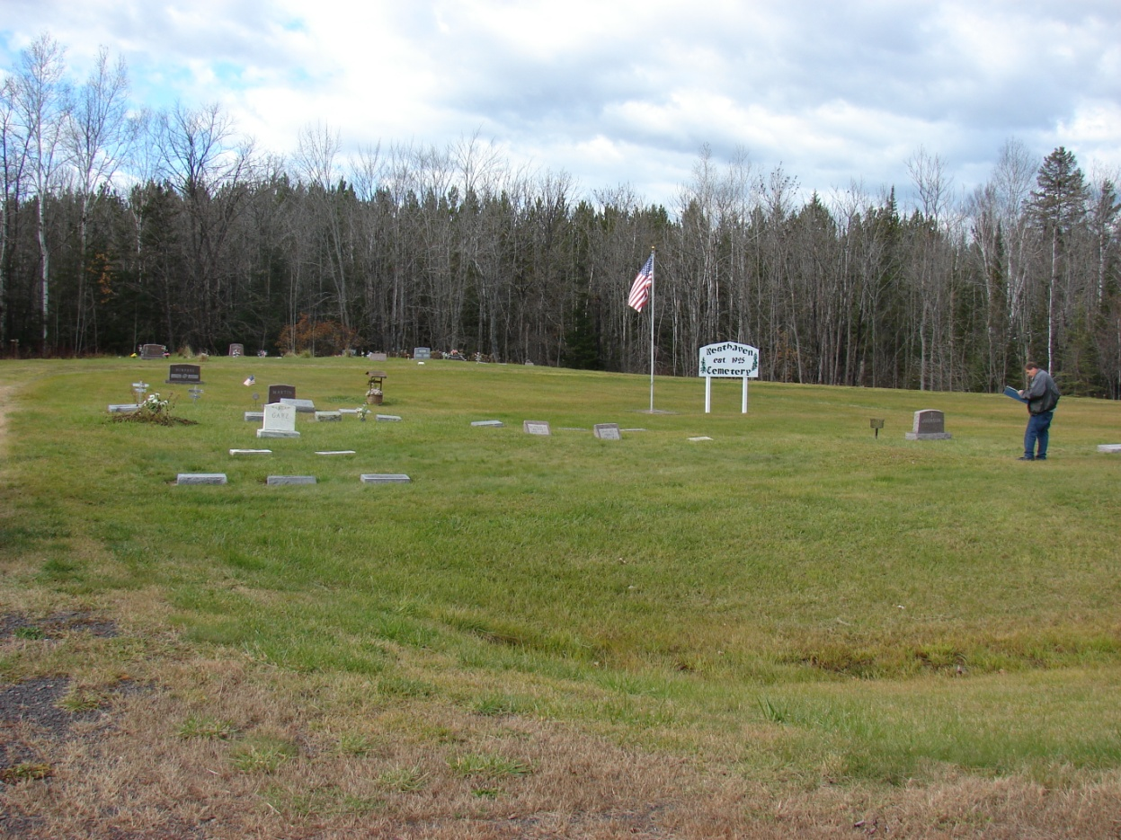
Staff Involvement
GIS staff
Jon Fiskness, Randy Jones & Ben Klitzke
GIS Interns
Charles Parent, Andrew Glusica & Brandon Christopherson
Veterans Services Staff
Ellen Oaks
Intern
IT Staff
John Kolstad
Medical Examiner
Darrell Witt

Slide 3
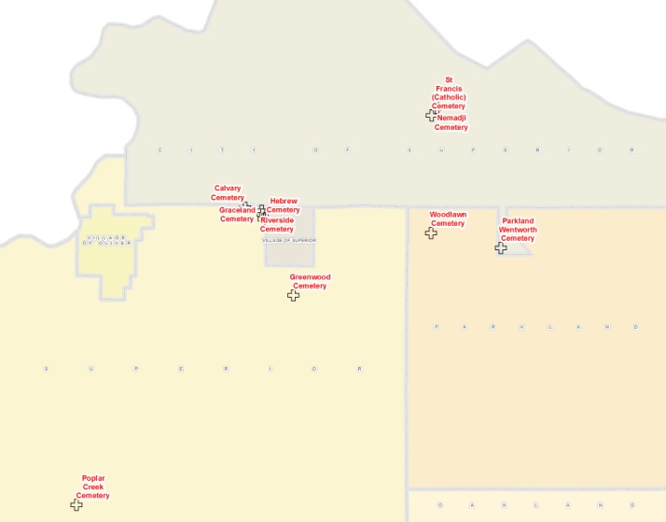
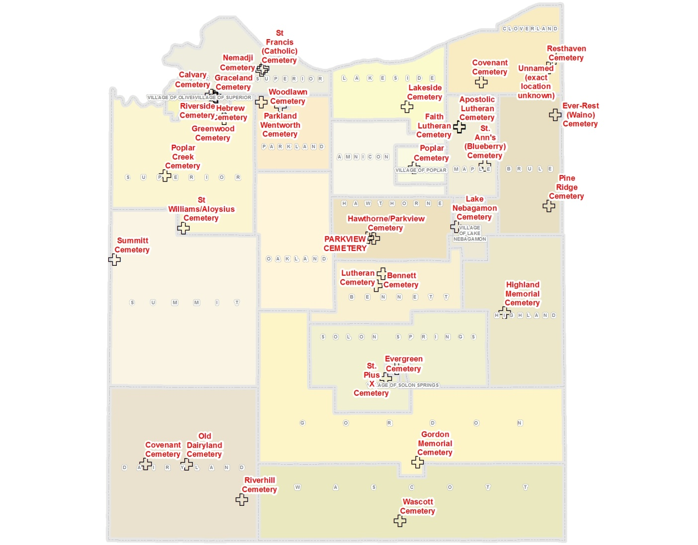
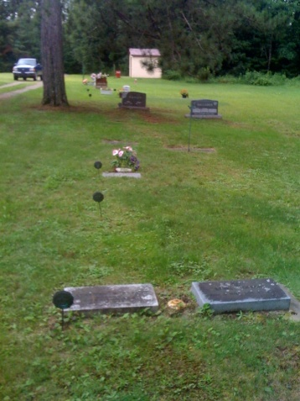
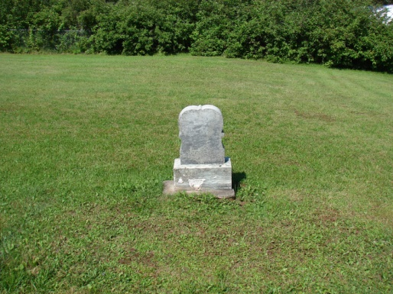
Cemeteries in Douglas County
36 Cemeteries
  3 “unlisted”
55,000+ Graves
Largest:
  Greenwood
  25,000+
Smallest
  Poplar Creek
  15
Military Veteran’s
  5500+

Slide 4
Douglas County Cemetery Data
Cemetery_Name | Number | Township | Owner
Apostolic Lutheran Cemetery | 40+ | Maple | Finnish Apostolic Lutheran Church
Bennett Cemetery | 250 | Bennett | Town of Bennett
Calvary Cemetery | 11000 | South Superior | Calvary Cemetery
Covenant Cemetery | 50 | Dairyland | Town of Dairyland
Covenant Cemetery | 50 | Cloverland | Cloverland Mission Covenant Church
Evergreen Cemetery | 1076 | Solon Springs | Town of Solon Springs
Ever-Rest (Waino) Cemetery | 400 | Brule | Cemetery Grounds
Faith Lutheran Cemetery | 290 | Maple | Faith Lutheran Church
Gordon Memorial Cemetery | 1000 | Gordon | Town of Gordon
Graceland Cemetery | 4000 | South Superior | Graceland Cemetery
Greenwood Cemetery | 25000 | South Superior | Greenwood Cemetery
Hawthorne/Parkview Cemetery | 500 | Hawthorne | Town of Hawthorne
Hebrew Cemetery | 800 | South Superior | Hebrew Cemetery
Highland Memorial Cemetery | 132 | Highland | Town of Highland
Lake Nebagamon Cemetery | 1300 | Lake Nebagamon | Village of Lake Nebagamon
Lakeside Cemetery | 400 | Lakeside | Lakeside Cemetery
Lutheran Cemetery | 90 | Bennett | Town of Bennett
Nemadji Cemetery | 1100 | East Superior | St Francis X Catholic Cong
Old Dairyland Cemetery | 80 | Dairyland | Town of Dairyland
Parkland Wentworth Cemetery | 300 | Parkland | Douglas County
PARKVIEW CEMETERY | 300 | Hawthorne | Town of Hawthorne
Pine Ridge Cemetery | 220 | Brule | Brule Cemetery Ground
Poplar Cemetery | 900 | Poplar | Lutheran Church Cemetery
Poplar Creek Cemetery | 15 | Town of Superior | Poplar Creek Cemetery
Resthaven Cemetery | 110 | Cloverland | Rest Haven Cemetery
Riverhill Cemetery | 160 | Dairyland | Town of Dairyland
Riverside Cemetery | 3000 | South Superior | Riverside Cemetery
St Francis (Catholic) Cemetery | 3300 | East Superior | St Francis X Catholic Cong
St Williams/Aloysius Cemetery | 60 | Foxboro | St Williams Catholic Church
St. Ann's (Blueberry) Cemetery | 135 | Maple | Mears Trust
St. Pius X Cemetery | 300 | Solon Springs | St Pius Catholic Church
Summitt Cemetery | 500 | Foxboro | Town of Summit
Wascott Cemetery | 330 | Wascott | Town of Wascott
Woodlawn Cemetery | 320 | Parkland | Parkland Cemetery

Slide 5
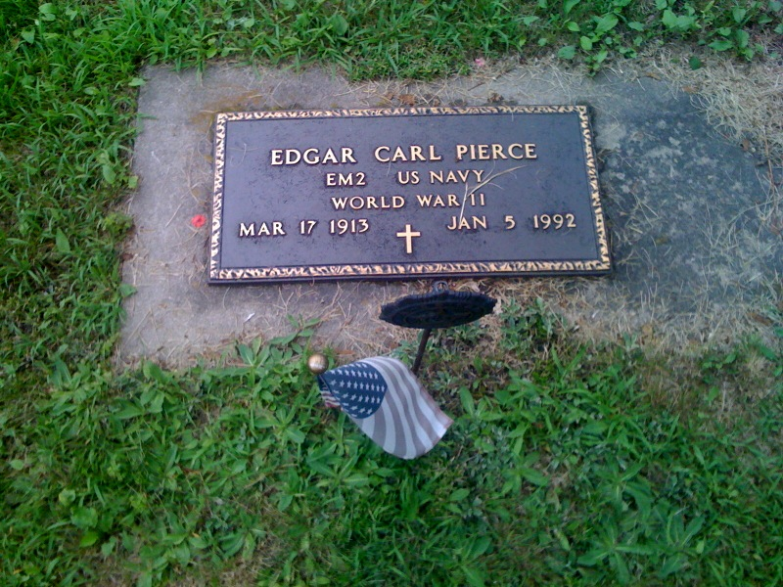
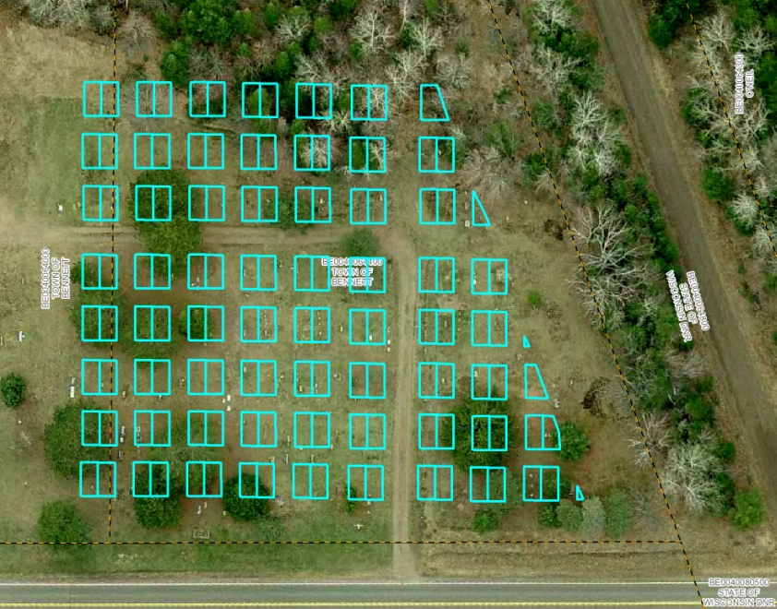
Reasons for Douglas County Interest
Veteran’s Service Office – Need for accurate veteran’s data
Land Records/GIS – Interest in accurate mapping of cemeteries and inventorying
Douglas County Medical Examiner – Public Calls and Research

Slide 6
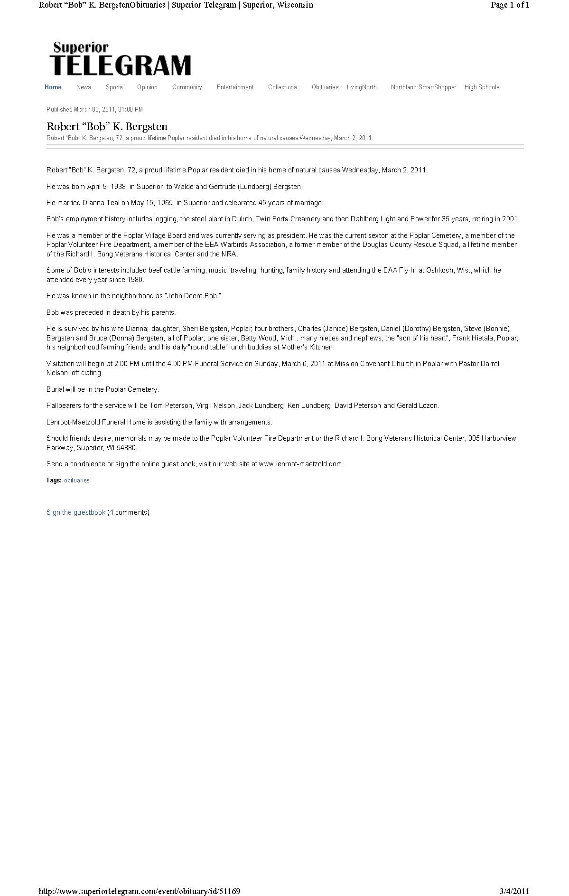
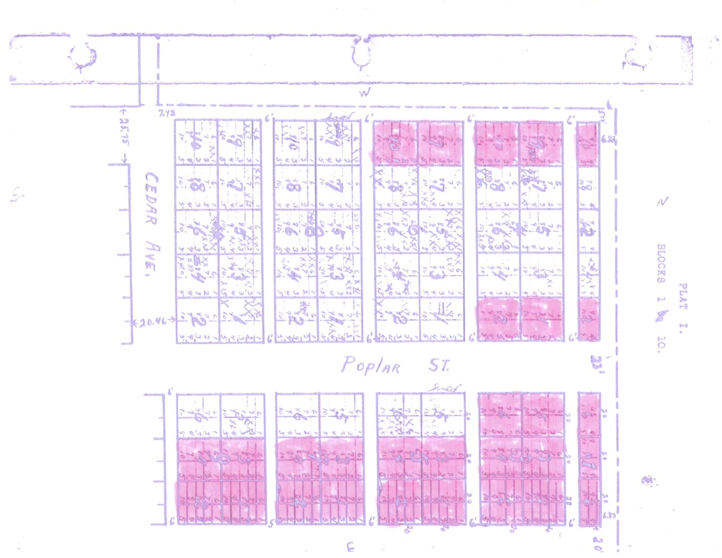
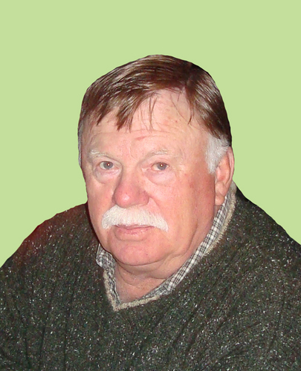
Bob Bergsten

Slide 7

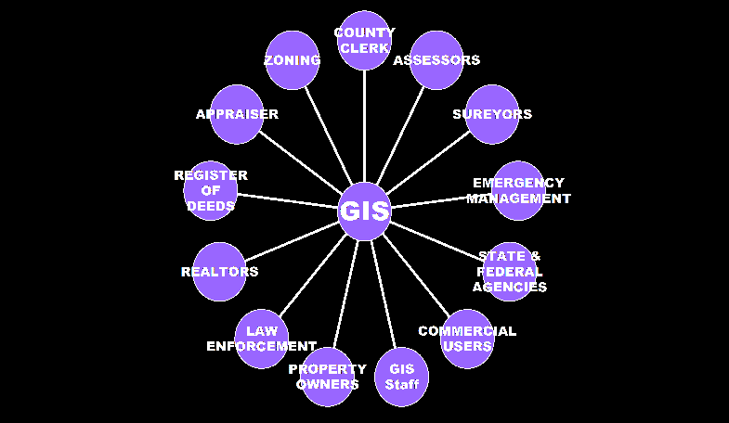
What is GIS?
Geographic Information Systems (GIS) - An integrated collection of computer software and data used to view and manage information about geographic places, analyze spatial relationships, and model spatial processes. A GIS provides a framework for gathering and organizing spatial data and related information so that it can be displayed and analyzed.
GIS is more than just maps, it is:
Data
Hardware
Software
People
Methods
GIS brings City/County Departments, the
private sector and public users together.

Slide 8
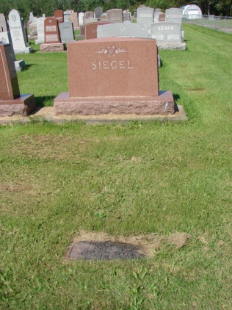
Mapping Process
Collection of mapping source data
  Recorded Plats, cemetery maps, veteran’s maps, aerial photography
Accurate creation of GIS based cemetery maps from source data and survey control for grave/plot level identification
  Each uniquely identified
Collection/Inventory of cemetery names
  Sexton Data
  Judith Mooney Lindgren (JML) – Douglas County Headstone Data
  Douglas County Veteran’s List

Slide 9
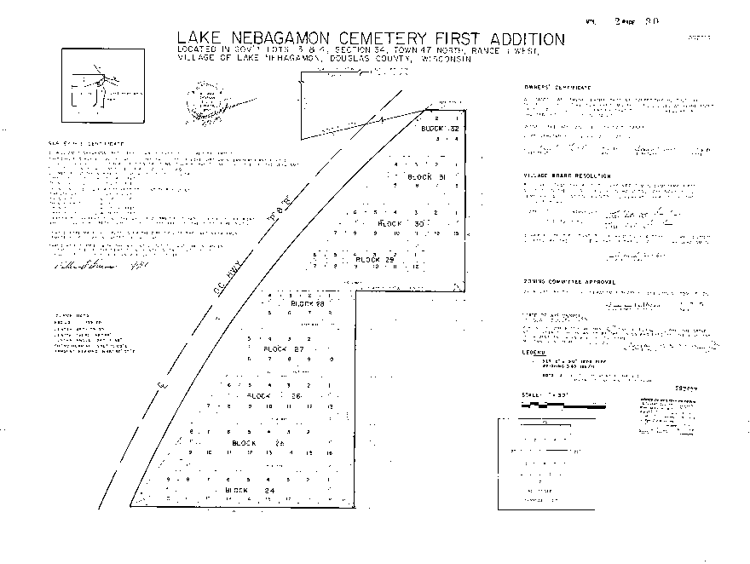
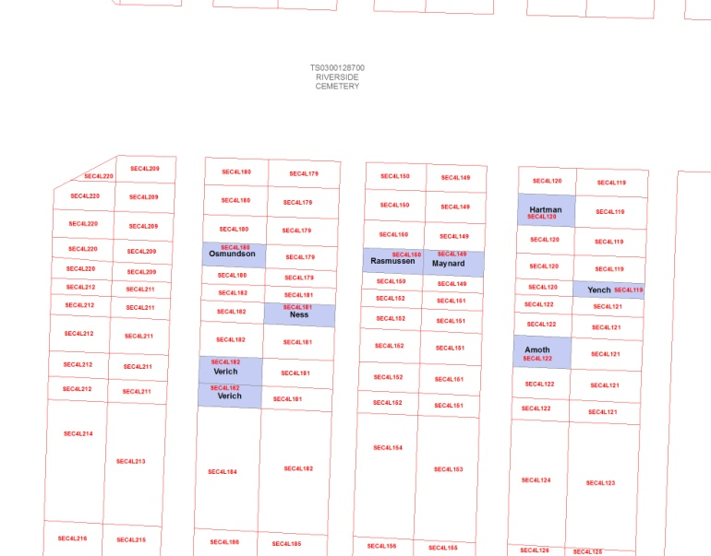
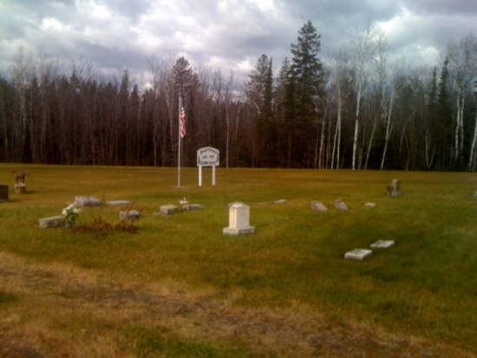
Mapping Process Cont.
  Walking survey of the cemeteries
  Linking sexton data to the correct location
  GPS Technologies for data collection and accuracy (control)
Verification of data

Slide 10
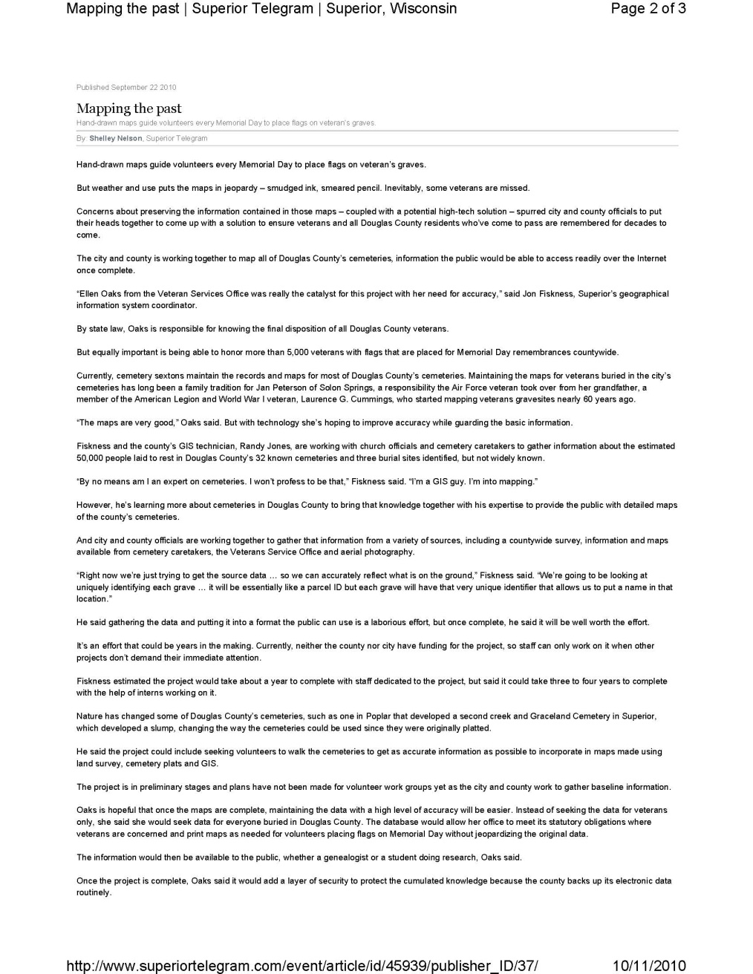
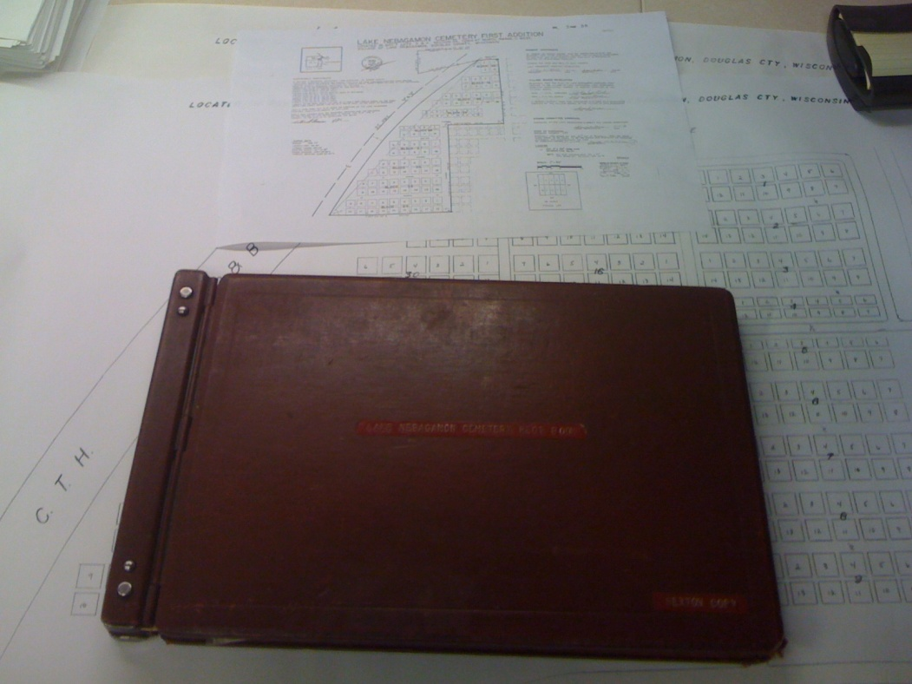
NEWS
Superior Daily Telegram, October 2010

Slide 11
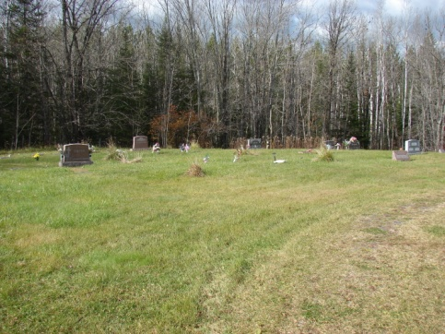
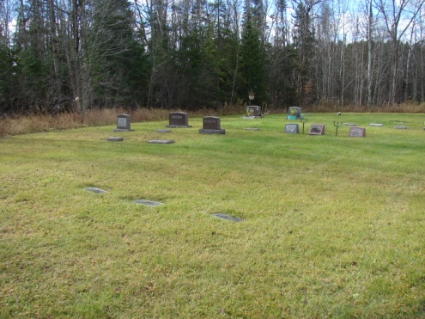
Cemetery Status Update
Christ Lutheran Memorial Garden: Inventoried
Covenant Dairyland Cemetery: Georeferenced, lots created
Hebrew Cemetery: Test cemetery, needs work on polygons and inventory
Highland: Completed
Summit: Lots Completed, but inventory not started. However, there is an issue when assigning unique identifiers. Calculation writes for double the number of polygons as is selected to be calculated. Other than that, it is a working model.
Greenwood: Not Georeferenced, no work completed
Lake Nebagamon: Georeferenced, Lots Created, Name Entered (unverified)
Lakeside Cemetery: Georeferenced and Lots Created
Parkview Cemetery: Georeferenced
Pine Ridge Cemetery: Georeferenced, lots created
Poplar Creek Cemetery: Georeferenced
  Polygons created
Rest Haven: Georeferenced
  Polygons (lots) created
  Some Names have been assigned (Not verified)
River Hill Cemetery: Georeferenced, lots uniquely IDed
Riverside Cemetery: Georeferenced, Some Polygons (graves) created with assigned names and values
    *Polygons only of actual burial sites
Graceland: Georeferenced
  Needs work on polygons
Woodlawn Cemetery: Georeferenced
  Needs work on polygon plots and Inventory
St. Ann’s Cemetery:
  Polygon work completed

Slide 12
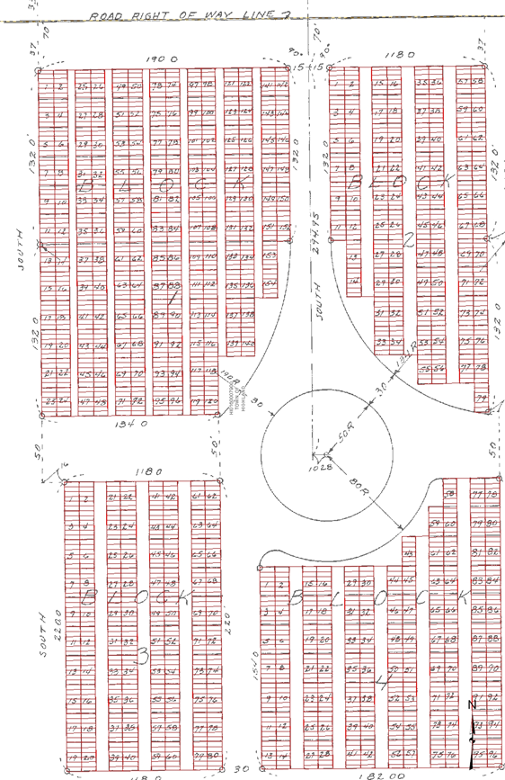
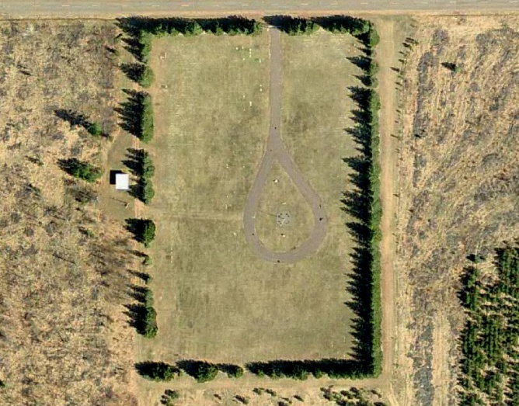
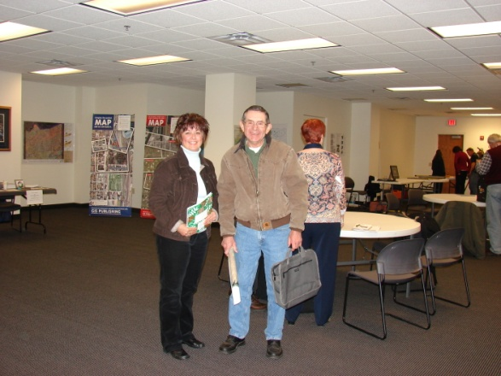
Highland Cemetery
Highland Cemetery
  Completed December 2010, the first one that was completed
  122 Entries
  Verified by Willard Kiefer
  Current
  Public showing at GIS Day 2010 in November

Slide 13
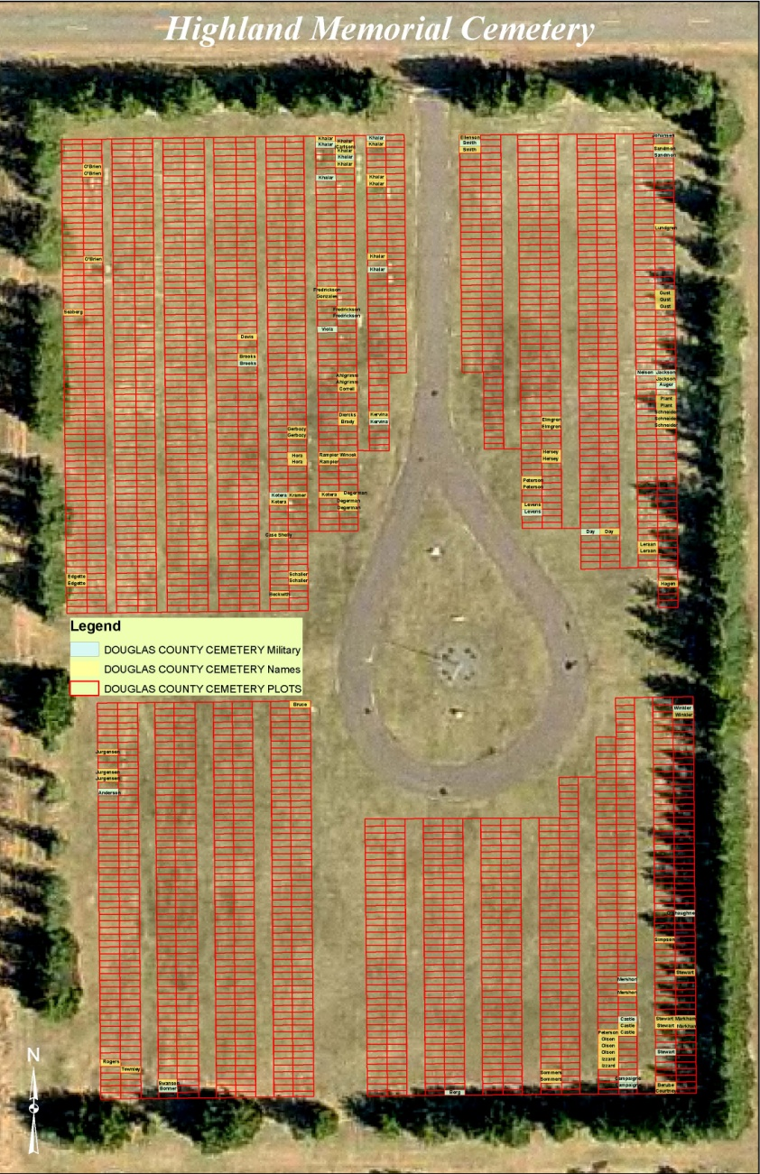
Highland Cemetery

Slide 14
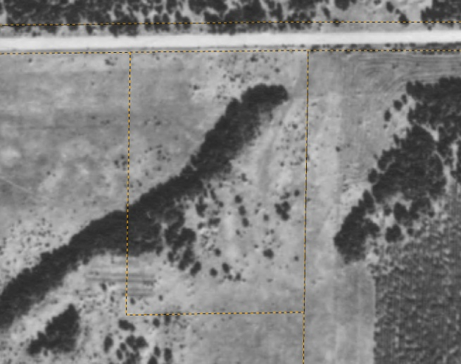
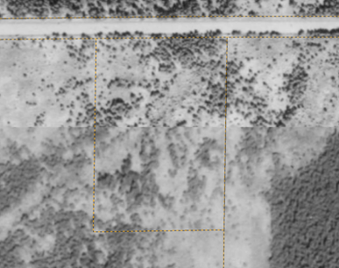
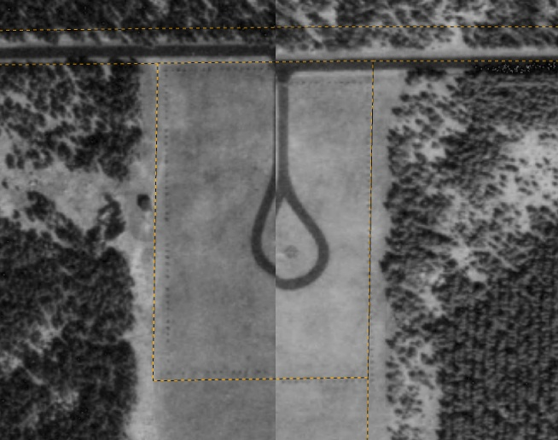
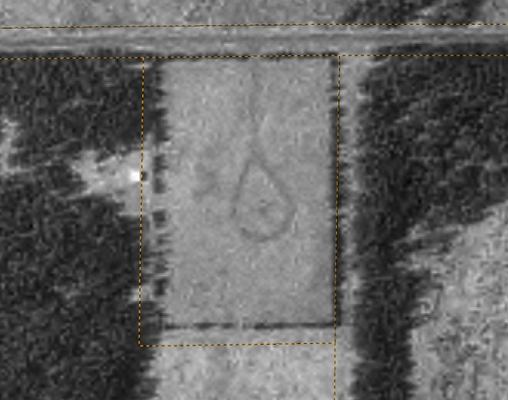
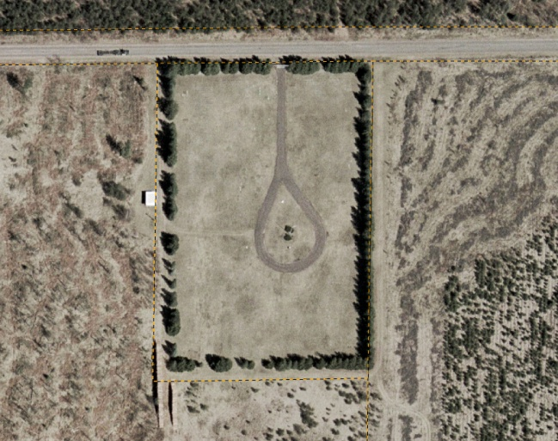
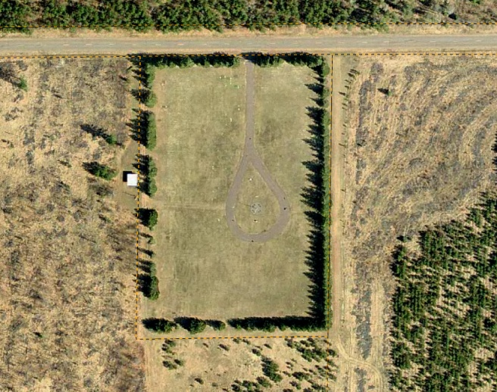
Highland Cemetery Aerials
1948
1973
1962
2006
2009
1992

Slide 15
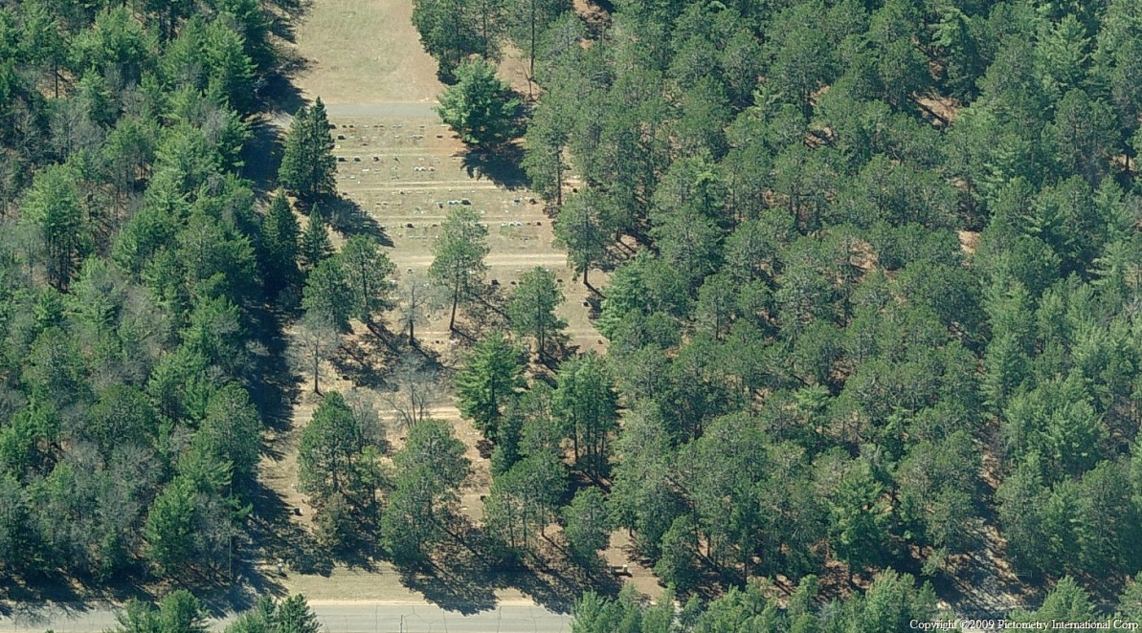
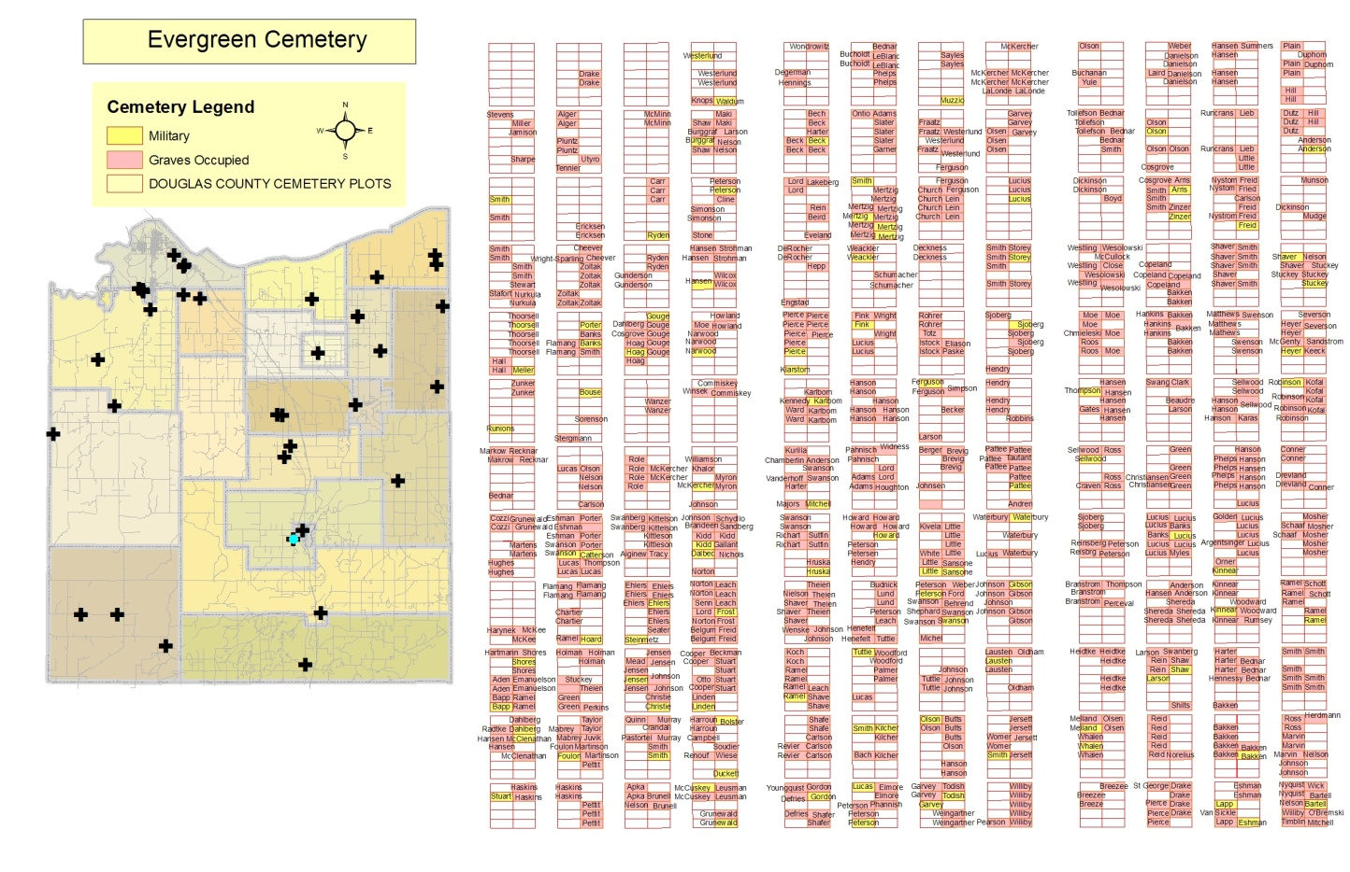
Evergreen Cemetery
Evergreen Cemetery (Solon Springs)
  Inventoried March 2011, 992 entries
  Unverified at this time

Slide 16
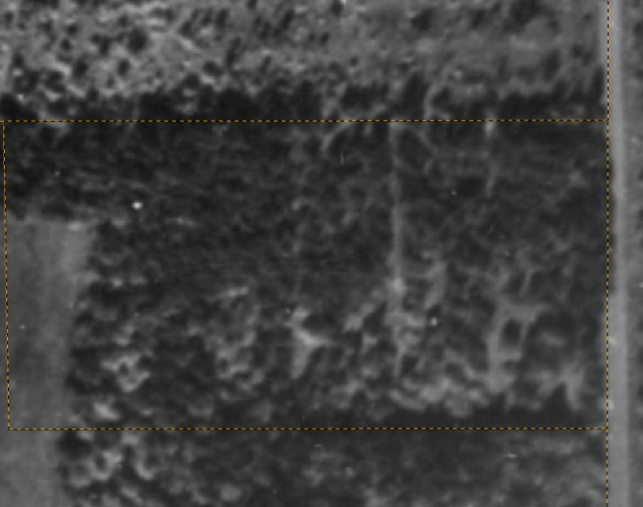
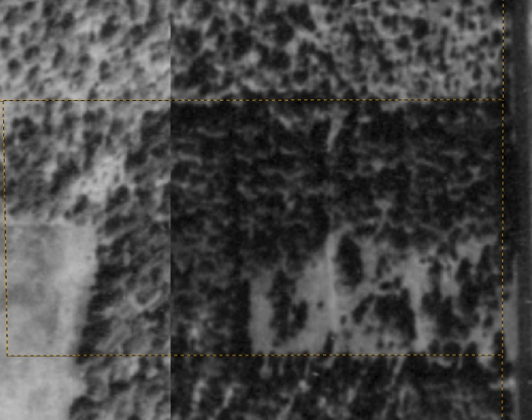
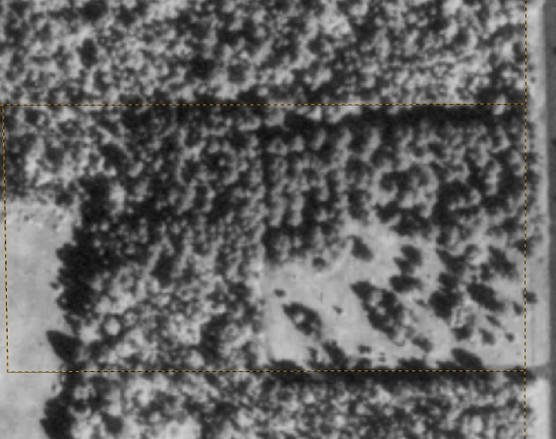
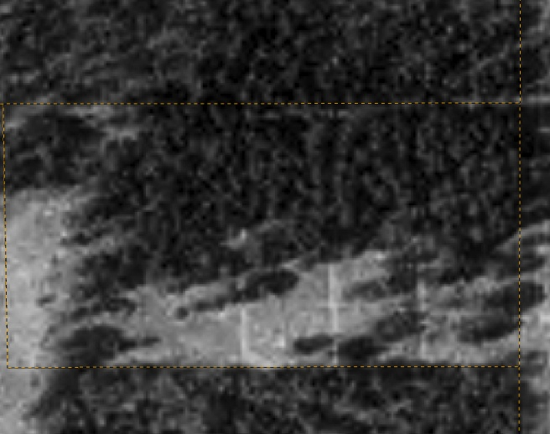
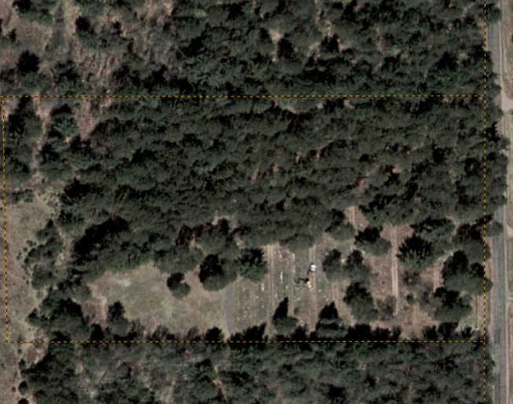
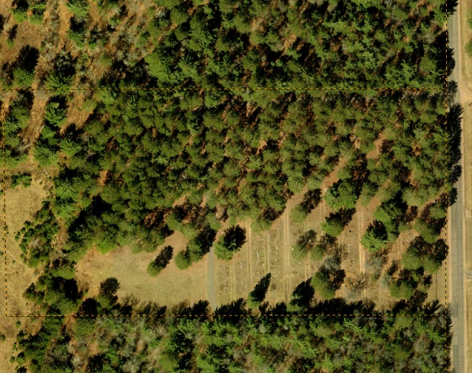
Evergreen Cemetery Aerials
1948
1962
1973
1992
2006
2009

Slide 17
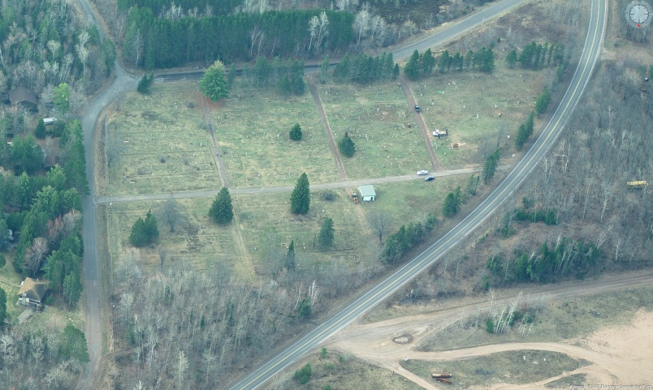
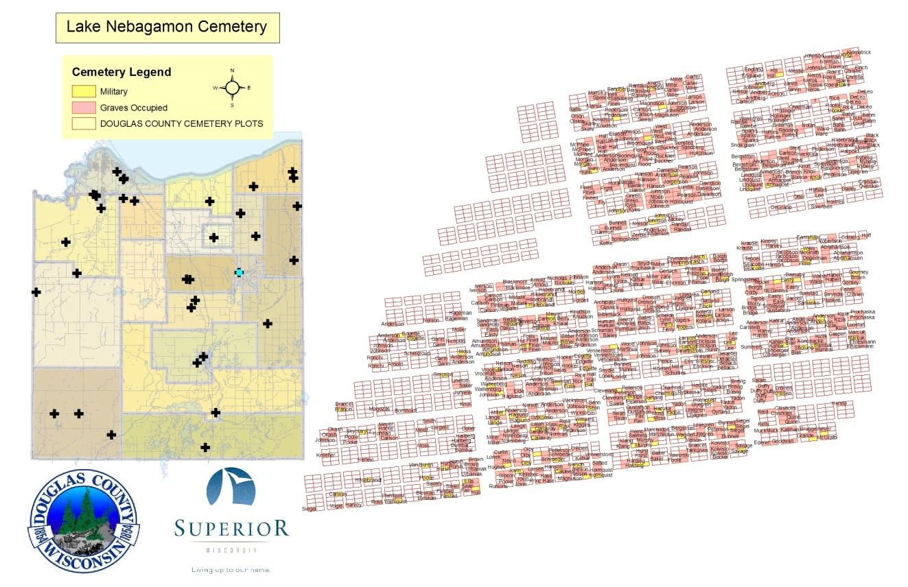
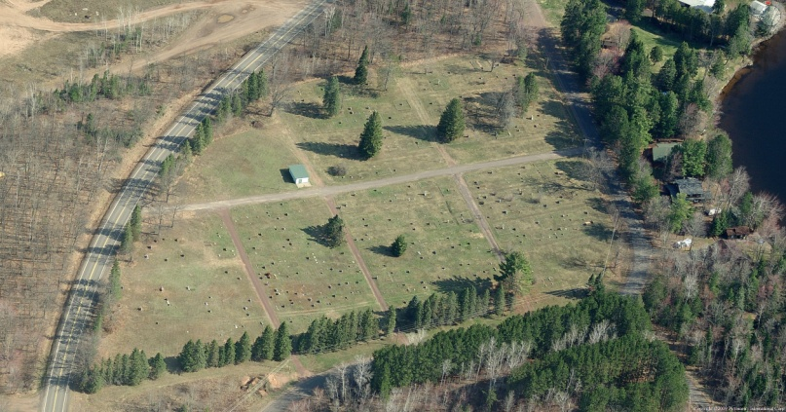
Lake Nebagamon Cemetery
Lake Nebagamon Cemetery
  February 2010, 1272 entries
  Unverified at this time

Slide 18
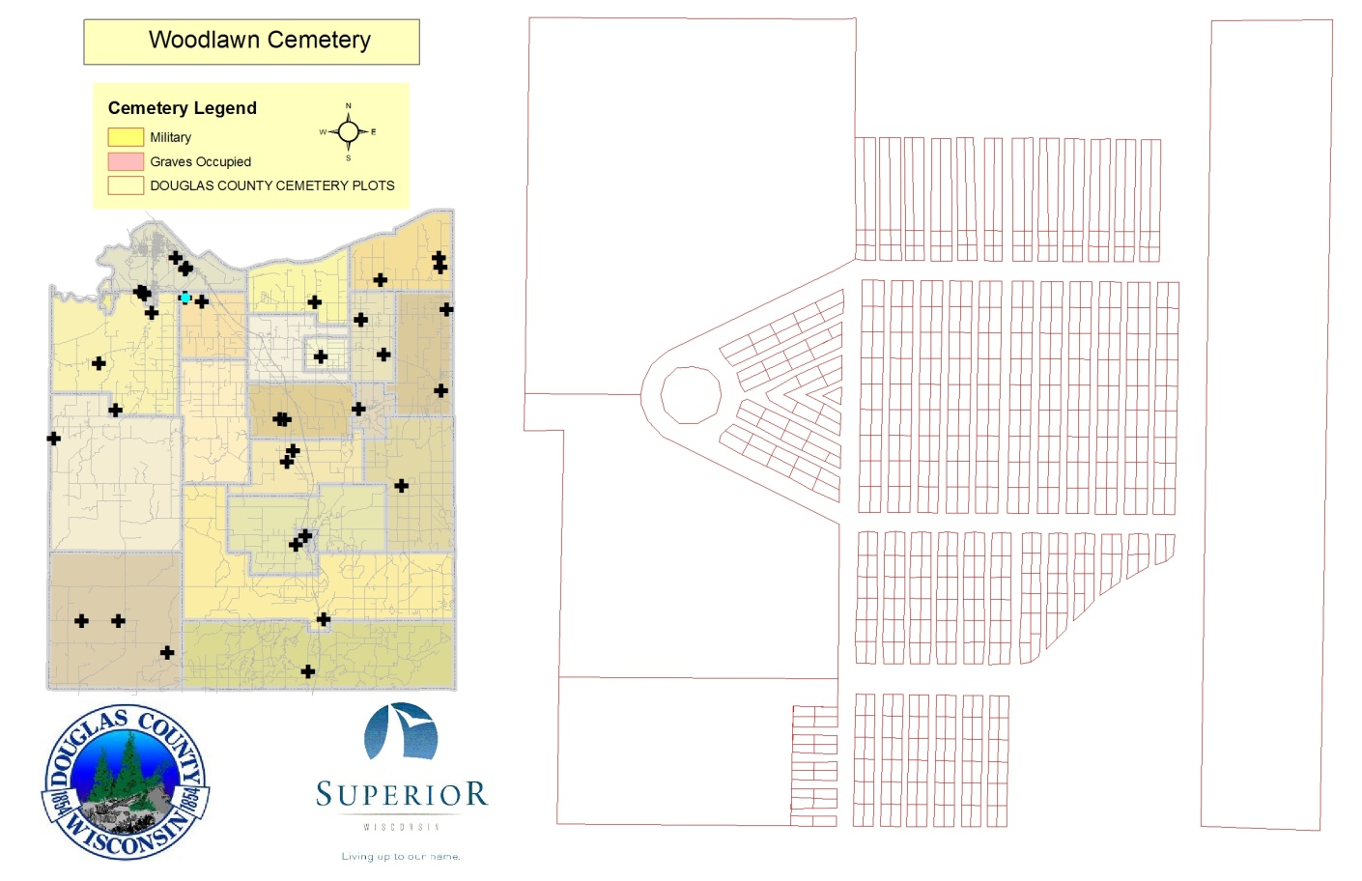
Woodlawn Cemetery
Woodlawn Cemetery
  Lots ID’ed, Sexton Book research, February 2011
  Data recorded from sexton books

Slide 19
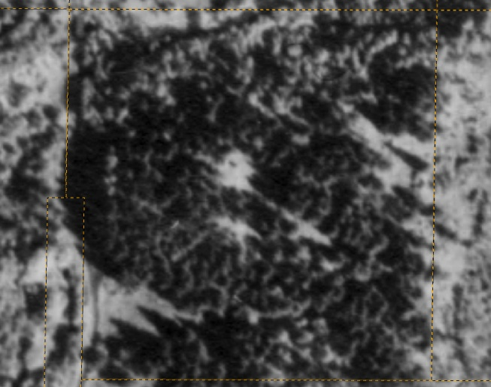
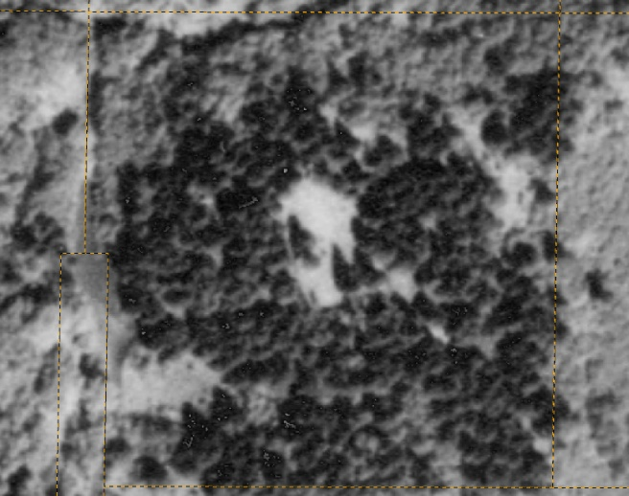
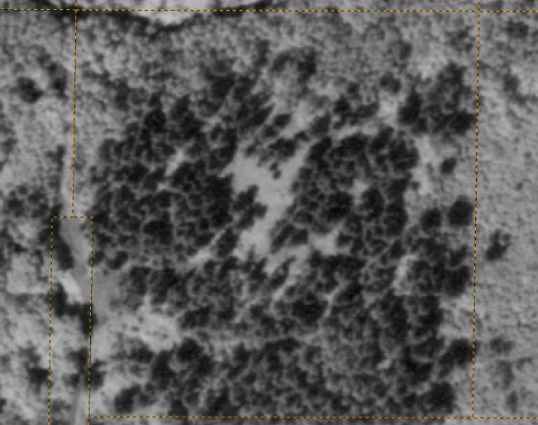
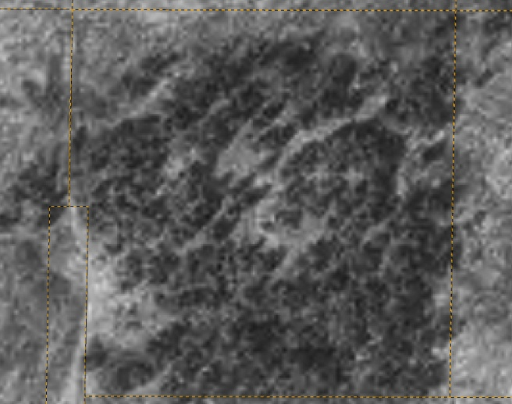
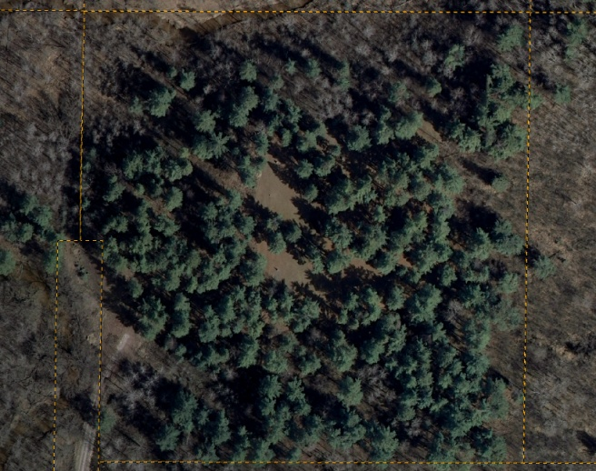
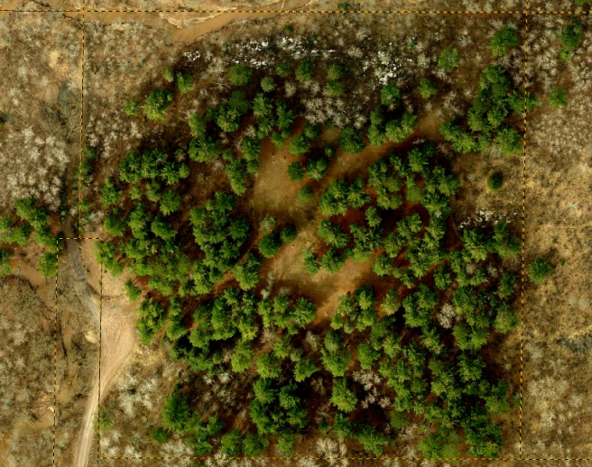
Woodlawn Cemetery Aerials
1948
1962
1973
1992
2006
2009

Slide 20
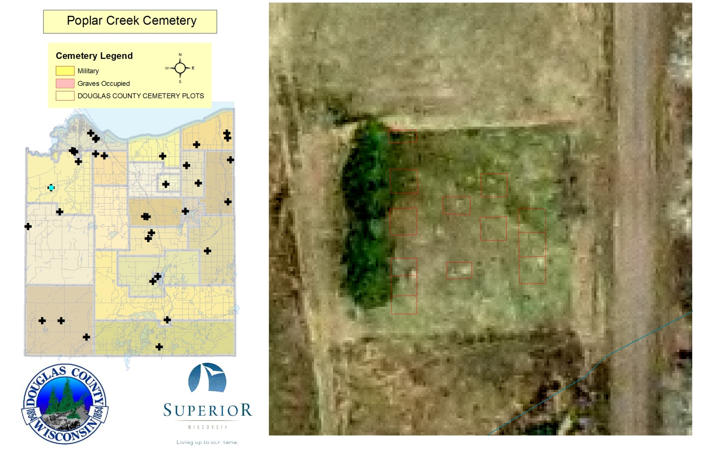
Poplar Creek Cemetery
Poplar Creek Cemetery
  Unverified at this time

Slide 21
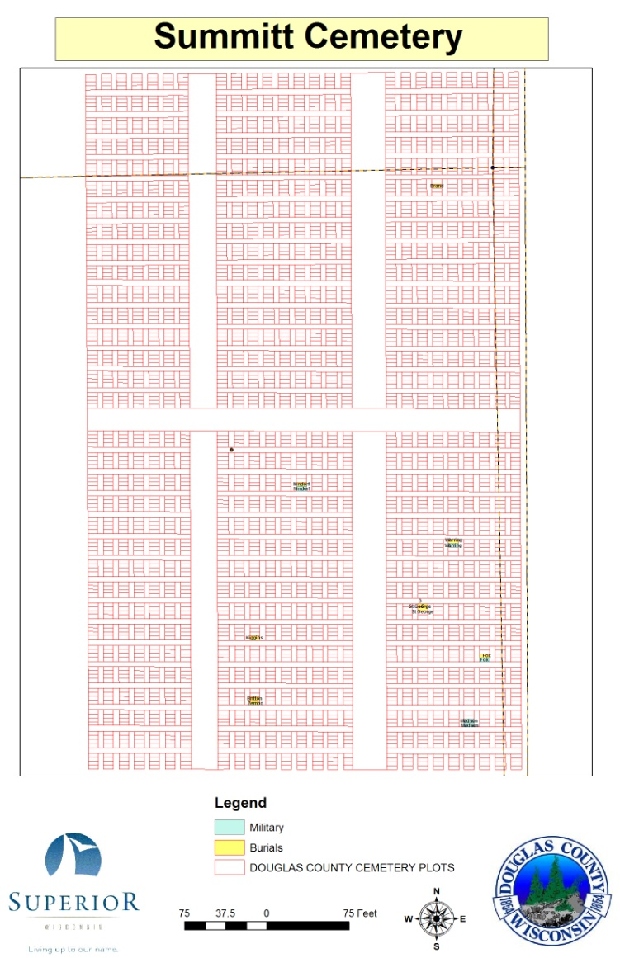

Summit Cemetery
Summit Cemetery
  Lots ID’ed, some names placed, December 2010
  Needs complete burial information
  Unverified at this time

Slide 22


Resthaven Cemetery
Resthaven Cemetery
  Started November 2010
  Unverified at this time

Slide 23



Hebrew Cemetery
Hebrew Cemetery
  Some Lots ID’ed, Summer 2010
  Need burial information

Slide 24


Bennett Cemetery
BennettCemetery
  Some Lots ID’ed, October 2010
    Grave layout not included
  Need burial information

Slide 25


Bennett Lutheran Cemetery
Bennett Lutheran Cemetery
  Lots IDed, February 2011
  Need additional burial information

Slide 26


St Ann’s (Blueberry) Cemetery
St Ann’s (Blueberry) Cemetery
  Lots ID’ed, October 2010
  Needs burial information

Slide 27



Douglas County Cemeteries
St Williams Cemetery
Covenant Cemetery
Dairyland
Parkview Cemetery

Slide 28



Douglas County Cemeteries
Riverhill Cemetery
Ever-Rest Cemetery
Hawthorne Parkview
Cemetery

Slide 29



Douglas County Cemeteries
Nemadji Cemetery
Old Dairyland Cemetery
St Francis Catholic
Cemetery

Slide 30



Douglas County Cemeteries
Gordon Memorial Cemetery
Lakeside Cemetery
Lake Nebagamon
Cemetery

Slide 31


Douglas County Cemeteries
Faith Lutheran Cemetery
Apostolic Lutheran Cemetery

Slide 32



Douglas County Cemeteries
Poplar Cemetery
St Pius X Cemetery
Wascott
Cemetery

Slide 33



Douglas County Cemeteries
Covenant Cemetery
(Cloverland)
Graceland Cemetery
Riverside Cemetery

Slide 34




Douglas County Cemeteries
Calvary Cemetery
Greenwood Cemetery
Pine Ridge
Cemetery

Slide 35




Douglas County Cemeteries
2009
1962
1992
1973
Parkland Wentworth Cemetery

Slide 36

Douglas County “Missing” Cemeteries/Graves
Unnamed Cemetery?

Slide 37


Important Statistics
Lot and Grave Data Construction
  On Average it takes about 4 (30 hours) days to create a 300-500 grave cemetery with unique IDs
Evergreen Cemetery
  Burial information was linked to the grave information in 4 days
    1076 Names (Averaged about 250 names for 6 Hours of work)
Estimated 55,000 graves in Douglas County
2386 have been assigned a grave location (4.4%)
Graves/Lots Created
18,557 and counting

Slide 38


Resources/References
Wi Gen Web, www.wigenweb.org
Cemetery Mapping Service, http://www.topographix.com/
Superior/Douglas County Mapping Site
  http://douglasco.mapping-online.com/DouglasCoWi/default.htm
Wisconsin Tombstone Project, http://www.usgwarchives.net/wi/cemetery/douglas.html
Wi Gen Web Archives, http://www.usgwarchives.net/wi/douglas.htm
Interment.net, http://www.interment.net/us/wi/index.htm
Wi Geneology Trails, http://genealogytrails.com/wis/
Civil War Lookup, http://www.itd.nps.gov/cwss/regiments.cfm

Slide 39



Project Completion Results
Accurate GIS maps/inventory of all cemeteries in Douglas County
Search Database for Veteran’s & Medical Examiner to use
Searchable online resource for public use

Slide 40



Next Steps
Meeting of Sextons in Douglas County to show pilot cemetery results and define what is needed to complete the remaining cemeteries
Develop verification process
Discuss Maintenance plan and options
Discuss adding a cemeteries theme to the DC mapping site (Long Term Goal)

Slide 41
Douglas County Cemeteries
Ben Klitzke
County Surveyor/LIO, Douglas County, WI
Ben.klitzke@douglascountywi.org
218-395-1340
Ellen Oaks
Douglas County Veterans Services Office
veterans@douglascountywi.org
715-395-1331
Jon Fiskness
GIS Coordinator, City of Superior, WI
fisknessj@ci.superior.wi.us
715-395-7423
Randy Jones
GIS Technician, Douglas County, WI
Randy.Jones@douglascountywi.org
715-395-1570

