Slide 1
Using the Media Fileserver with Directory Browsing Information Technology Staff Instructions
Https://media.superiordcgis.org/FTP/
1/18/2022

Slide 2
Introduction
Internally uploading a file
Directory Structure
Superior or Douglas
Use the appropriate share
Finding the URL to Share
Directory Browsing
Uses and Limitations
Read-Only/Download
Support Information
Notes:
How presentation will benefit audience: Adult learners are more interested in a subject if they know how or why it is important to them.
Presenter’s level of expertise in the subject: Briefly state your credentials in this area, or explain why participants should listen to you.

Slide 3
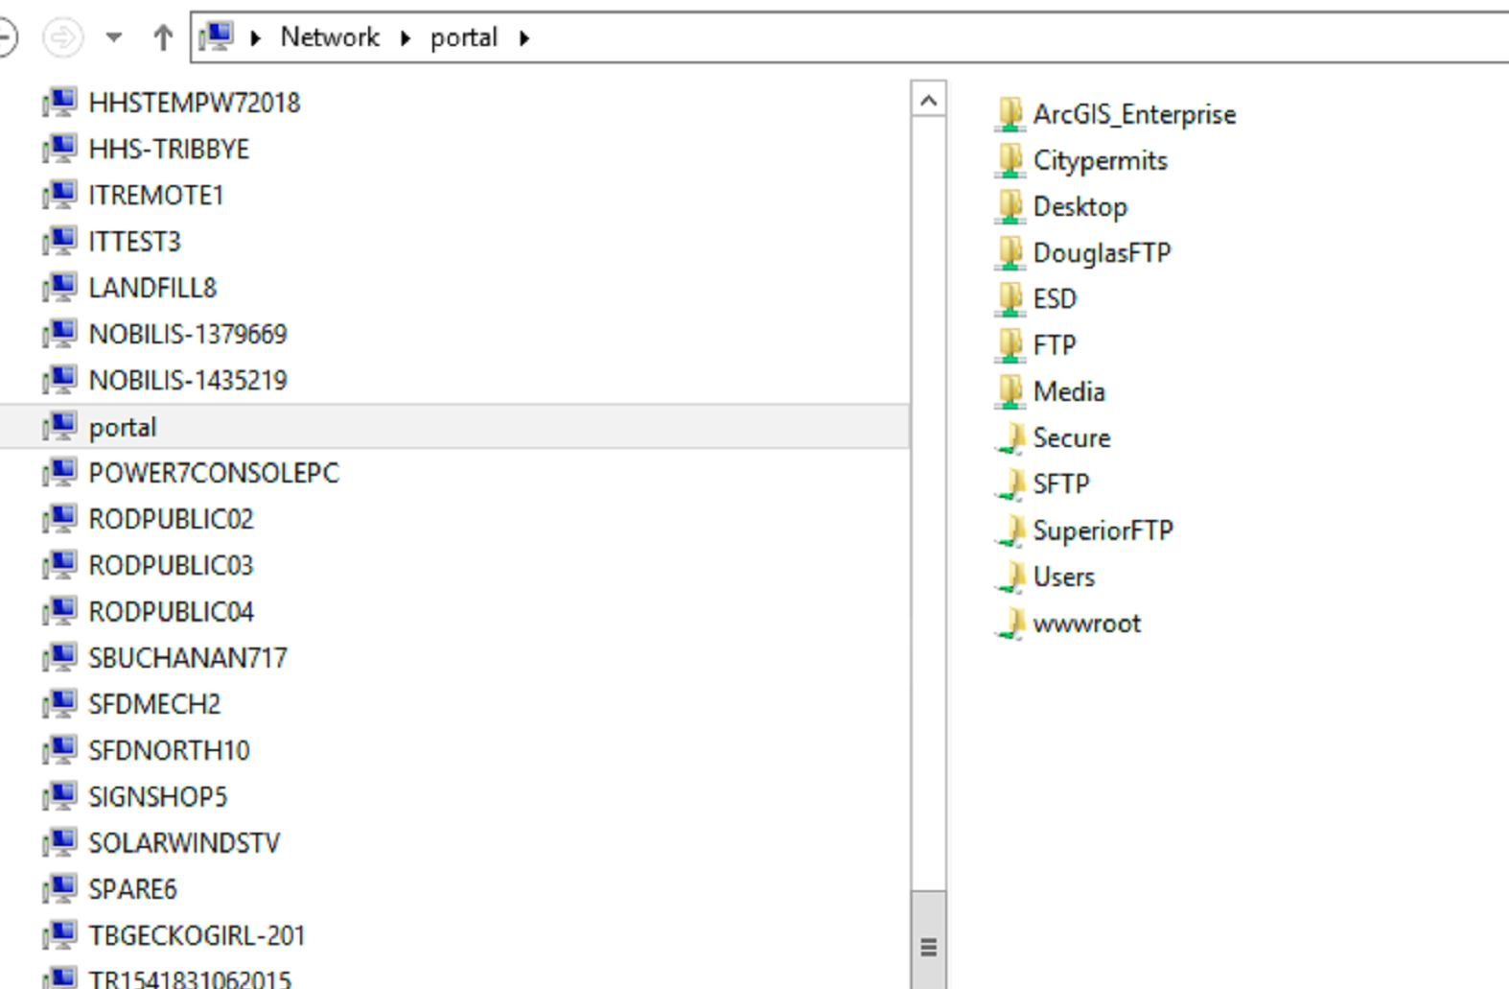
Internal File/Folder Upload
In Windows Explorer
Type in the File Path Line
Douglas = \\portal\DouglasFTP
Superior = \\portal\SuperiorFTP
Then choose your appropriate department
Add your folder or Files
Notes:
Example objectives
At the end of this lesson, you will be able to:
Save files to the team Web server.
Move files to different locations on the team Web server.
Share files on the team Web server.

Slide 4
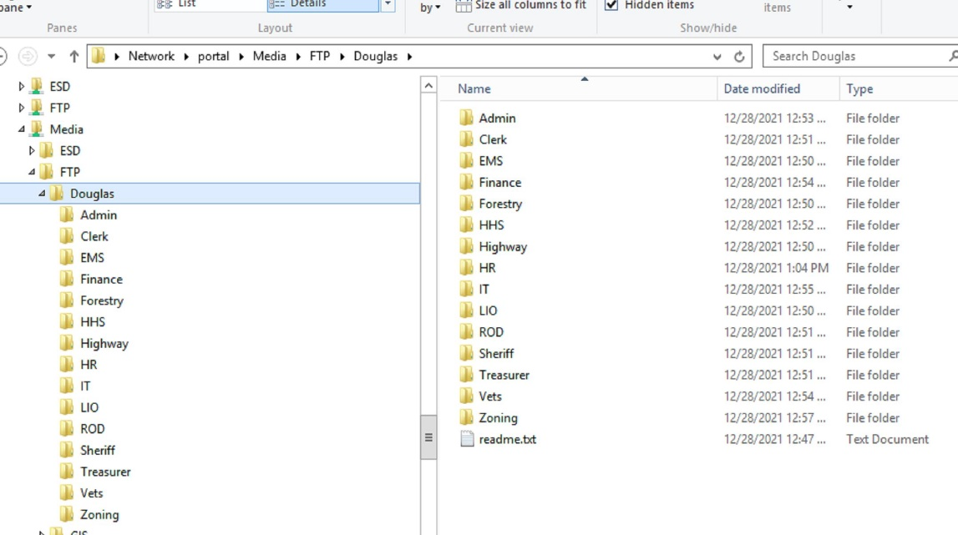
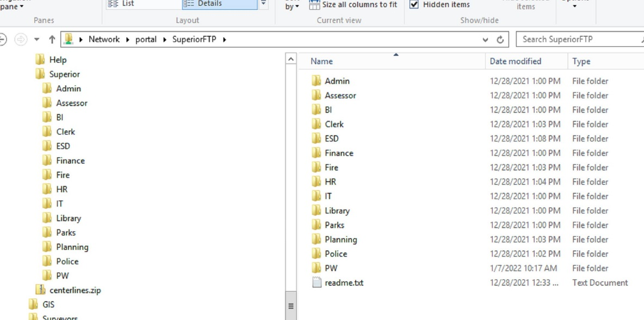
Internal File/Folder Upload
In Windows Explorer
Type in the File Path Line
Douglas = \\portal\DouglasFTP
Superior = \\portal\SuperiorFTP
Then choose your appropriate department
Add your folder or Files
Notes:
Example objectives
At the end of this lesson, you will be able to:
Save files to the team Web server.
Move files to different locations on the team Web server.
Share files on the team Web server.

Slide 5
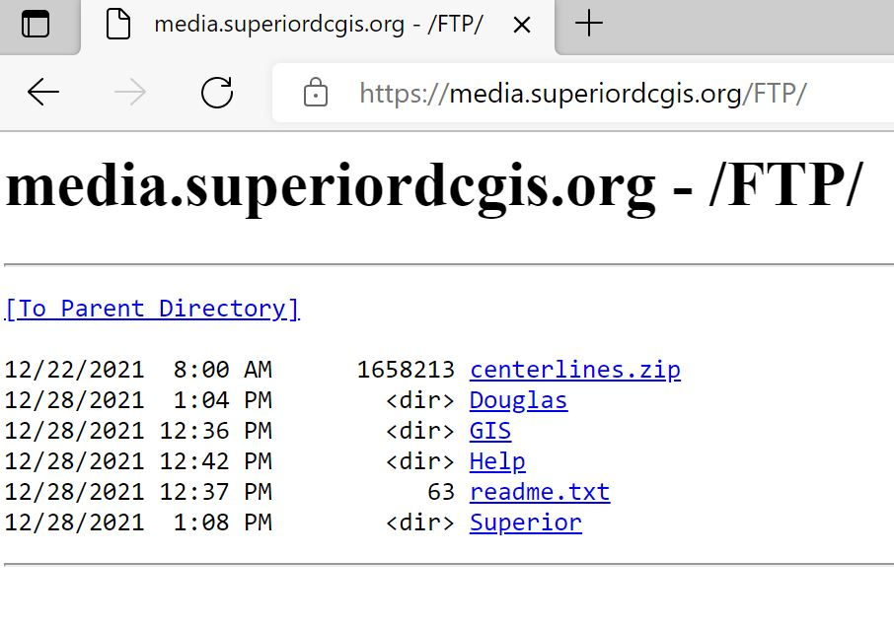
Determine the URL to share your files/folder
In a browser (Chrome, Edge, etc) go to
https://media.superiordcgis.org/FTP/
Using Directory Browsing select the directory structure you chose to follow (Superior or Douglas)
Follow the Directories to your upload location
Right click on the folder or file to share and copy link address
Paste link address in email (might want to test the address before sending)
Send email with URL

Slide 6
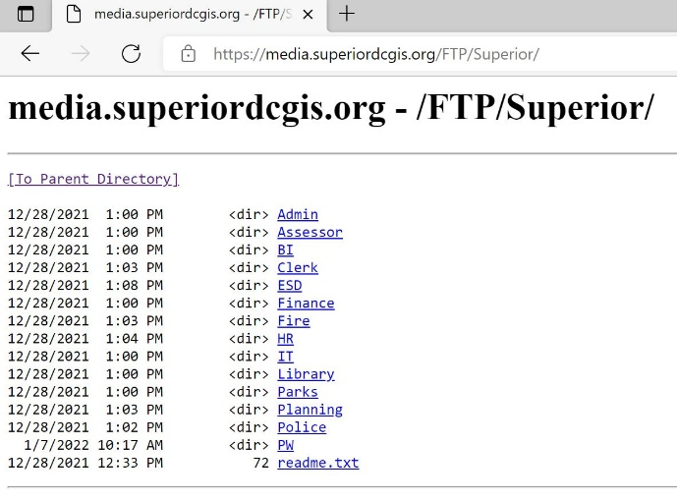
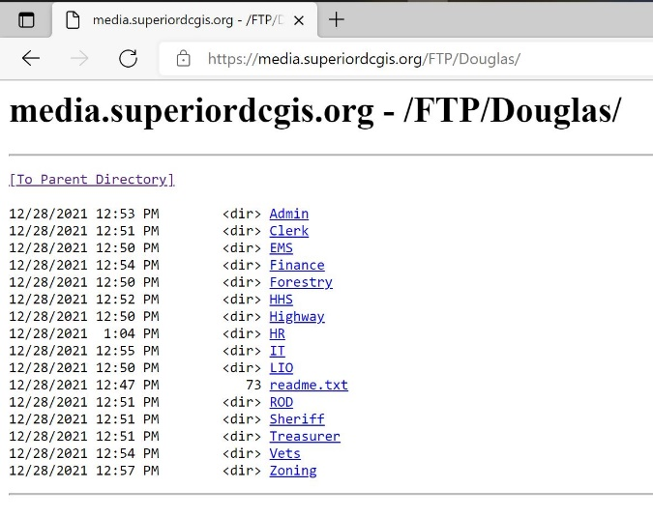
Determine the URL to share your files/folder
https://media.superiordcgis.org/ftp/
Using Directory Browsing select the directory structure you chose to follow (Superior or Douglas)

Slide 7
Limitations/Policy
Not really a FTP site, so no upload capabilities from External Clients
Files will be removed after 6 months, unless specifically requested: use the following links
https://arcg.is/1jzSKu
https://survey123.arcgis.com/share/04dadd5380e343eb96dd8f0481870825
All files are viewable through Directory Browsing, not secure, anyone has access to them
Confidential data should NOT be placed here
Whenever possible try to zip(compress) the files into one (1) .zip file
For Admin Use Only:
https://www.arcgis.com/apps/dashboards/97a010cc626243718bddc6df937fc8a4

Slide 8
For Assistance
Contact
gishelp@ci.superior.wi.us

