Slide 1

Superior Wisconsin Geographic Information System
August 1, 2023

Slide 2
City/County GIS Staff
Superior GIS Staff (2)
GIS Coordinator
GIS Technician (Douglas County WLIP Grant Fabric Maintenance)
Douglas County Land Information Office Staff (2)
Two GIS Technicians

Slide 3
GIS Infrastructure
GIS Infrastructure
11 - GIS SERVERS
  5 are web servers also
  500+ Data Sets
150+ internal users
  City/County ESRI ELA Licensing Agreement – Cost savings
City/County GIS Online Site – 50,000 hits per year
  Douglas County COVID Site – 100,000+ hits during its run

Slide 4
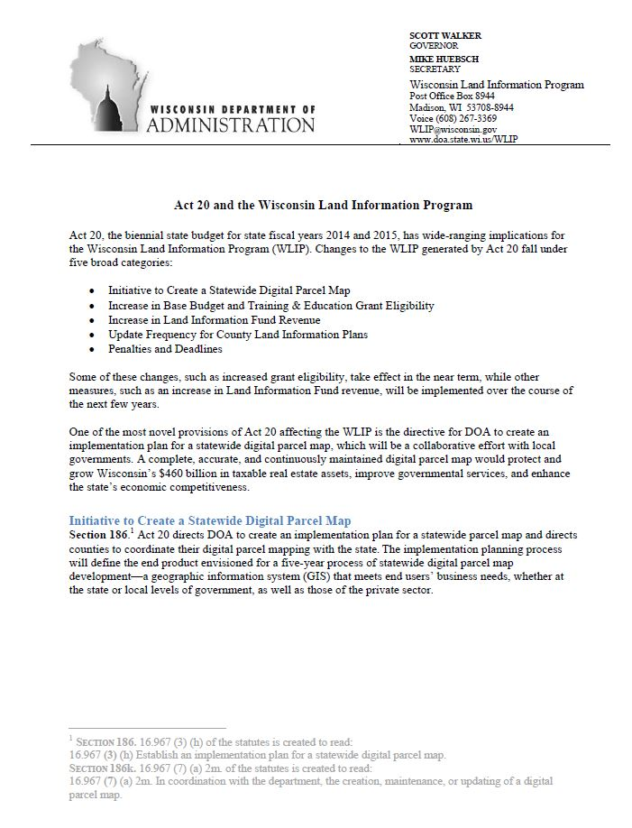
WI Statewide Parcel Initiative
Act 20

Slide 5
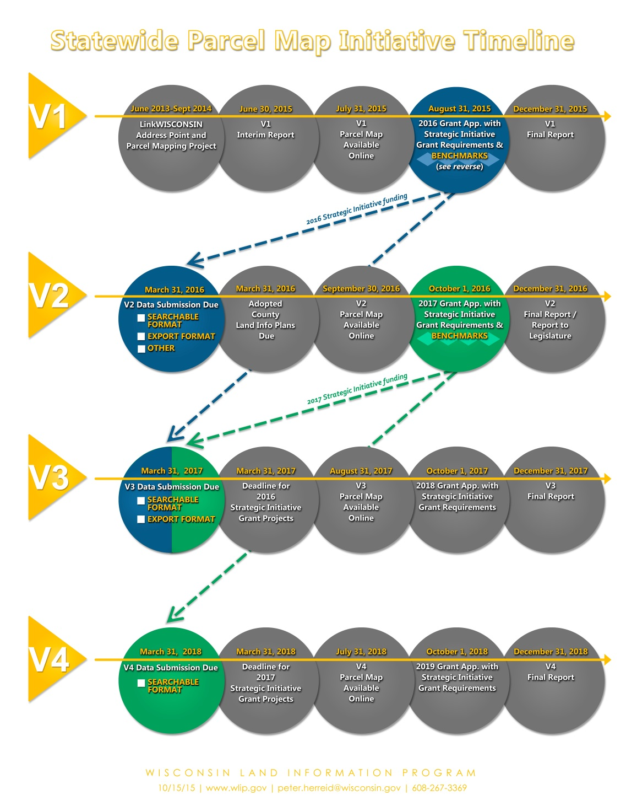
WI Statewide Parcel Initiative
Now at V7
Benchmarks

Slide 6
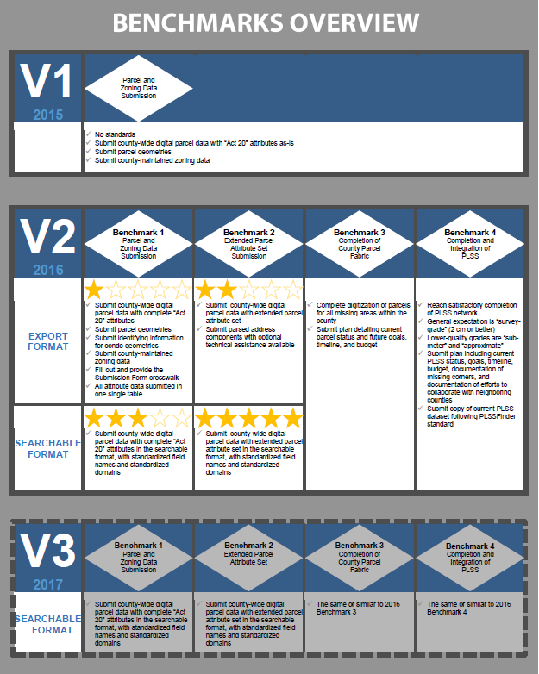
WI Statewide Parcel Initiative
Benchmarks

Slide 7
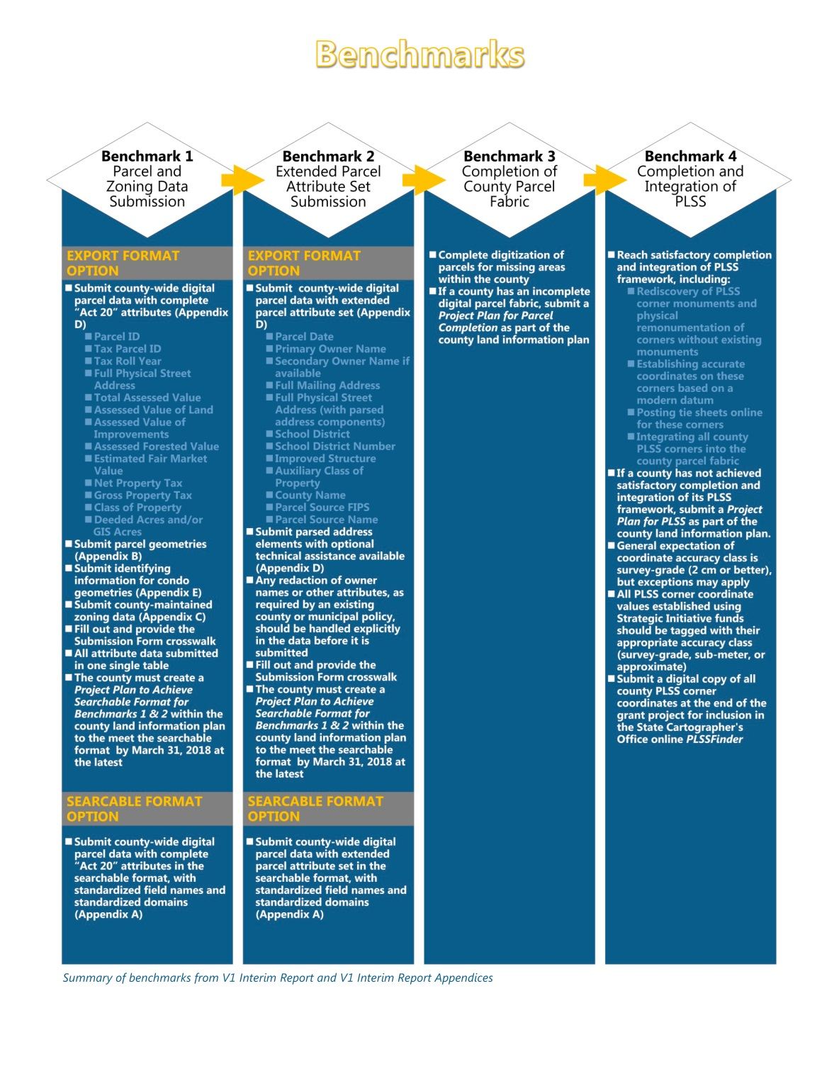
WI Statewide Parcel Initiative
Benchmarks

Slide 8
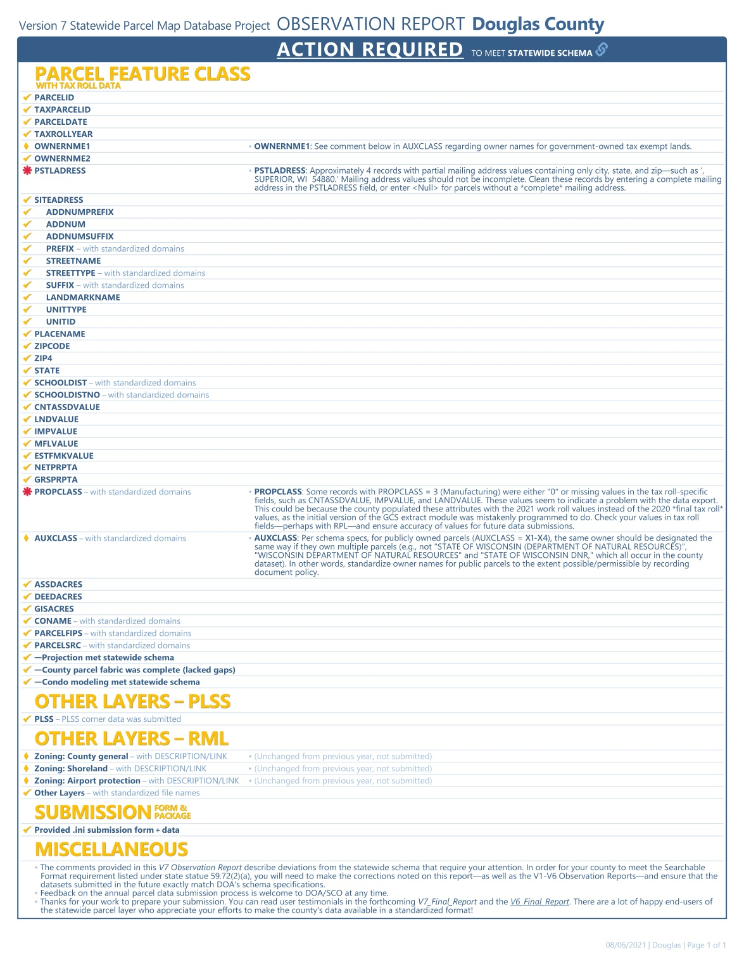
WI Statewide Parcel Initiative
V7 submittal on
March 31, 2020

Slide 9
WI Statewide Parcel Initiative
Data Submitted
Parcels
Zoning General
Shoreland
Floodplain
PLSS Corners
Roads
Addresses
Hydrography
ROW
CBAS Submitted twice a year
Wards
Supervisor Districts
Annexations

Slide 10
Background Information on Parcels and Ownership Data
Parcel Editing Process
Currently every 24 hours parcels
Ownership is updated and replicated from
GCS, Parcels are updated in groups of
edits once every week
2022 – 8284 Edis
2021 - 6337 Edits
2020 – 7541 Edits
2019 – 6875 Edits
2018 – 3725 Edits
Ownership data and parcels are the
most critical data the City and County
Maintain. It is used by all departments for
Various purposes.

Slide 11
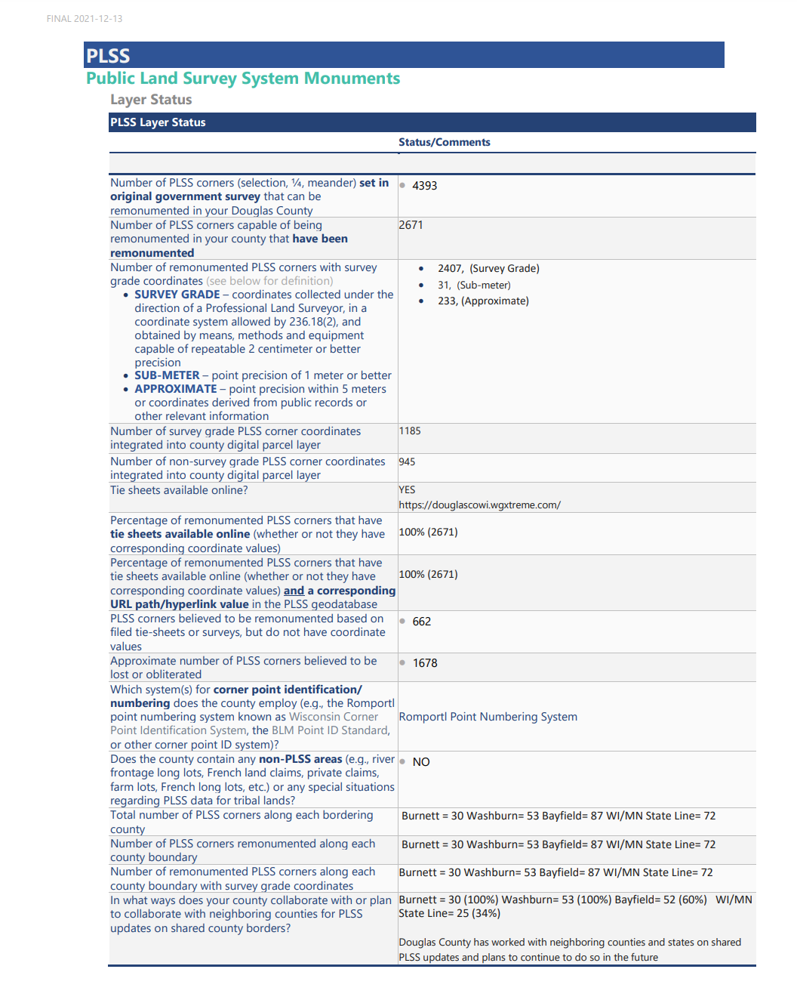
V9 Benchmark Status for PLSS Corner Integration

Slide 12
Survey Documents Inventory
Douglas County Surveyor Control Summary
2022 (As of 11/30/2022)
Centerline Monuments = 14
Section Corners = 130
Section Corners via the County Bounty System = 36
Contracted Section Corners = 52 (32 more in progress)
New Collected Corners = 10
Survey Site , http://www.superiordcgis.org/surveyors/
Updated with new corners and current links to survey docs. Currently being taken down due to software sun setting.
We also added Survey data to the County GIS Online Site at http://douglascowi.wgxtreme.com/

Slide 13
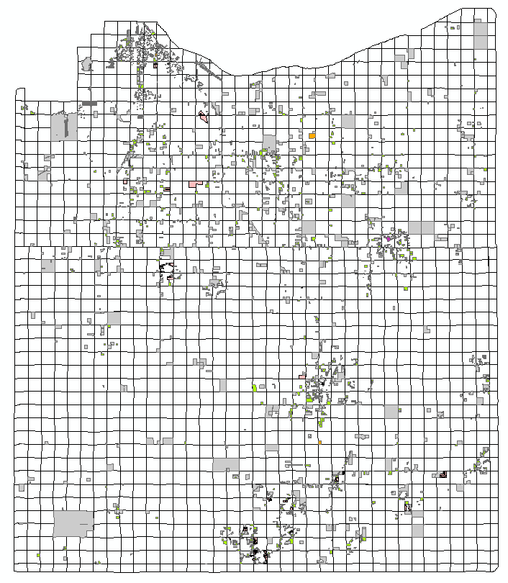
Survey Documents Inventory
Georeferenced Survey Documents Inventory
5314 Total Documents
ALTA = 51
Certified Survey Maps = 1604
Site Plans = 226
Maps of Survey = 3382
Plats = 48

Slide 14
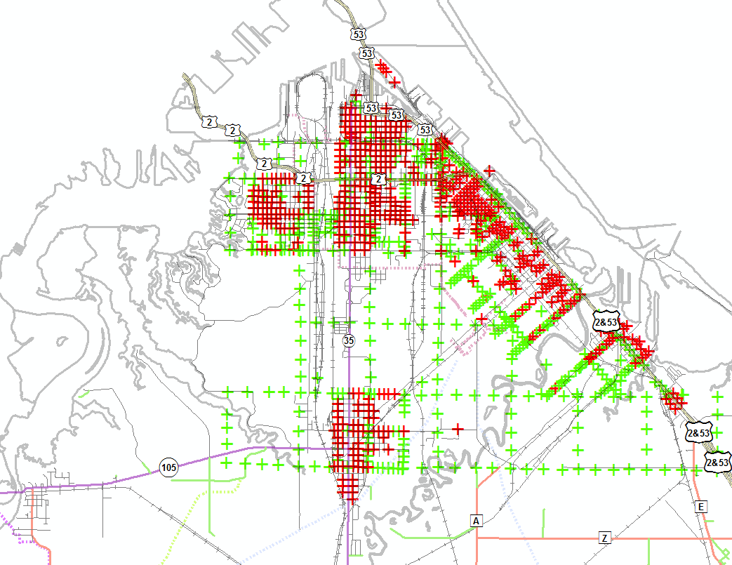
Street Centerline Monuments
City of Superior Street Centerline Monuments
Attributed Monuments = 517 (Red)
Unattributed Monuments = 539 (Green)

Slide 15
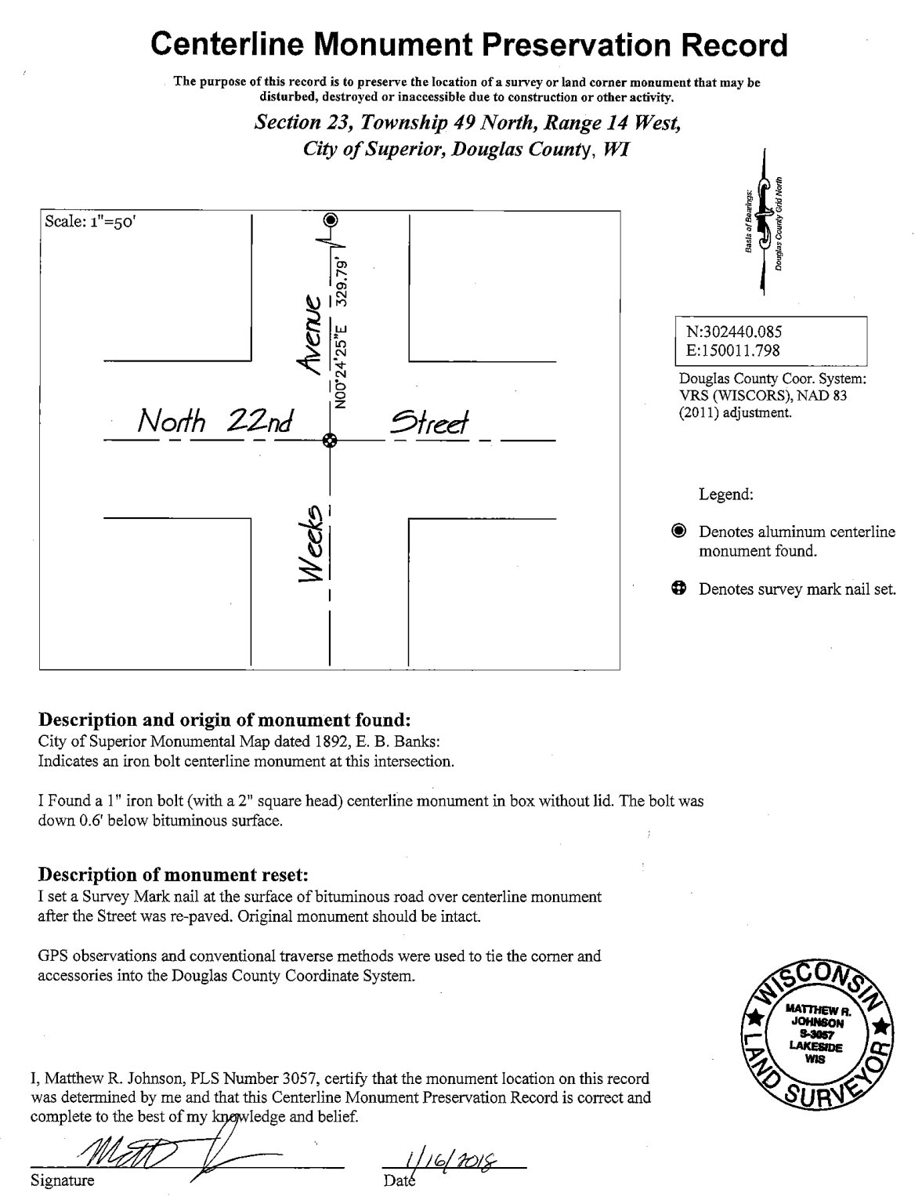
Street Centerline Monument Record
City of Superior Street Centerline Monument Record Sample
26 CMPRs

Slide 16
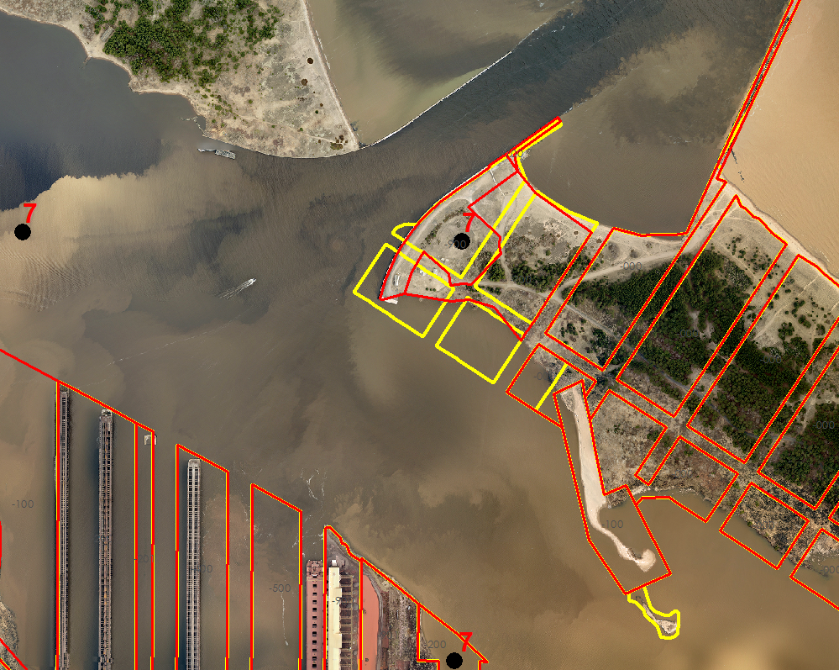
Wisconsin Point
Adjustment
Yellow = Before Adjustment
Red = After Adjustment

Slide 17

Land Information Office’s NextGen911 Activities in 2022
NextGen911(NG911) is a Federally required upgrade to the CAD/911 systems throughout the nation. Wisconsin is developing standards and requirements for County systems to meet. NG911is a fully GIS integrated system with stringent requirements that must be met.
Douglas County NG911 Activities include:
CAD911/GIS data assessment in 2020
Budgeting for GIS staff assistance
Continued monitoring of the State’s NG911 recommendations and needed response
Implementation of GIS data changes as required by the State and Federal governments
Challenges for LIO in NG911
Address system used by Douglas County
Migration of current data to required schema
Future maintenance needs and costs

Slide 18

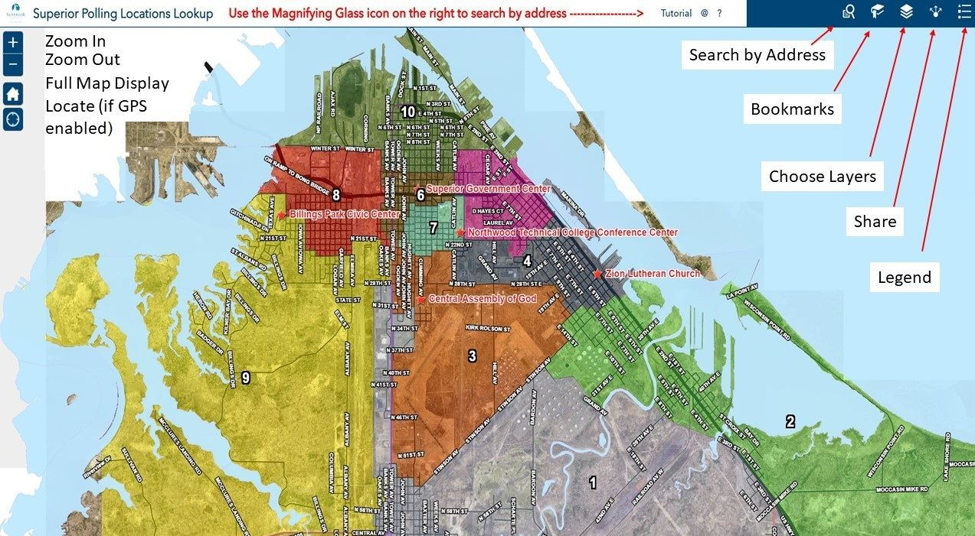
City Polling Locations Lookup
City Poll Site Lookup
https://portal.superiordcgis.org/portal/apps/webappviewer/index.html?id=b2eeeb1a43124ffbb0e0db2ad2a3f65b
Views = 3200

Slide 19
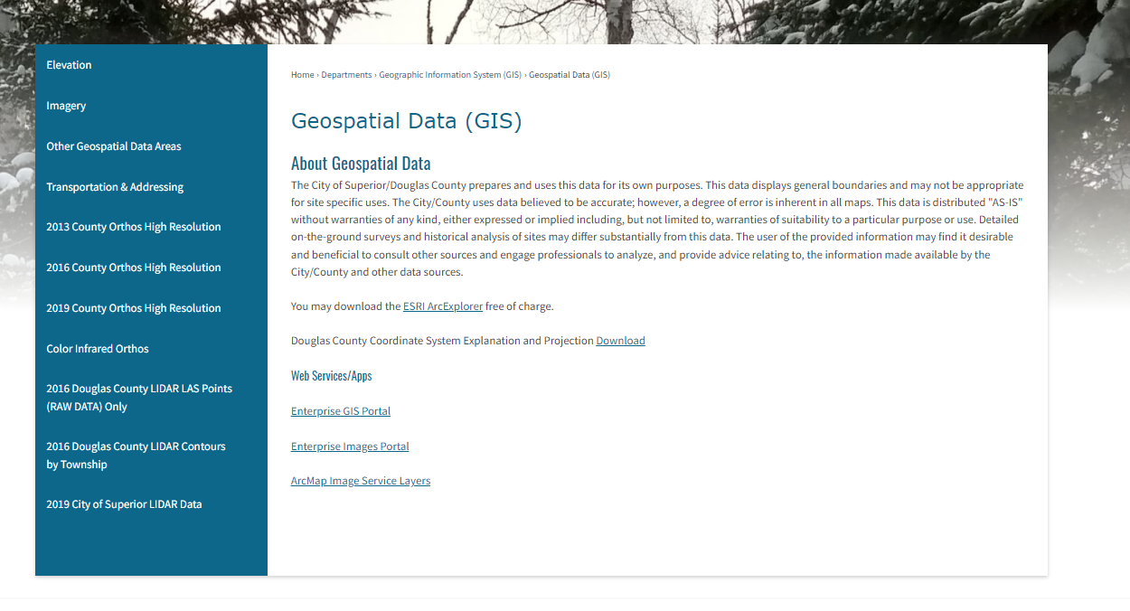
Geospatial Data Downloads
The City/County LIO currently has nearly all it’s GIS data available for download (free)it’s been in place since 2010
http://www.ci.superior.wi.us/474/Geospatial-Data-GIS

Slide 20
City/County Aerial Photos
City/County Aerial Photos
2022 - Pictometry
2019 - Pictometry
2016 - Pictometry
2013 - Pictometry
2009 - Pictometry
2006
1999
1986
1973
1962
1948
1938

Slide 21
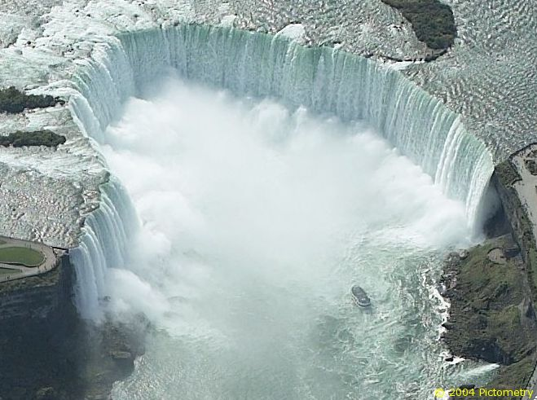
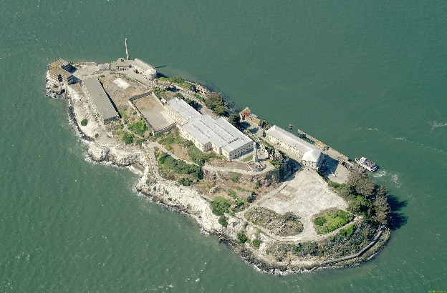
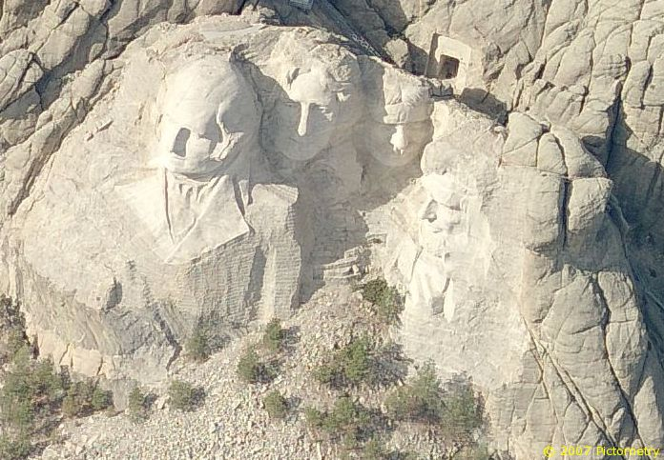
What is Pictometry?
Pictometry - has been described as “geometry on images” but that description only captures one aspect of Pictometry.
Pictometry technologies are widely used by county GIS, planning and assessing professionals around the country and a growing number of commercial businesses including those in insurance, utilities, real estate, construction, and more.
Unlike traditional geospatial information systems that rely on only an orthogonal, or top-down view of an area, Pictometry captures images obliquely, or from an angle, and create a more natural three-dimensional view so that users can see land features and structures clearly and in their entirety.

Slide 22
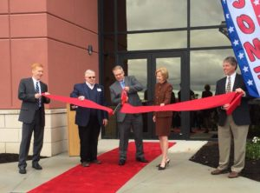
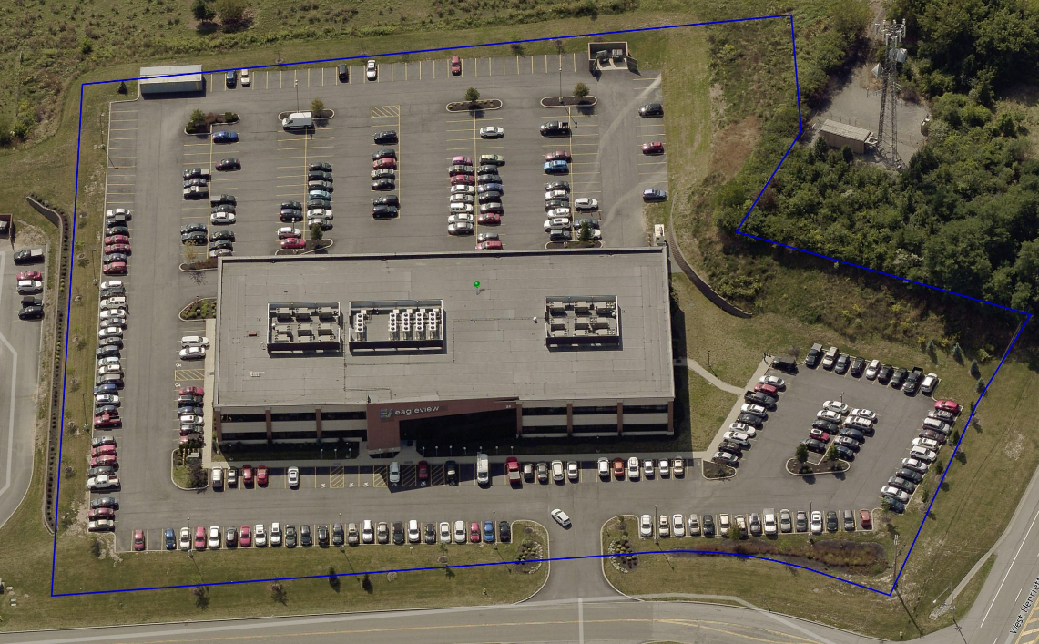
Why Pictometry?
Pictometry (now Eagleview) is based out of Rochester New York
Why Rochester – RIT
Eastman/Kodak
Students developed the Technology
Why Not Google or satelittes?
Control of the data
Control of the dates
Resolution and Obliques
Cost, $8317/year
Timeliness of Access to Photos
What about Drones?

Slide 23
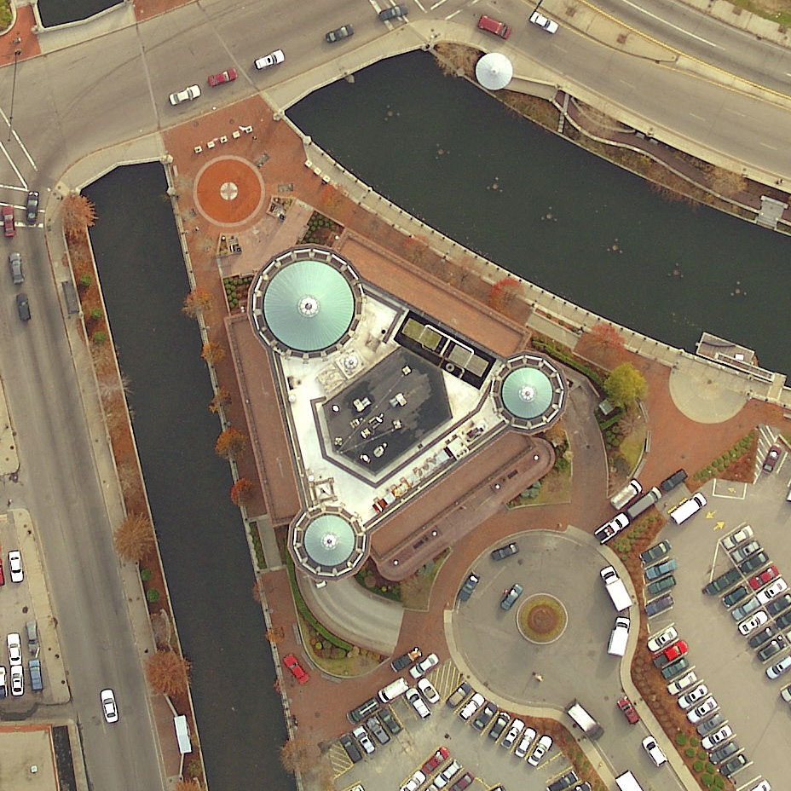
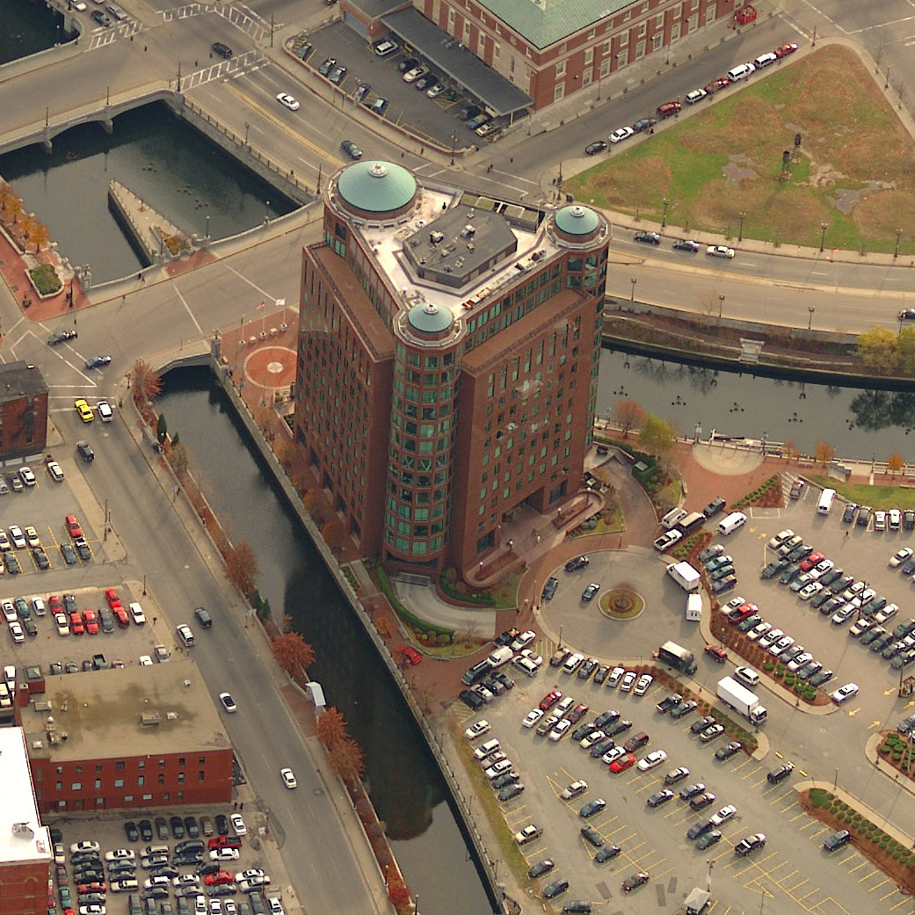
Traditional Ortho Image
Oblique Image
Providence, Rhode Island
Notes:
Building is in Providence RI. Review that ortho imagery is useful but it takes a trained eye to analyze it and it has limitations.

Slide 24
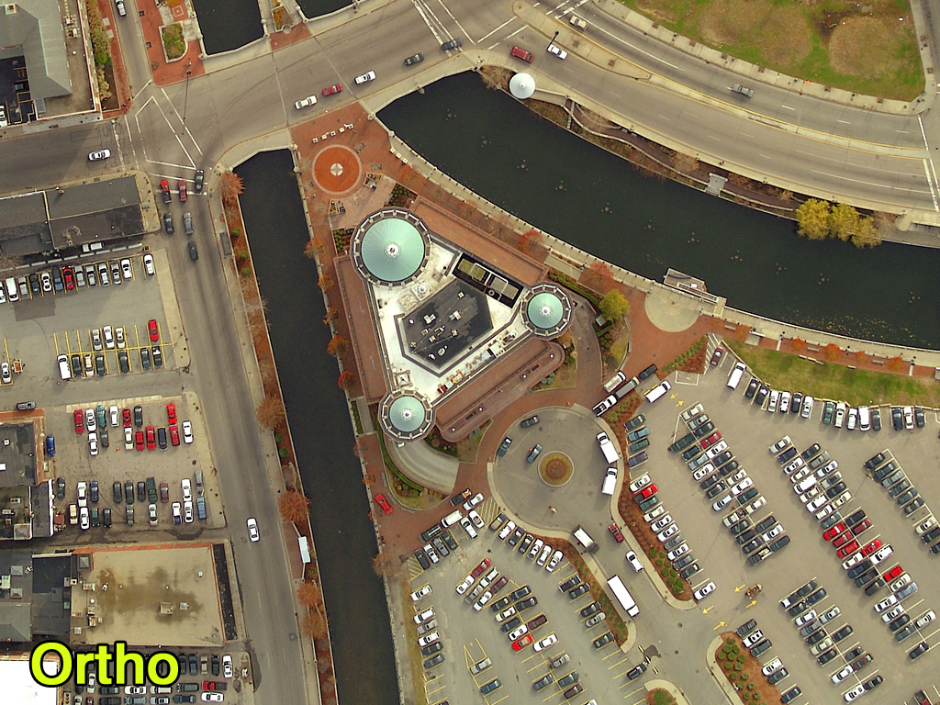
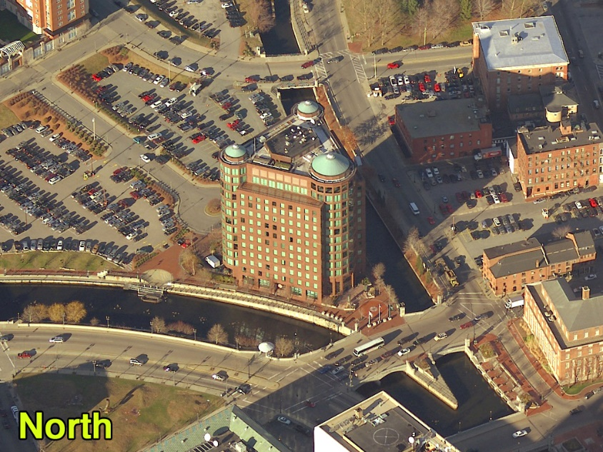
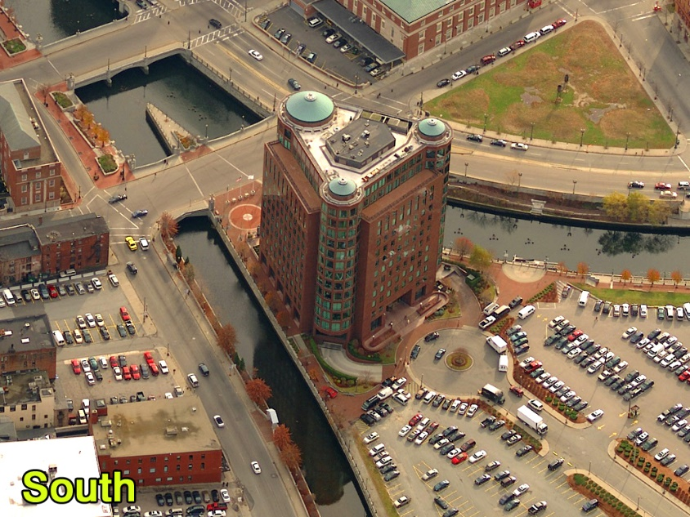
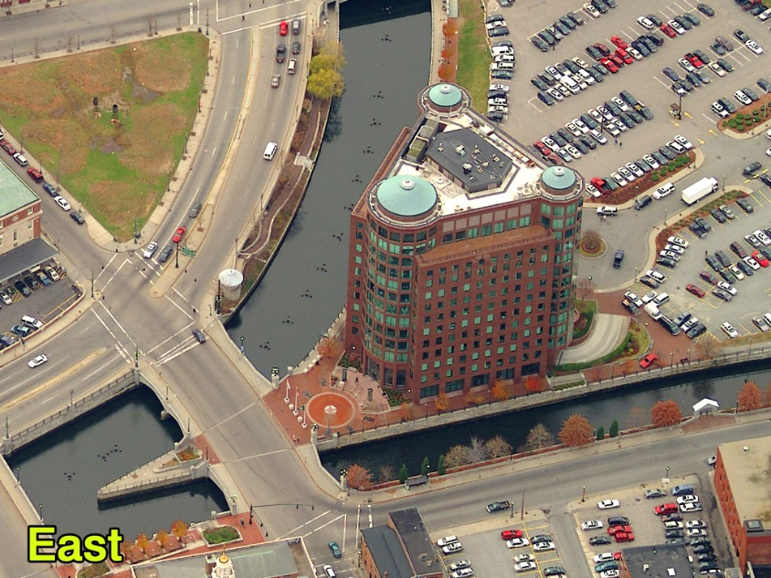
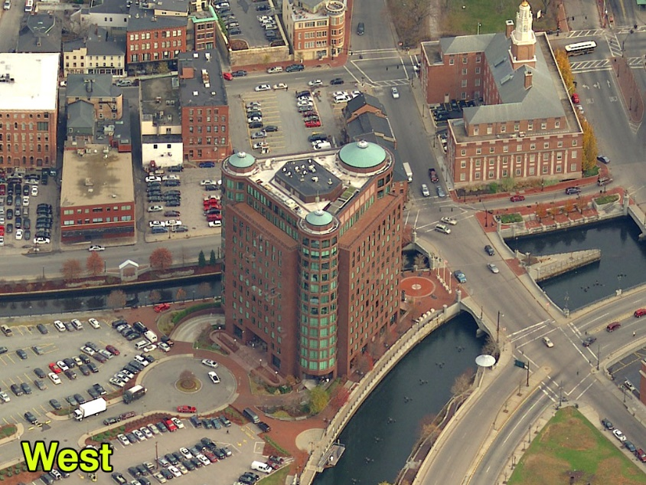
So In Addition To This…
You Get This…
Providence, Rhode Island

Slide 25
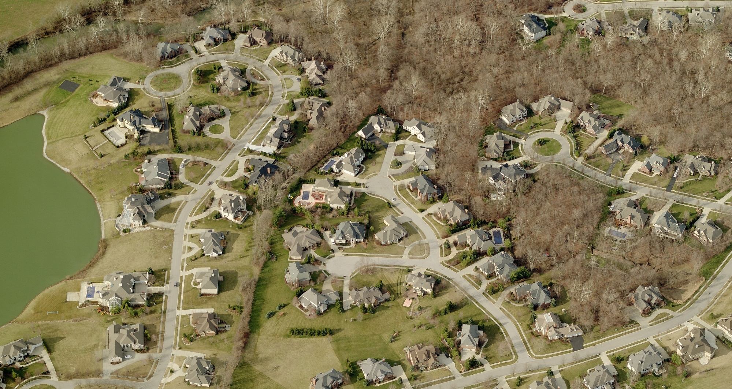

Slide 26
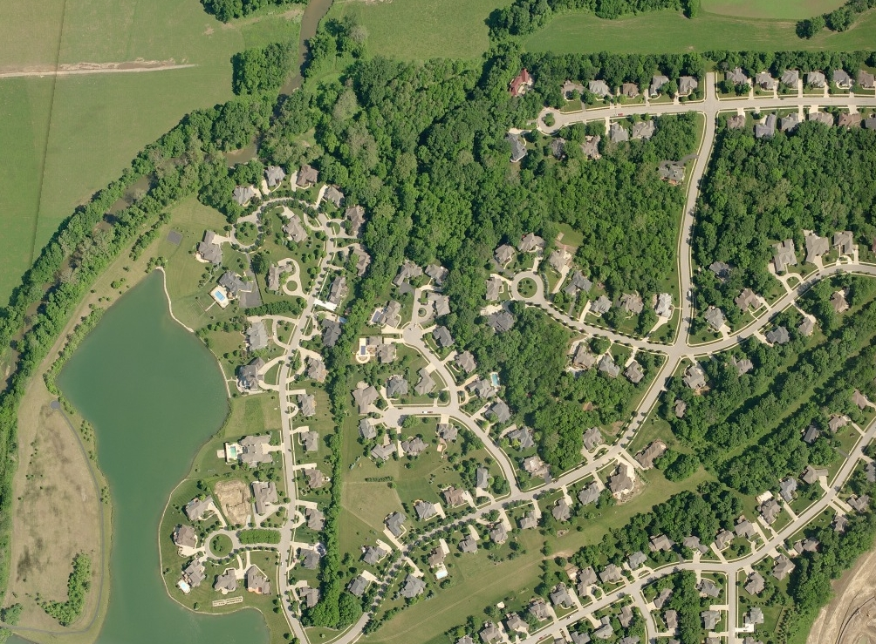
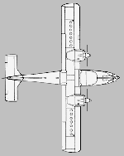

Slide 27

Methodology
Produces Color, Digital Imagery
Natural Perspective in Height & Scale
Accurate Measurements can be Obtained
Overlay GIS Data on Imagery
Obliques and Orthos in One Flight!
Quick Delivery of Photos

Slide 28
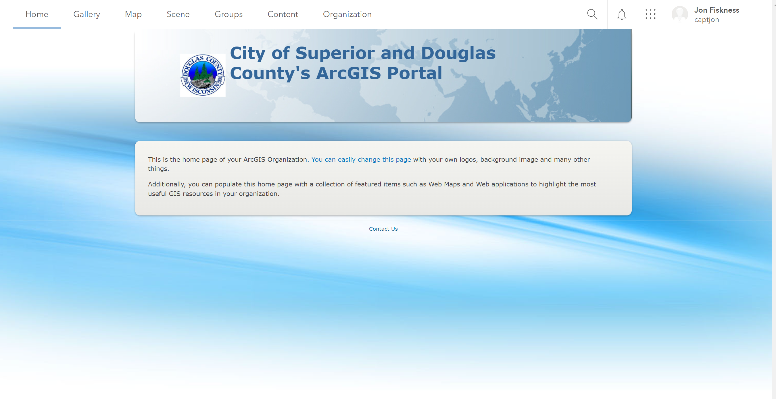
Land Information Office’s Mobile /online Presence
City/County Portal Servers in 2020-2022
City/County COSDC Enterprise Server
  https://portal.superiordcgis.org/portal
Currently working on permissions and training
for 2023

Slide 29
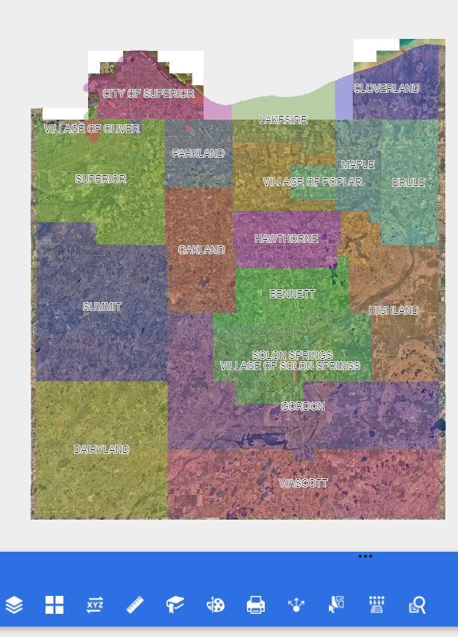
Land Information Office’s Mobile /online Presence
City/County Map Services
https://portal.superiordcgis.org/portal/apps/webappviewer/index.html?id=cccdec273dc342828351bc3bca1e49ee

Slide 30

Land Information Office’s Mobile /online Presence
City/County ArcGIS Online
Total of 525 Items
Apps = 17
Dashboard = 12
Map Services = 4
Data Layers = 142
Image Services = 1
Survey 123 = 40

Slide 31

Land Information Office’s Mobile /online Presence
City/County
Portal
Total of 714 Items
Apps = 38
Dashboard = 18
Map Services = 177
Data Layers = 215
Image Services = 65

Slide 32
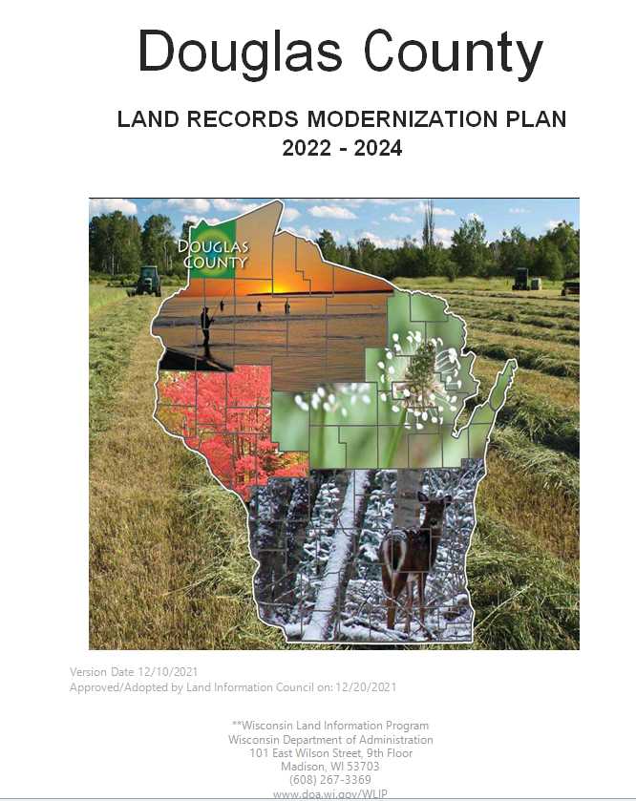
Land Information Plan
Douglas County Land Information Plan 2022-2024
Submitted 12/31/2021

