Slide 1


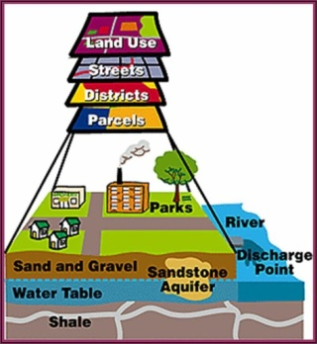
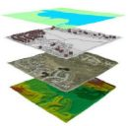


City of Superior/Douglas County Enterprise GIS
Geographic Information Systems
(GIS)
Presented to the Douglas County Highway Department
August 8, 2012

Slide 2

Cooperative Agreement Between the City of Superior and Douglas County
Cooperative Agreement:
Statement of Services
The County agrees to maintain Geographical Information System (GIS) hardware and software for the County and City users to include:
Perform system functions to transfer data into GIS software or new software packages.
Cooperatively perform GIS mapping and data entry support for base map data, roads, geocoded addresses, voting data/boundaries, Public Land Survey System (PLSS), etc.
Maintain City parcel map edits.
Perform imaging and indexing of survey maps,
County Surveyor review of Certified Survey Maps (CSM) maps and plats for the City
Provide GIS data to any appropriate person, agency or entity.
Facilitate public access to City/County spatial data through a GIS web site.

Slide 3
Cooperative Agreement Between the City of Superior and Douglas County
Cooperative Agreement: Statement of Services
The City agrees to provide the following consultation services to the County provided by the City’s Geographic Information System Coordinator:
Identify and propose which hardware/software solutions will be implemented.
Install, configure and manage the maintenance of GIS and Microsoft software on workstations.
Evaluate and create procedures for data edits and data capture.
Design custom macros and scripts that will be available to all GIS users.
Represent the City/County GIS interests as a GIS liaison to departments, organizations and other government agencies.
Provide ongoing GIS training and facilitate a technical users group.
Provide access to GIS data to any appropriate employee or agency.
Secure cost sharing for software and technical support that will benefit both parties.
Establish and Implement a GIS Strategic Plan for City/County
Administer and manage the Enterprise License Agreement with ESRI
Manage the Enterprise GIS System for the County
Develop Map Service templates for GIS users within the County
Creation and maintenance of a Data Infrastructure Catalog
IS support for GIS related activities
Coordinate and Supervise the County GIS Technicians efforts to meet the provisions of the City/County GIS Strategic Plan and the Land Records Modernization Plan
Supervise/manage GIS Interns for the City and County

Slide 4
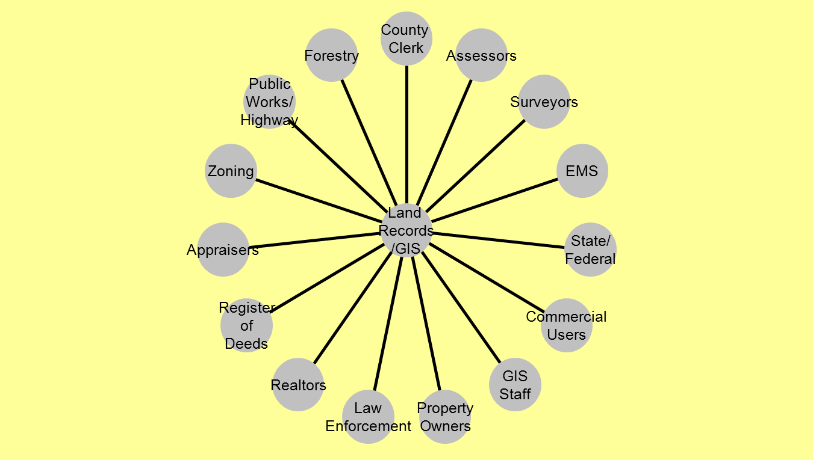
City of Superior/Douglas County Enterprise GIS
Bud’s Wheel

Slide 5

City of Superior/Douglas County Enterprise GIS
ESRI ArcGIS ELA Products
ArcGIS Desktop | ArcGIS for Desktop
ArcInfo | ArcGIS for Desktop Advanced
ArcEditor | ArcGIS for Desktop Standard
ArcView | ArcGIS for Desktop Basic
ArcGIS Server | ArcGIS for Server
Esri Data and Maps | Data and Maps for ArcGIS
Unlimited Licensing to ArcGIS and Core Extensions

Slide 6
City of Superior/Douglas County Enterprise GIS
Server Infrastructure and Replication
Enterprise SDE
(75)
Highway SDE
(6)
Springbrook
(?)
CAD/
911
(15)
ESD
(25)
Forestry
(10)
Enterprise Server Based Management allows for:
Multiple Editors and Viewers
Replication of data
Backups Simplified
Less Duplication of data
More efficient data delivery and speeds to users

Slide 7
City of Superior/Douglas County Enterprise GIS
GIS Implementation
Land Records Live
GIS Users Training
  Beginner/Novice - 2008-2010
  Pictometry Extension for ArcGIS Trainings held 2009 - 2011
GIS DAY Held in November 2008 -2011
  Attendance for 2008 – 50 attendees
  Attendance for 2009 – 55 attendees
  Attendance for 2010 – 75 attendees
  Attendance for 2011 – 100 attendees
  November 14, 2012
“Help Desk” Creation
  Email Address gishelp@ci.superior.wi.us for taking GIS questions for City/County employees

Slide 8
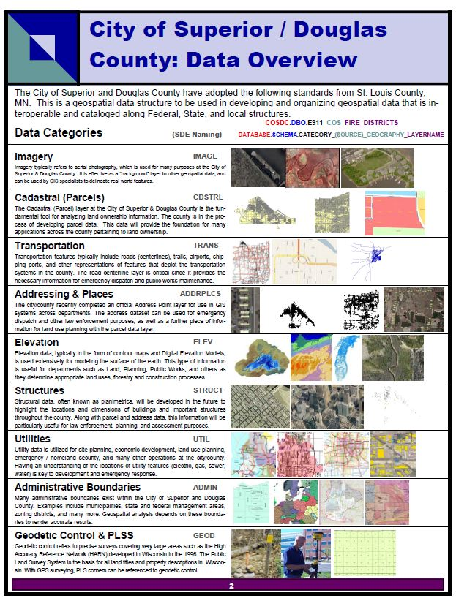
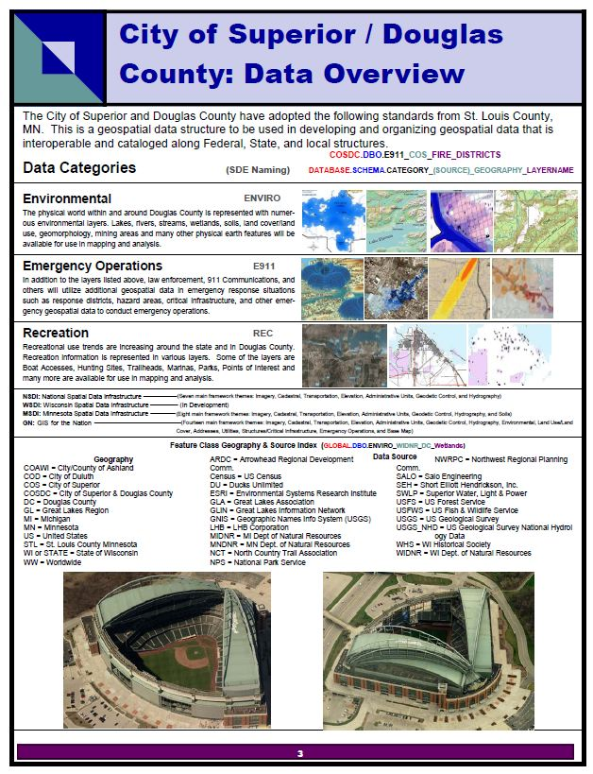
City of Superior/Douglas County Enterprise GIS
Over 500 Feature Classes Maintained

Slide 9
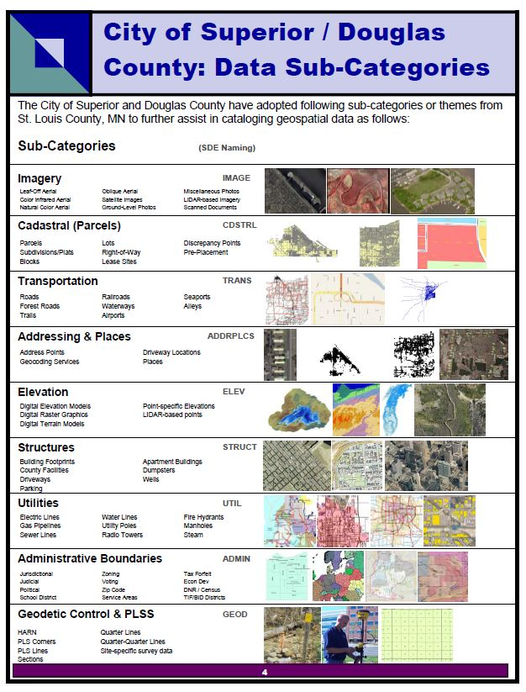
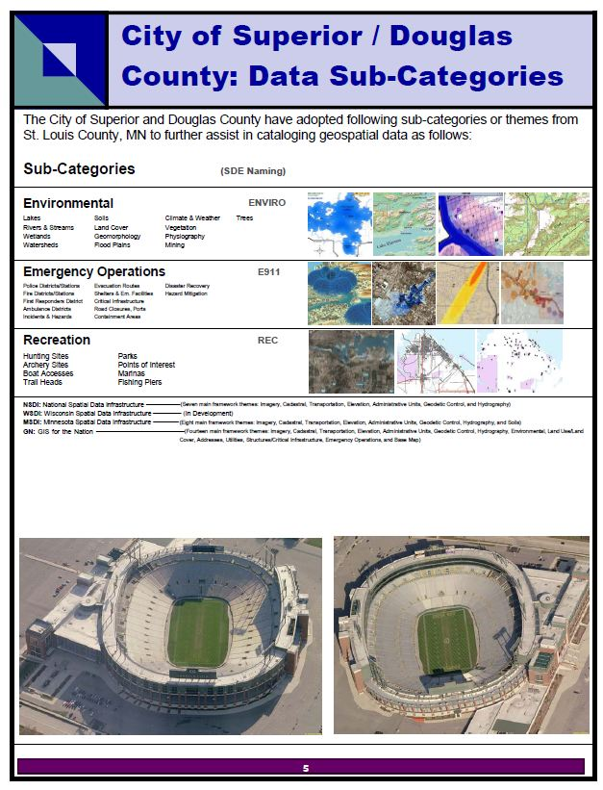
City of Superior/Douglas County Enterprise GIS
Highway Bridges, Culverts, ROW, Construction Projects,
Load Limits, Road Damage Areas,
Sign Inventory, Adopt A Highway

Slide 10

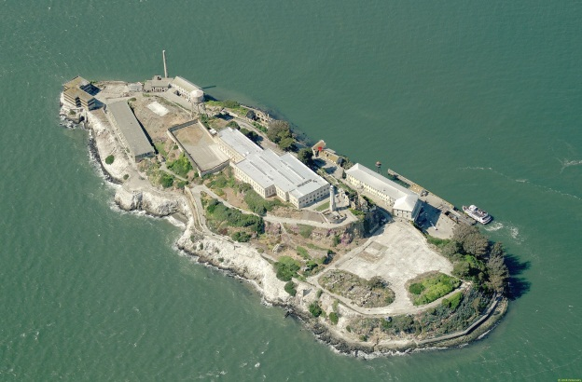
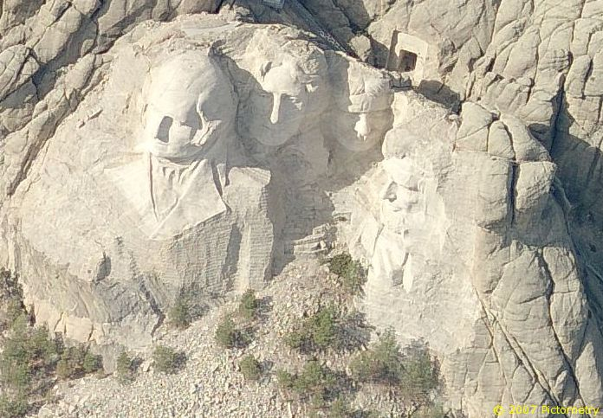
What is Pictometry?
Pictometry - has been described as “geometry on images” but that description only captures one aspect of Pictometry.
Pictometry technologies are widely used by county GIS, planning and assessing professionals around the country and a growing number of commercial businesses including those in insurance, utilities, real estate, construction, and more.
Unlike traditional geospatial information systems that rely on only an orthogonal, or top-down view of an area, Pictometry captures images obliquely, or from an angle, and create a more natural three-dimensional view so that users can see land features and structures clearly and in their entirety.

Slide 11
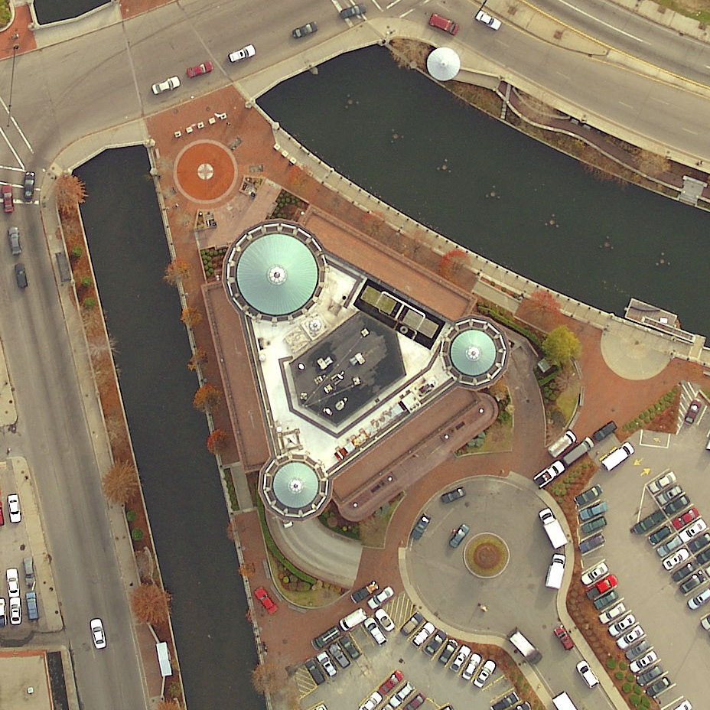
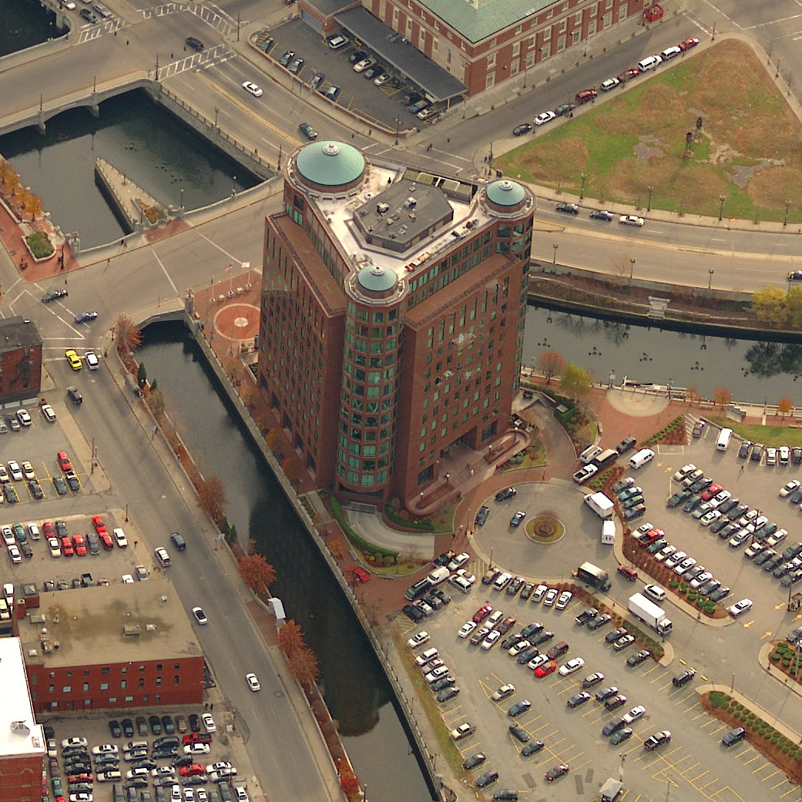
Traditional Ortho Image
Oblique Image
Providence, Rhode Island
Notes:
Building is in Providence RI. Review that ortho imagery is useful but it takes a trained eye to analyze it and it has limitations.

Slide 12
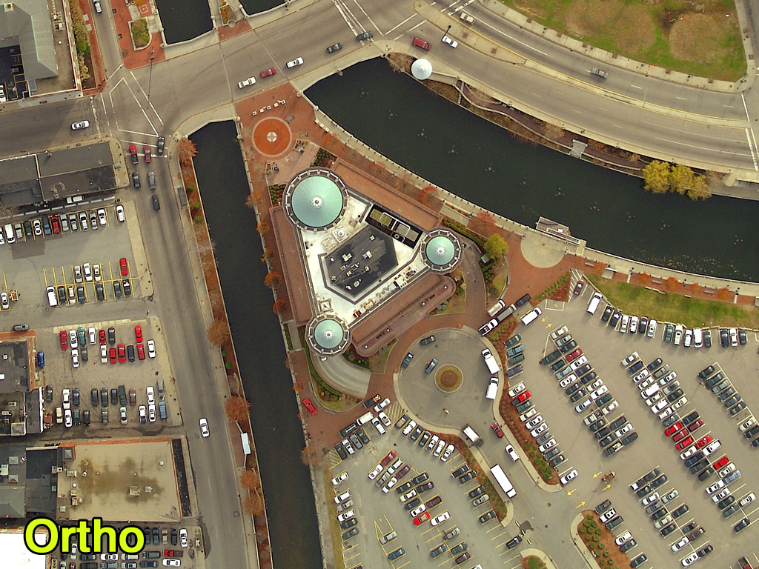
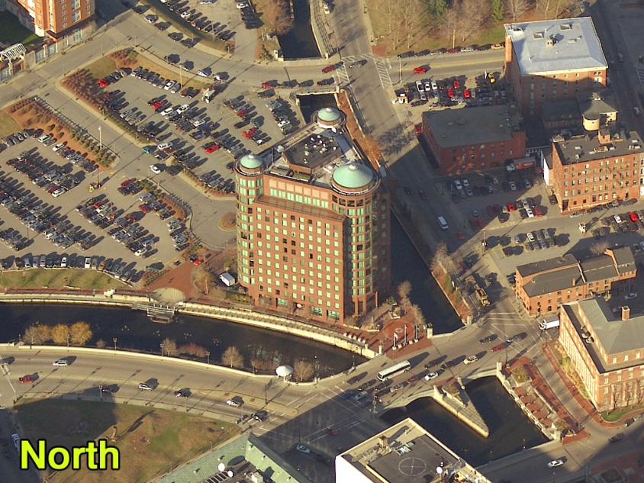
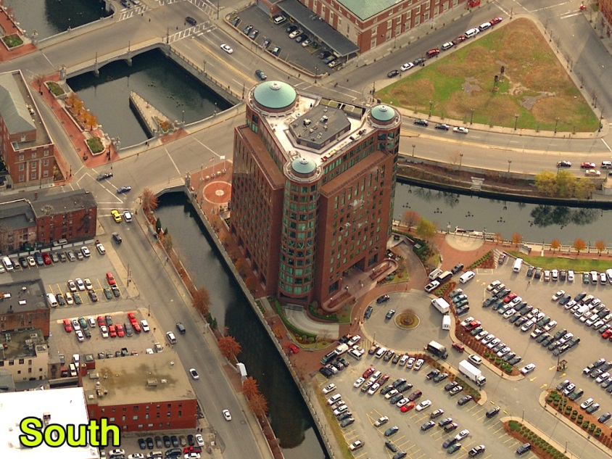
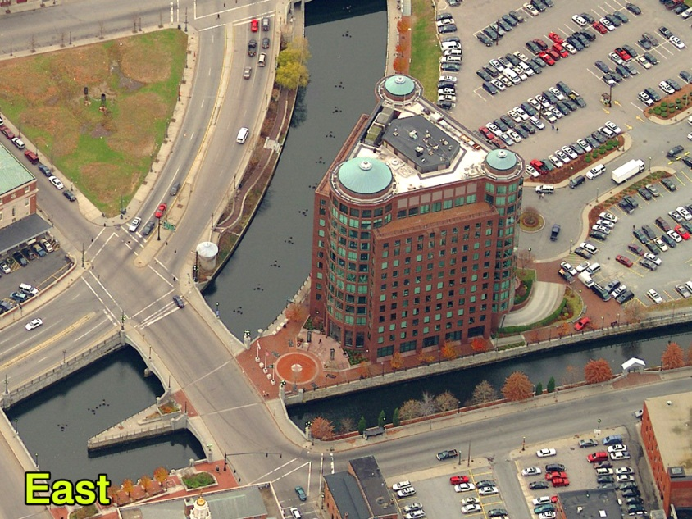
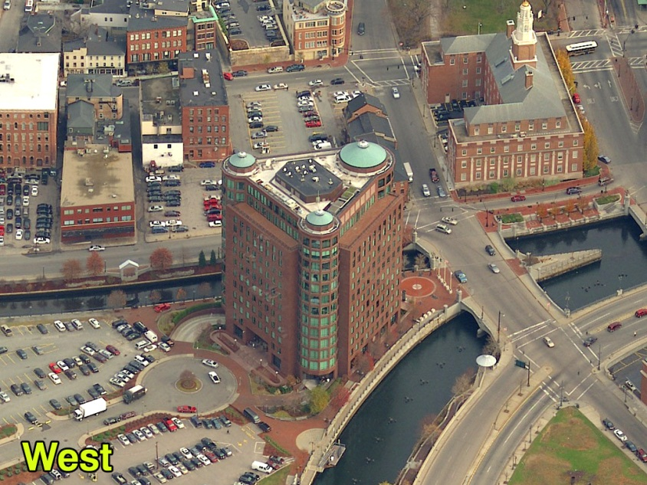
So In Addition To This…
You Get This…
Providence, Rhode Island

Slide 13
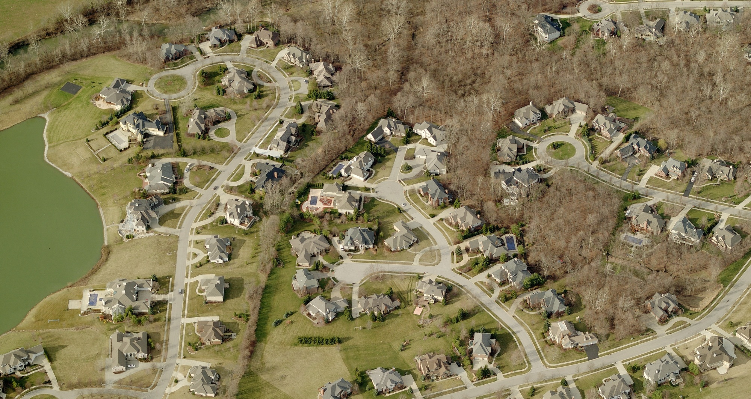

Slide 14
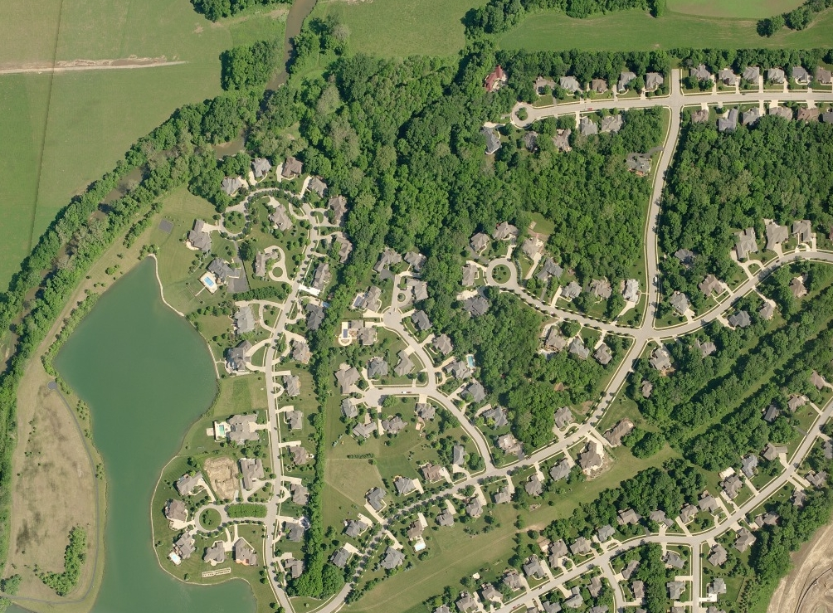
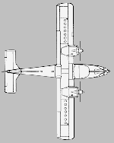

Slide 15

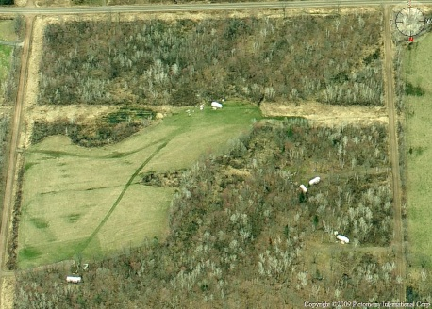
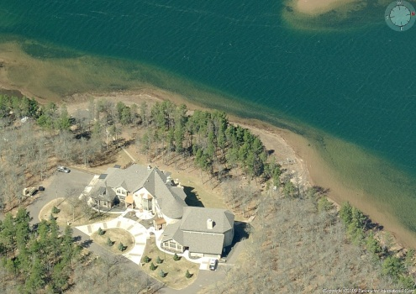
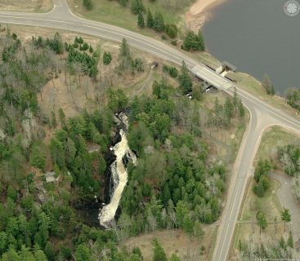
Methodology
Produces Color, Digital Imagery
Natural Perspective in Height & Scale
Accurate Measurements can be Obtained
Overlay GIS Data on Imagery
Obliques and Orthos in One Flight!

Slide 16
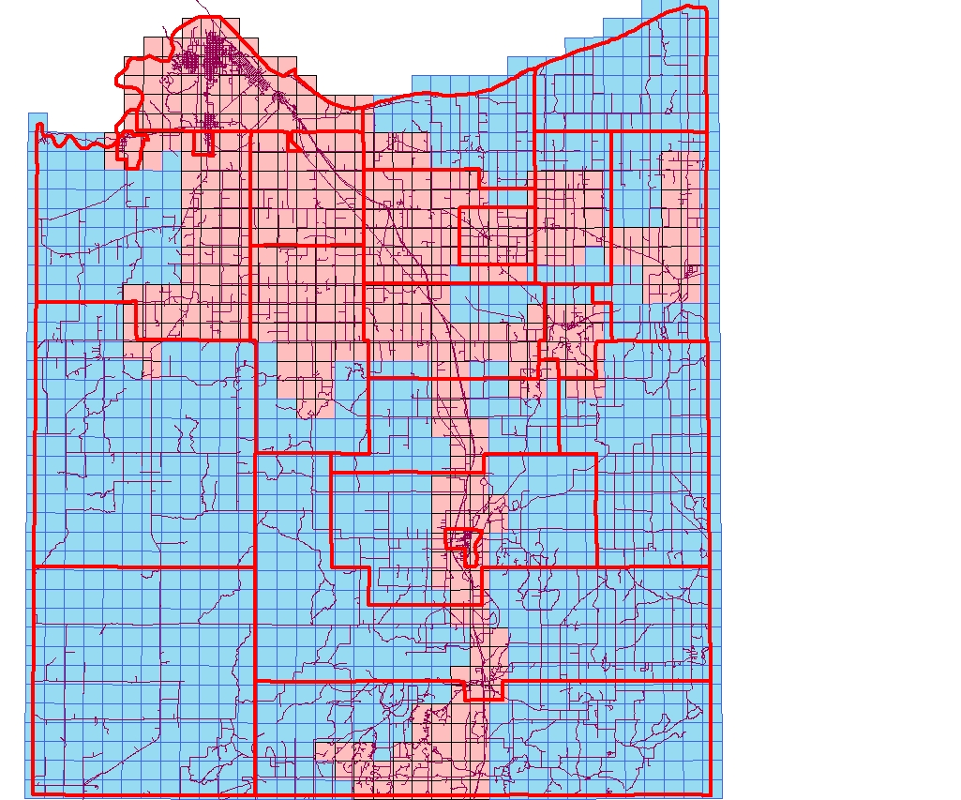
2013 Pictometry Flight
Red = 3”
Blue = 9”

Slide 17
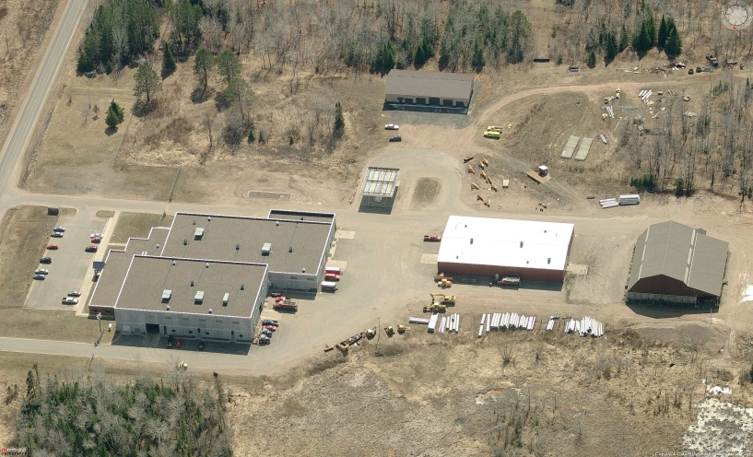

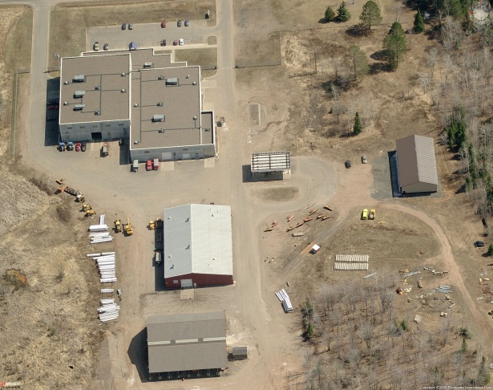
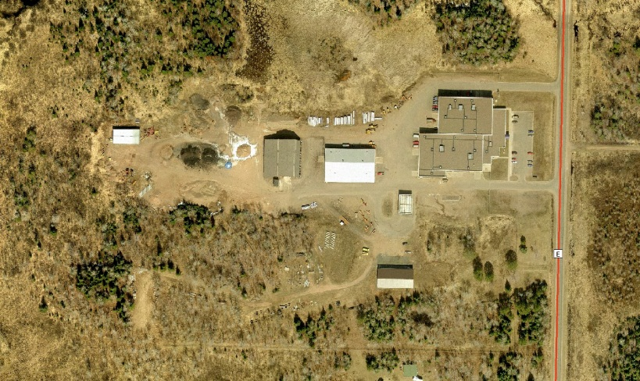
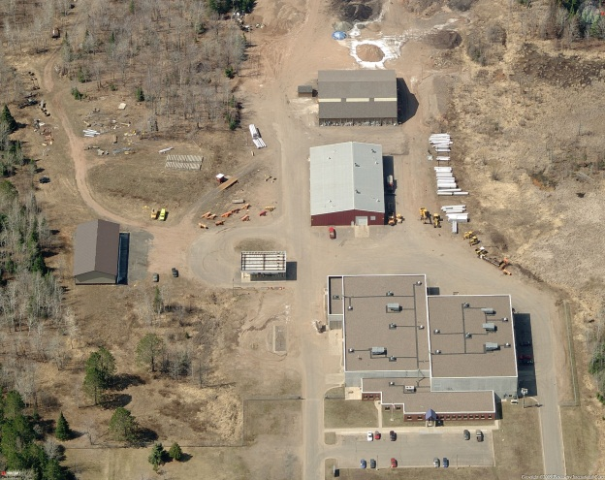
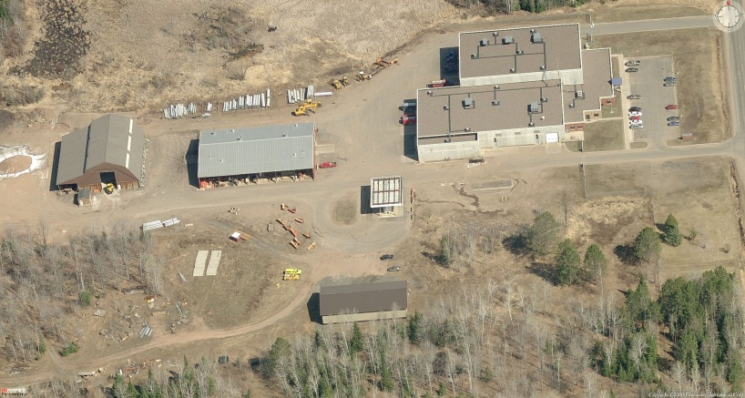
City of Superior/Douglas County Enterprise GIS
Libraries
Superior 2007
Douglas, Bayfield, Washburn Counties 2009
Douglas County Forestry Blow Down 2011
Douglas County 2013
St Louis County Duluth, Iron Range 2007

Slide 18
City of Superior/Douglas County Enterprise GIS
In Progress
Remonumentation efforts continue we will be able to tighten up accuracy of the data, parcels, ROW, etc
Parcel Fabric implemented Jan 1 –incorporates all the remonumentation work into a powerful cadastral management tool to greater increase accuracy and efficiencies in the Land Records
Land Information Office – Office to create a 1 stop shop for Land Records information at the County
  Leveraging the ArcGIS Technologies for GIS and Parcel Fabric combined with the Remonumentation and bringing the land records staff together in 1 place will greatly increase customer service

Slide 19
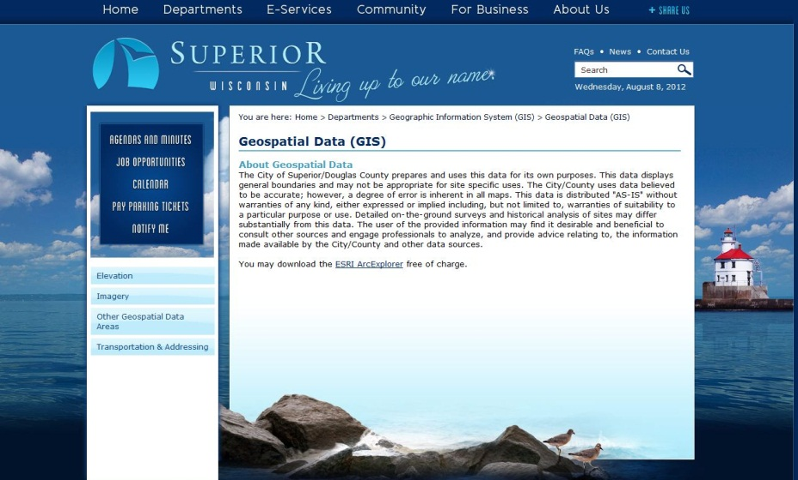
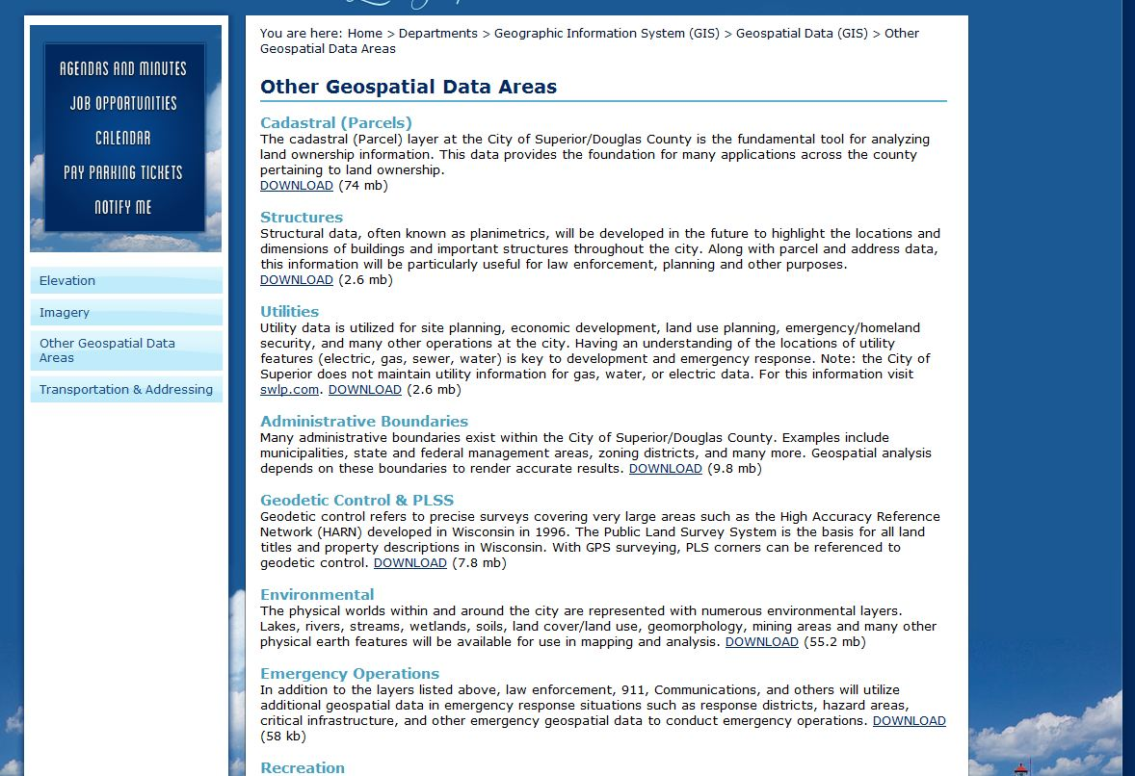
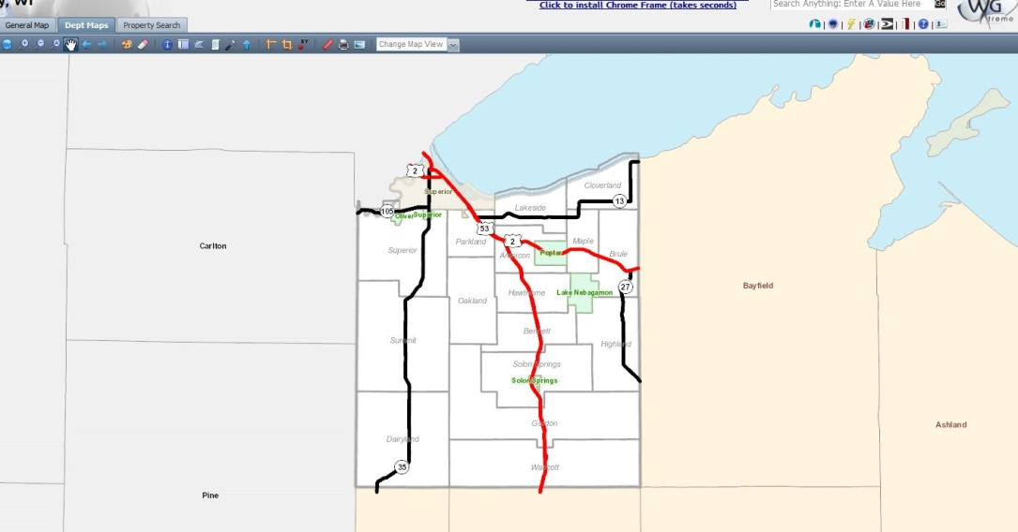
City of Superior/Douglas County Enterprise GIS
Data Requests & Data Queries
Available Free on the web site
Free Mapping on web site
Data Downloads = http://www.ci.superior.wi.us/index.aspx?nid=474
Free Mapping = http://douglascowi.wgxtreme.com/

Slide 20
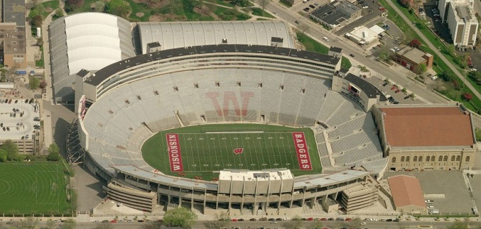
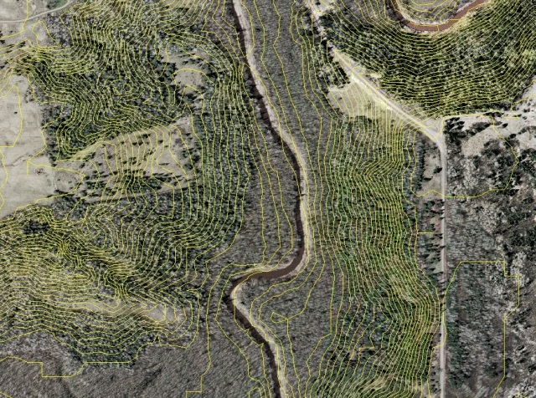
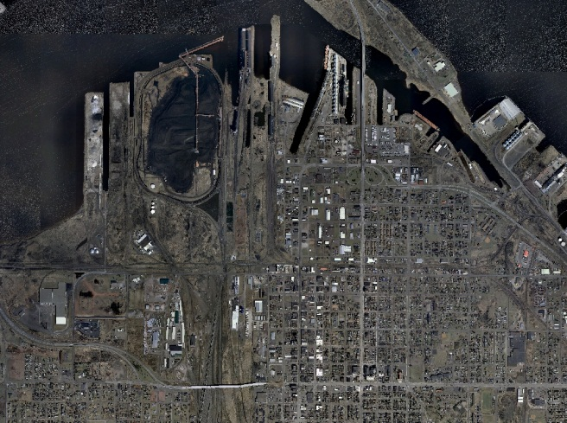
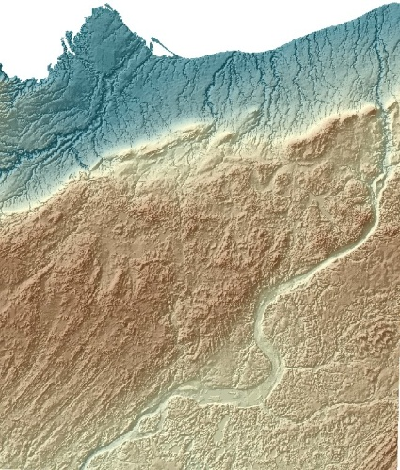
City of Superior/Douglas County Enterprise GIS
Data Types & Definitions
Spatial Database Engine = SDE
Feature Class = Data Layer
Feature Data Set = Data Folder
Shapefile = Non Enterprise Data Layer
Geodatabase = Personal, File or Enterprise
LIDAR = Light Density and Ranging (Elevation Data) flown from a plane
Aerial Photography = Flown from a plane (snapshot in time)
DEM = Digital Elevation Model

Slide 21
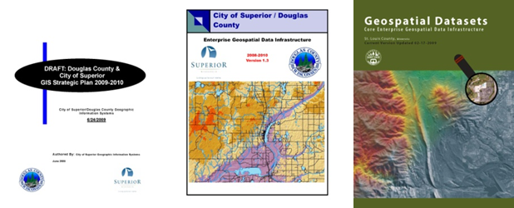
City of Superior/Douglas County Enterprise GIS
Available Resources

Slide 22
City of Superior/Douglas County Enterprise GIS
Some Online GIS Resources
ESRI.com
  Arcgis.com
City/County Data Download Page (FREE)
  http://www.ci.superior.wi.us/index.aspx?nid=474
Douglas County Web Mapping
  http://douglascowi.wgxtreme.com/

Slide 23
City of Superior/Douglas County Enterprise GIS
Jon Fiskness, GISP
GIS Coordinator,
fisknessj@ci.superior.wi.us
715-395-7423
Ben Klitzke
County Surveyor/LIO,
Ben.klitzke@douglascountywi.org
715-395-1340
Dan Martin
GIS Technician,
dan.martin@douglascountywi.org
715-395-1209
Randy Jones
GIS Technician,
randy.jones@douglascountywi.org
715-395-1570

